Slide 1
PL HW#5 Solution
助教 賴瑞舜

Slide 2
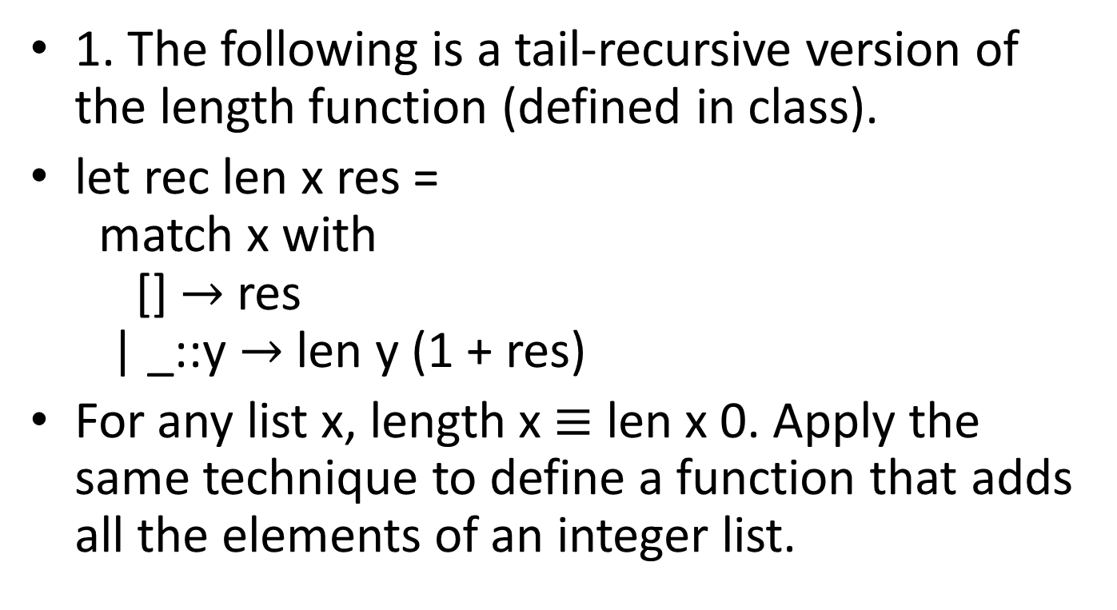
Problem 1
1. The following is a tail-recursive version of the length function (defined in class).
let rec len x res =
match x with
[] $→$ res
| _::y $→$ len y (1 + res)
For any list x, length x $≡$ len x 0. Apply the same technique to define a function that adds all the elements of an integer list.

Slide 3
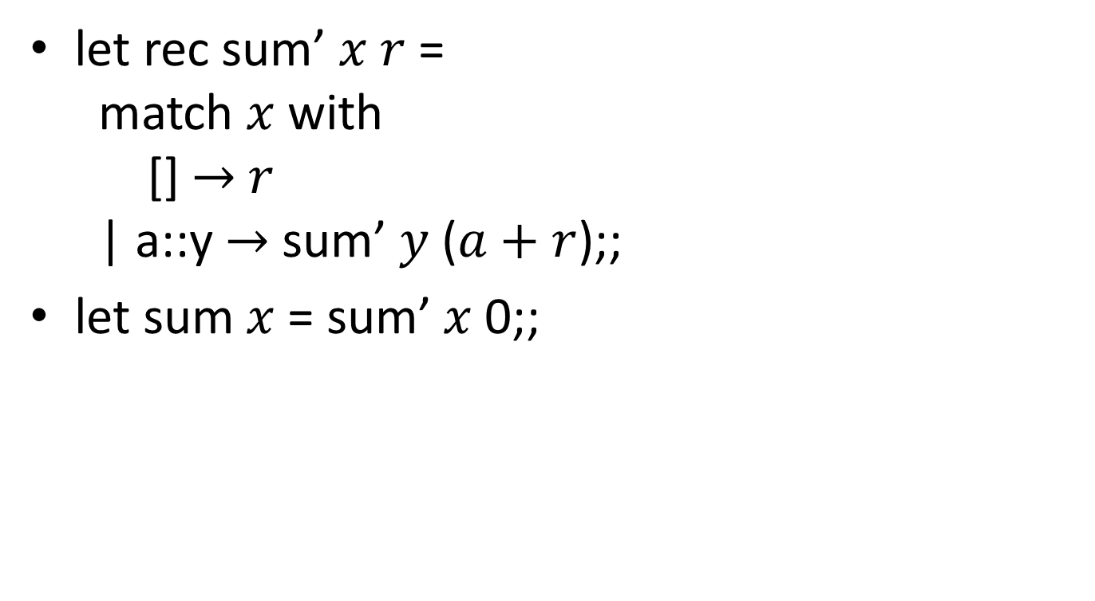
Problem 1 (cont.)
let rec sum’ $x r$ =
match $x$ with
[] $→$ $r$
| a::y $→$ sum’ $y$ ($a+r$);;
let sum $x$ = sum’ $x$ 0;;

Slide 4
Problem 2
2. Define a function that sorts a list of numbers, using the partition technique in QuickSort. Pick an element (probably the first) of the list and partition the remainder of the list into two sublists where the first contains all elements smaller than the pivot and the second contains all the other elements. Recursively sort the two sublists and then combine the pivot and the two sorted sublists into a sorted list.

Slide 5
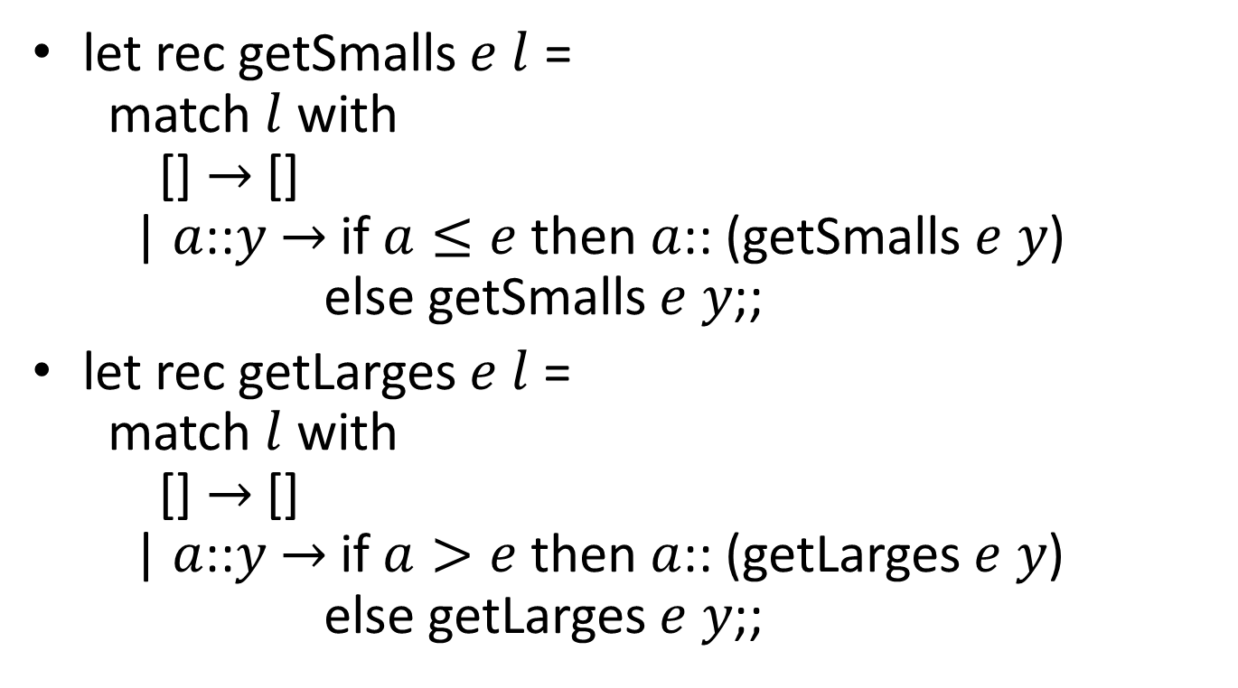
Problem 2 (cont.)
let rec getSmalls $e l$ =
match $l$ with
[] $→$ []
| $a$::$y$ $→$ if $a≤e$ then $a$:: (getSmalls $e y$)
else getSmalls $e y$;;
let rec getLarges $e l$ =
match $l$ with
[] $→$ []
| $a$::$y$ $→$ if $a>e$ then $a$:: (getLarges $e y$)
else getLarges $e y$;;

Slide 6
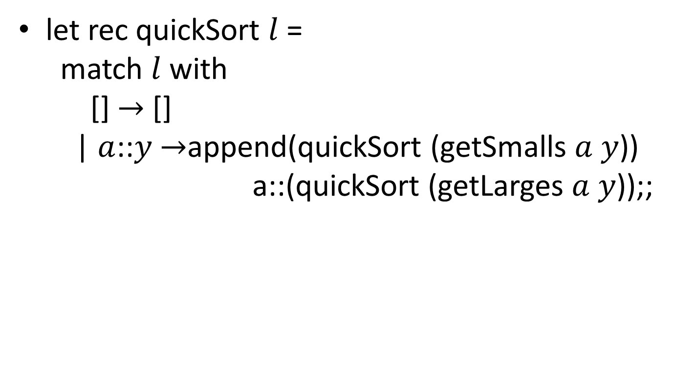
Problem 2 (cont.)
let rec quickSort $l$ =
match $l$ with
[] $→$ []
| $a$::$y$ $→$append(quickSort (getSmalls $a y$))
a::(quickSort (getLarges $a y$));;

Slide 7
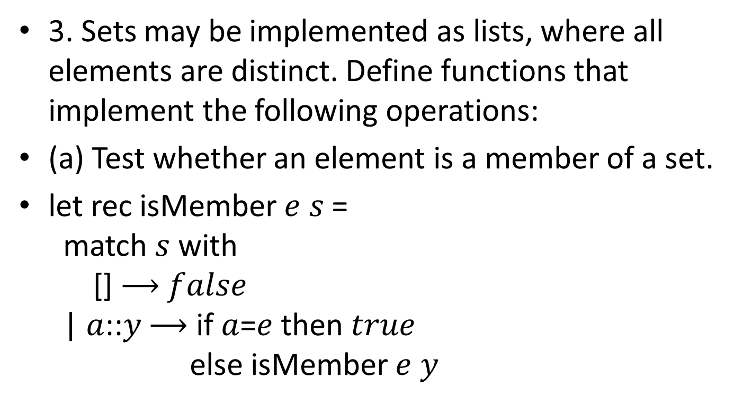
Problem 3
3. Sets may be implemented as lists, where all elements are distinct. Define functions that implement the following operations:
(a) Test whether an element is a member of a set.
let rec isMember $e s$ =
match $s$ with
[] $⟶$ $false$
| $a$::$y$ $⟶$ if $a$=$e$ then $true$
else isMember $e y$

Slide 8
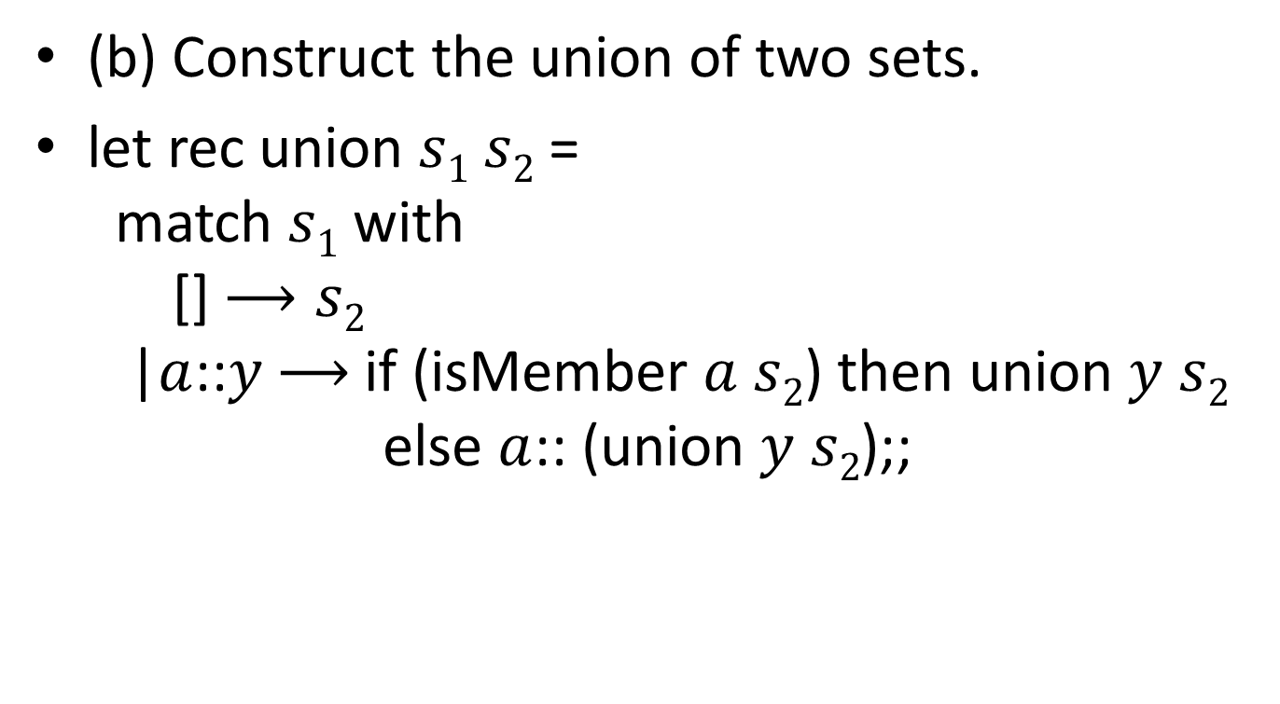
Problem 3 (cont.)
(b) Construct the union of two sets.
let rec union $s1 s2$=
match $s1$ with
[] $⟶s2$
|$a$::$y$ $⟶$if (isMember $a$ $s2$) then union $y s2$
else $a$:: (union $y s2$);;

Slide 9
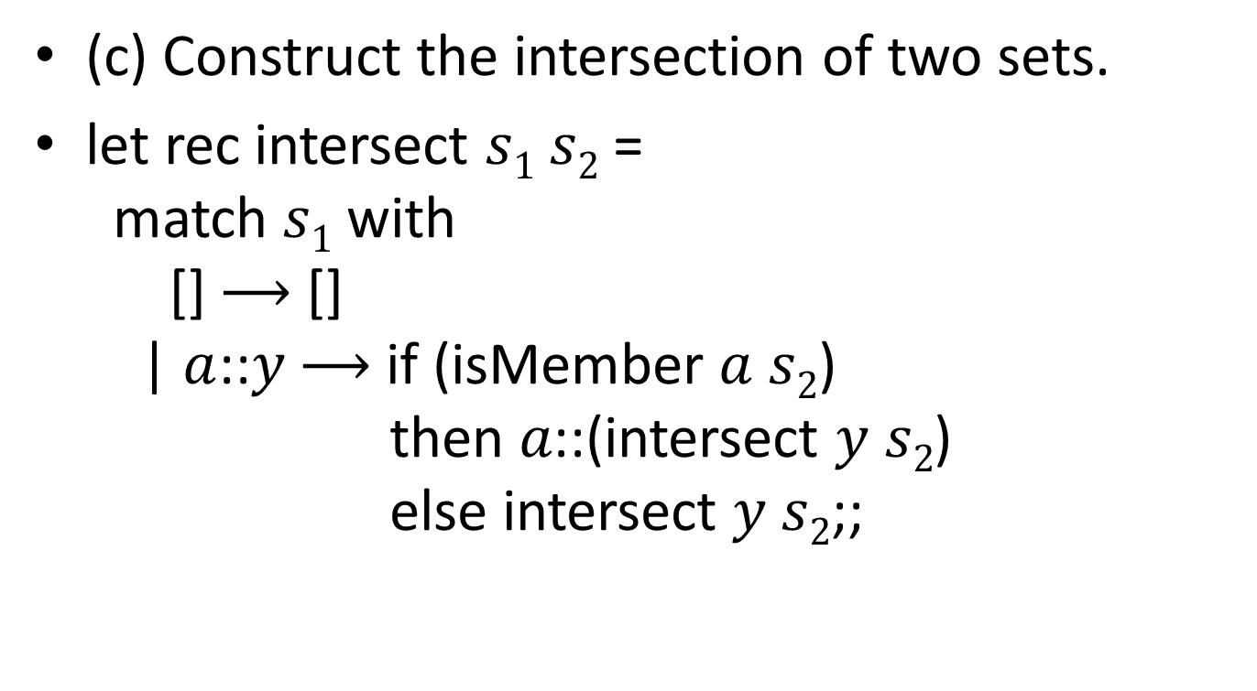
Problem 3 (cont.)
(c) Construct the intersection of two sets.
let rec intersect $s1 s2$=
match $s1$ with
[] $⟶$ []
| $a$::$y$ $⟶$ if (isMember $a$ $s2$)
then $a\text{::}$(intersect $y s2$)
else intersect $y s2$;;

Slide 10
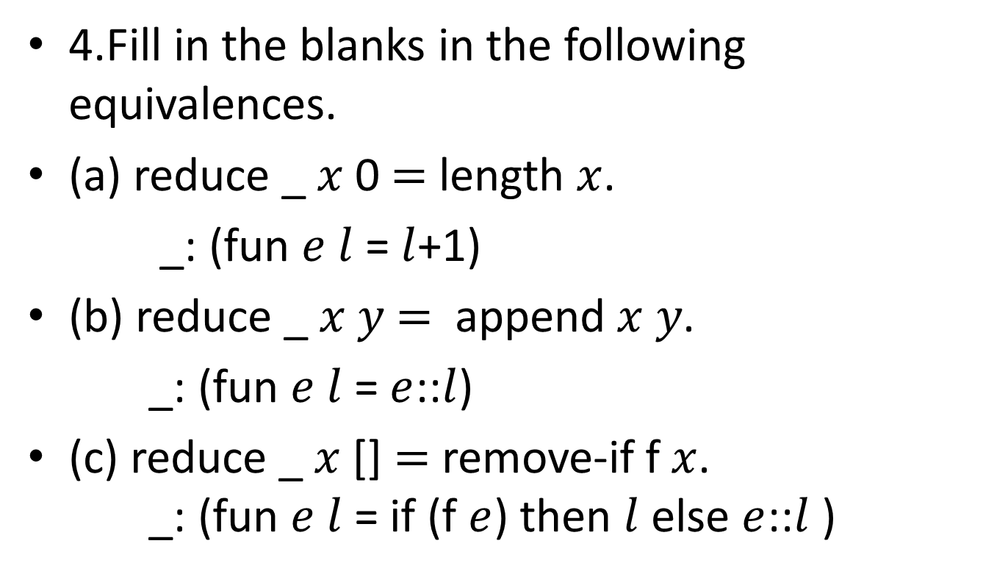
Problem 4
4.Fill in the blanks in the following equivalences.
(a) reduce _ $x$ 0 $=$ length $x$.
_: (fun $e l$ = $l$+1)
(b) reduce _ $x y$ $=$ append $x y$.
_: (fun $e l$ = $e$::$l$)
(c) reduce _ $x$ [] $=$ remove-if f $x$.
_: (fun $e l$ = if (f $e$) then $l$ else $e$::$l$ )

