Slide 1
PL HW#7 Solution
助教 賴瑞舜

Slide 2
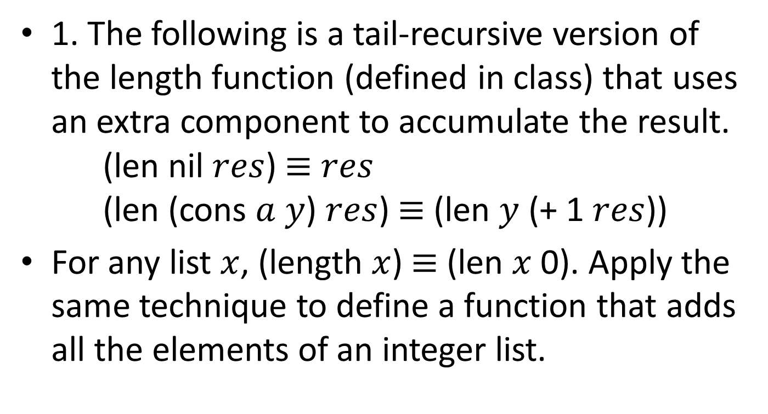
Problem 1
1. The following is a tail-recursive version of the length function (defined in class) that uses an extra component to accumulate the result.
(len nil $res$) $≡$ $res$
(len (cons $a$ $y$) $res$) $≡$ (len $y$ (+ 1 $res$))
For any list $x$, (length $x$) $≡$ (len $x$ 0). Apply the same technique to define a function that adds all the elements of an integer list.

Slide 3
Problem 1 (cont.)
(defun sum (x res)
(cond ((null x) res)
(t (sum (cdr x) (+ (car x) res)))))
(defun ss (x) (sum x 0))

Slide 4
Problem 2
2. Define a Lisp function that sorts a list of numbers, using the partition technique in QuickSort. Pick an element (probably the first) of the list and partition the remainder of the list into two sublists where the first contains all elements smaller than the pivot and the second contains all the other elements. Recursively sort the two sublists and then combine the pivot and the two sorted sublists into a sorted list.

Slide 5
Problem 2 (cont.)
(defun getSmalls (e l)
(remove-if (lambda (x) (> x e)) l))
(defun getLarges (e l)
(remove-if (lambda (x) (<= x e)) l))
(defun quickSort (l)
(cond ((null l) nil)
(t (append (quickSort (getSmalls (car l) (cdr l)))
(cons (car l) (quickSort
(getLarges (car l) (cdr l))))))))

Slide 6
Problem 3
3. Sets may be implemented as lists, where all elements are distinct. Define Lisp functions that implement the following operations:
(a) Test whether an element is a member of a set.
(defun isMember (e s)
(cond ((null s) nil)
((= e (car s)) t)
(t (isMember e (cdr s)))))

Slide 7
Problem 3 (cont.)
(b) Construct the union of two sets.
(defun union1 (s1 s2)
(cond ((null s1) s2)
((isMember (car s1) s2) (union1 (cdr s1) s2))
(t (cons (car s1) (union1 (cdr s1) s2)))))

Slide 8
Problem 3 (cont.)
(c) Construct the intersection of two sets.
(defun intersect (s1 s2)
(cond ((null s1) nil)
((isMember (car s1) s2)
(cons (car s1) (intersect (cdr s1) s2)))
(t (intersect (cdr s1) s2))))

Slide 9
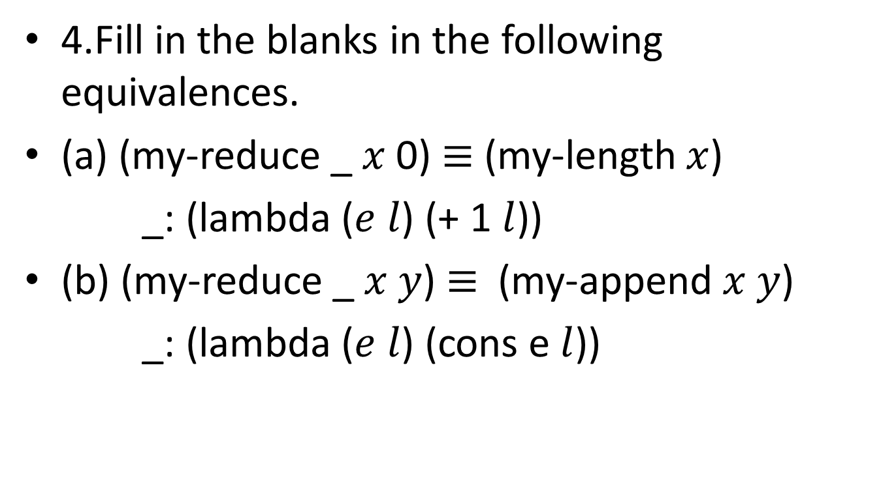
Problem 4
4.Fill in the blanks in the following equivalences.
(a) (my-reduce _ $x$ 0) $≡$ (my-length $x$)
_: (lambda ($e l$) (+ 1 $l$))
(b) (my-reduce _ $x y$) $≡$ (my-append $x y$)
_: (lambda ($e l$) (cons e $l$))

Slide 10
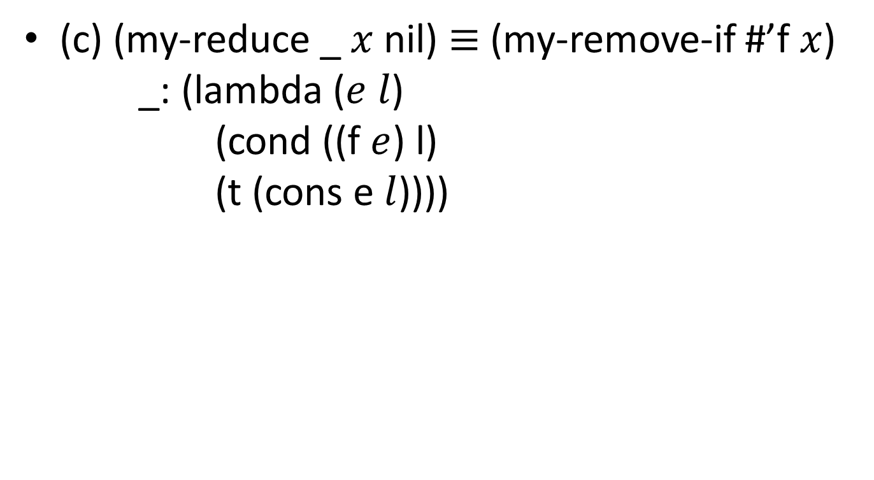
(c) (my-reduce _ $x$ nil) $≡$ (my-remove-if #’f $x$)
_: (lambda ($e l$)
(cond ((f $e$) l)
(t (cons e $l$))))

