Slide 1
Code Management
Sega Cheng (程世嘉)
CEO, iKala

Slide 2
About Me
CEO, LiveHouse.in & iKala (2012 - Present)
Supervisor, Gamania (2012 - Present)
Google Software Engineer (2006 – 2012)
Stanford Computer Science Master (2005 – 2007)
NTU Information Management (1999 - 2003)

Slide 3
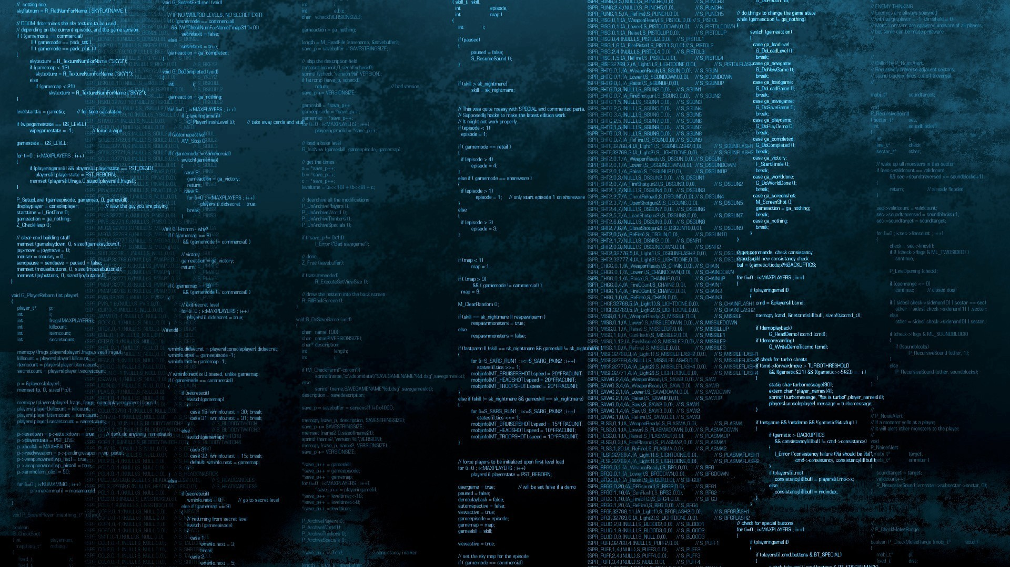
Today
How does iKala do code management?
Source: http://www.socwall.com/images/wallpapers/36659-1920x1080.jpg

Slide 4
Why Code Management?
Produce high-quality software products

Slide 5
Our Code Management Principles
As lightweight as possible
  Easy to maintain, minimum human interventions
Productivity over formalism
  It’s really about the balance among “speed”, “quality”, and “cost”

Slide 6
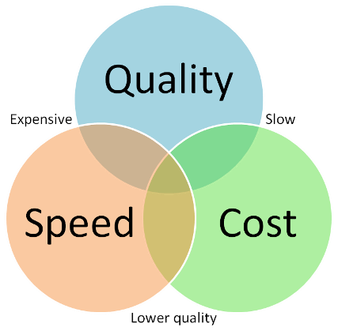
It’s possible that you improve all of them at the same time!

Slide 7
Step 0: LDAP

Slide 8

LDAP
(Lightweight Directory Access Protocol)
Establish universal identities and a single point of authentication for all of your team members. This will facilitate future deployment of new internal systems.

Slide 9
Redmine (Issue Tracking & Project Management)

Slide 10
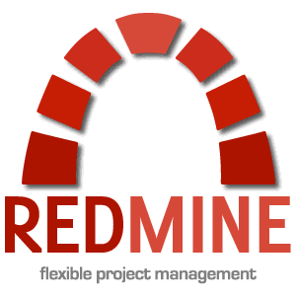
Redmine
A popular issue tracking system based on Ruby on Rails. Easy to set up, extend, and integrate w/ other systems

Slide 11
Git

Slide 12
Git
A distributed revision control system that can be easily integrated w/ other tools

Slide 13
Git → GitLab

Slide 14

GitLab
GitLab is open source software to collaborate on code. Create projects and repositories, manage access and do code reviews

Slide 15
Continuous Integration (Jenkins)

Slide 16

What is Continuous Integration (CI)?
Automate the build
Make the build self-testing
Automate the deployment

Slide 17
Principles of CI
Everyone commits to the baseline every day
Every commit (to baseline) should be built
Keep the build fast
Test in a clone of the production environment
Make it easy to get the latest deliverables
Everyone can see the results of the latest build
Source: http://en.wikipedia.org/wiki/Continuous_integration

Slide 18
They are all free!
Tons of open-sourced alternatives out there
  Issue tracking: http://en.wikipedia.org/wiki/Comparison_of_issue-tracking_systems
  Revision control: http://en.wikipedia.org/wiki/List_of_revision_control_software

Slide 19
Putting them all together
Dev
Staging & Production Environment
(AWS, IDC …)
Collaboration Tools
Dev
Code
Review
GitLab
(Git)
Build
Jenkins
Deploy
Redmine
Dev
Revision Control
Continuous Integration
Issue Tracking
LDAP
Authentication
Access Control

Slide 20
Final Words for Code Management
Avoid not-invented-here complex: Excellent free open source tools are out there at your service
Manage complexities of internal tools and let them grow organically: Do not over-engineer at any time. Remember your goal: improve productivity
It is painful at the beginning, but your team will benefit in the long run. Just do it.
Training and education are necessary: it’s all about the engineering culture we are talking about. Your culture is critical to your success, handle it with care
Your team is unique: find your own best practices and combinations. Anything you learn today is just a reference

Slide 21
iKala 徵才中!
履歷請寄朱佩霜小姐 shelly@ikala.tv
■ 上下班免打卡，可在家工作
■ 開放的文化，找到你的熱情
■ 與一流的團隊一起工作
■ 勞、健保及退休金提撥
■ 節慶禮金：端午節禮金、中秋節禮金
■ 績效獎金：員工推薦獎金、專案獎金及年終獎金
■ 其它福利：月會早餐、下午茶、部門聚餐、慶生會、電影欣賞、員工旅遊、員工教育訓練補助
Software Engineer (interns welcome!)

Slide 22
Cool Projects @ iKala

Slide 23



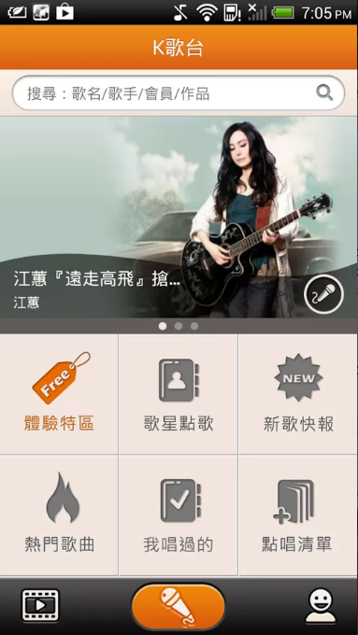
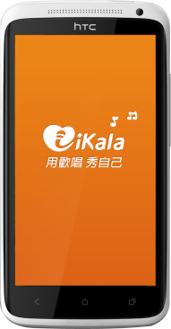
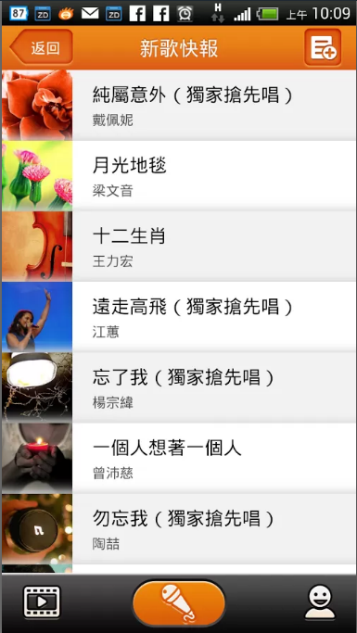

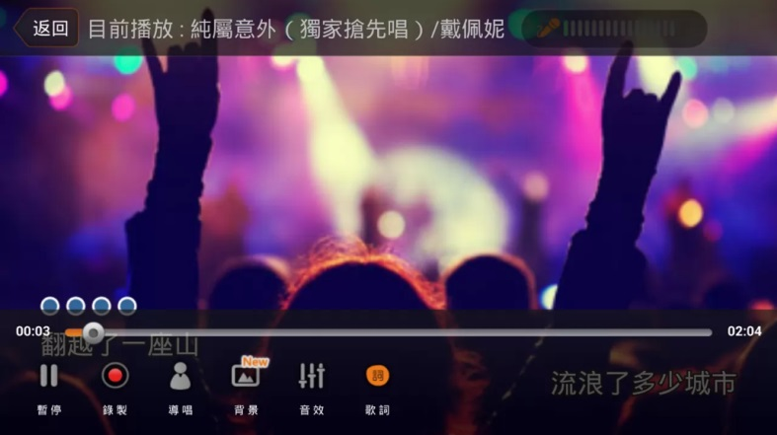
iKala app – mobile Karaoke

Slide 24
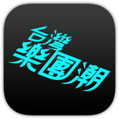
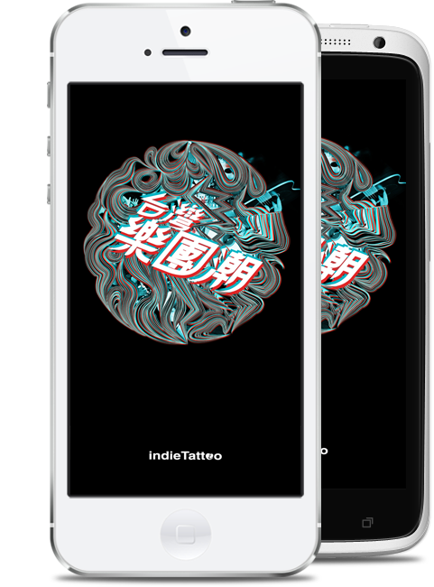

indie Tattoo
解搖滾的渴

Slide 25

分類標題
嶄新直播平台
免下載、免安裝、免設定

Slide 26
And more secret projects!
Come talk to us and learn more!

Slide 27
^{Follow us on facebook}
^{「LiveHouse.in 台灣粉絲團」}
^{「indie Tattoo 解搖滾的渴」}
^{「愛卡拉全球在線」}

