Slide 1
Object Constraint Language
(OCL)
(Based on [OMG 2012])
Yih-Kuen Tsay
Dept. of Information Management
National Taiwan University

Slide 2
Outline
Introduction
Relation with UML Models
Values, Types, and Expressions
Objects and Properties
Collection Operations

Slide 3
About the OCL
The Object Constraint Language (OCL) is a formal language for writing expressions (such as invariants) on UML models.
It can also be used to specify queries over objects.
OCL expressions are pure specifications without side effects (they do not alter the state).
The OCL is a typed first-order language, using a familiar programming language-like syntax.
The current version OCL 2.4 was published in February 2014.

Slide 4
Why OCL
UML diagrams do not provide all the relevant aspects of a specification.
Additional constraints expressed by a natural language may be ambiguous.
Traditional formal languages are precise, but hard to use.
OCL tries to be formal and yet easy to use.
Note: OCL does not seem to be in wide use, perhaps due to other similar competing specification languages such as JML; however, this exposition shows how UML specifications can be made more precise.

Slide 5
How Can the OCL Be Used
Queries over objects
Invariants on classes and types
Pre and post-conditions on operations
Guards
Target sets for messages and actions
Constraints on operations
Derivation rules for attributes

Slide 6
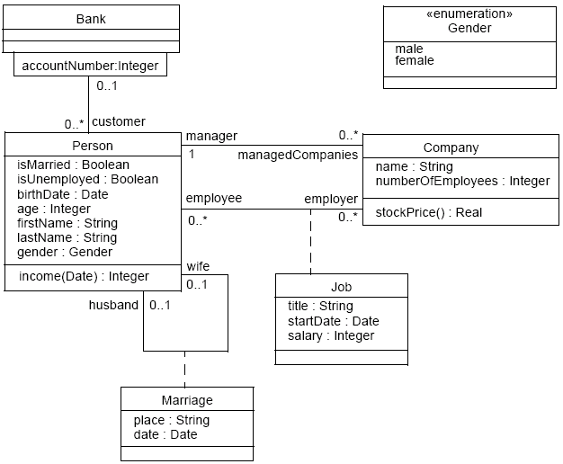
Class Diagram Example

Slide 7
Relation with UML Models: Contexts
Each OCL expression is written in the context of an instance of a specific type.
The reserved word self is used to refer to the contextual instance.
The context may be specified by a context declaration.
An explicit context declaration may be omitted if the OCL expression is properly placed in a diagram.

Slide 8
Context for Invariants
Inside the class diagram, as part of the constraint stereotype <<invariant>>
Example:
self.numberOfEmployees > 50
specifies that the number of employees (of an object in the class Company) must always exceed 50.
Alternatively (in a separate file),
context Company inv:
self.numberOfEmployees > 50

Slide 9
Context for Invariants (cont.)
The keyword self may be omitted.
Also, a different name may be used for self :
context c : Company inv:
c.numberOfEmployees > 50
The invariant itself can also be given a name (after inv) for later references:
context c : Company inv enoughEmployees:
c.numberOfEmployees > 50

Slide 10
Context for Pre and Post-Conditions
As part of the <<precondition>> and <<postcondition>> constraint stereotypes associated with an operation
Here, self refers to an instance of the class that owns the operation.
Basic form:
context Typename::operationName(param1 : Type1, ... ): ReturnType
pre: param1 > ...
post: result = ... (result is a reserved keyword)

Slide 11
Context for Pre and Post-Conditions (cont.)
Example:
context Person::income(d : Date) : Integer
post: result = 5000
Names may be given:
context Typename::operationName(param1 : Type1, ... ): ReturnType
pre parameterOk: param1 > ...
post resultOk: result = ...

Slide 12
Package Context
When necessary, the package context can be given.
Package statement:
package Package::SubPackage
context X inv:
... some invariant ...
context X::operationName(..)
pre: ... some precondition ...
endpackage

Slide 13
Context for Initial and Derived Values
context Person::income : Integer
init: parents.income->sum() * 1%
-- pocket allowance
-- the “income” attribute will be defined later
derive: if underAge
then parents.income->sum() * 1%
-- pocket allowance
else job.salary -- income from regular job
endif

Slide 14
Basic (Predefined) Values and Types
Boolean: true, false
Integer: 1, -5, 2, 34, 26524, ...
Real: 1.5, 3.14, ...
String: ‘To be or not to be’, ‘This is a system message’, …
Others
  Collection: Set, Bag, Sequence
  Tuple

Slide 15
Basic Operations (partial list)
Integer: *, +, -, /, abs()
Real: *, +, -, /, floor()
Boolean: and, or, xor, not, implies, if-then-else
String: concat(), size(), substring()
Collection: select, reject, forAll, exists, … (to be described later)

Slide 16
Other Types
Classifiers
  All classifiers of a UML model are types in its OCL expressions.
Enumerations

Slide 17
Sub-expressions: the Use of let
context Person inv:
let income : Integer = self.job.salary->sum() in
if isUnemployed then
income < 100
else
income >= 100
endif

Slide 18
Definition Expressions
Variables and operations may be introduced for reuse across multiple OCL expressions.
Example:
context Person
def: income : Integer = self.job.salary->sum()
def: nickname : String = ’Little Red Rooster’
def: hasTitle(t : String) : Boolean
= self.job->exists(title = t)

Slide 19
Previous Values in Post-Conditions
context Person::birthdayHappens()
post: age = age@pre + 1
context Company::hireEmployee(p : Person)
post: employees = employees@pre->including(p) and
stockprice() = stockprice@pre() + 10

Slide 20
Previous Values in Post-Conditions (cont.)
a.b@pre.c
-- takes the old value of property b of a, say x
-- and then the new value of c of x.
a.b@pre.c@pre
-- takes the old value of property b of a, say x
-- and then the old value of c of x.

Slide 21
More about Types and Operations
Type conformance (like in an object-oriented language)
Casting (re-typing)
  Syntax: object.oclAsType(OclType)
Precedence rules
Infix operators
  Example: “a.+(b)” as “a+b”

Slide 22
Properties
More generally, OCL expressions may talk about things called properties.
A property is one of the following:
  An Attribute
  context Person inv: self.age > 0
  An AssociationEnd
  An Operation with isQuery (no side effects)
  A Method with isQuery (no side effects)
Syntax: object.property
Multiplicities greater than 1 result in collections.

Slide 23
Properties: AssociationEnds
Starting from an object, we can navigate an association to refer to other objects.
Example:
  context Person
  inv: self.manager.isUnemployed = false
  inv: self.employee->notEmpty()
By default, navigation results in a Set.
When the multiplicity is 1, the result may be treated as a single object.

Slide 24
Collections
OCL Collection Types:
  Set
  Bag (may contain duplicates)
  Sequence (like a bag, but ordered)
Collection literals:
  Set { 1, 2, 5 }
  Bag { 1, 3, 4, 3 }
  Sequence { 1..10 }
The OCL defines many operations on collections.

Slide 25
Collection Operations
Select
context Company inv:
self.employee->select(age > 50)->notEmpty()
Reject
context Company inv:
self.employee->reject( isMarried )->isEmpty()
The select and reject operations always give a sub-collection of the original collection.

Slide 26
Derived Collections
From a collection, one may also derive a collection of different objects.
Examples:
self.employee->collect( birthDate )
self.employee->collect( p|p.birthDate )
self.employee->collect( p:Person|p.birthDate )
The result above is a Bag, which may be turned into a Set:
  self.employee->collect( birthDate )->asSet()

Slide 27
Collection Operation: ForAll
context Company
inv: self.employee->forAll( age <= 65 )
inv: self.employee->forAll( p | p.age <= 65 )
inv: self.employee->forAll( p : Person | p.age <= 65 )
context Company inv:
self.employee->forAll( e1, e2 : Person |
e1 <> e2 implies e1.firstName <> e2.firstName)

Slide 28
Collection Operation: Exists
context Company inv:
self.employee->exists( firstName = 'Jack' )
context Company inv:
self.employee->exists( p | p.firstName = 'Jack' )
context Company inv:
self.employee->exists( p : Person | p.firstName = 'Jack' )

Slide 29
The Iterate Operation
Reject, Select, forAll, Exists, and Collect can all be described in terms of iterate.
Example:
collection->collect(x : T | x.property)
-- is identical to
collection->iterate(x : T; acc : T2 = Bag{} |
acc->including(x.property))
-- here x is the iterator and acc is the accumulator

Slide 30
Features on Classes Themselves
It is also possible to use features defined on classes themselves.
A predefined feature is allInstances, which gives the set of all instances at the time of evaluation.
Example:
context Person inv:
Person.allInstances()->forAll(p1, p2|
p1 <> p2 implies p1.firstName <> p2.firstName)

