Slide 1
UML Diagrams
(Based on [Booch et al. 2005])
Yih-Kuen Tsay
Dept. of Information Management
National Taiwan University

Slide 2
Outline
Structural Diagrams
Behavioral Diagrams
Advanced Structural Modeling
  Object Diagrams
  Components
Advanced Behavioral Modeling
  State Machines
  Processes and Threads
  Timing Constraints

Slide 3
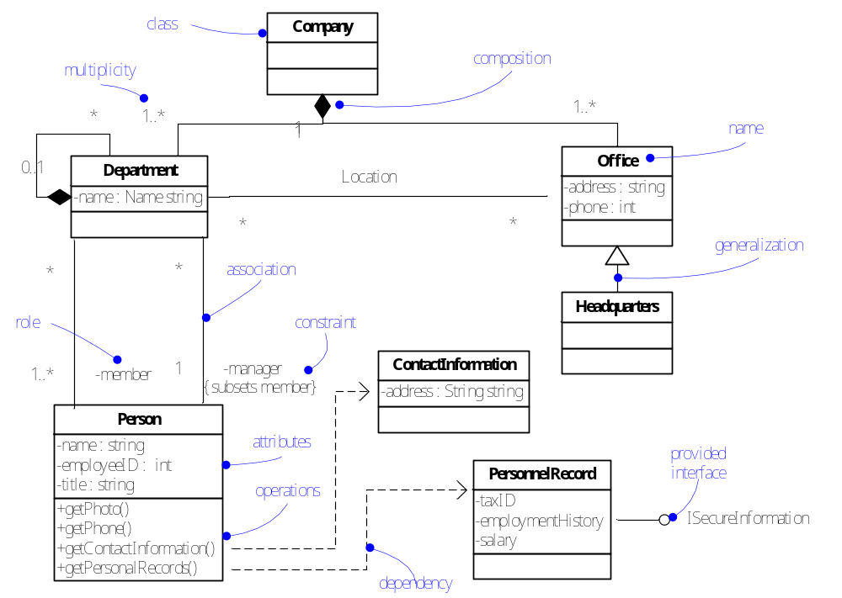
Class Diagram

Slide 4
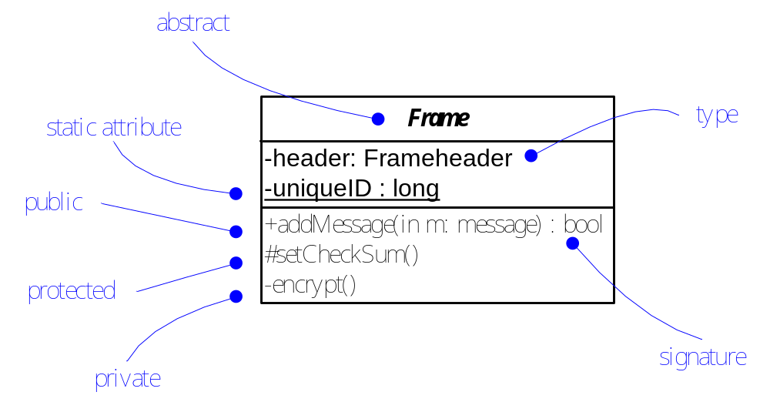
Advanced Classes

Slide 5
Classifiers
In general, those modeling elements that can have instances are called classifiers.
Interface
Datatype
Signal
Component
Node
Use case
Subsystem

Slide 6
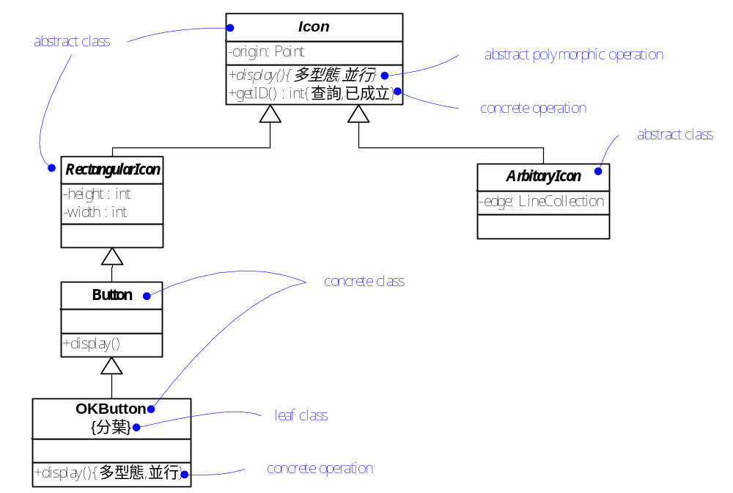
Abstract and Concrete Classes
Properties:
多型態：polymorphic
查詢：query
並行：concurrent
已成立：guarded
分葉：leaf

Slide 7
Properties on Operations
query: no side effects
sequential: relying on the callers to do the coordination
guarded: all calls sequentialized (by the object)
concurrent: concurrency control enforced
static: like a global procedure

Slide 8
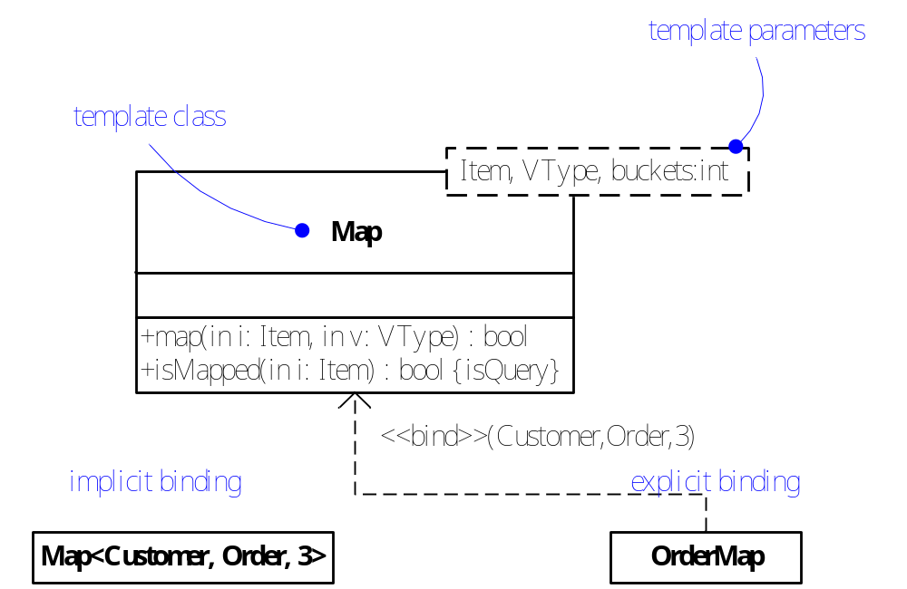
Template Classes

Slide 9
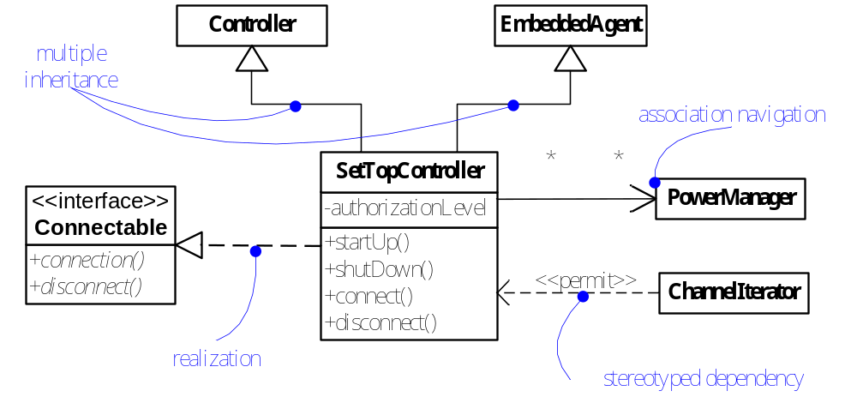
Advanced Relationships

Slide 10
Advanced Relationships (cont.)
Stereotypes for dependency
  Among classes and objects (in class diagrams): bind, derive, permit (friend), instanceOf, instantiate, powertype, refine, use
  Among packages: import, access
  Among use cases: extend, include
  In state machines: send
  In subsystems and models: trace

Slide 11
Advanced Relationships (cont.)
A stereotype for generalization:
  realization
Constraints for generalization:
  complete: all children have been specified
  incomplete
  disjoint: subtypes are incompatible
  overlapping

Slide 12
Advanced Relationships (cont.)
Properties of association
  Navigability
  Visibility
  Qualification
  Interface specifier (obsolete in UML2)
  Composition
  Association classes
  Constraints: ordered, set, bag, ordered set, list or sequence, readonly

Slide 13
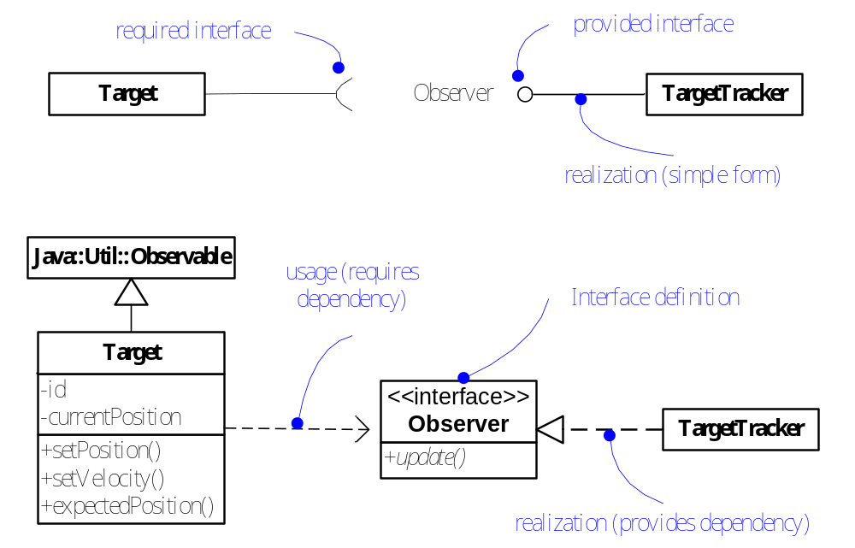
Realizations

Slide 14
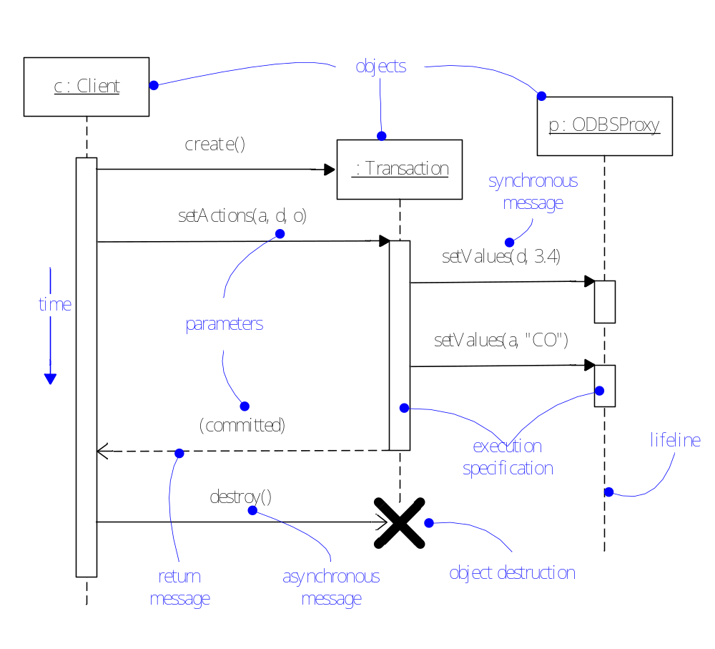
Sequence Diagram

Slide 15
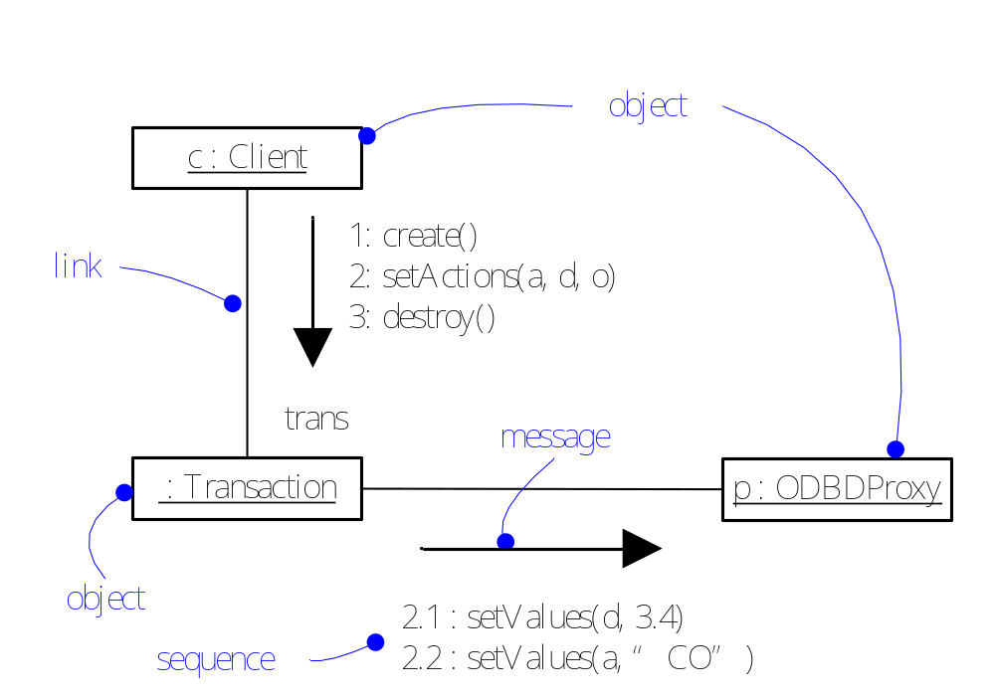
Communication Diagram

Slide 16
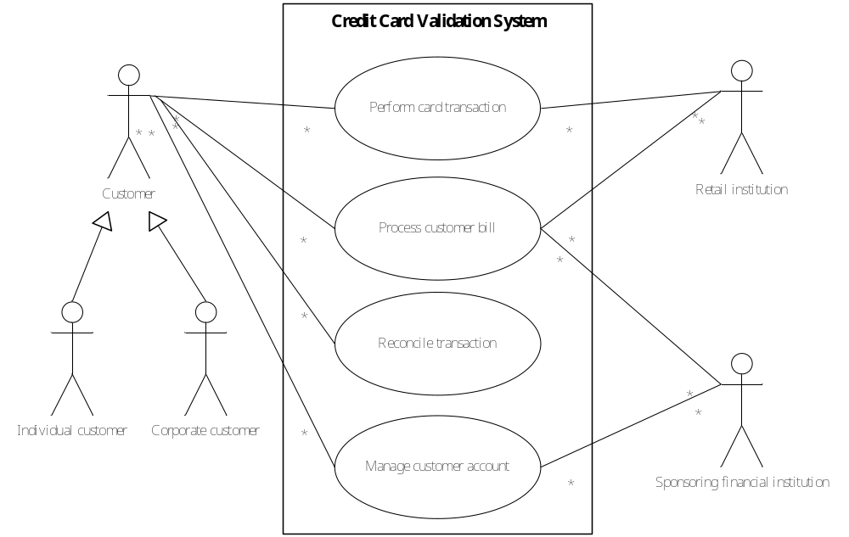
Use Case Diagram

Slide 17
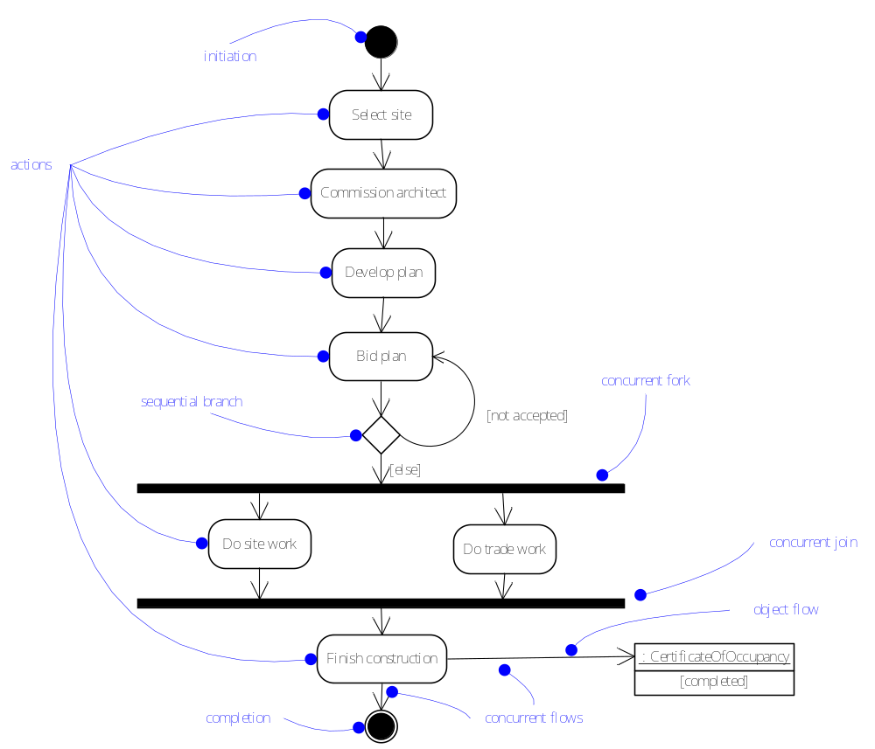
Activity Diagram

Slide 18
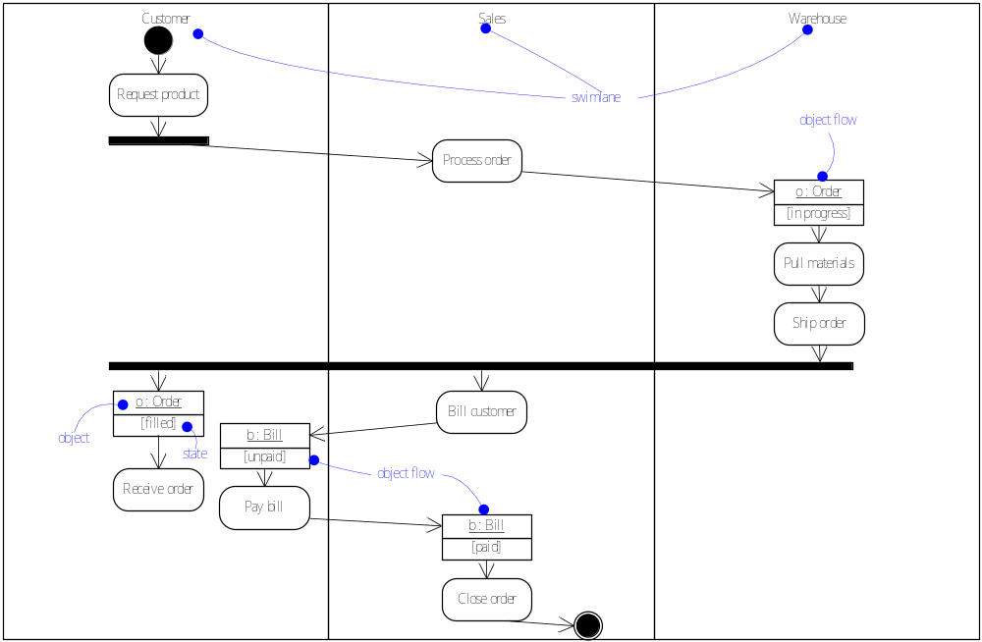
Activity Partitions and Object Flows
Note: an activity partition
is also called a swimlane.

Slide 19
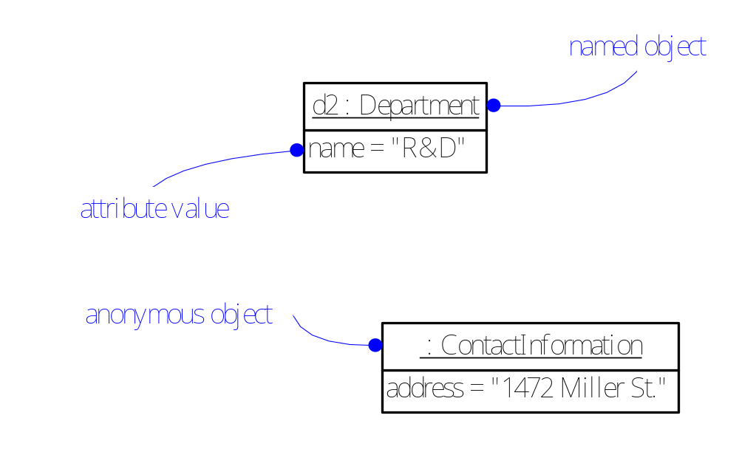
Instances
An instance is a concrete manifestation of an abstraction
  Set of operations (that can be applied to the instance)
  State (that stores the effects of operations)
Graphical notation:

Slide 20
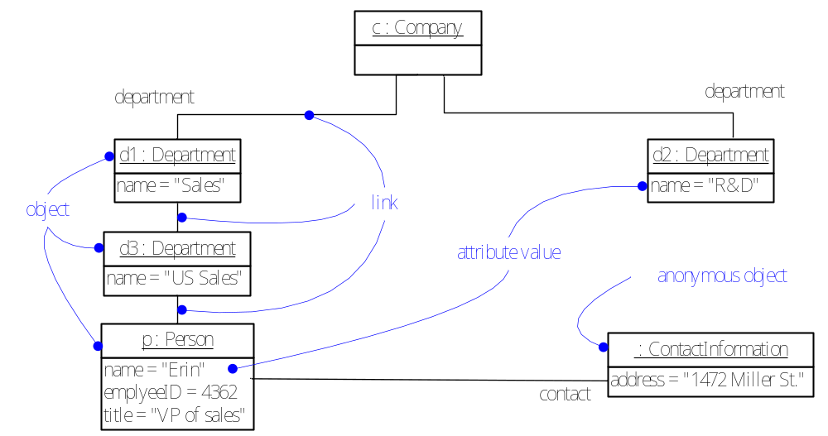
Object Diagrams
An object diagram shows a set of objects and their relationships at a point in time.

Slide 21
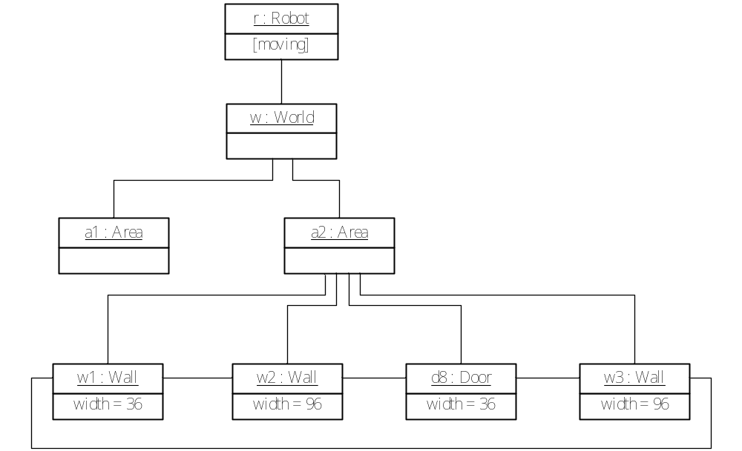
Modeling Object Structures

Slide 22
Components
A component is a logical, replaceable part of a system that conforms to and realizes a set of interfaces.
Relevant concepts
  Interface: a collection of operations. Interfaces are the glue that binds components together.
  Port: a window for accepting and sending messages
  Internal structure: implementation of a component
  Part: a unit of the implementation
  Connector: a communication relationship between two parts or ports

Slide 23
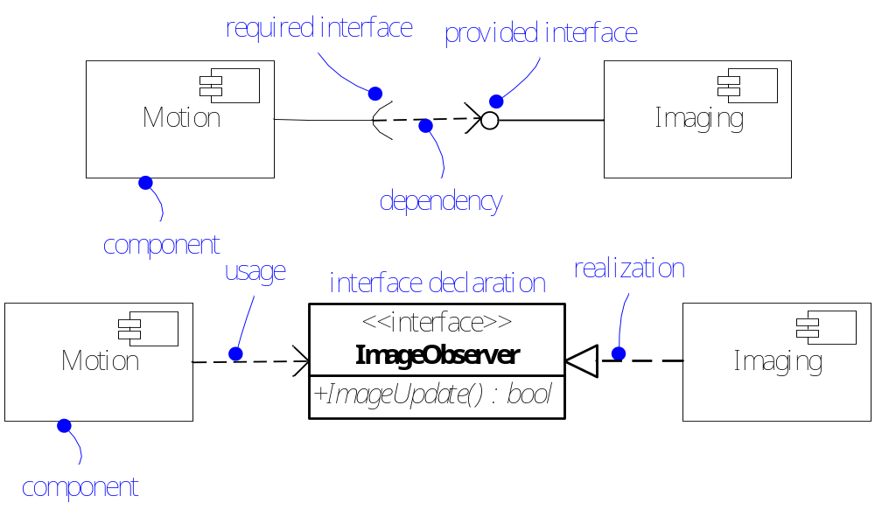
Component Diagrams
Components are bound by interfaces.

Slide 24
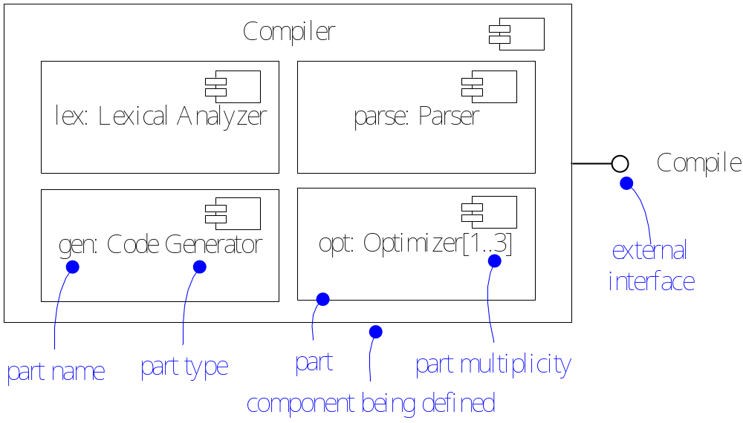
Component Diagrams (cont.)
Components can be nested.

Slide 25
Events and Signals
“Things that happen” are called events.
They are used to model the occurrence of a stimulus that changes the state of a system.
Events may include
  Signals,
  Calls,
  The passing of time, or
  A change in state
Events may be synchronous or asynchronous.

Slide 26
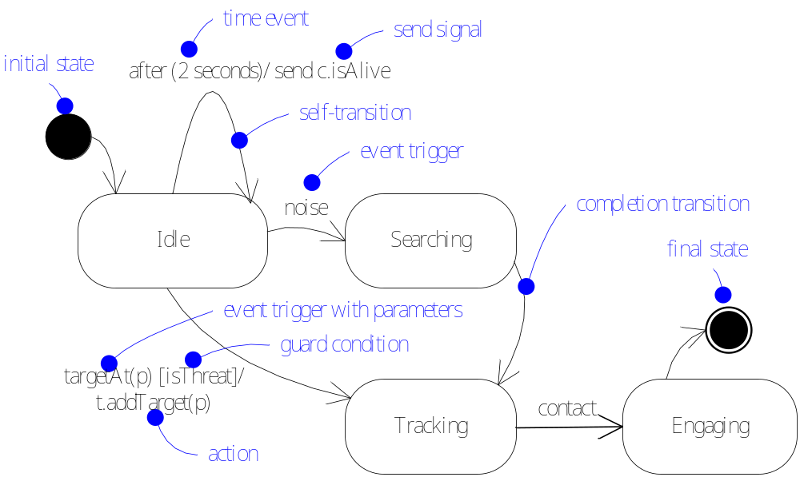
State Machines
A state machine models the lifetime of an object.

Slide 27
Advanced States and Transitions
Entry/exit effects
Internal transitions
Do-activities
Deferred events
Submachines
Nonorthogonal vs. orthogonal states
(sequential vs. concurrent states)
History states (cf. static variables in C)
Fork and Join

Slide 28
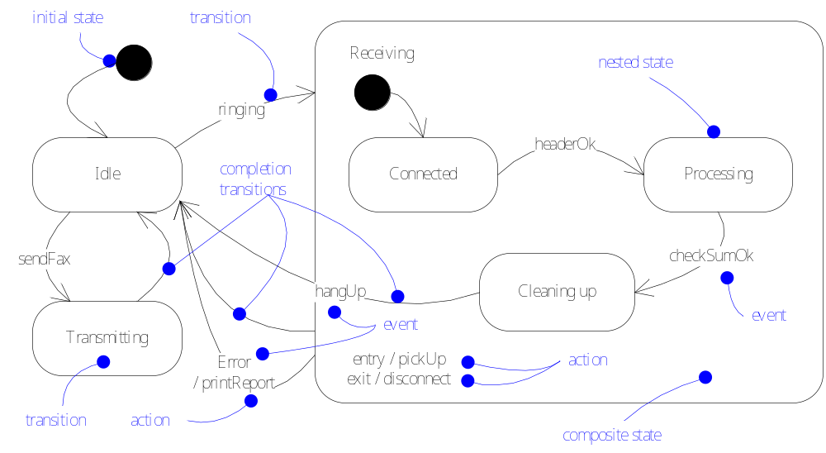
State (Statemachine) Diagrams

Slide 29
Processes and Threads
Flow of control
  Heavyweight: Process
  Lightweight: Thread
Active class/object (representing a process or thread)
Communication
Synchronization
  Sequential
  Guarded
  Concurrent

Slide 30
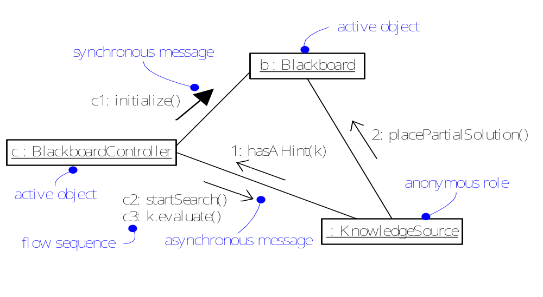
Communication

Slide 31
Timing Constraints
Some systems may be time-critical.
Even if not time-critical, meeting more stringent timing constraints is a good indicator of efficiency.
Typical timing constraints:
  Duration
  Frequency

Slide 32
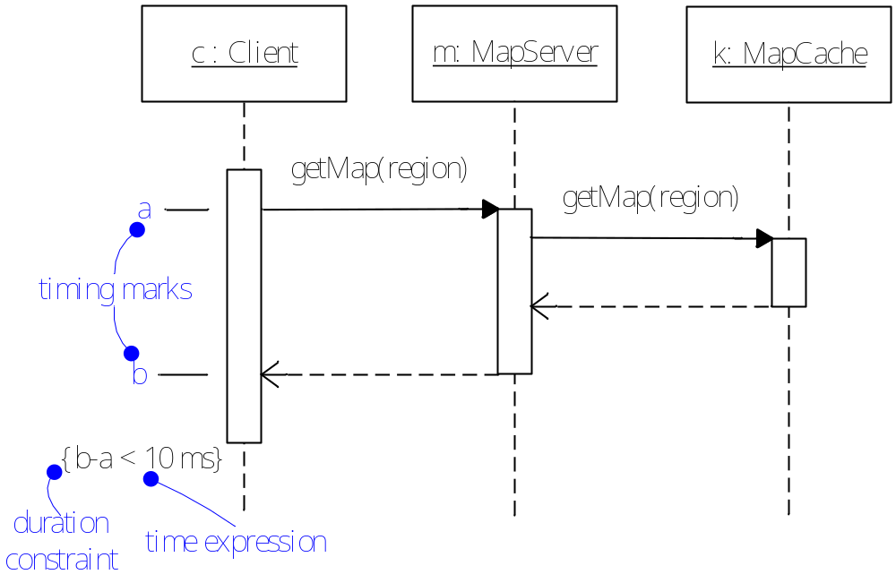
Duration Constraints

Slide 33
Improvements Made in UML 2.0
Hierarchical decomposition of structures and support for component-based development:
  Composite structure diagrams
Hierarchical decomposition of behavior
Improved integration between structural and behavioral models
Support for executable models
  fully integrated Action Semantics

