Slide 1
Chrome DevTools
Chih-Pin Tai

Slide 2
Reference
Chrome DevTools

Slide 3
Outline
Overview
View and Change the DOM
View and Change a Page's Styles (CSS)
Debug JavaScript
Inspect Network Activity

Slide 4
Outline
Overview
View and Change the DOM
View and Change a Page's Styles (CSS)
Debug JavaScript
Inspect Network Activity

Slide 5
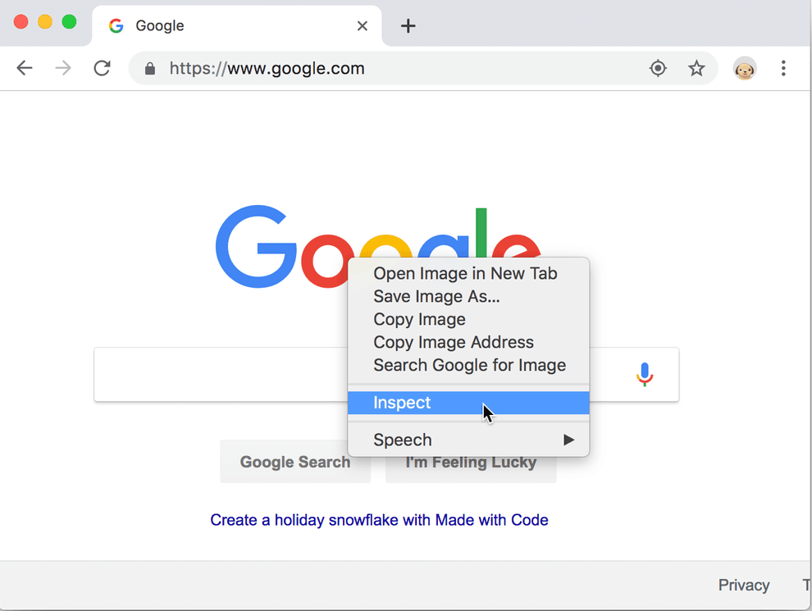
Overview (1/5)
Chrome DevTools is a set of web developer tools built directly into the Google Chrome browser.
You can open the elements panel to inspect the DOM or CSS.

Slide 6
Overview (2/5)
Chrome DevTools is a set of web developer tools built directly into the Google Chrome browser.
You can open the elements panel to inspect the DOM or CSS.

Slide 7
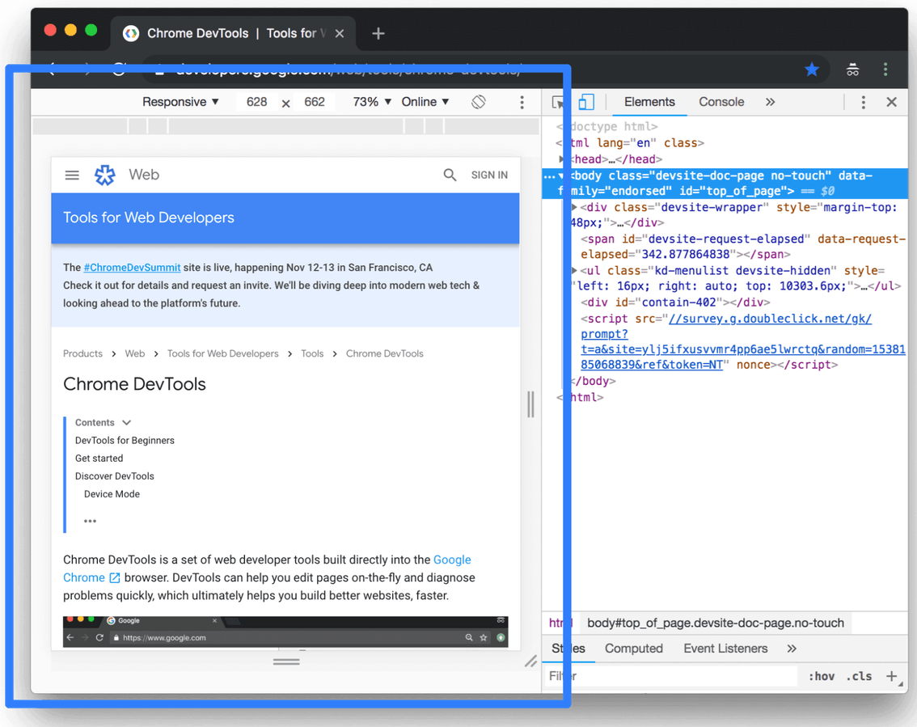
Overview (3/5)
You can test responsive and device-specific viewports.

Slide 8
Overview (4/5)
Elements panel: View and change the DOM and CSS.
Console panel: View messages and run JavaScript from the Console.
Sources panel: Debug JavaScript, persist changes made in DevTools across page reloads, save and run snippets of JavaScript, and save changes that you make in DevTools to disk.
Network panel: View and debug network activity.

Slide 9
Overview (5/5)
Performance panel: Find ways to improve load and runtime performance.
Memory panel: Monitor memory.
Application panel: Inspect all resources that are loaded, including IndexedDB or Web SQL databases, local and session storage, cookies, Application Cache, images, fonts, and stylesheets.
Security panel: Debug mixed content issues, certificate problems, and more.

Slide 10
Outline
Overview
View and Change the DOM
View and Change a Page's Styles (CSS)
Debug JavaScript
Inspect Network Activity

Slide 11
Veiw and change the DOM (1/3)
<div>
<a>
text
<img>
document
<html>
<head>
<body>
<title>
Yahoo!
DOM Nodes
Attributes
Read, Update,
Insert, Delete

Slide 12
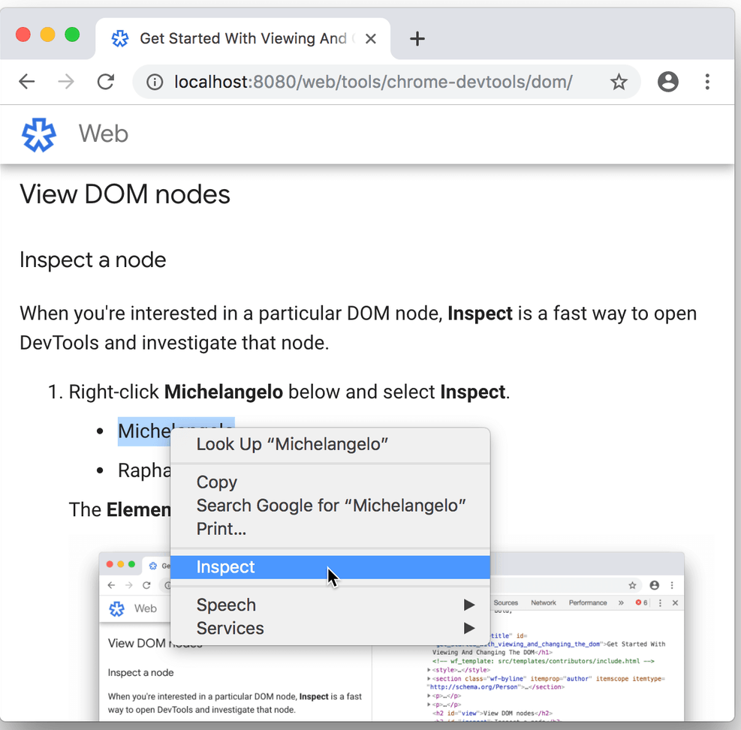
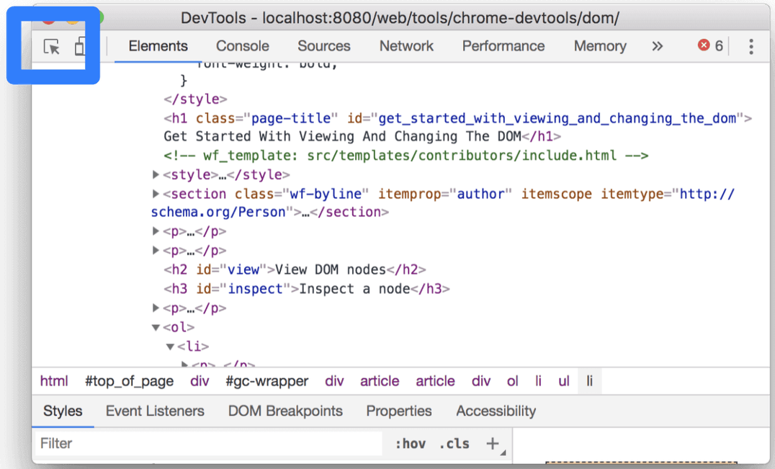
Veiw and change the DOM (2/3)
Inspect a node

Slide 13
Veiw and change the DOM (3/3)
Edit content
Edit attributes (including CSS style)
Edit note type
Force state
Reorder DOM nodes
Hide a node
Delete a node
Edit as HTML
Demo

Slide 14
Outline
Overview
View and Change the DOM
View and Change a Page's Styles (CSS)
Debug JavaScript
Inspect Network Activity

Slide 15
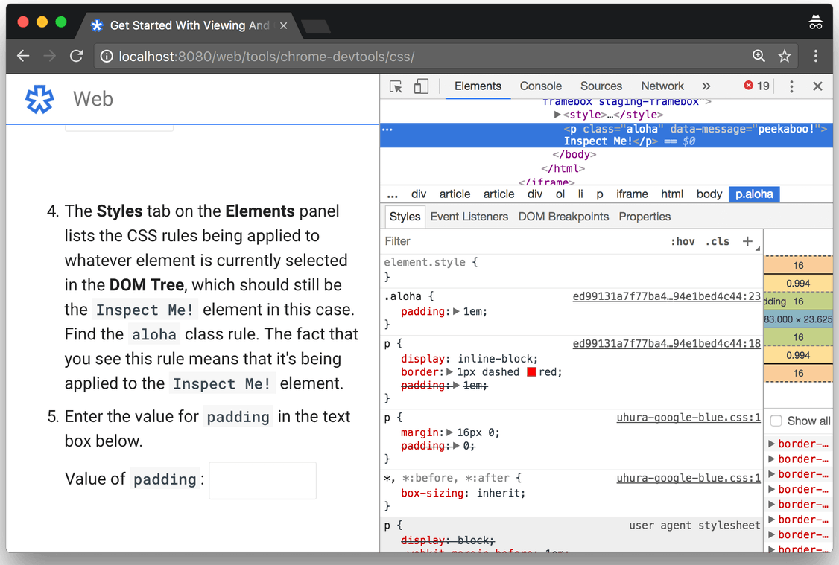
View a Page's Styles (CSS)
View an element's CSS

Slide 16
Change a Page's Styles (CSS)
Add a CSS declaration to an element
Add a CSS class to an element
Add a pseudostate to a class
Change the dimensions of an element
Demo

Slide 17
Outline
Overview
View and Change the DOM
View and Change a Page's Styles (CSS)
Debug JavaScript
Inspect Network Activity

Slide 18
Debug Javascript (1/3)
alert
  alert("test");
  alert("v="+v);
console.log
  console.log("test");
  console.log("v="+v);
Sources panel + Breakpoints

Slide 19
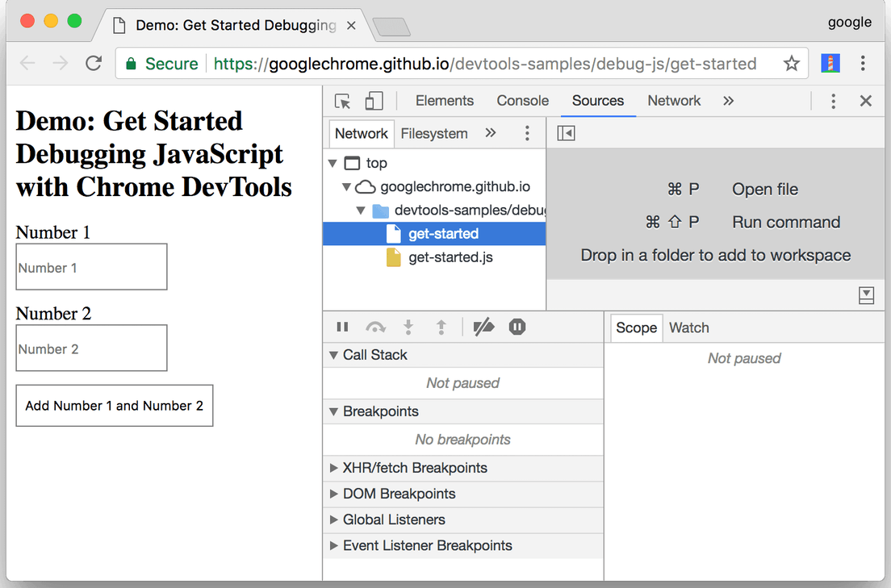
Debug Javascript (2/3)
Sources panel
  File Navigator
  Code Editor
  JavaScript Debugging
Breakpoints
  With breakpoints, you can pause on the relevant code without even knowing how the code is structured.
  With breakpoints, DevTools shows you the values of all variables at that moment in time.

Slide 20
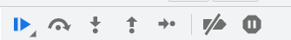
Debug Javascript (3/3)
Pause the code with a event listener breakpoint
Step through the code
Set a line-of-code breakpoint
Check variable values
  Method 1: The Scope pane
  Method 2: Watch Expressions
  Method 3: The Console
Demo

Slide 21
Outline
Overview
View and Change the DOM
View and Change a Page's Styles (CSS)
Debug JavaScript
Inspect Network Activity

Slide 22
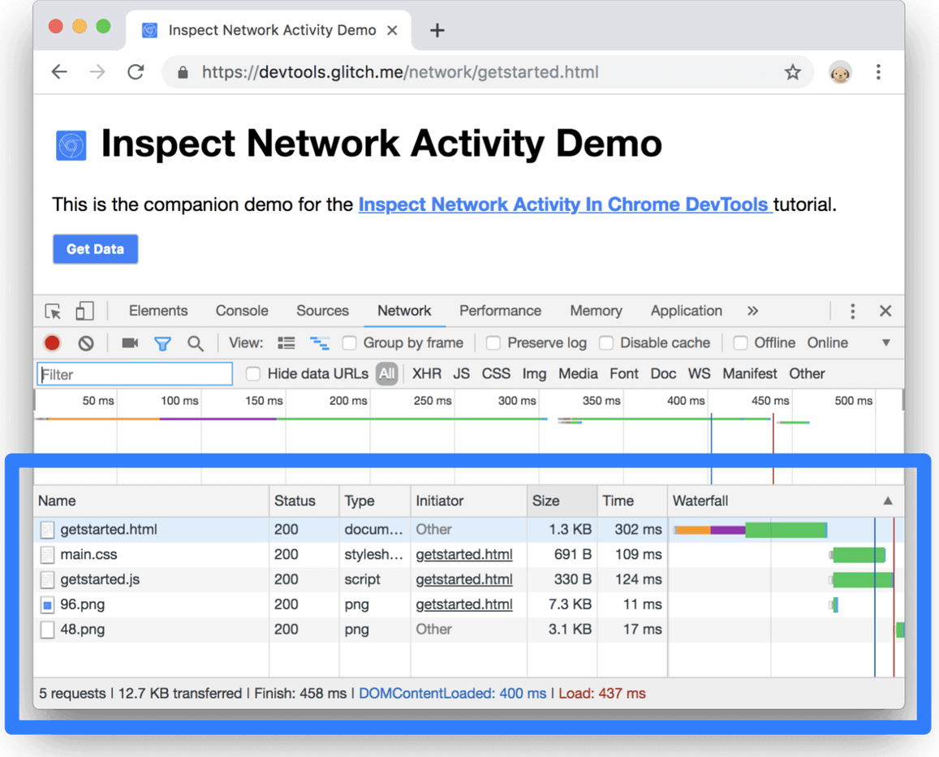
Inspect Network Activity (1/3)
Log network activity

Slide 23
Inspect Network Activity (1/4)
Log network activity
Demo

Slide 24
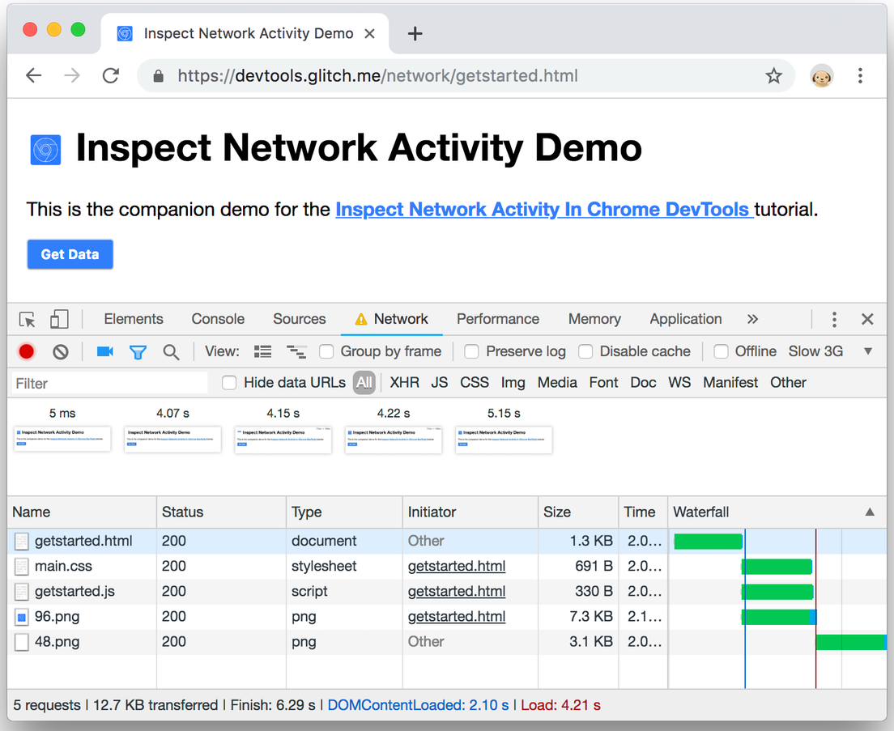
Inspect Network Activity (2/4)
Capture screenshots
Demo

Slide 25
Inspect Network Activity (3/4)
Client
Server
Database
HTML
CSS
Javascript
PHP
SQL
AJAX

Slide 26
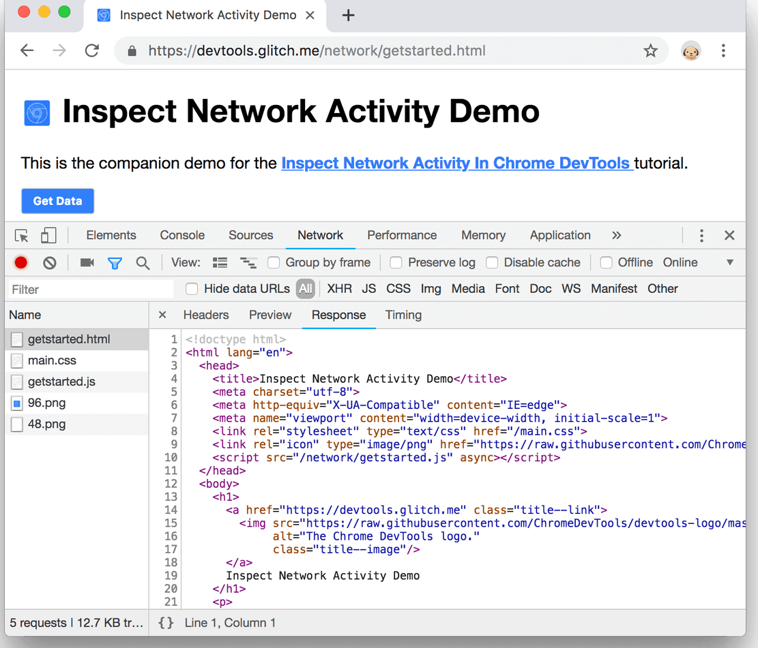
Inspect Network Activity (4/4)
View Ajax requests and responses
Demo

Slide 27
Q & A

