Slide 1
Chrome DevTools
Chih-Pin Tai

Slide 2
Reference
Chrome DevTools

Slide 3
Outline
Overview
View and Change the DOM
View and Change a Page's Styles (CSS)
Debug JavaScript
Inspect Network Activity

Slide 4
Outline
Overview
View and Change the DOM
View and Change a Page's Styles (CSS)
Debug JavaScript
Inspect Network Activity

Slide 5
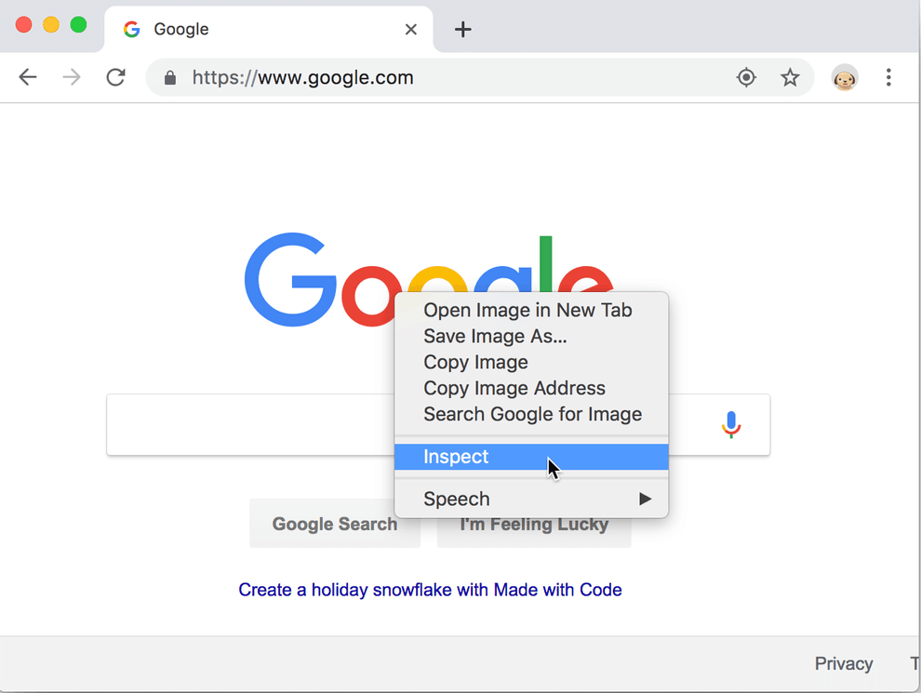
Overview (1/4)
Chrome DevTools is a set of web developer tools built directly into the Google Chrome browser.
You can open the elements panel to inspect the DOM or CSS.

Slide 6
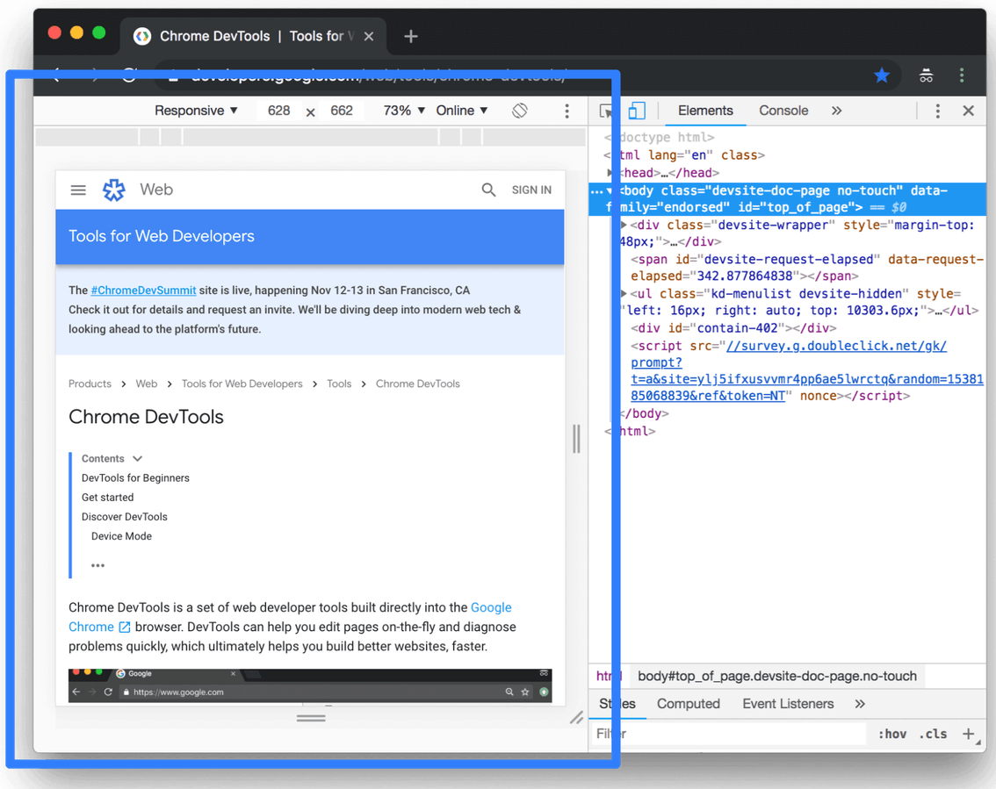
Overview (2/4)
You can test responsive and device-specific viewports.

Slide 7
Overview (3/4)
Elements panel: View and change the DOM and CSS.
Console panel: View messages and run JavaScript from the Console.
Sources panel: Debug JavaScript, persist changes made in DevTools across page reloads, save and run snippets of JavaScript, and save changes that you make in DevTools to disk.
Network panel: View and debug network activity.

Slide 8
Overview (4/4)
Performance panel: Find ways to improve load and runtime performance.
Memory panel: Monitor memory.
Application panel: Inspect all resources that are loaded, including IndexedDB or Web SQL databases, local and session storage, cookies, Application Cache, images, fonts, and stylesheets.
Security panel: Debug mixed content issues, certificate problems, and more.

Slide 9
Outline
Overview
View and Change the DOM
View and Change a Page's Styles (CSS)
Debug JavaScript
Inspect Network Activity

Slide 10
Veiw and change the DOM (1/3)
<div>
<a>
text
<img>
document
<html>
<head>
<body>
<title>
Yahoo!
DOM Nodes
Attributes
Read, Update,
Insert, Delete

Slide 11
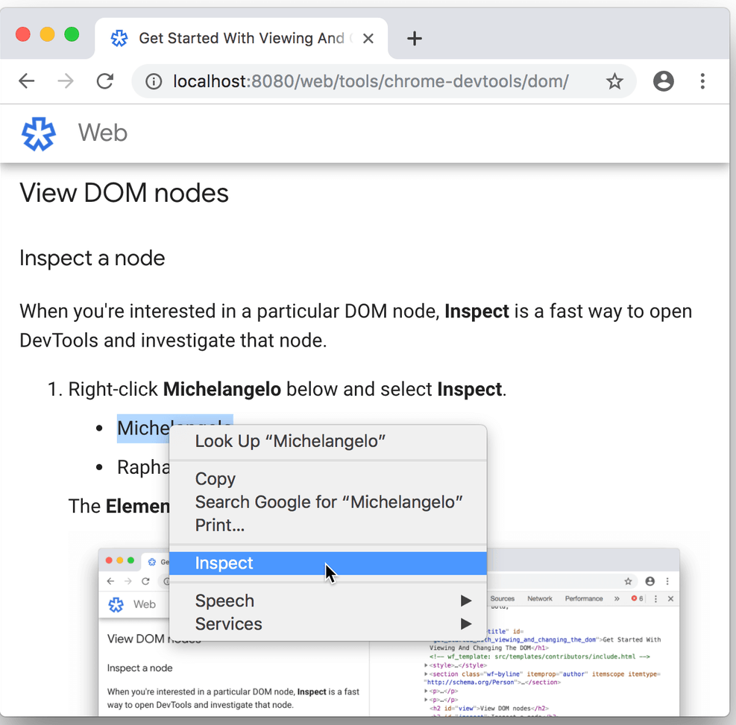
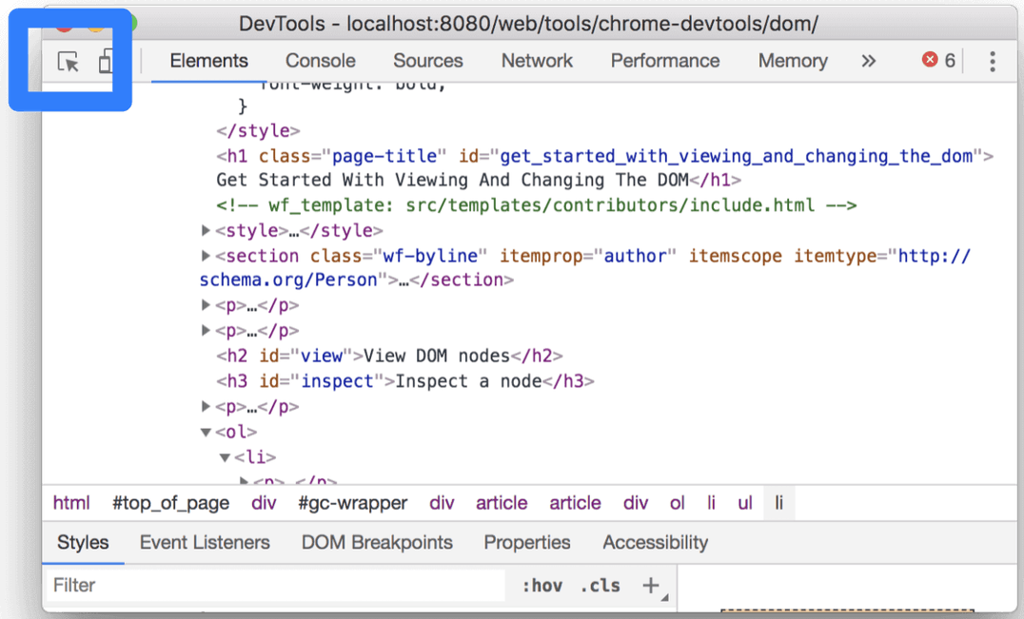
Veiw and change the DOM (2/3)
Inspect a node

Slide 12
Veiw and change the DOM (3/3)
Edit content
Edit attributes (including CSS style)
Edit node type
Force state
Reorder DOM nodes
Hide a node
Delete a node
Edit as HTML
Demo

Slide 13
Outline
Overview
View and Change the DOM
View and Change a Page's Styles (CSS)
Debug JavaScript
Inspect Network Activity

Slide 14
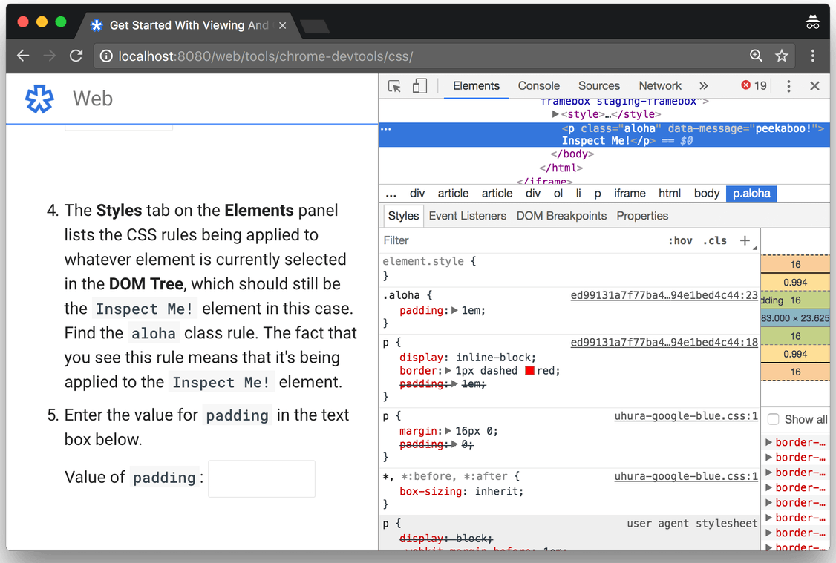
View a Page's Styles (CSS)
View an element's CSS

Slide 15
Change a Page's Styles (CSS)
Add a CSS declaration to an element
Add a CSS class to an element
Add a pseudostate to a class
Change the dimensions of an element
Demo

Slide 16
Outline
Overview
View and Change the DOM
View and Change a Page's Styles (CSS)
Debug JavaScript
Inspect Network Activity

Slide 17
Debug Javascript (1/3)
alert
  alert("test");
  alert("v="+v);
console.log
  console.log("test");
  console.log("v="+v);
Sources panel + Breakpoints

Slide 18
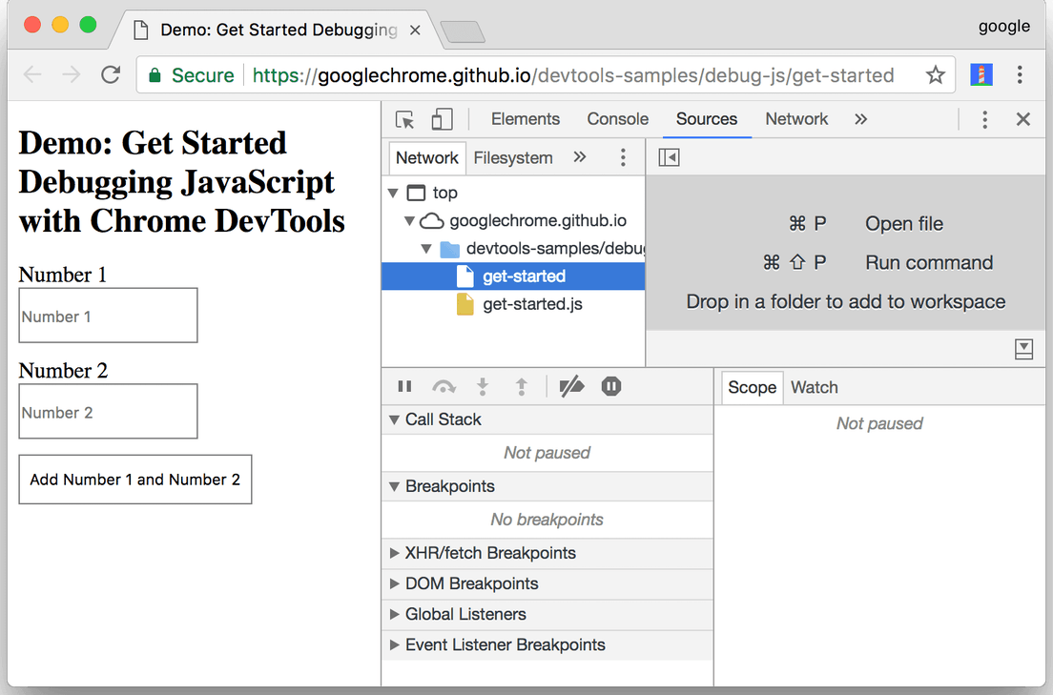
Debug Javascript (2/3)
Sources panel
  File Navigator
  Code Editor
  JavaScript Debugging
Breakpoints
  With breakpoints, you can pause on the relevant code without even knowing how the code is structured.
  With breakpoints, DevTools shows you the values of all variables at that moment in time.

Slide 19
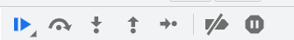
Debug Javascript (3/3)
Pause the code with a event listener breakpoint
Step through the code
Set a line-of-code breakpoint
Check variable values
  Method 1: The Scope pane
  Method 2: Watch Expressions
  Method 3: The Console
Demo

Slide 20
Outline
Overview
View and Change the DOM
View and Change a Page's Styles (CSS)
Debug JavaScript
Inspect Network Activity

Slide 21
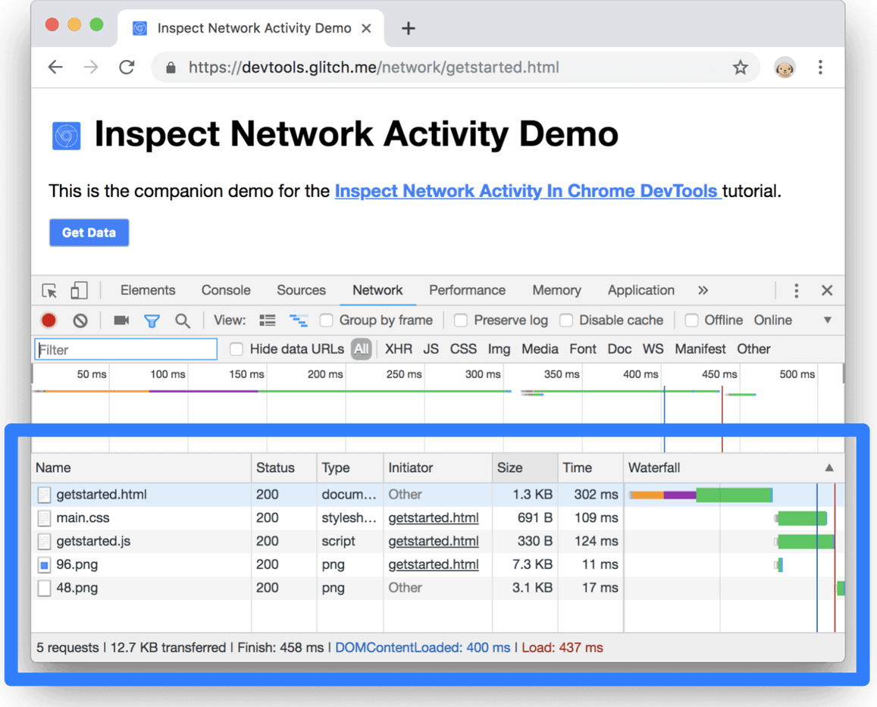
Inspect Network Activity (1/3)
Log network activity

Slide 22
Inspect Network Activity (1/4)
Log network activity
Demo

Slide 23
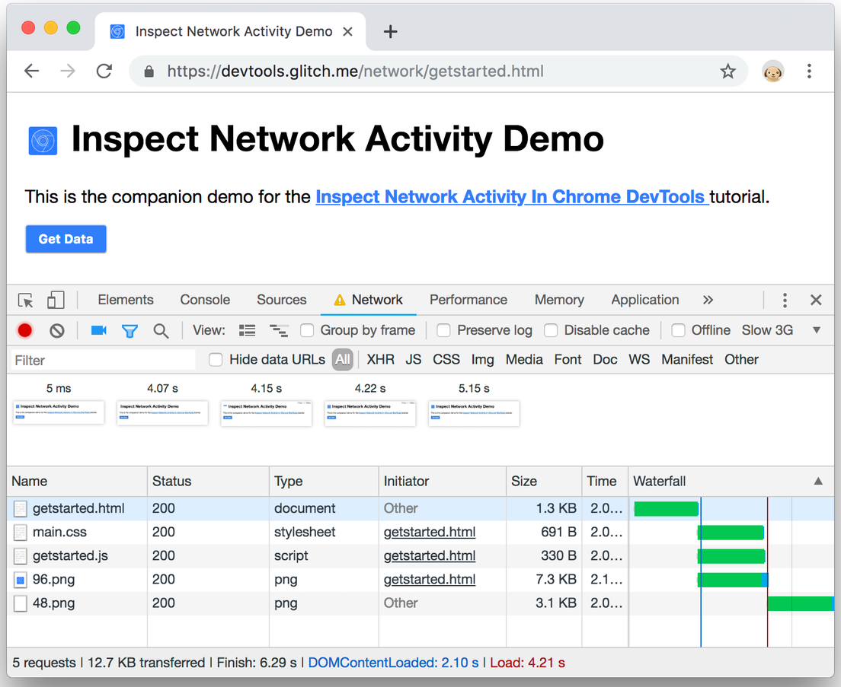
Inspect Network Activity (2/4)
Capture screenshots
Demo

Slide 24
Inspect Network Activity (3/4)
Client
Server
Database
HTML
CSS
Javascript
PHP
SQL
AJAX

Slide 25
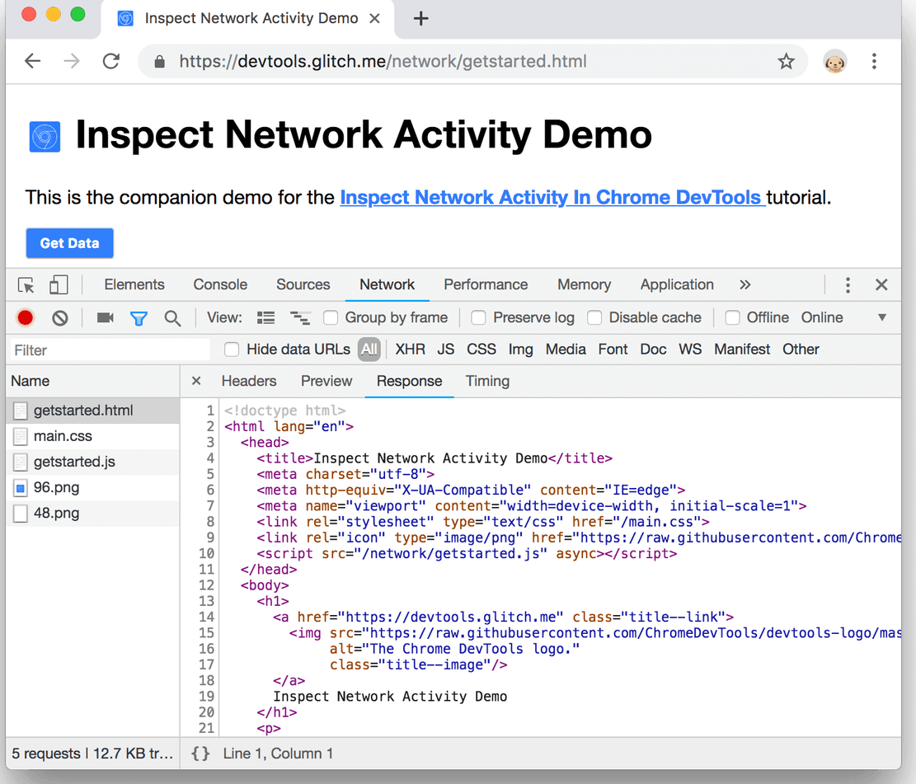
Inspect Network Activity (4/4)
View Ajax requests and responses
Demo

Slide 26
Q & A

