Slide 1
Computing Theory – HW#10
Jui-Shun Lai
Wei-Hsien Chang

Slide 2
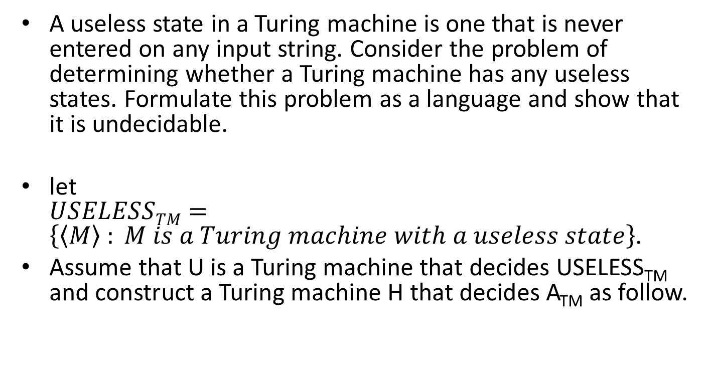
HW#10 Q1.
A useless state in a Turing machine is one that is never entered on any input string. Consider the problem of determining whether a Turing machine has any useless states. Formulate this problem as a language and show that it is undecidable.
let $USELESSTM=\left\{\left\langle M\right\rangle \right. \left.: M is a Turing machine with a useless state\right\}$.
Assume that U is a Turing machine that decides USELESS_{TM} and construct a Turing machine H that decides A_{TM} as follow.
Notes:
It is easy to see that L(A) and L(A^{C}) are the complement of each other with respect to $Σ$*. That is, L(A) = $Σ$* - L(A^{C}).
Hence, L(A) = $Σ$* iff L(A^{C}) = empty. Determining if L(A^{C}) is empty is decidable due to Theorem 4.5, and so determining if L(A) = $Σ$* is decidable as well.

Slide 3
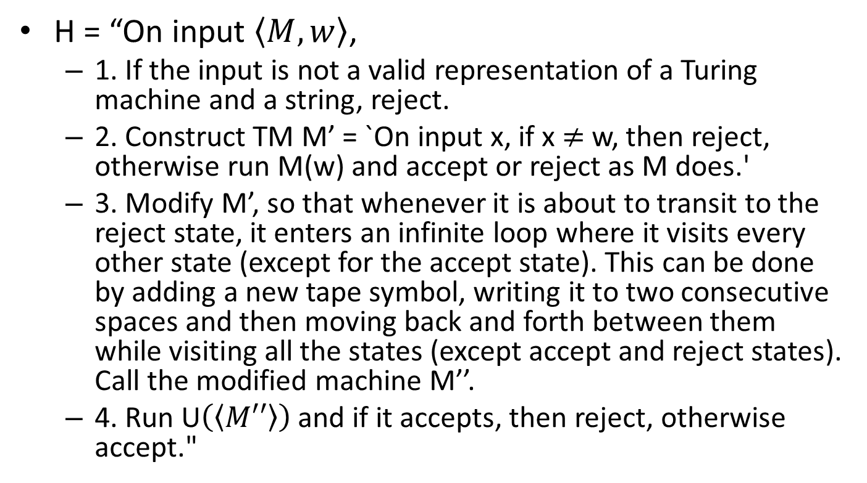
HW#10 Q1. (cont.)
H = “On input $\left\langle M, w\right\rangle$,
  1. If the input is not a valid representation of a Turing machine and a string, reject.
  2. Construct TM M’ = `On input x, if x $≠$ w, then reject, otherwise run M(w) and accept or reject as M does.'
  3. Modify M’, so that whenever it is about to transit to the reject state, it enters an infinite loop where it visits every other state (except for the accept state). This can be done by adding a new tape symbol, writing it to two consecutive spaces and then moving back and forth between them while visiting all the states (except accept and reject states). Call the modified machine M’’.
  4. Run U$\left(\left\langle M′′\right\rangle \right)$ and if it accepts, then reject, otherwise accept."
Notes:
To see that the reduction is correct, consider a TM M and input w. Since any string other than w causes M’’ to enter every state except for the accept state, M’’ will have a useless state if and only if w $∉$ L(M). [Note: This can be modified slightly to define a map reduction from A_{TM} to the complement of USELESS_{TM}, that is A_{TM} $≤$_{m} $\overline{USELESSTM}$.]

Slide 4
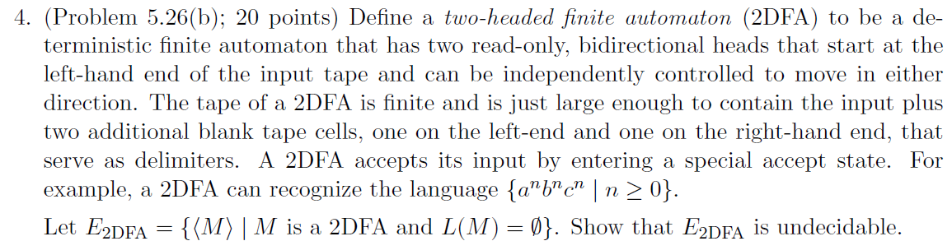
HW#10 Q4.

Slide 5
Given a TM M and input w, we can construct a 2DFA M’ to test if M accepts w.
Given a TM D can decide E_{2DFA}, we can decide E_{TM} based on D. (Reduction: E_{TM} → E_{2DFA})
That is,
M = “On input <M>,
  Construct a 2DFA M’ which recognizes the accepting computation history of M.
  Run D on M’. If D accepts, accept. Otherwise, reject.”
→ Since E_{TM} is undecidable, we meet a contradiction.
→ E_{2DFA} is undecidable.

Slide 6
How to construct M’?
For a TM M and an input w, M’ accepts an accepting computation history for M on w.
  We assume a computation history should look like:
  C₁#C₂#C₃#...#C_{k}
  And M’ will decide the computation history by checking following 2 conditions:
  C₁ and C_{k} are valid start and accepting configurations.
    Check if C₁ contains q₀ and C_{k} contains q_{accept}.
  For each C_{i}, C_{i+1} will legally follow from C_{i}.
    Using two heads, we check if the symbol of C_{i} applying to the transition function leads to the corresponding position of C_{i+1}.
  If both conditions holds, M’ accepts. Otherwise, reject.

Slide 7
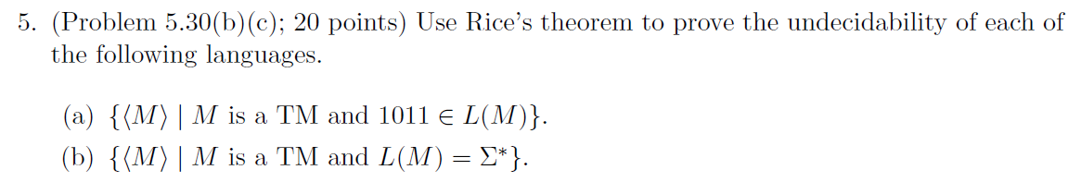
HW#10 Q5.

Slide 8
HW#10 Q5.(a)
Check two conditions
  Some TMs recognize languages containing 1011 and some do not.
    For example, L(M₁) = Σ* and L(M₂) = Φ
  If two TMs recognize the same language, then they will both contain 1011 or both not contain 1011.
→ the property is non-trivial, this is undecidable.
Notes:
This property is nontrivial
This property is a TM’s property (depends on language)

Slide 9
HW#10 Q5.(b)
Check two conditions
  Some TMs recognize languages recognize Σ* and some do not.
    For example, L(M₁) = Σ* and L(M₂) = Φ
  If two TMs recognize the same language, then they will both contain Σ* or both do not.
→ the property is non-trivial, this is undecidable.

Slide 10
HW#10 Q6.

Slide 11
Let R be a TM that decides X. We use R to construct a TM S that decides A_{TM}.
TM S = “On input <M, w>,
TM M’ = “On input y,
      Scan w and put # to the right end, # is not in Γ_{M}
      Copy w to right-hand side of #, we call it w’
      Simulate M on w’
      If M accepts, write anything on the first cell of the input and accept. Otherwise, reject.
”
    Input <M’, w> to R.
    If R accepts, accept. Otherwise, reject.
”
→ M will accept w iff M’ once modifies the input
→ We get a reduction from A_{TM}, X is undecidable.

