Slide 1
Computing Theory - HW#2
Jui-Shun Lai
Wei-Hsien Chang

Slide 2
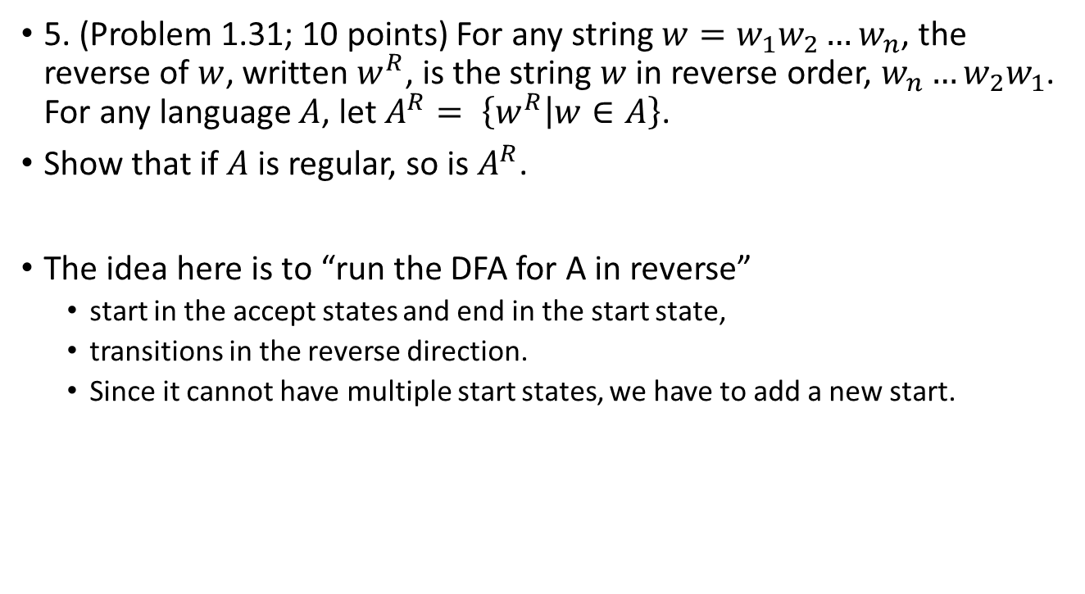
HW#2 – Q5.
5. (Problem 1.31; 10 points) For any string $w=w_{1}w_{2}…w_{n}$, the reverse of $w$, written $w^{R}$, is the string $w$ in reverse order, $w_{n}…w_{2}w_{1}$. For any language $A$, let $A^{R}= \left\{w^{R} | w∈A\right\}$.
Show that if $A$ is regular, so is $A^{R}$.
The idea here is to “run the DFA for A in reverse”
  start in the accept states and end in the start state,
  transitions in the reverse direction.
  Since it cannot have multiple start states, we have to add a new start.

Slide 3
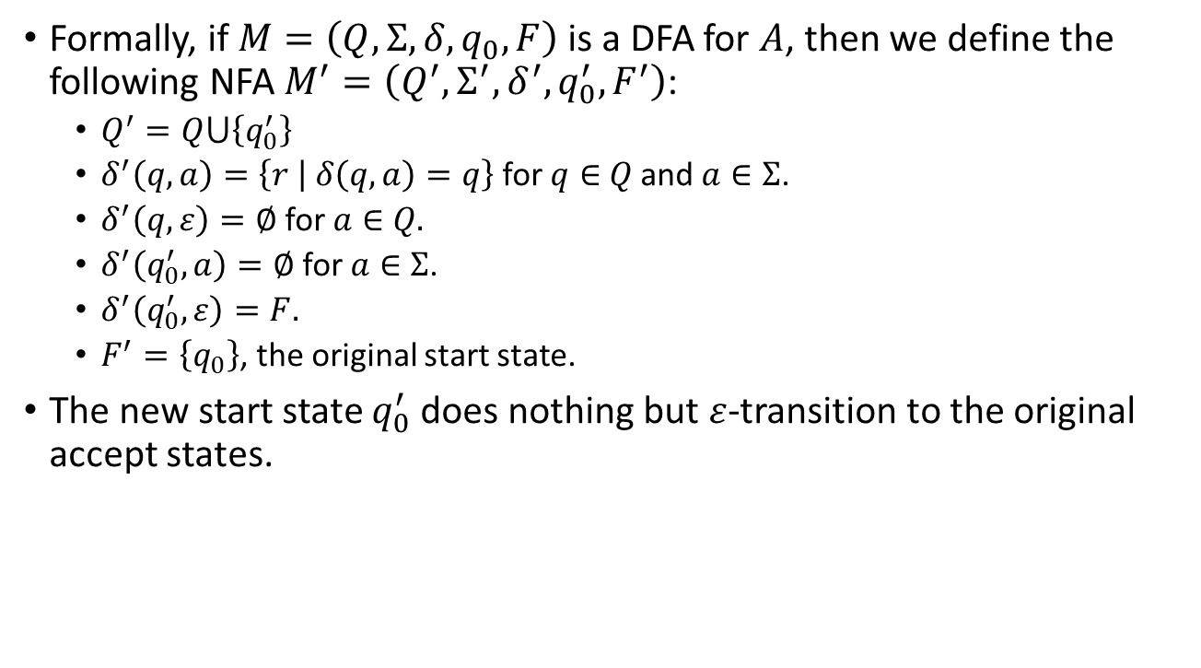
HW#2 – Q5.(cont.)
Formally, if $M=\left(Q,Σ,δ,q_{0},F\right)$ is a DFA for $A$, then we define the following NFA $M^{′}=\left(Q^{′},Σ^{′},δ^{′},q_{0}^{′},F^{′}\right)$:
  $Q^{′}=Q⋃\left\{q_{0}^{′}\right\}$
  $δ^{′}\left(q, a\right)=\left\{r | δ\left(q, a\right)=q\right\}$ for $q∈$ $Q$ and $a∈Σ$.
  $δ^{′}\left(q,ε\right)=∅$ for $a∈$ $Q.$
  $δ^{′}\left(q_{0}^{′}, a\right)=∅$ for $a∈$ $Σ$.
  $δ^{′}\left(q_{0}^{′},ε\right)=F.$
  $F^{′}=\left\{q_{0}\right\}$, the original start state.
The new start state $q_{0}^{′}$ does nothing but $ε$-transition to the original accept states.

Slide 4
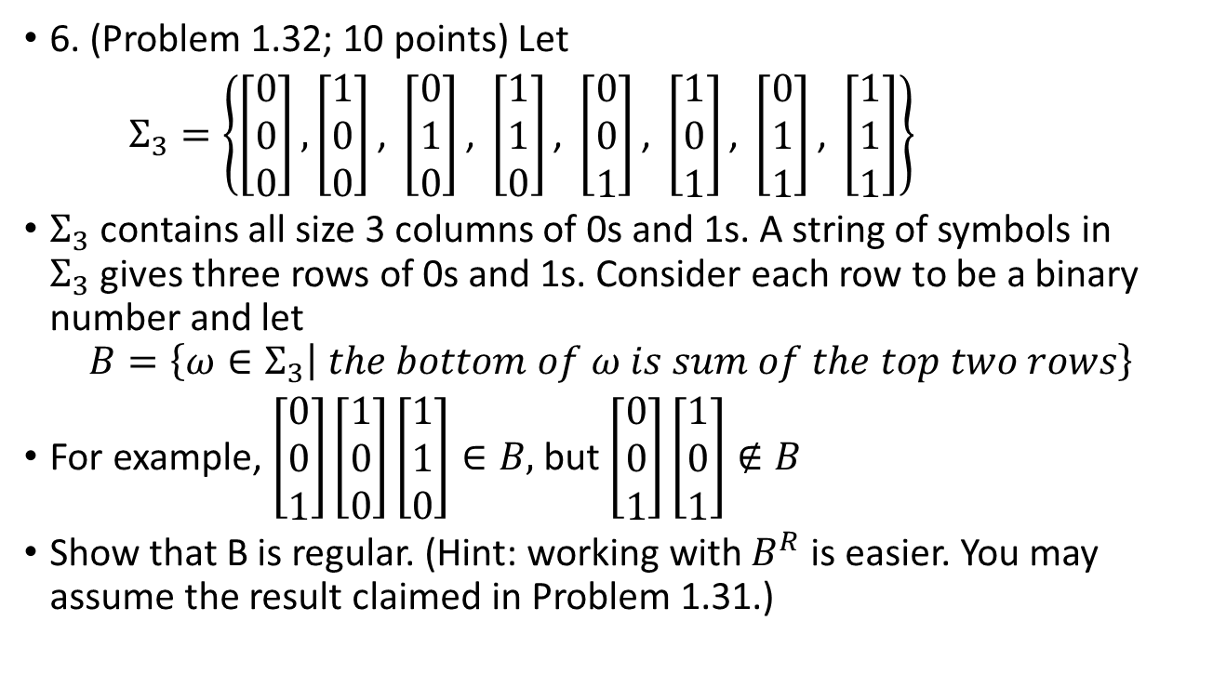
HW#2 – Q6.
6. (Problem 1.32; 10 points) Let
$Σ_{3}=\left\{\left[\begin{matrix}0 \\ 0 \\ 0\end{matrix}\right],\left[\begin{matrix}1 \\ 0 \\ 0\end{matrix}\right]\text{, }\left[\begin{matrix}0 \\ 1 \\ 0\end{matrix}\right]\text{, }\left[\begin{matrix}1 \\ 1 \\ 0\end{matrix}\right]\text{, }\left[\begin{matrix}0 \\ 0 \\ 1\end{matrix}\right]\text{, }\left[\begin{matrix}1 \\ 0 \\ 1\end{matrix}\right]\text{, }\left[\begin{matrix}0 \\ 1 \\ 1\end{matrix}\right]\text{, }\left[\begin{matrix}1 \\ 1 \\ 1\end{matrix}\right]\right\}$
$Σ_{3}$ contains all size 3 columns of 0s and 1s. A string of symbols in $Σ_{3}$gives three rows of 0s and 1s. Consider each row to be a binary number and let
$$B=\left\{ω∈Σ_{3} | the bottom of ω is sum of the top two rows\right\}$$
For example, $\left[\begin{matrix}0 \\ 0 \\ 1\end{matrix}\right]\left[\begin{matrix}1 \\ 0 \\ 0\end{matrix}\right]\left[\begin{matrix}1 \\ 1 \\ 0\end{matrix}\right]∈B,$ but $\left[\begin{matrix}0 \\ 0 \\ 1\end{matrix}\right]\left[\begin{matrix}1 \\ 0 \\ 1\end{matrix}\right]∉B$
Show that B is regular. (Hint: working with $B^{R}$ is easier. You may assume the result claimed in Problem 1.31.)

Slide 5
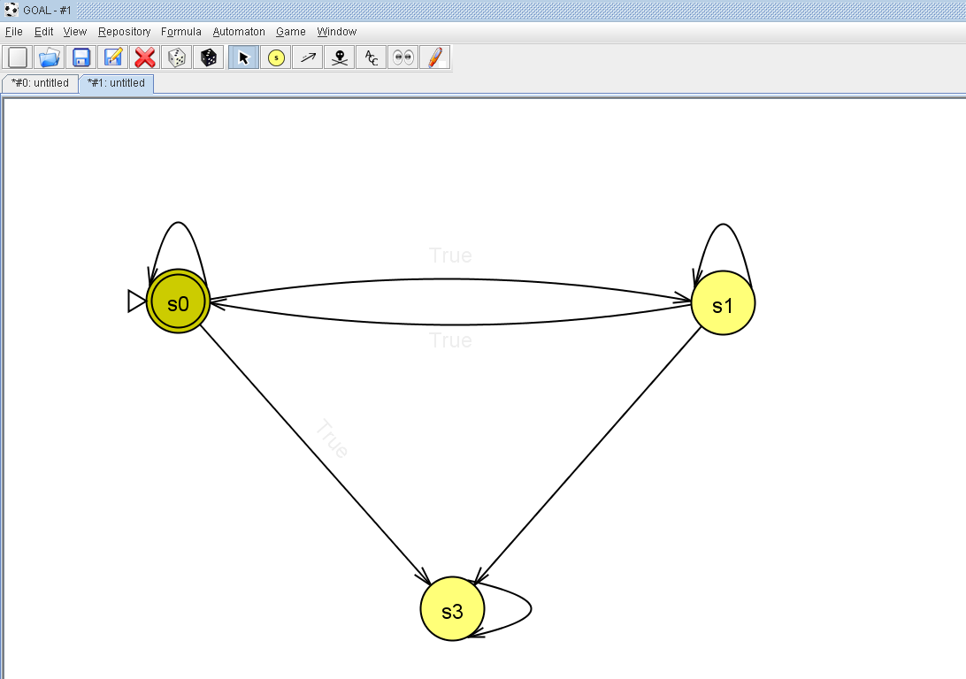
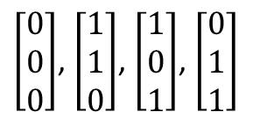
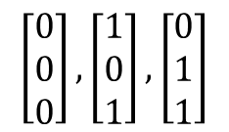






HW#2 – Q6.(cont.)
$$B^{R}$$
$$\left[\begin{matrix}0 \\ 0 \\ 0\end{matrix}\right],\left[\begin{matrix}1 \\ 0 \\ 1\end{matrix}\right],\left[\begin{matrix}0 \\ 1 \\ 1\end{matrix}\right]$$
$$\left[\begin{matrix}1 \\ 0 \\ 0\end{matrix}\right],\left[\begin{matrix}0 \\ 1 \\ 0\end{matrix}\right],\left[\begin{matrix}1 \\ 1 \\ 1\end{matrix}\right]$$
$$\left[\begin{matrix}1 \\ 1 \\ 0\end{matrix}\right]$$
$$\left[\begin{matrix}0 \\ 0 \\ 1\end{matrix}\right]$$
$\left[\begin{matrix}1 \\ 0 \\ 0\end{matrix}\right]$, $\left[\begin{matrix}0 \\ 1 \\ 0\end{matrix}\right]$, $\left[\begin{matrix}0 \\ 0 \\ 1\end{matrix}\right]$, $\left[\begin{matrix}1 \\ 1 \\ 1\end{matrix}\right]$
$\left[\begin{matrix}0 \\ 0 \\ 0\end{matrix}\right]$, $\left[\begin{matrix}1 \\ 1 \\ 0\end{matrix}\right]$, $\left[\begin{matrix}1 \\ 0 \\ 1\end{matrix}\right]$, $\left[\begin{matrix}0 \\ 1 \\ 1\end{matrix}\right]$
$\left[\begin{matrix}0 \\ 0 \\ 0\end{matrix}\right],\left[\begin{matrix}1 \\ 0 \\ 0\end{matrix}\right]$, $\left[\begin{matrix}0 \\ 1 \\ 0\end{matrix}\right]$, $\left[\begin{matrix}1 \\ 1 \\ 0\end{matrix}\right]$, $\left[\begin{matrix}0 \\ 0 \\ 1\end{matrix}\right]$, $\left[\begin{matrix}1 \\ 0 \\ 1\end{matrix}\right]$, $\left[\begin{matrix}0 \\ 1 \\ 1\end{matrix}\right]$, $\left[\begin{matrix}1 \\ 1 \\ 1\end{matrix}\right]$

Slide 6
HW#2 Q7.
We use the same pre-definition as the powerpoint.
Suppose M₁ = (Q₁, ∑₁, δ₁, q₁, F₁) recognizes A₁ and M₂ = (Q₂, ∑₂, δ₁, q₂, F₂) recognizes A₂.
Construct M = (Q, ∑, δ, q₀, F) to recognize A1∪A2

Slide 7
Q = {(r₁, r₂) │ r₁ Q₁ and r₂ Q₂}.
∑ = ∑₁∪∑₂
For each (r₁, r₂) Q and each a ∑₁, b ∑₂, let δ((r₁, r₂), a) = (δ(r₁, a), r₂) and δ((r₁, r₂), b) = (r₁, δ(r₂, b)).
q₀ = (q₁, q₂).
F = {(r₁, r₂) │ r₁ F₁ or r₂ F₂}.
Notes:
亦可以更改成“遇到不認識的就不accpet”

