Slide 1
Computing Theory HW#4
Jui-Shun Lai
Wei-Hsien Chang

Slide 2
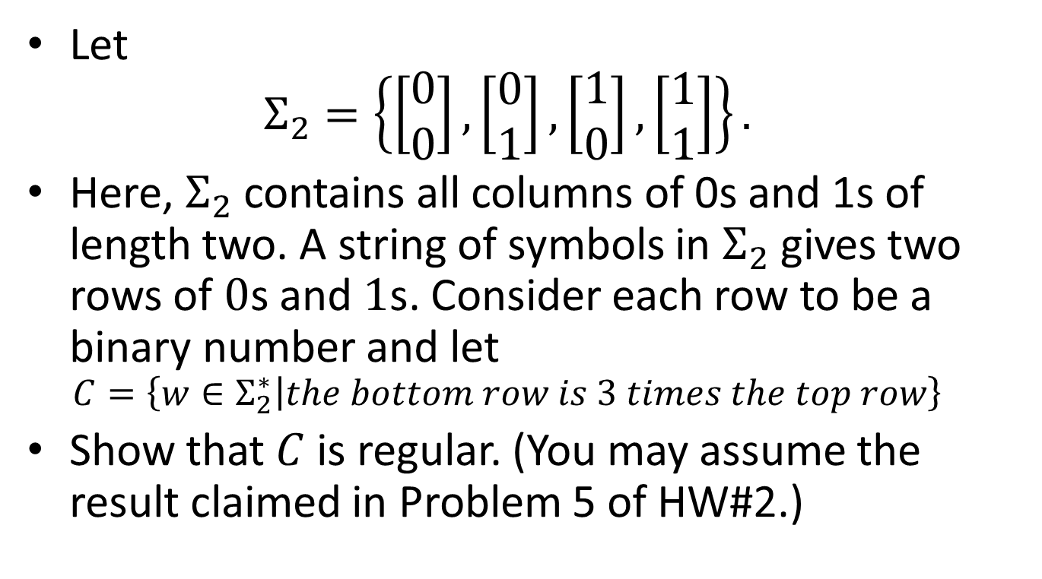
HW#4 Problem 1
Let
$Σ_{2}=\left\{\left[\begin{matrix}0 \\ 0\end{matrix}\right],\left[\begin{matrix}0 \\ 1\end{matrix}\right],\left[\begin{matrix}1 \\ 0\end{matrix}\right],\left[\begin{matrix}1 \\ 1\end{matrix}\right]\right\}.$
Here, $Σ_{2}$ contains all columns of 0s and 1s of length two. A string of symbols in $Σ_{2}$ gives two rows of $0$s and $1$s. Consider each row to be a binary number and let
$C=\left\{w∈Σ_{2}^{∗} | the bottom row is 3 times the top row\right\}$
Show that $C$ is regular. (You may assume the result claimed in Problem 5 of HW#2.)

Slide 3
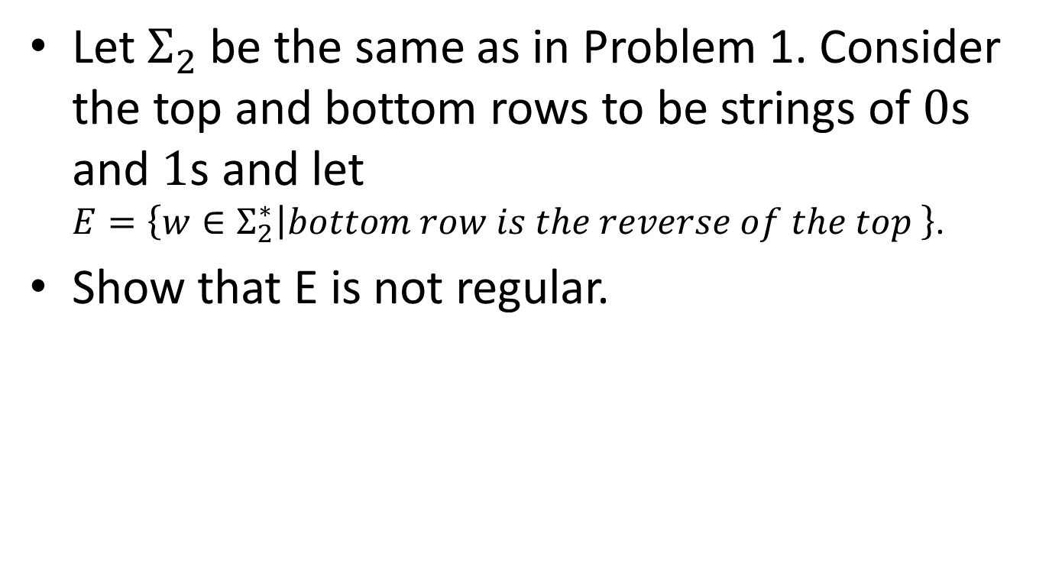
HW#4 Problem 2
Let $Σ_{2}$ be the same as in Problem 1. Consider the top and bottom rows to be strings of $0$s and $1$s and let
$E=\left\{w∈Σ_{2}^{∗} | bottom row is the reverse of the top \right\}$.
Show that E is not regular.

Slide 4
HW#4 Q3.
Q = {q_{i}|0 ≦ i < n}
Σ = {0,1}
δ(q_{i},0) = q(2*i mod n)
δ(q_{i},1) = q((2*i+1) mod n)
q₀
F={q₀}
Notes:
看到一個值，判斷現在讀到的數字(用binary的算法找出數字)是否是5的倍數(mod 5)，如果又看到一個值，表示binary尚未算完
因為
((a+b) mod n) = (a mod n) + (b mod n)
((a*b) mod n) = (a mod n) * (b mod n)

Slide 5
HW#4 Q3. (cont.)
0
q₀
1
1
q₁
0
q₂
1
0
1
0
q₃
q₄
0
1
Notes:
以5為例

Slide 6
HW#4 Q4.
Convert any all-NFA (Q, Σ, δ, q₀, F) to DFA (Q’, Σ’, δ’, q₀’, F’)
  Q’ = P(Q)
  Σ’ = Σ
  δ’ = standard NFA/DFA conversion
  q₀’ = The set of states reachable by ε from q₀
  F’ = P(F)-{{}}
If there is a state Q in all-NFA can be reached by an input string, a state-set containing Q will be reached in DFA.
All DFAs are special cases of all-NFAs.
Notes:
all-NFA M接受 x: M讀了x後最後有可能跑到的所有state都屬於F
Let P(Q) be the power set of Q and let Σ_{ε} denote Σ∪{ε}
前四個和一般NFA轉DFA過程相同，但接受的F轉換不同
原本一般NFA轉DFA: F’ = {R 屬於 Q’ | R contains some element of F}.
現在不同的是，R要contains all element of F except empty set
all-NFA可以透過input走到的Q必會在DFA用同樣的input走到包含Q的state-set的state
→ 如果說Q是final state，則all-NFA和DFA一樣

Slide 7
HW#4 Q5.
Design an NFA M = (Q, Σ, δ, q₀, F) that recognize the shuffle of A and B, whose recognized by DFA_{A} (Q_{A}, Σ, δ_{A}, q_{0A}, F_{A}) and DFA_{B} (Q_{B}, Σ, δ_{B}, q_{0B}, F_{B}).
Q = Q_{A} ×Q_{B} ∪{q₀}
δ(q₀, ε) = (q_{A}, q_{B})
δ(δ_{A}(x, a), y) δ((x, y), a)
δ(x, δ_{B}(y, a)) δ((x, y), a)
F = Q_{A} ×Q_{B} ∪{q₀}
Notes:
目前的Q=(x, y)讀到a的時候，可能是讓x跑δ_{A}，也可能讓y跑δ_{B}。

Slide 8
HW#4 Q6.
Suppose that the set A of palindromes were regular. Let s be 0^{p}10^{p} that is a palindrome
  No matter how s is divided as xyz with
  |xy| ≦ p and |y| > 0,
  there exists an i ≧0 s.t. xy^{i}z A
Since |xy|≦p, xy must be 0…0 in the start of s that the length ≦ p. So x and y are all 0s, say x = 0ª y = 0^{b} and z = 0^{c}10^{p}. (a+b+c=p)

Slide 9
HW#4 Q6. (cont.)
  Now consider i=0, xy⁰z = 0ª0^{c}10^{p} = 0^{(a+c)}10^{p}
  Because b>0, a+c < p. So 0^{(a+c)}10^{p} is not a palindrome.
  The set of palindromes doesn’t satisfy pumping lemma, it is not regular.

Slide 10
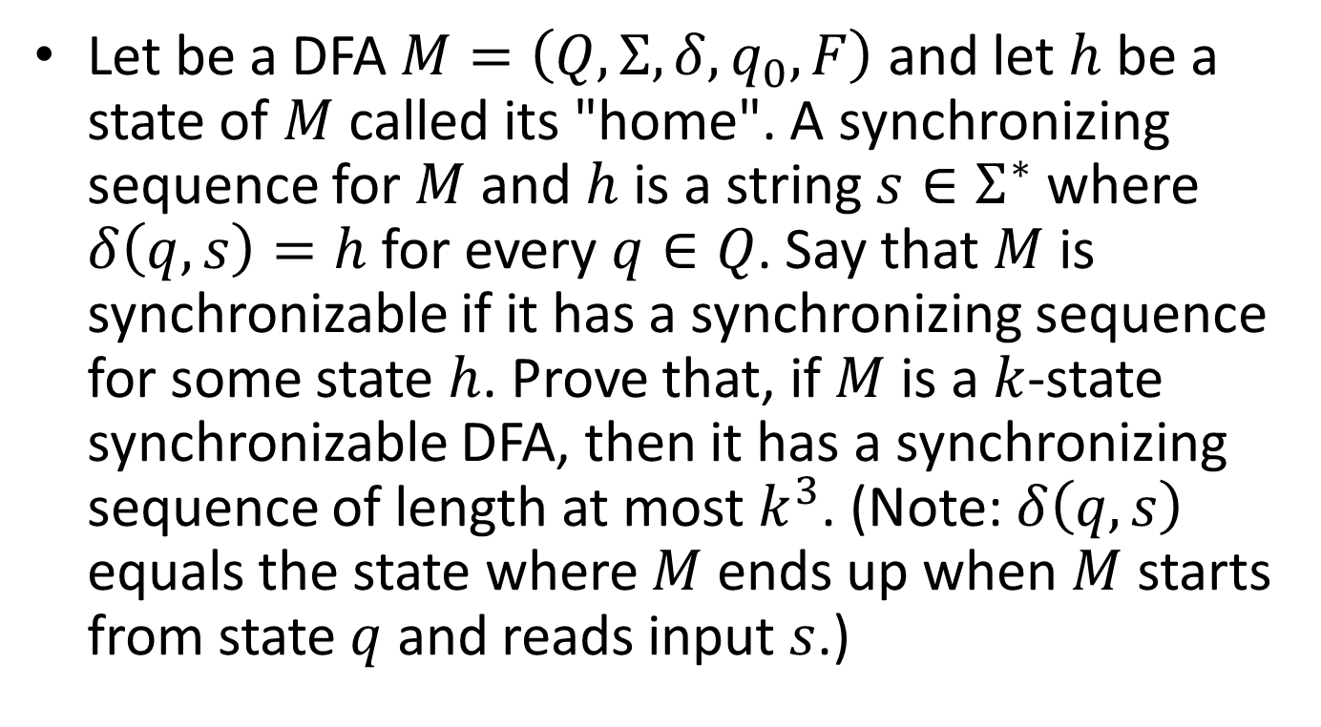
HW#4 Problem 7
Let be a DFA $M=\left(Q, Σ, δ, q_{0}, F\right)$ and let $h$ be a state of $M$ called its "home". A synchronizing sequence for $M$ and $h$ is a string $s∈Σ^{∗}$ where $δ\left(q, s\right)=h$for every $q∈Q$. Say that $M$ is synchronizable if it has a synchronizing sequence for some state $h$. Prove that, if $M$ is a $k$-state synchronizable DFA, then it has a synchronizing sequence of length at most $k^{3}$. (Note: $δ\left(q, s\right)$ equals the state where $M$ ends up when $M$ starts from state $q$ and reads input $s$.)

Slide 11
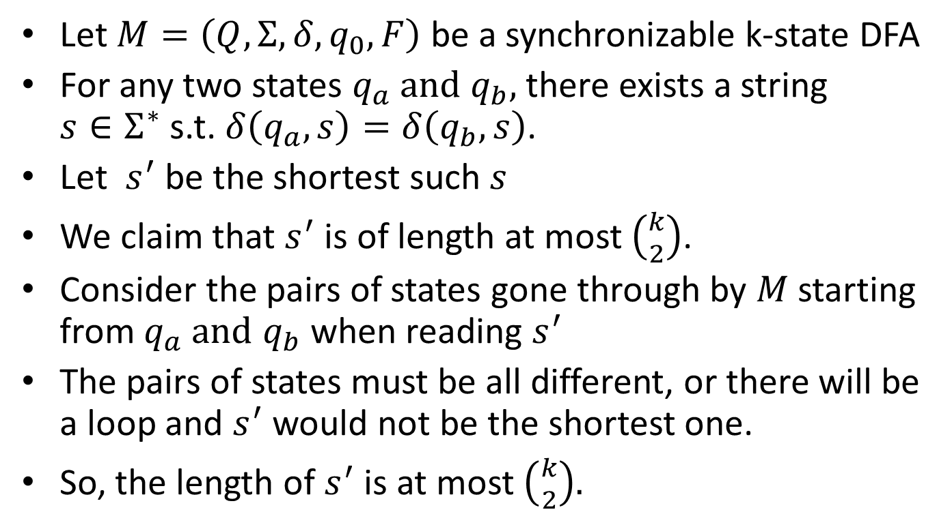
HW#4 Problem 7 (cont.)
Let $M=\left(Q, Σ, δ, q_{0}, F\right)$ be a synchronizable k-state DFA
For any two states $q_{a} and$ $q_{b},$there exists a string $s∈Σ^{∗}$ s.t.$δ\left(q_{a}, s\right)=δ\left(q_{b}, s\right)$.
Let $s^{′}$be the shortest such $s$
We claim that $s^{′}$is of length at most $\left({k \atop 2}\right)$.
Consider the pairs of states gone through by $M$ starting from $q_{a} and$ $q_{b}$ when reading $s^{′}$
The pairs of states must be all different, or there will be a loop and $s^{′}$ would not be the shortest one.
So, the length of $s^{′}$ is at most $\left({k \atop 2}\right).$
Notes:
$\left(c_{1a},c_{1b}\right),c_{1a}=δ\left(q_{a},w_{1}\right),$ $c_{1b}=δ\left(q_{b},w_{1}\right)$

Slide 12
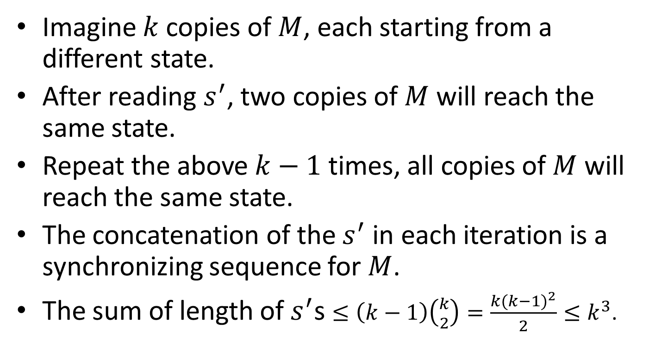
HW#4 Problem 7 (cont.)
Imagine $k$ copies of $M$, each starting from a different state.
After reading $s^{′}$, two copies of $M$ will reach the same state.
Repeat the above $k−1$ times, all copies of $M$ will reach the same state.
The concatenation of the $s^{′}$ in each iteration is a synchronizing sequence for $M$.
The sum of length of $s^{′}$s $≤\left(k−1\right)\left({k \atop 2}\right)=\frac{k{(k−1)}^{2}}{2}≤k^{3}$.

