Slide 1
Computing Theory - HW#5
Jui-Shun Lai
Wei-Hsien Chang

Slide 2
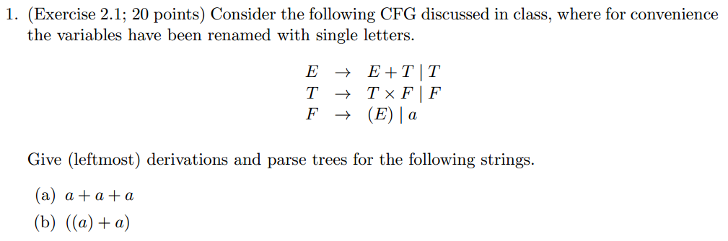
HW#5 Q1.

Slide 3
HW#5 Q1.(cont.)
E
T
(a) a + a + a.
(b) ((a) + a).
F
E
E
E
T
E
T
E
T
T
F
T
F
F
F
F
E
a
+
a
+
a
T
F
(
(
a
)
+
a
)

Slide 4
HW#5 Q2.
All strings over a and b that are not palindromes.

Slide 5
HW#5 Q4.
S → LPR | LBR
P → aPa | bPb | a | b | ε
B → aBa | bBb | #L
R → #T | ε
T → #T | Ta | Tb | ε
L → M# | ε
M → M#| aM | bM | ε
Notes:
LPR: i = j
LBR: i != j

Slide 6
HW#5 Q7.
A → BAB | B | ε
B → 00 | ε
(1) Add S₀ → A
  S₀ → A
  A → BAB | B | ε
  B → 00 | ε

Slide 7
(2) Remove ε rules
2-1: Remove B → ε
      S₀ → A
      A → BAB | AB | BA | A | B | ε
      B → 00
2-2: Remove A → ε
      S₀ → A | ε
      A → BAB | AB | BA | A | B | BB
      B → 00

Slide 8
(3) Remove unit rules
3-1: Remove A → A
      S₀ → A | ε
      A → BAB | AB | BA | B | BB
      B → 00
3-2: Remove A → B
      S₀ → A | ε
      A → BAB | AB | BA | BB | 00
      B → 00
3-3: Remove S₀ → A
      S₀ → BAB | AB | BA | BB | 00 | ε
      A → BAB | AB | BA | BB | 00
      B → 00

Slide 9
(4) Replacement
      S₀ → BA₁ | AB | BA | BB | U₁U₁ | ε
      A → BA₁ | AB | BA | BB | U₁U₁
      B → U₁U₁
      A₁ → AB
      U₁ → 0

Slide 10
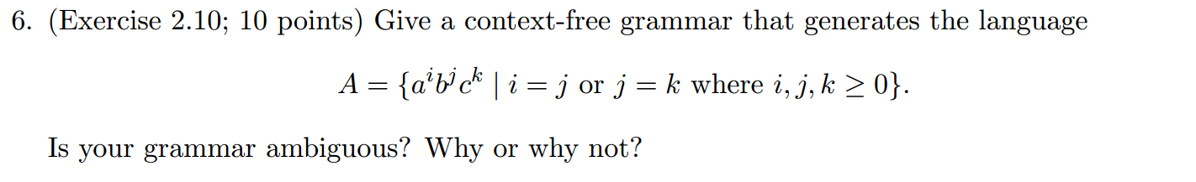
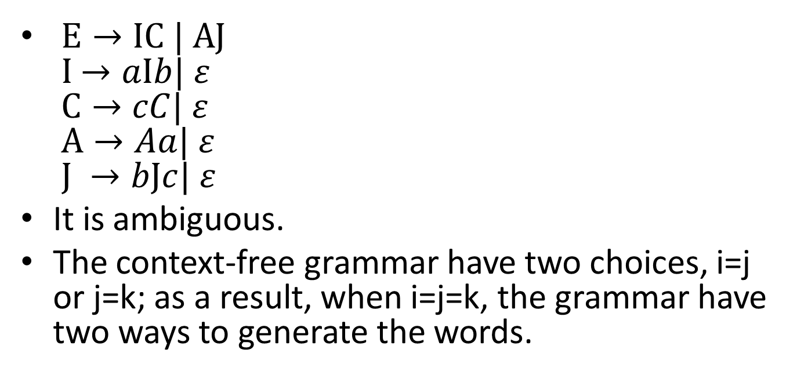
HW#5 Problem 6
$E→IC | A$J
I$→aIb| ε$
$C→cC| ε$
$A→Aa| ε$
$J →bJc| ε$
It is ambiguous.
The context-free grammar have two choices, i=j or j=k; as a result, when i=j=k, the grammar have two ways to generate the words.

