Slide 1
Computing Theory - HW#6
Jui-Shun Lai
Wei-Hsien Chang

Slide 2
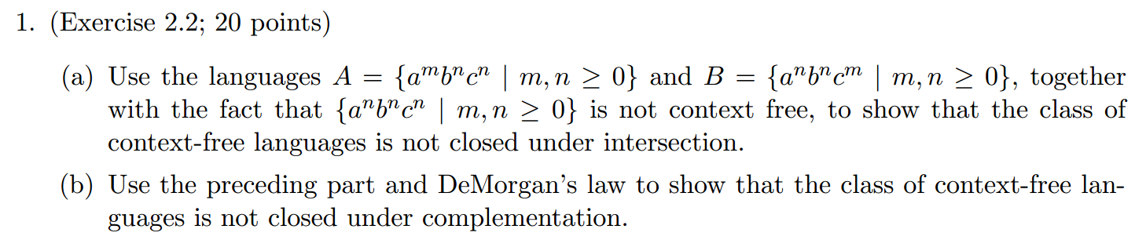
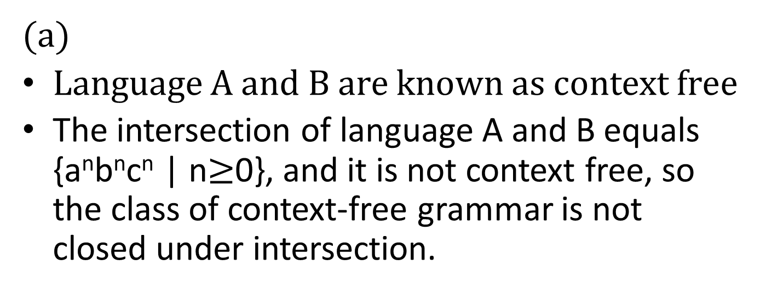
HW#6 Q1.
(a)
Language A and B are known as context free
The intersection of language A and B equals {a^{n}b^{n}c^{n} | n$≥$0}, and it is not context free, so the class of context-free grammar is not closed under intersection.

Slide 3
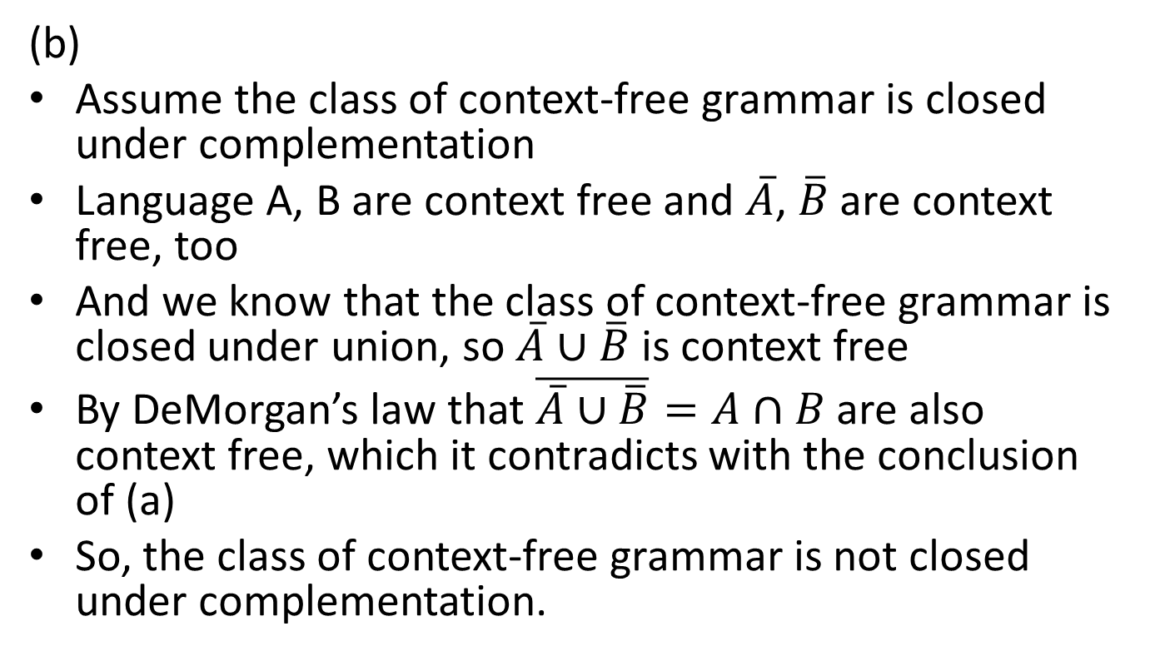
HW#6 Q1.(cont.)
(b)
Assume the class of context-free grammar is closed under complementation
Language A, B are context free and $\overline{A}$, $\overline{B}$ are context free, too
And we know that the class of context-free grammar is closed under union, so $\overline{A}∪\overline{B}$ is context free
By DeMorgan’s law that $\overline{\overline{A}∪\overline{B}}=A∩B$ are also context free, which it contradicts with the conclusion of (a)
So, the class of context-free grammar is not closed under complementation.

Slide 4
HW#6 Q4.
Suppose M_{A} is a PDA recognizing A and M_{B} a DFA recognizing B. To show that A/B is context free, we construct a PDA M_{A/B} that recognizes A/B.
M_{A/B} proceeds in two stages:
  In the first stage, M_{A/B} simulates M_{A} on the input w, and additionally in each step non-deterministically guessing that the end of w has been reached, branches to the second stage.
  When in the second stage, M_{A/B} simulates both M_{A} and M_{B} on an imaginary input x, which is “self-supplied”, rather than coming from the actual input.
M_{A/B} is defined such that every possible x is attempted.

Slide 5
With M_{A}=(Q_{A}, Σ, Γ_{A}, δ_{A}, q_{0A}, F_{A}) and M_{B}=(Q_{B}, Σ, Γ_{B}, δ_{B}, q_{0B}, F_{B}), we defined DFA M_{A/B}=(Q_{A/B}, Σ, Γ_{A}, δ_{A/B}, q_{0A}, F_{A/B})
Q_{A/B}=Q_{A}∪(Q_{A}×Q_{B})
δ_{A/B} =
    Simulation of M_{A} on actual input and non-deterministic branching to the second stage. For q_{A} Q_{A}, a Σ_{ε}, b Σ_{ε},
    Simulation of M_{A} and M_{B} on imaginary input. For (q_{A}, q_{B}) Q_{A}×Q_{B}, a Σ_{ε}, b Σ_{ε},
F_{A/B}={(q_{A},q_{B})|q_{A} F_{A} and q_{B} F_{B}}
if a=ε
if a≠ε
if a=ε
for some a’ Σ s.t. q’_{B}= δ_{B}(q_{B},a’)}
if a≠ε

Slide 6
HW#6 Q5. (a)
<STMT> → <IF-THEN>
→ if…<STMT>
→ if…<IF-THEN-ELSE>
→ if…if…<STMT> else <STMT>
<STMT> → <IF-THEN-ELSE>
→ if…<STMT> else <STMT>
→ if…<IF-THEN> else <STMT>
→ if…if…<STMT> else <STMT>

Slide 7
HW#6 Q5. (b)
<STMT> → <ASSIGN> | <IF-THEN> | <IF-THEN-ELSE>
<STMT2> → <ASSIGN> | <IF-THEN-ELSE>
<IF-THEN> → if condition then <STMT>
<IF-THEN-ELSE> → if condition then <STMT2> else <STMT>
<ASSIGN> → a:=1

Slide 8
HW#6 Q6.
Assume two DFA M_{A} = (Q_{A}, Σ, δ_{A}, q_{0A}, F_{A}) and M_{B} = (Q_{B}, Σ, δ_{B}, q_{0B}, F_{B}) can recognize language A and B respectively.
Now construct a PDA P = (Q, Σ, Γ, δ, q₀, F) recognizes A◇B by M_{A} and M_{B}.
We separate the input string into x and y non-deterministically. And we push and pop ‘0’ from the stack for counting.

Slide 9
Q = Q_{A} Q_{B} {q₀, q_{f}}
Γ = {$, 0}, $ is used as a mark of the beginning of the stack
δ(q, a, b) =
{(q_{0A}, $)} if q=q₀, a=b=ε
{(δ_{A}(q, a), 0)} if q Q_{A}, a Σ, b=ε
{(q_{0B}, ε)} if q F_{A}, a=b=ε
{(δ_{B}(q, a), ε)} if q Q_{B}, a Σ, b=0
{(q_{f}, ε)} if q F_{B}, a=ε, b=$
∮ otherwise
F = {q_{f}}

