Slide 1
Computing Theory – HW#8
Jui-Shun Lai
Wei-Hsien Chang

Slide 2
HW#8 Q1.
Formal definition of a Turing machine M = (Q, Σ, Γ, δ, q₀, q_{accept}, q_{reject}):
Q = {q₀, … , q₁₁, q_{accept}, q_{reject}}
Σ = {0, 1}
Γ = {0, 1, #, x, ⊔}
δ = Shown with the state diagram in next page

Slide 3
q₀
0 → x, R
1 → x, R
q₁
q₄
0, 1 → R
⊔ → #, R
0, 1 → R
⊔ → #, R
⊔ → #, R
q_{accept}
q₂
q₅
⊔ → 0, L
⊔ → 1, L
q₃
# → R
q₆
0, 1, # → L
0, 1, # → L
x → 0, R
x → 1, R
0, 1, # → L
q₇
x → 0, R
x → 1, R
0, 1, # → L
q₉
0 → x, R
1 → x, R
q₁₁
⊔ → 0, L
q₈
q₁₀
⊔ → 1, L
0, 1, # → R
0, 1, # → R
Notes:
7之前，第一階段(加上#之前)
7之後，第二階段(加上#之後)

Slide 4
HW#8 Q2.
Formal definition of an enumerator E = (Q, Σ, Γ, δ, q₀, q_{halt}):
Q is finite set of states
Σ: the output alphabet, not including #
Γ: the work tape alphabet
δ: Q × Γ → Q × Γ × {L, R} × Σ∪{ε, #}
work tape print tape
q₀: initial state
q_{halt}: final state
When the machine reads on the work tape, the print tape may writes nothing(ε), writes something including #, which stands for next line. The machine keeps print until meets q_{halt}.
So the configuration of the print tape is:
C₁#C₂#C₃#...
, for any C_{i} that included in the print tape, it should be in the enumerated language.

Slide 5
HW#8 Q3.
(→)
If a language A is decidable by some TM M, the enumerator operates by generating the strings in lexicographic order, testing each in turn for membership in A using M, and printing the string if it is in A.
(←)
If A is enumerable by some enumerator E in lexicographic order. A TM M that decides A operates as follows.
On receiving input w, M runs E to enumerate all strings in A in lexicographic order until some string lexicographically after w appears. If w has appeared in the enumeration, accept. Otherwise, reject.

Slide 6
HW#8 Q4.
Let the single-tape TM M = (Q, Σ, Γ, δ, q₀, q_{accept}, q_{reject}) that cannot write on the input of the tape.
A typical case when M works on an input string x is as follows:
  the tape head will stay in the input portion for some time, and then enter the non-input portion (ex: the right of |x|_{th} cell) and stay there for some time, then go back to the input portion, and stay there for some time, and then enter the non-input portion, and so on.
  We call the event that the tape head switches from input portion to non-input portion an out event, and the event that the tape head switches from non-input portion to input-portion an in event.

Slide 7
Let first_{x} be the state of M that it is the first out event and first enters the non-input portion. In case M never enters non-input portion, we make first_{x} = q_{accept} if M accepts x and first_{x}=q_{reject} if M rejects x.
And we define function f_{x}:
For any states q, f_{x}(q) = q’ implies if M is at state q and about to perform an in event, the next out event will change M in state q’. In case M never enters the non-input portion again, we let f_{x}(q) =q_{accept} if M enters the accept state inside the input portion, f_{x}(q) =q_{reject} otherwise.
For two strings x and y, if first_{x} = first_{y} and for all q, f_{x}(q)=f_{y}(q), x and y makes no difference to M. Because there are finite possibilities of first_{x} and f_{x} (|Q|^{|Q|+1} choices), the number of distinguishable strings are finite. So the language recognized by M is regular.
Notes:
if first_{x} = first_{y} and for all q, f_{x}(q)=f_{y}(q), x and y makes no different to M.
→ xz 和 yz會導致一樣的結果
Q 指的是不包含accept和reject的states
The conclusion is made by Myhill–Nerode theorem

Slide 8
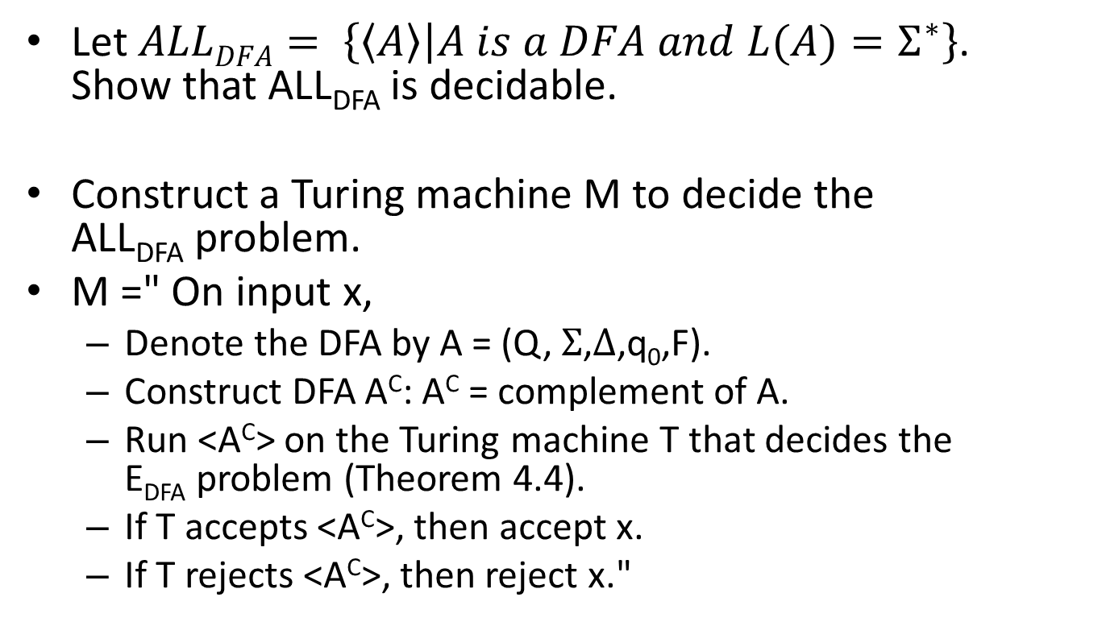
HW#8 Q6.
Let $ALLDFA= \left\{\left\langle A\right\rangle | A is a DFA and L(A)=Σ^{∗}\right\}$.
Show that ALL_{DFA} is decidable.
Construct a Turing machine M to decide the ALL_{DFA} problem.
M =" On input x,
  Denote the DFA by A = (Q, $Σ$,$Δ$,q₀,F).
  Construct DFA A^{C}: A^{C} = complement of A.
  Run <A^{C}> on the Turing machine T that decides the E_{DFA} problem (Theorem 4.4).
  If T accepts <A^{C}>, then accept x.
  If T rejects <A^{C}>, then reject x."
Notes:
It is easy to see that L(A) and L(A^{C}) are the complement of each other with respect to $Σ$*. That is, L(A) = $Σ$* - L(A^{C}).
Hence, L(A) = $Σ$* iff L(A^{C}) = empty. Determining if L(A^{C}) is empty is decidable due to Theorem 4.5, and so determining if L(A) = $Σ$* is decidable as well.

Slide 9
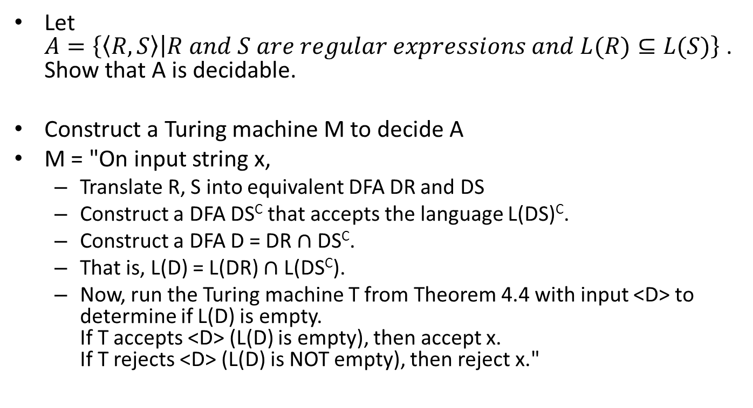
HW#8 Q7.
Let
$A=\left\{\left\langle R, S\right\rangle | R and S are regular expressions and L(R)⊆L(S)\right\}$. Show that A is decidable.
Construct a Turing machine M to decide A
M = "On input string x,
  Translate R, S into equivalent DFA DR and DS
  Construct a DFA DS^{C} that accepts the language L(DS)^{C}.
  Construct a DFA D = DR $∩$ DS^{C}.
  That is, L(D) = L(DR) $∩$ L(DS^{C}).
  Now, run the Turing machine T from Theorem 4.4 with input <D> to determine if L(D) is empty.
  If T accepts <D> (L(D) is empty), then accept x.
  If T rejects <D> (L(D) is NOT empty), then reject x."

