Slide 1
Computing Theory – HW#9
Jui-Shun Lai
Wei-Hsien Chang

Slide 2
HW#9 Q2.
Let “are of the same size” relation be R. For every set X, Y and Z, we check
  Reflexivity:
    The identity function f : X → X is a correspondence. (f(x)=x for every x X)
    A R A is true
  Symmetry:
    If there is a correspondence function f : X → Y, then the inverse function f ⁻¹: Y → X is a correspondence.
    A R B → B R A
  Transitivity:
    Suppose A R B and B R C there are correspondence functions f :X → Y and g : Y → Z. Then the composition of functions f and g is correspondence from A to C.
    A R B and B R C → A R C

Slide 3
HW#9 Q3.
For two DFAs A and B, we claim that if L(A) ≠ L(B), there will be a string w whose length ≦ n*m and A(w) ≠ B(w), which n=|Q_{A}| and m=|Q_{B}|
<pf> By contradiction, let a string w₀’ yields different output of A and B and |w₀’|=k > n*m.
While processing w₀’ in A and B, let a₀, a₁, …, a_{k} be the states of A and b₀, b₁, …, b_{k} be the states of B. Because k>n*m, there must exist (a_{i}, b_{i}) and (a_{j}, b_{j}) s.t. a_{i}=a_{j} and b_{i}=b_{j}. So we can delete them and get a new string w₁’ that can get the same result as w₀’.
We can keep doing it until |w_{n}’| ≦nm, and meet contradiction as A(w_{n}’) ≠ B(w_{n}’).

Slide 4
With the prove on the last page, we can decide EQ_{DFA}:
  On input <A, B>
    Verify A and B with the same alphabet Σ.
    Calculate n=|Q_{A}| and m=|Q_{B}|
    Enumerate all strings in Σ to length nm and for each string w:
      Simulate A and B on w.
      If the result is different, reject. Otherwise, continue.
    If all possible w is checked, accpet.

Slide 5
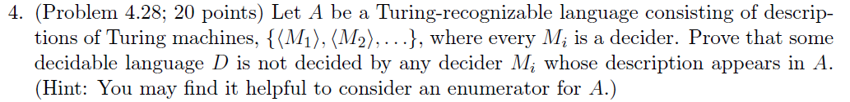
HW#9 Q4.
Since A is Turing-recognizable, there is an enumerator E which enumerates A. Let <M_{i}> be the i_{th} output string of E and s₁, s₂, … be the list of all possible strings. Now define a TM M:
  M = “ On input w:
      Determine i s.t. w=s_{i}.
      Use E to enumerate <M₁>, <M₂>, …, <M_{i}>.
      Run M_{i} on w.
      If M_{i} accepts, reject. Otherwise, accept.”
Because M_{i} is a decider, M is a decider and D = L(M) is a decidable language. However, s_{i} D iff s_{i} L(M_{i}). So D ≠ L(M_{i}) .
So we found some decidable language D can’t be decided by any decider M_{i} in A.

Slide 6
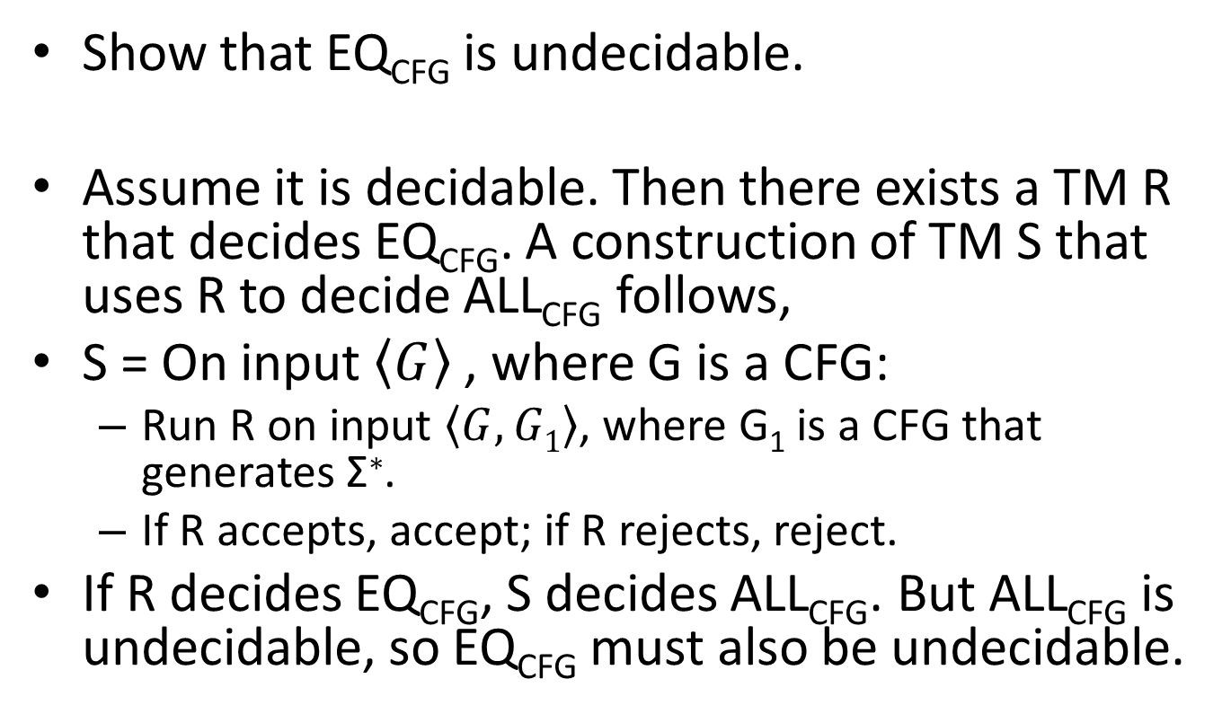
HW#9 Q5.
Show that EQ_{CFG} is undecidable.
Assume it is decidable. Then there exists a TM R that decides EQ_{CFG}. A construction of TM S that uses R to decide ALL_{CFG} follows,
S = On input $\left\langle G\right\rangle$ , where G is a CFG:
  Run R on input $\left\langle G, G1\right\rangle$, where G₁ is a CFG that generates Σ∗.
  If R accepts, accept; if R rejects, reject.
If R decides EQ_{CFG}, S decides ALL_{CFG}. But ALL_{CFG} is undecidable, so EQ_{CFG} must also be undecidable.

