Slide 1
Theory of Computing
TA times #2
Hsu, Hung-Wei
2014/04/09

Slide 2
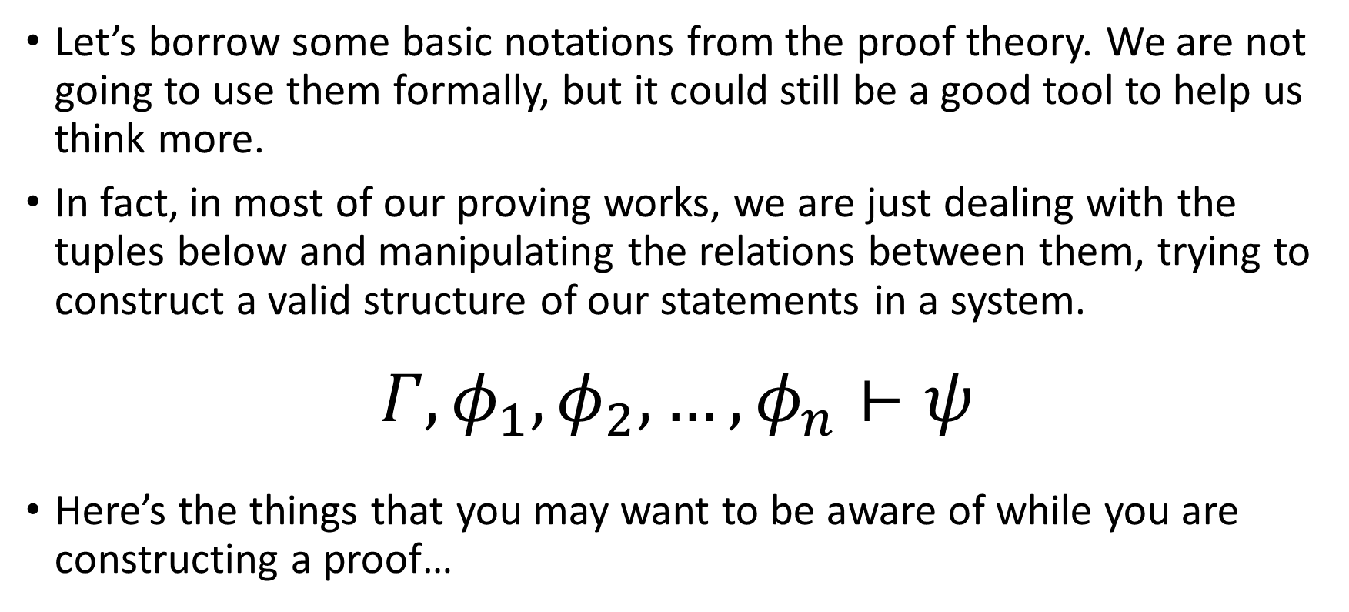
Something notable in a proving work (1/3)
Let’s borrow some basic notations from the proof theory. We are not going to use them formally, but it could still be a good tool to help us think more.
In fact, in most of our proving works, we are just dealing with the tuples below and manipulating the relations between them, trying to construct a valid structure of our statements in a system.
$$Γ, φ_{1},φ_{2},…,φ_{n}⊢ψ$$
Here’s the things that you may want to be aware of while you are constructing a proof…

Slide 3
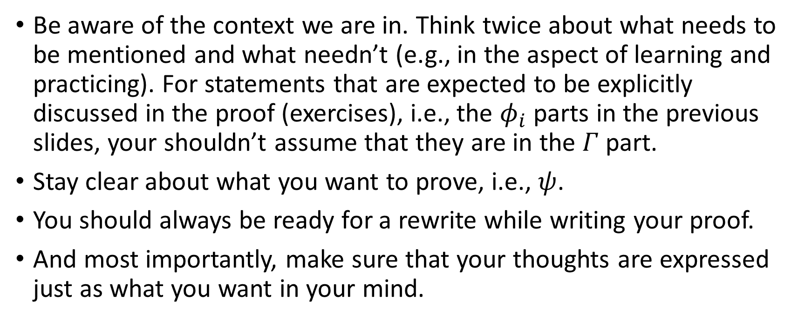
Something notable in a proving work (2/3)
Be aware of the context we are in. Think twice about what needs to be mentioned and what needn’t (e.g., in the aspect of learning and practicing). For statements that are expected to be explicitly discussed in the proof (exercises), i.e., the $φ_{i}$ parts in the previous slides, your shouldn’t assume that they are in the $Γ$ part.
Stay clear about what you want to prove, i.e., $ψ$.
You should always be ready for a rewrite while writing your proof.
And most importantly, make sure that your thoughts are expressed just as what you want in your mind.

Slide 4
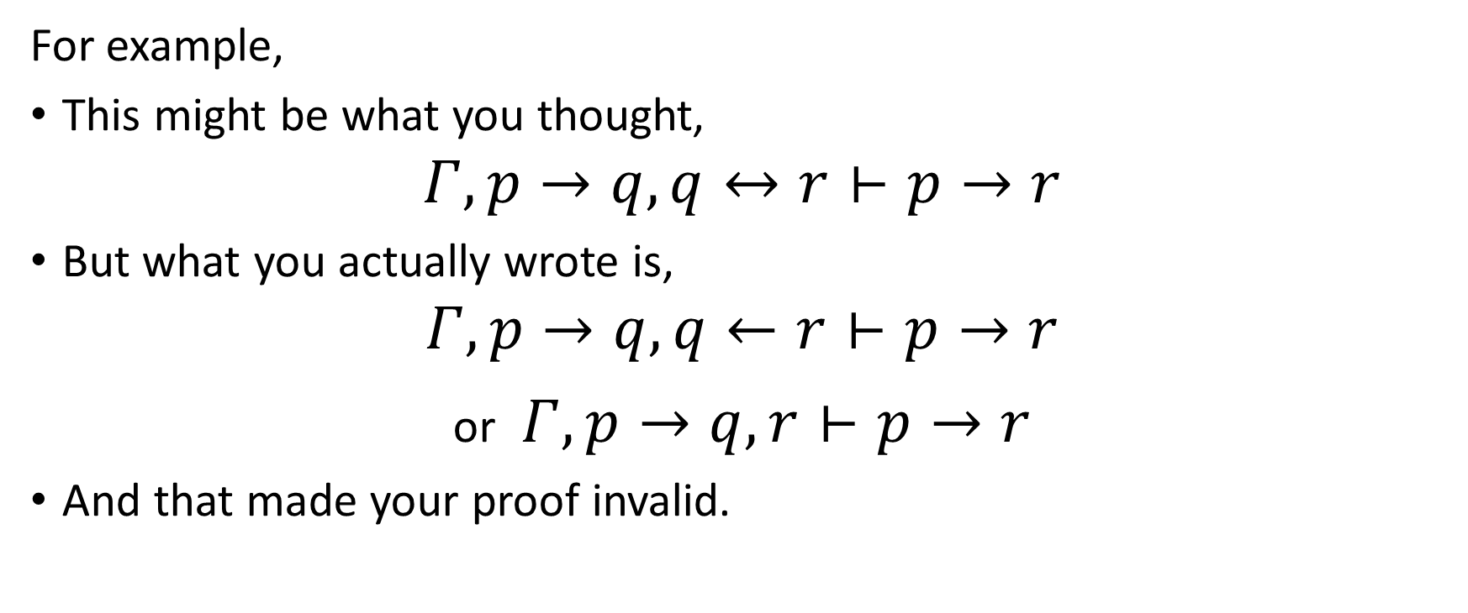
Something notable in a proving work (3/3)
For example,
This might be what you thought,
$$Γ, p→q,q↔r⊢p→r$$
But what you actually wrote is,
$$Γ, p→q,q←r⊢p→r$$
or $Γ, p→q,r⊢p→r$
And that made your proof invalid.

Slide 5
Graph v.s. Formal definition form of automata
In your homework, if it is not operation-sensitive, we will treat the graph expression and the formal definition form the same.
While they have different advantages, respectively, for different uses.
If you’d like to provide both, please be sure to make them consistent.

Slide 6
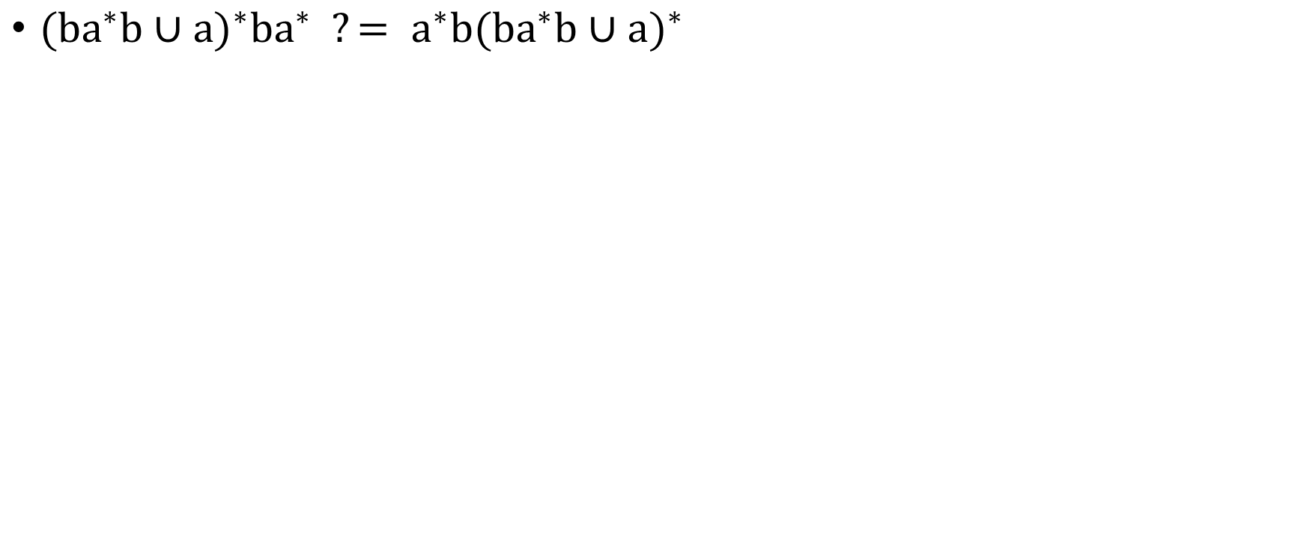
How to know that two Regex are equivalent? (1/3)
${(ba^{∗}b∪a)}^{∗}ba^{∗} ?= a^{∗}{b(ba^{∗}b∪a)}^{∗}$

Slide 7
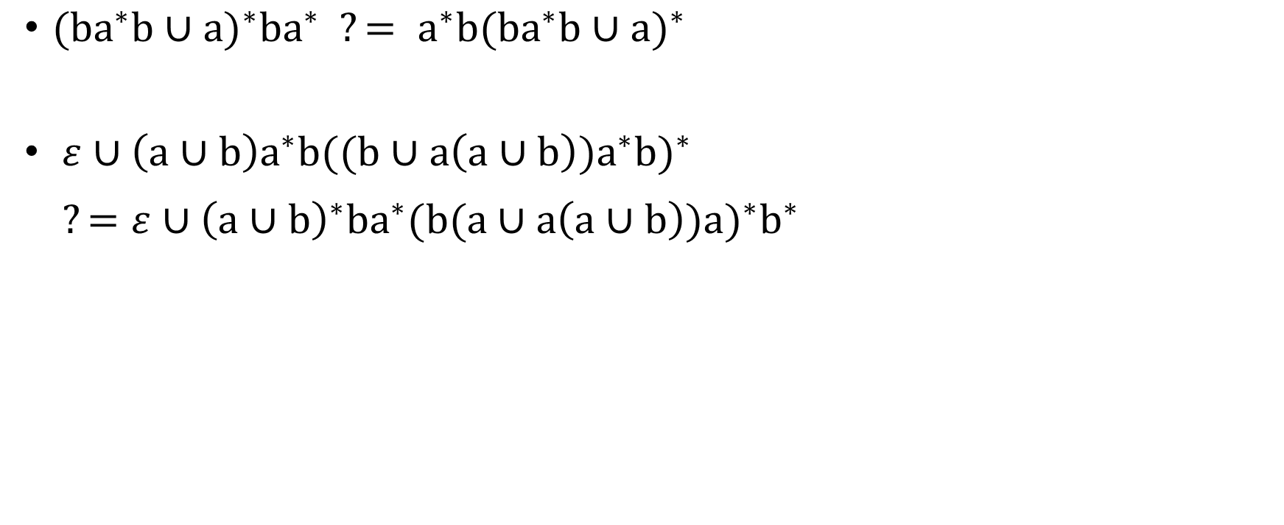
How to know that two Regex are equivalent? (1/3)
${(ba^{∗}b∪a)}^{∗}ba^{∗} ?= a^{∗}{b(ba^{∗}b∪a)}^{∗}$
$ε∪\left(a∪b\right)a^{∗}b{((b∪a\left(a∪b\right))a^{∗}b)}^{∗}$
$$?=ε∪{{\left(a∪b\right)}^{∗}ba}^{∗}(b{(a∪a\left(a∪b\right)){a)}^{∗}b}^{∗}$$

Slide 8
How to know that two Regex are equivalent? (2/3)
Reducing a regex is something harder than what you may have expected!
Do we have a normal form for regex? Is there any systematical way to simplify a regex to the minimized form? Or at least, any efficient approximation?

Slide 9
How to know that two Regex are equivalent? (3/3)
Well, no matter what the answer is, we could still deal with the problem by converting our two regex into DFA form.
In DFA, we have the way to simplify any DFA to its reduced form. The DFAs that recognize a same language would share the same reduced form.
By thus, we can determine whether the two DFAs, converted respectively from the two NFAs, the two origin regex, are the same.
Check out the Myhill-Nerode theorem in your book for further details.

Slide 10
CAUTION
Most solutions we showed in TA’s slides are more
like the ideas rather then completed solutions.
You may take them as guides, but shouldn’t
consider them as everything you need
to complete an exercise.

Slide 11
Stats.
Homework #3
  Average 64.2
  Std. Dev. 11.5
Homework #4
  Average 64.5
  Std. Dev. 23.9

Slide 12
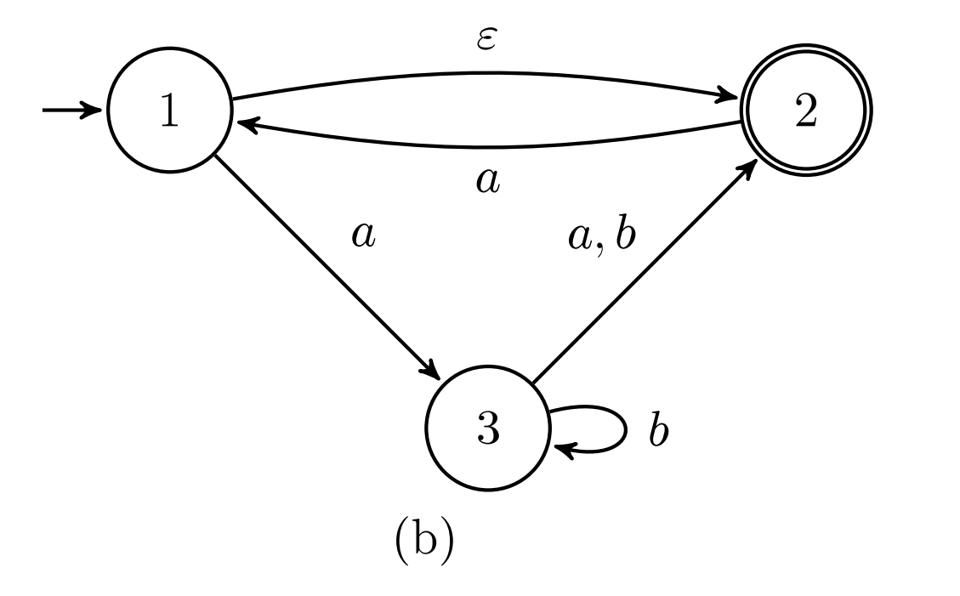
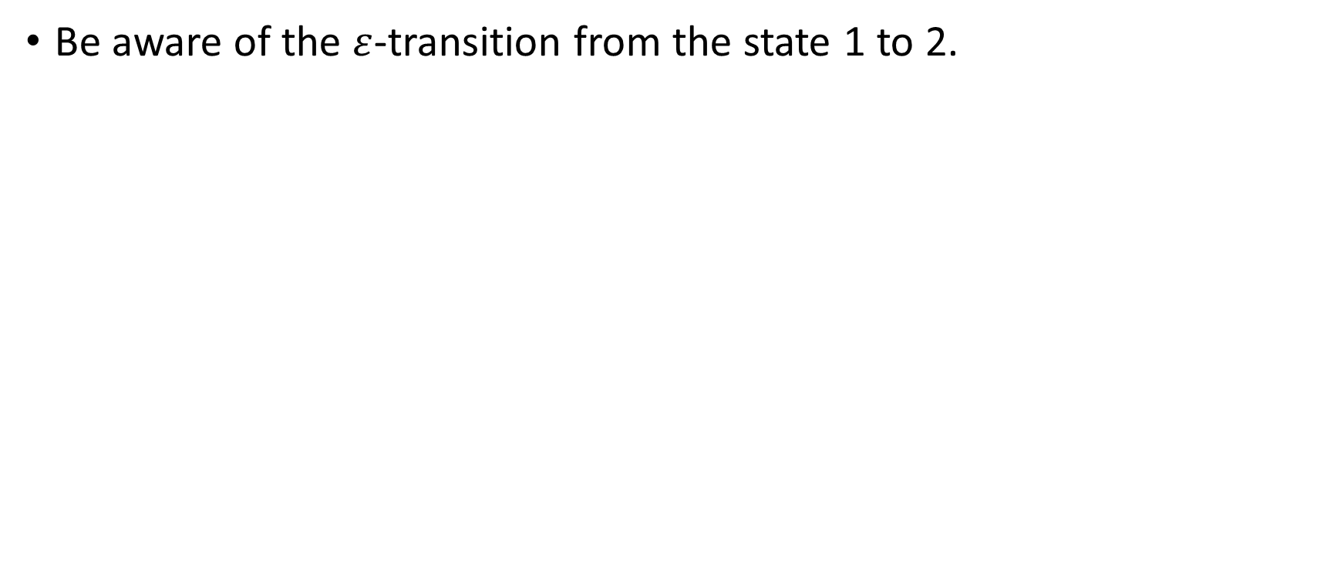
HW#3 – Q5.b
Be aware of the $ε$-transition from the state 1 to 2.

Slide 13
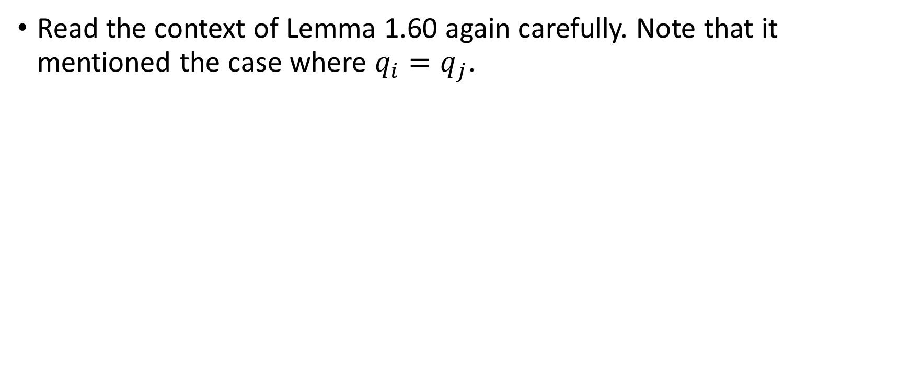
HW#3 – Q8.a
Read the context of Lemma 1.60 again carefully. Note that it mentioned the case where $q_{i}=q_{j}$.

Slide 14
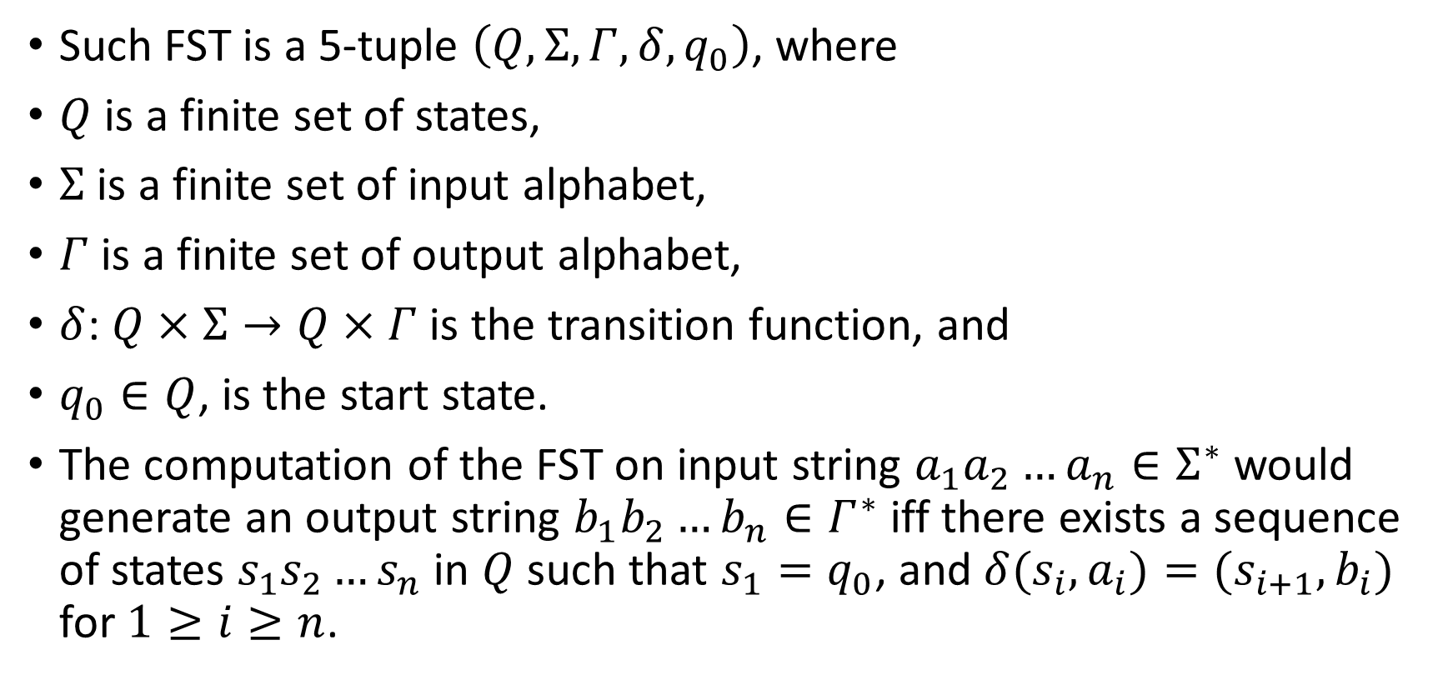
HW#3 – Q10
Such FST is a 5-tuple $\left(Q,Σ,Γ,δ, q_{0}\right)$, where
$Q$ is a finite set of states,
$Σ$ is a finite set of input alphabet,
$Γ$ is a finite set of output alphabet,
$δ$: $Q×Σ→Q×Γ$ is the transition function, and
$q_{0}∈Q$, is the start state.
The computation of the FST on input string $a_{1}a_{2}…a_{n}∈Σ^{∗}$would generate an output string $b_{1}b_{2}…b_{n}∈Γ^{∗}$ iff there exists a sequence of states $s_{1}s_{2}…s_{n}$ in $Q$ such that $s_{1}=q_{0}$, and $δ(s_{i},a_{i})=(s_{i+1},b_{i})$ for $1≥i≥n$.

Slide 15
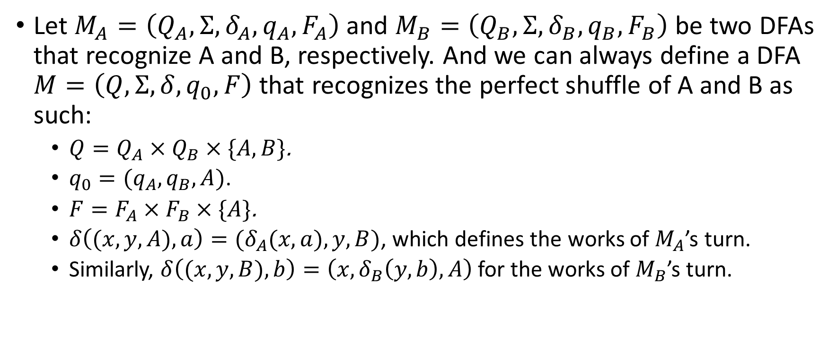
HW#4 – Q1
Let $M_{A}=\left(Q_{A},Σ, δ_{A},q_{A}, F_{A}\right)$ and $M_{B}=\left(Q_{B},Σ, δ_{B},q_{B}, F_{B}\right)$ be two DFAs that recognize A and B, respectively. And we can always define a DFA $M=\left(Q,Σ,δ,q_{0},F\right)$ that recognizes the perfect shuffle of A and B as such:
  $Q=Q_{A}×Q_{B}×\{A,B\}$.
  $q_{0}=(q_{A},q_{B},A)$.
  $F=F_{A}×F_{B}×\{A\}$.
  $δ\left((x,y,A), a\right)=(δ_{A}(x,a),y,B)$, which defines the works of $M_{A}$’s turn.
  Similarly, $δ\left((x,y,B), b\right)=\left(x,δ_{B}\left(y,b\right),A\right)$ for the works of $M_{B}$’s turn.

Slide 16
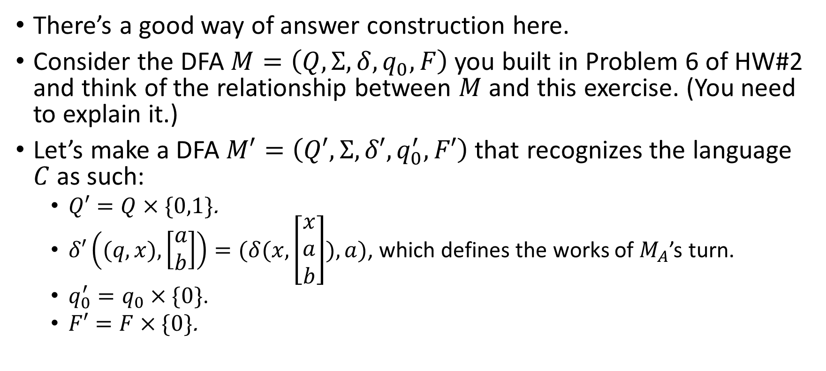
HW#4 – Q2 (1/2)
There’s a good way of answer construction here.
Consider the DFA $M=\left(Q,Σ,δ,q_{0},F\right)$ you built in Problem 6 of HW#2 and think of the relationship between $M$ and this exercise. (You need to explain it.)
Let’s make a DFA $M′=\left(Q′,Σ,δ′,q_{0}^{′},F′\right)$ that recognizes the language $C$ as such:
  $Q′=Q×\{0,1\}$.
  $δ′\left((q,x), \left[\begin{matrix}a \\ b\end{matrix}\right]\right)=(δ(x,\left[\begin{matrix}x \\ a \\ b\end{matrix}\right]),a)$, which defines the works of $M_{A}$’s turn.
  $q_{0}^{′}=q_{0}×\{0\}$.
  $F′=F×\{0\}$.

Slide 17

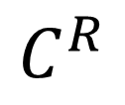







HW#4 – Q2 (2/2)
Plain
$$\left[\begin{matrix}0 \\ 0\end{matrix}\right]$$
$$C^{R}$$
q0
$$\left[\begin{matrix}1 \\ 1\end{matrix}\right]$$
$$\left[\begin{matrix}0 \\ 1\end{matrix}\right]$$
$$\left[\begin{matrix}0 \\ 1\end{matrix}\right]$$
CarryIn
q1
q3
ComboResolved
$$\left[\begin{matrix}1 \\ 0\end{matrix}\right]$$
$$\left[\begin{matrix}1 \\ 0\end{matrix}\right]$$
$$\left[\begin{matrix}0 \\ 0\end{matrix}\right]$$
q2
$$\left[\begin{matrix}1 \\ 1\end{matrix}\right]$$
CarryInCombo

Slide 18
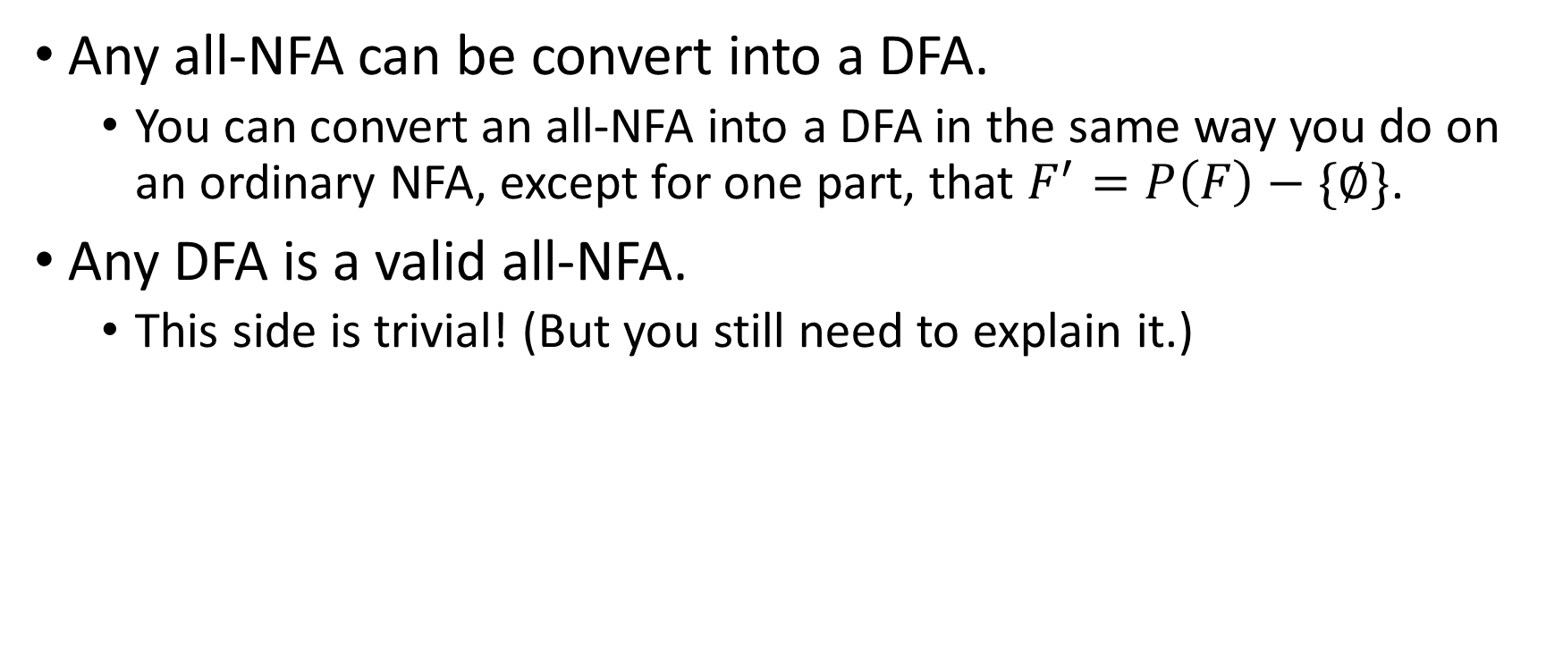
HW#4 – Q5
Any all-NFA can be convert into a DFA.
  You can convert an all-NFA into a DFA in the same way you do on an ordinary NFA, except for one part, that $F^{′}=P\left(F\right)−\{∅\}$.
Any DFA is a valid all-NFA.
  This side is trivial! (But you still need to explain it.)

Slide 19
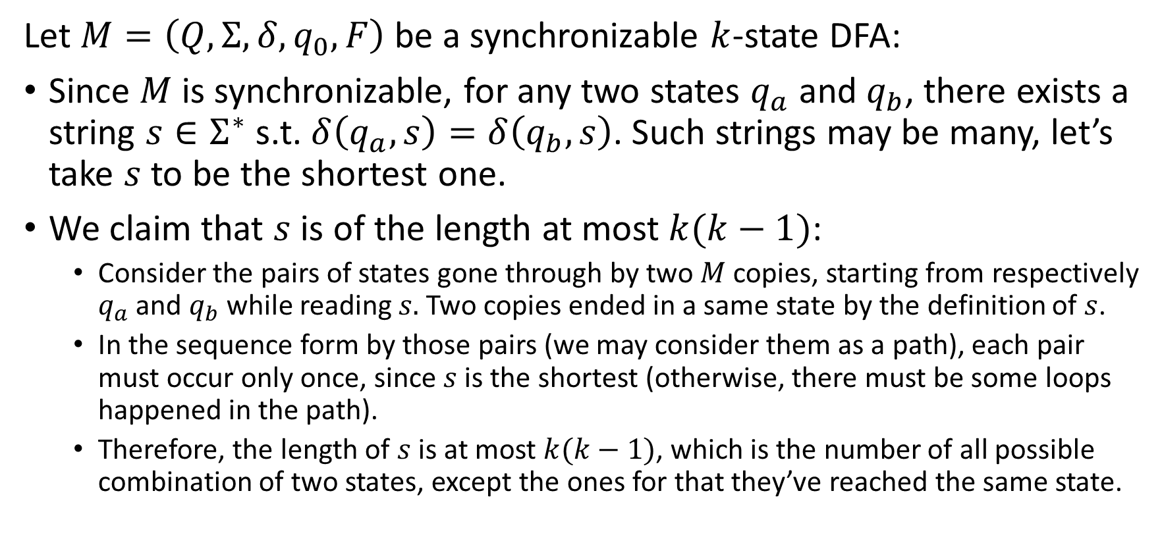
HW#4 – Q7 (1/3)
Let $M=\left(Q, Σ, δ, q_{0}, F\right)$ be a synchronizable $k$-state DFA:
Since $M$is synchronizable, for any two states $q_{a}$ and $q_{b}$, there exists a string $s∈Σ^{∗}$ s.t. $δ\left(q_{a}, s\right)=δ\left(q_{b}, s\right)$. Such strings may be many, let’s take $s$ to be the shortest one.
We claim that $s$is of the length at most $k(k−1)$:
  Consider the pairs of states gone through by two $M$ copies, starting from respectively $q_{a}$ and $q_{b}$ while reading $s.$ Two copies ended in a same state by the definition of $s$.
  In the sequence form by those pairs (we may consider them as a path), each pair must occur only once, since $s$ is the shortest (otherwise, there must be some loops happened in the path).
  Therefore, the length of $s$ is at most $k(k−1)$, which is the number of all possible combination of two states, except the ones for that they’ve reached the same state.

Slide 20
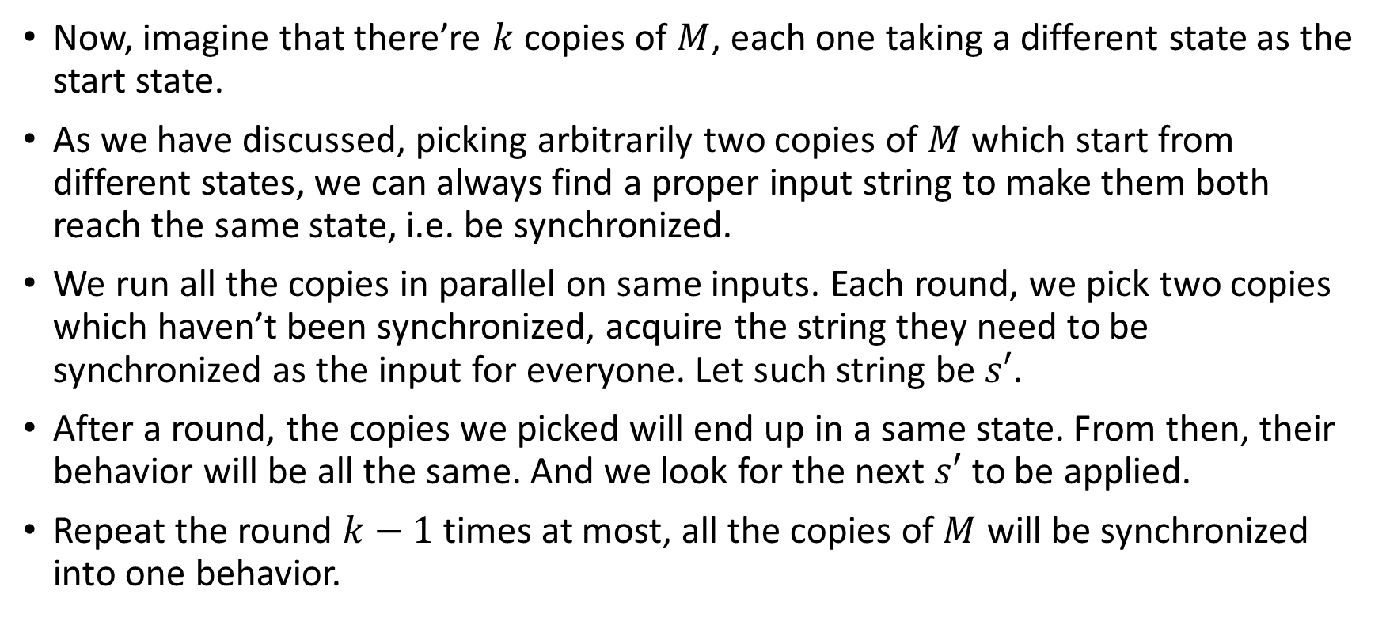
HW#4 – Q7 (2/3)
Now, imagine that there’re $k$ copies of $M$, each one taking a different state as the start state.
As we have discussed, picking arbitrarily two copies of $M$ which start from different states, we can always find a proper input string to make them both reach the same state, i.e. be synchronized.
We run all the copies in parallel on same inputs. Each round, we pick two copies which haven’t been synchronized, acquire the string they need to be synchronized as the input for everyone. Let such string be $s′$.
After a round, the copies we picked will end up in a same state. From then, their behavior will be all the same. And we look for the next $s′$ to be applied.
Repeat the round $k−1$ times at most, all the copies of $M$ will be synchronized into one behavior.

Slide 21
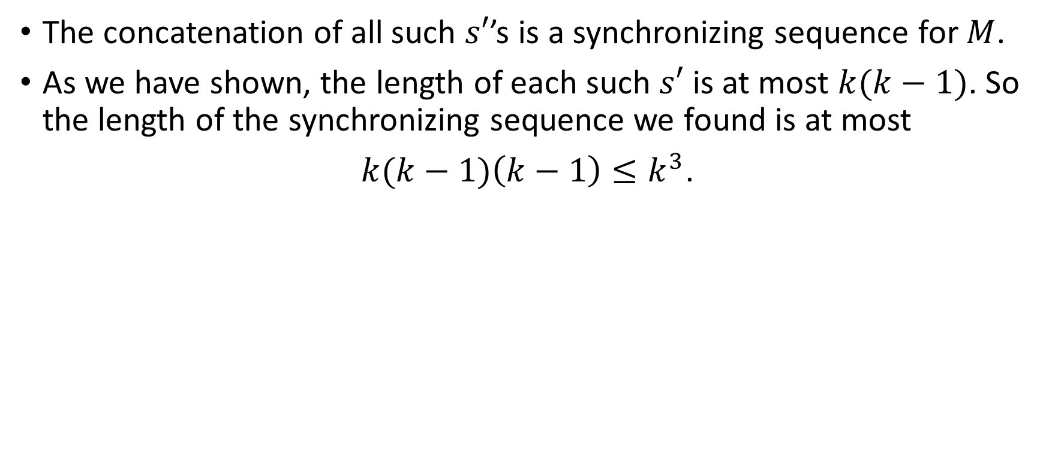
HW#4 – Q7 (3/3)
The concatenation of all such $s′$’s is a synchronizing sequence for $M$.
As we have shown, the length of each such $s′$ is at most $k(k−1)$. So the length of the synchronizing sequence we found is at most
$k(k−1)\left(k−1\right)≤k^{3}$.

