Slide 1
Theory of Computing
TA times #2
Hsu, Hung-Wei
2015/04/16

Slide 2
CAUTION
Most solutions we showed in TA’s slides are more
like the ideas rather then completed solutions.
You may take them as guides, but shouldn’t
consider them as everything you need
to get your homework done.

Slide 3
Stats.
Homework #3
  Average 72.5
  Std. Dev. 10.9
Homework #4
  Average 66.1
  Std. Dev. 13.7

Slide 4
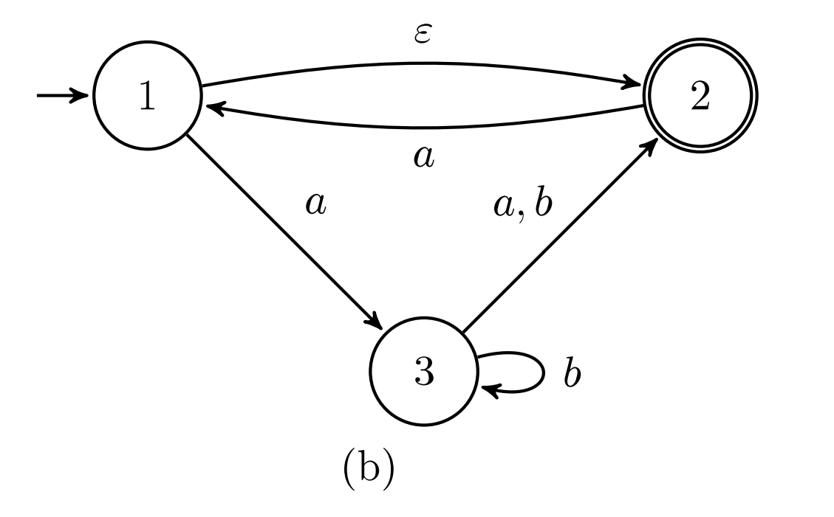
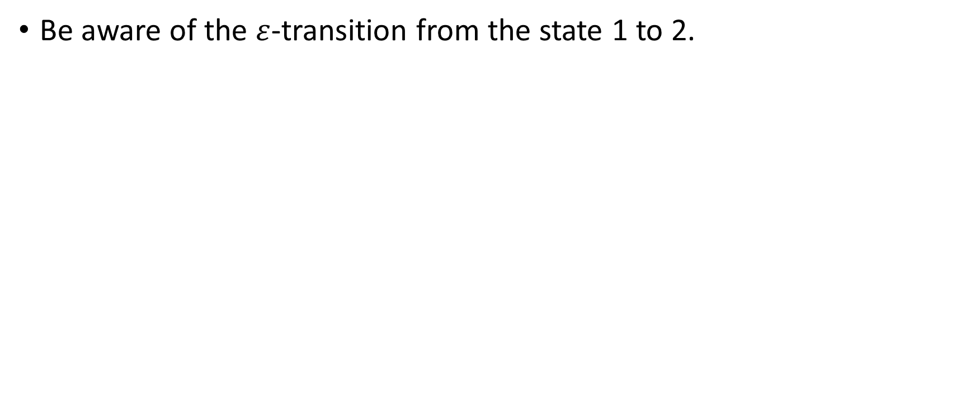
HW#3 – Q5.b
Be aware of the $ε$-transition from the state 1 to 2.

Slide 5
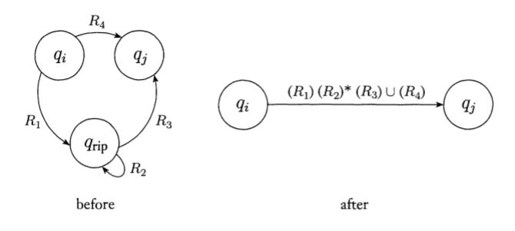
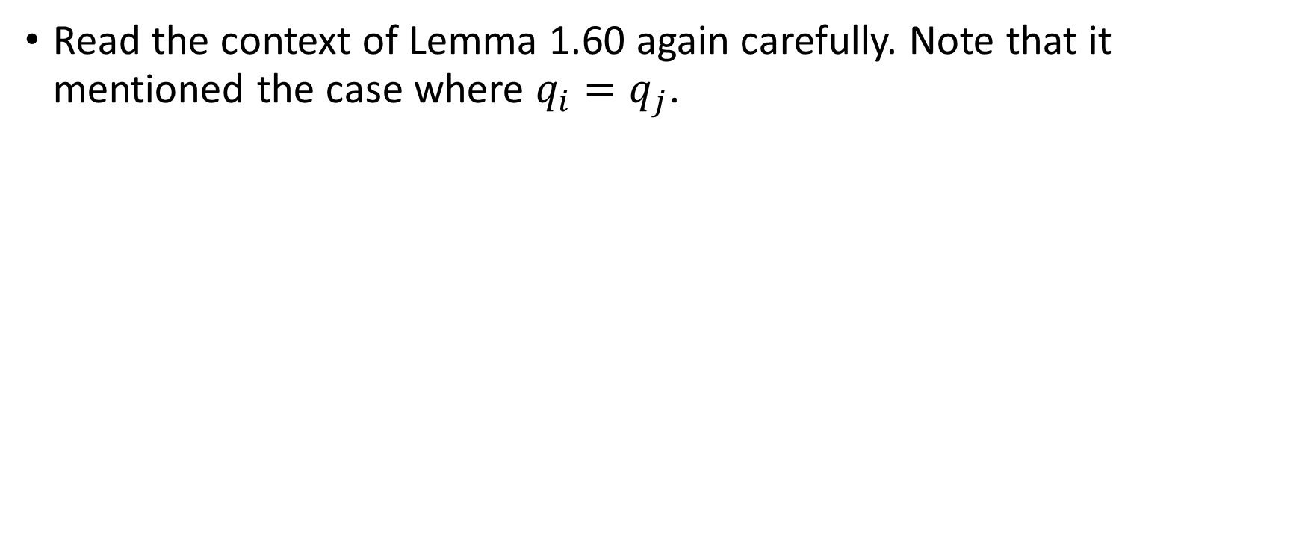
HW#3 – Q8.a
Read the context of Lemma 1.60 again carefully. Note that it mentioned the case where $q_{i}=q_{j}$.

Slide 6
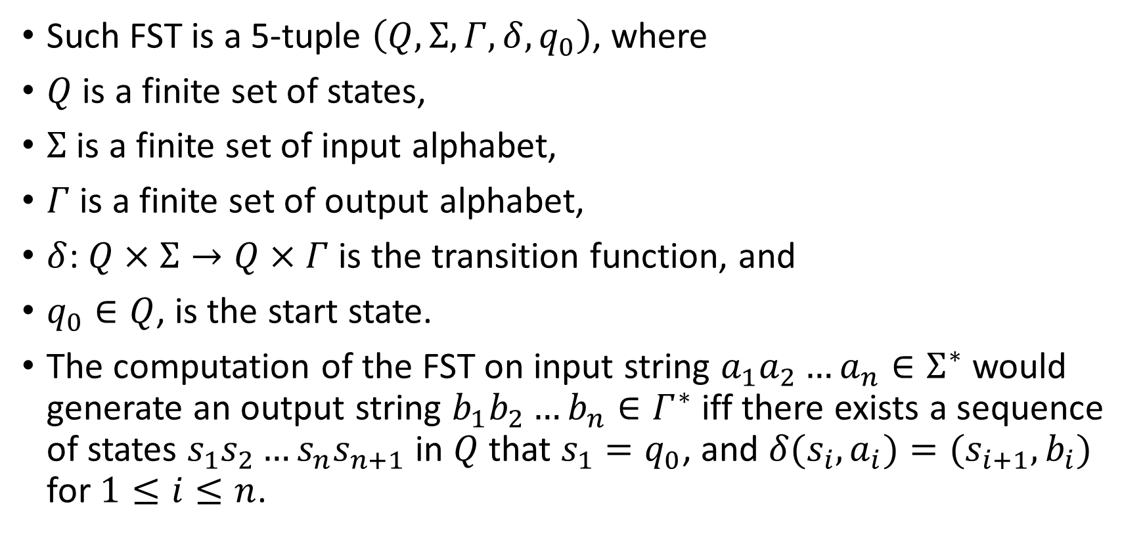
HW#3 – Q10
Such FST is a 5-tuple $\left(Q,Σ,Γ,δ, q_{0}\right)$, where
$Q$ is a finite set of states,
$Σ$ is a finite set of input alphabet,
$Γ$ is a finite set of output alphabet,
$δ$: $Q×Σ→Q×Γ$ is the transition function, and
$q_{0}∈Q$, is the start state.
The computation of the FST on input string $a_{1}a_{2}…a_{n}∈Σ^{∗}$would generate an output string $b_{1}b_{2}…b_{n}∈Γ^{∗}$ iff there exists a sequence of states $s_{1}s_{2}…s_{n}s_{n+1}$ in $Q$ that $s_{1}=q_{0}$, and $δ(s_{i},a_{i})=(s_{i+1},b_{i})$ for $1≤i≤n$.

Slide 7
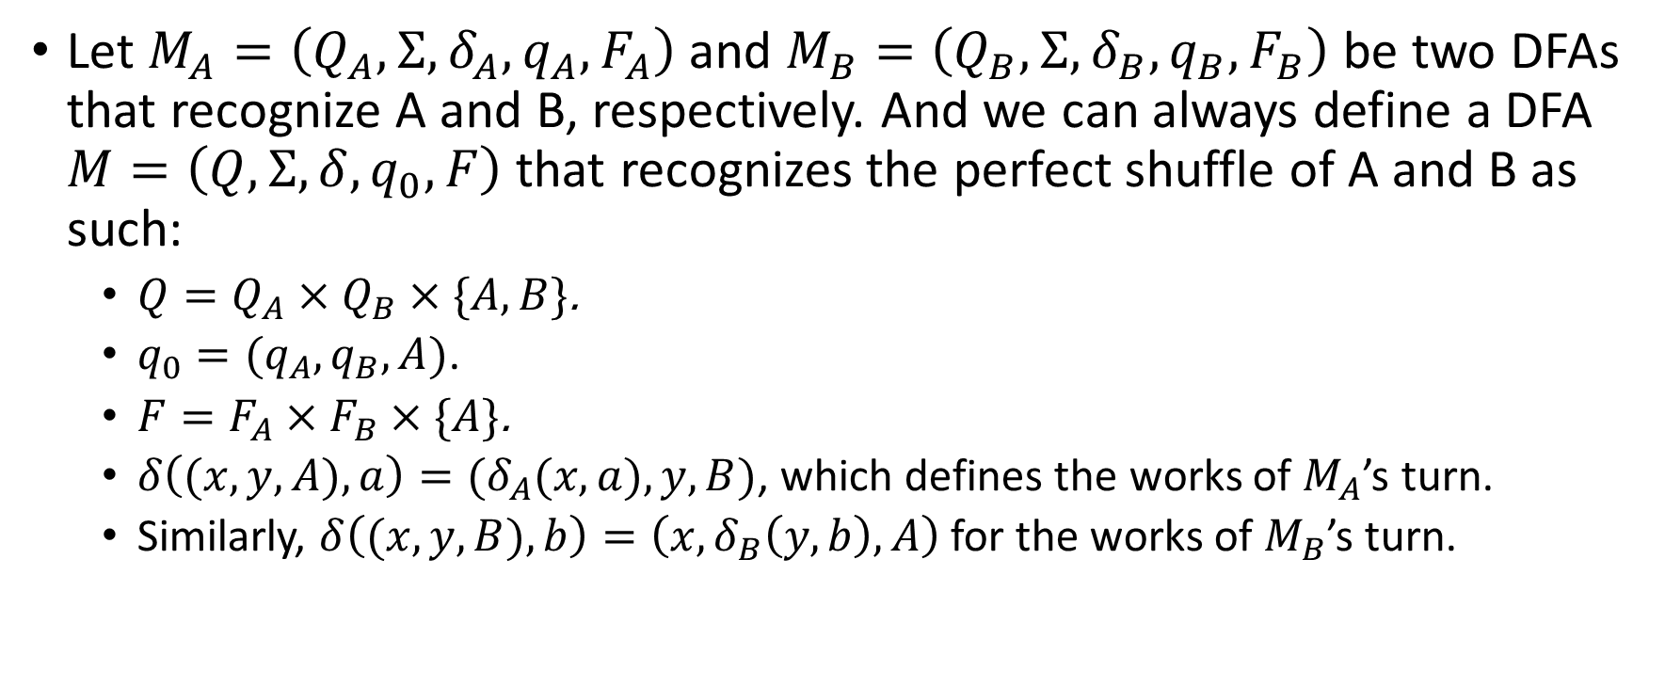
HW#4 – Q1
Let $M_{A}=\left(Q_{A},Σ, δ_{A},q_{A}, F_{A}\right)$ and $M_{B}=\left(Q_{B},Σ, δ_{B},q_{B}, F_{B}\right)$ be two DFAs that recognize A and B, respectively. And we can always define a DFA $M=\left(Q,Σ,δ,q_{0},F\right)$ that recognizes the perfect shuffle of A and B as such:
  $Q=Q_{A}×Q_{B}×\{A,B\}$.
  $q_{0}=(q_{A},q_{B},A)$.
  $F=F_{A}×F_{B}×\{A\}$.
  $δ\left((x,y,A), a\right)=(δ_{A}(x,a),y,B)$, which defines the works of $M_{A}$’s turn.
  Similarly, $δ\left((x,y,B), b\right)=\left(x,δ_{B}\left(y,b\right),A\right)$ for the works of $M_{B}$’s turn.

Slide 8
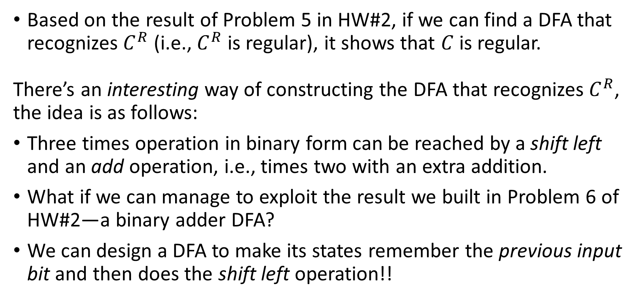
HW#4 – Q3 (1/2)
Based on the result of Problem 5 in HW#2, if we can find a DFA that recognizes $C^{R}$ (i.e., $C^{R}$ is regular), it shows that $C$ is regular.
There’s an interesting way of constructing the DFA that recognizes $C^{R}$, the idea is as follows:
Three times operation in binary form can be reached by a shift left and an add operation, i.e., times two with an extra addition.
What if we can manage to exploit the result we built in Problem 6 of HW#2—a binary adder DFA?
We can design a DFA to make its states remember the previous input bit and then does the shift left operation!!

Slide 9
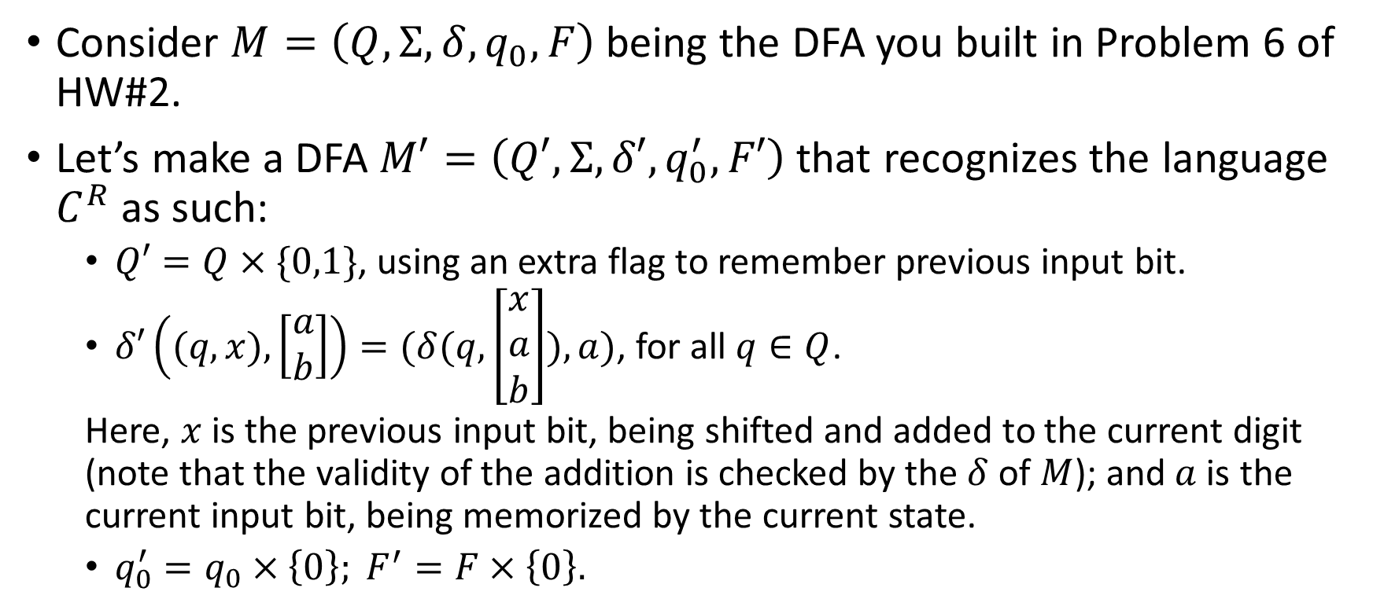
HW#4 – Q3 (2/2)
Consider $M=\left(Q,Σ,δ,q_{0},F\right)$ being the DFA you built in Problem 6 of HW#2.
Let’s make a DFA $M′=\left(Q′,Σ,δ′,q_{0}^{′},F′\right)$ that recognizes the language $C^{R}$ as such:
  $Q′=Q×\{0,1\}$, using an extra flag to remember previous input bit.
  $δ′\left((q,x), \left[\begin{matrix}a \\ b\end{matrix}\right]\right)=(δ(q,\left[\begin{matrix}x \\ a \\ b\end{matrix}\right]),a)$, for all $q∈Q$.
  Here, $x$ is the previous input bit, being shifted and added to the current digit (note that the validity of the addition is checked by the $δ$ of $M$); and $a$ is the current input bit, being memorized by the current state.
  $q_{0}^{′}=q_{0}×\left\{0\right\}; F^{′}=F×\left\{0\right\}.$

Slide 10
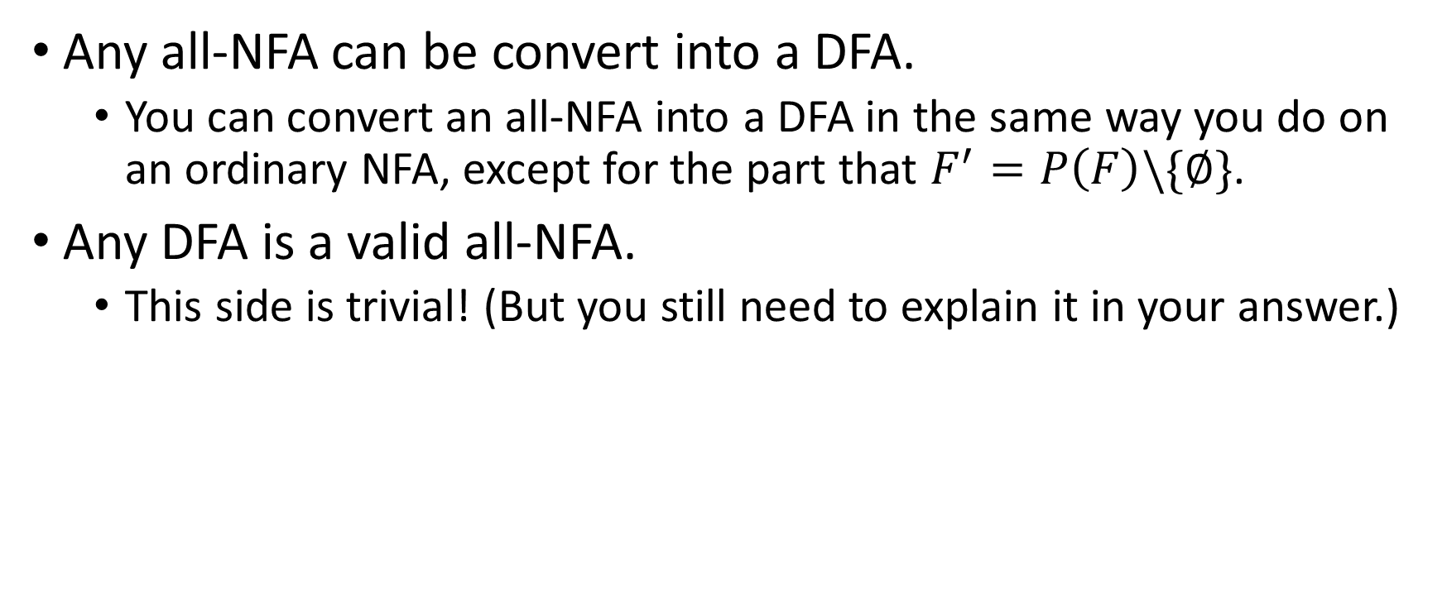
HW#4 – Q5
Any all-NFA can be convert into a DFA.
  You can convert an all-NFA into a DFA in the same way you do on an ordinary NFA, except for the part that $F^{′}=P\left(F\right)\backslash \{∅\}$.
Any DFA is a valid all-NFA.
  This side is trivial! (But you still need to explain it in your answer.)

Slide 11
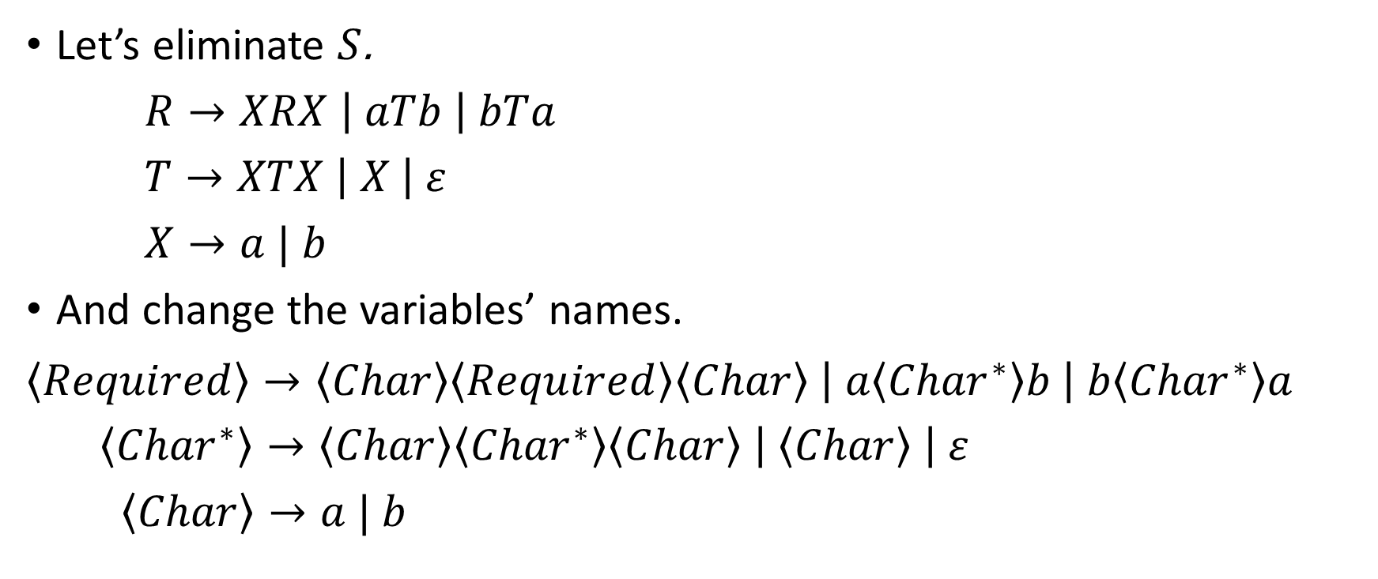
HW#5 – Q2 (1/2)
Let’s eliminate $S$.
$R→XRX \left| aTb \right| bTa$
$T→XTX \left| X \right| ε$
$X→a | b$
And change the variables’ names.
$$\left\langle Required\right\rangle →\left\langle Char\right\rangle \left\langle Required\right\rangle \left\langle Char\right\rangle \left| a\left\langle {Char}^{∗}\right\rangle b \right| b\left\langle {Char}^{∗}\right\rangle a$$
$\left\langle {Char}^{∗}\right\rangle →\left\langle Char\right\rangle \left\langle {Char}^{∗}\right\rangle \left\langle Char\right\rangle \left| \left\langle Char\right\rangle \right| ε$
$\left\langle Char\right\rangle →a | b$

Slide 12
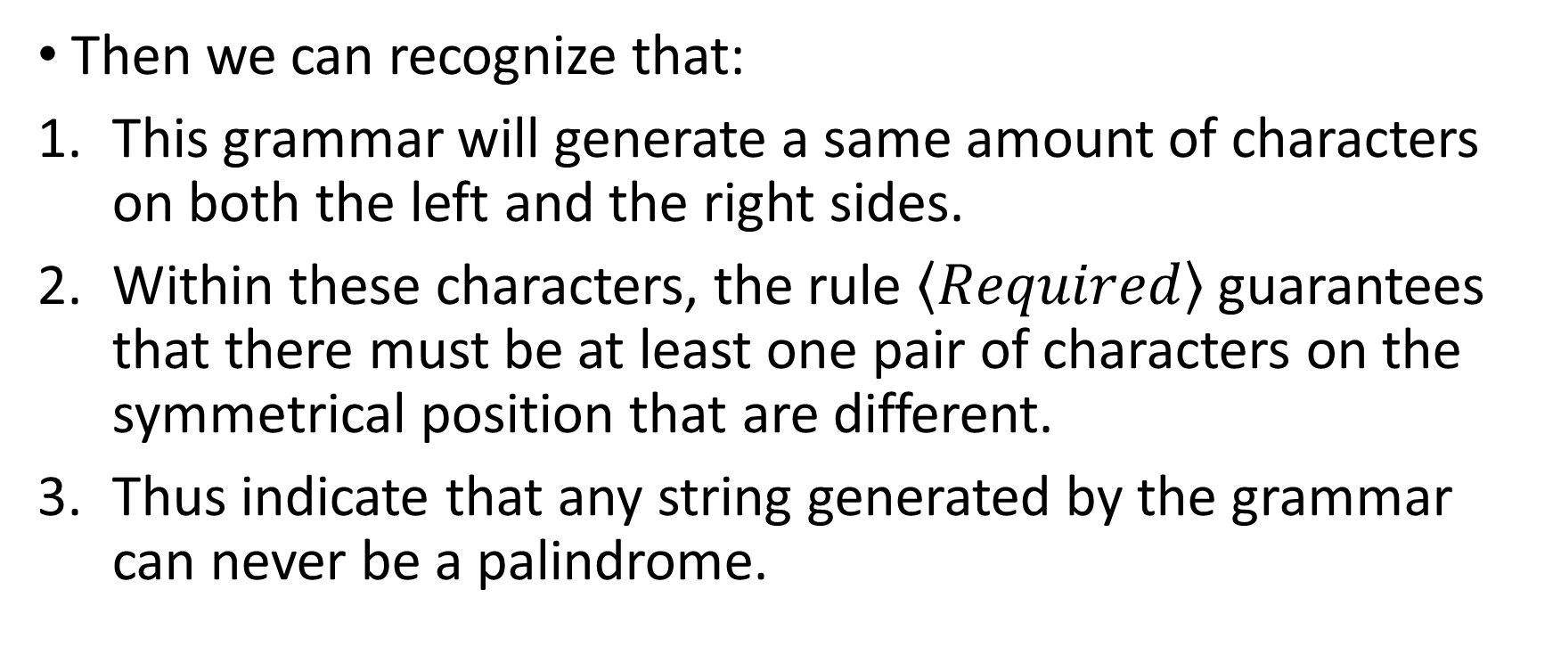
HW#5 – Q2 (2/2)
Then we can recognize that:
This grammar will generate a same amount of characters on both the left and the right sides.
Within these characters, the rule $\left\langle Required\right\rangle$ guarantees that there must be at least one pair of characters on the symmetrical position that are different.
Thus indicate that any string generated by the grammar can never be a palindrome.

Slide 13
HW#5 – Q4
We modified the answer for generating the palindromes to be our answer:
$S→T \left| T\#U \right| U\#T | U\#T\#U$
$U→aU \left| bU \right| \#U | ε$
$T→aTa \left| bTb \right| a \left| b \right| ε | \# | \#U\#$
$T$ stands for the “Target”, and $U$ stands for the “Universal cases”.

Slide 14
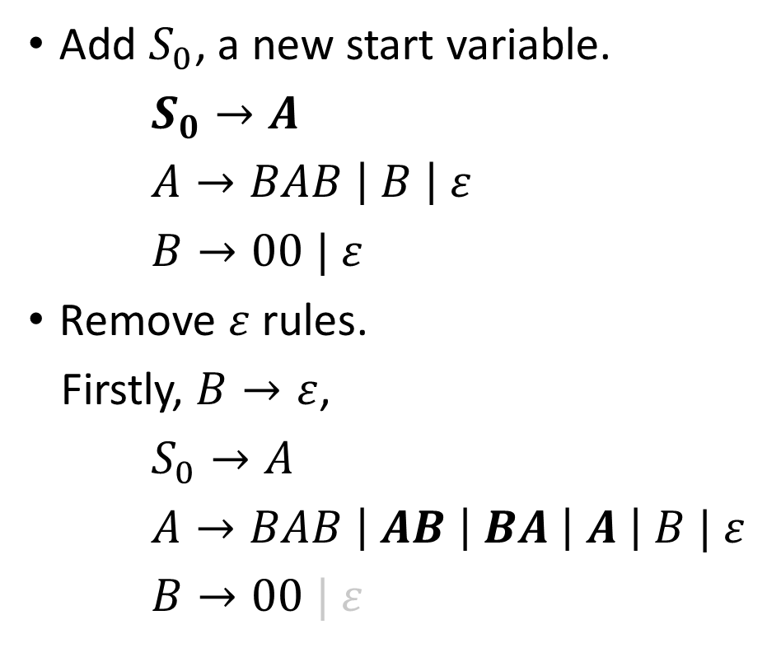
HW#5 – Q7 (1/3)
Add $S_{0}$, a new start variable.
$S_{0}→A$
$A→BAB \left| B \right| ε$
$B→00 | ε$
Remove $ε$ rules.
Firstly, $B→ε$,
$S_{0}→A$
$A→BAB \left| AB \right| BA \left| A \right| B | ε$
$B→00 | ε$
Then, $A→ε$,
$S_{0}→A | ε$
$A→BAB \left| AB \right| BA | BB \left| A \right| B | ε$
$B→00$

Slide 15
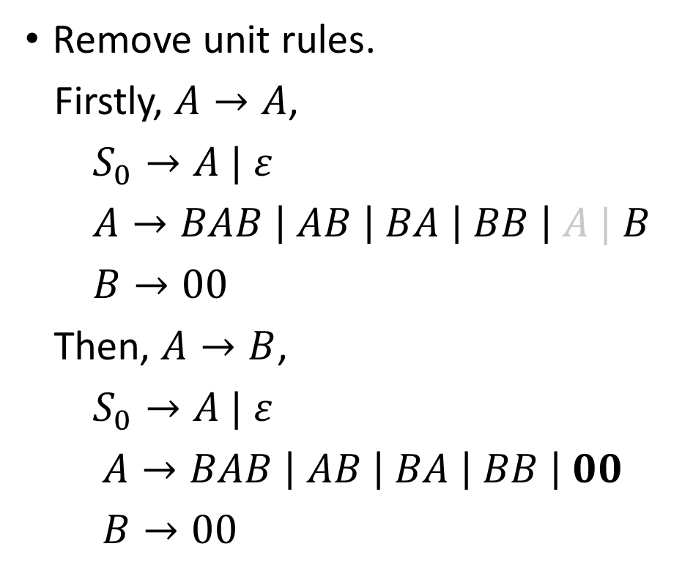
HW#5 – Q7 (2/3)
Remove unit rules.
Firstly, $A→A$,
$S_{0}→A | ε$
$A→BAB \left| AB \right| BA \left| BB \right| A | B$
$B→00$
Then, $A→B$,
$S_{0}→A | ε$
$A→BAB \left| AB \right| BA \left| BB \right| 00$
$B→00$
Then, $S_{0}→A$,
$S_{0}→BAB \left| AB \right| BA \left| BB \right| 00 | ε$
$A→BAB \left| AB \right| BA \left| BB \right| 00$
$B→00$

Slide 16
HW#5 – Q7 (3/3)
Variables replacement.
$S_{0}→BA_{1} \left| AB \right| BA \left| BB \right| U_{1}U_{1} | ε$
$A →BA_{1} \left| AB \right| BA \left| BB \right| U_{1}U_{1}$
$B →U_{1}U_{1}$
$A_{1}→AB$
$U_{1}→0$

