Slide 1
Theory of Computing
TA times #3
Hsu, Hung-Wei
2015/05/20

Slide 2
CAUTION
Most solutions we showed in TA’s slides are more
like the ideas rather then completed solutions.
You may take them as guides, but shouldn’t
consider them as everything you need
to get your homework done.

Slide 3
Stats.
Homework #5
  Average 82.1
  Std. Dev. 11

Slide 4
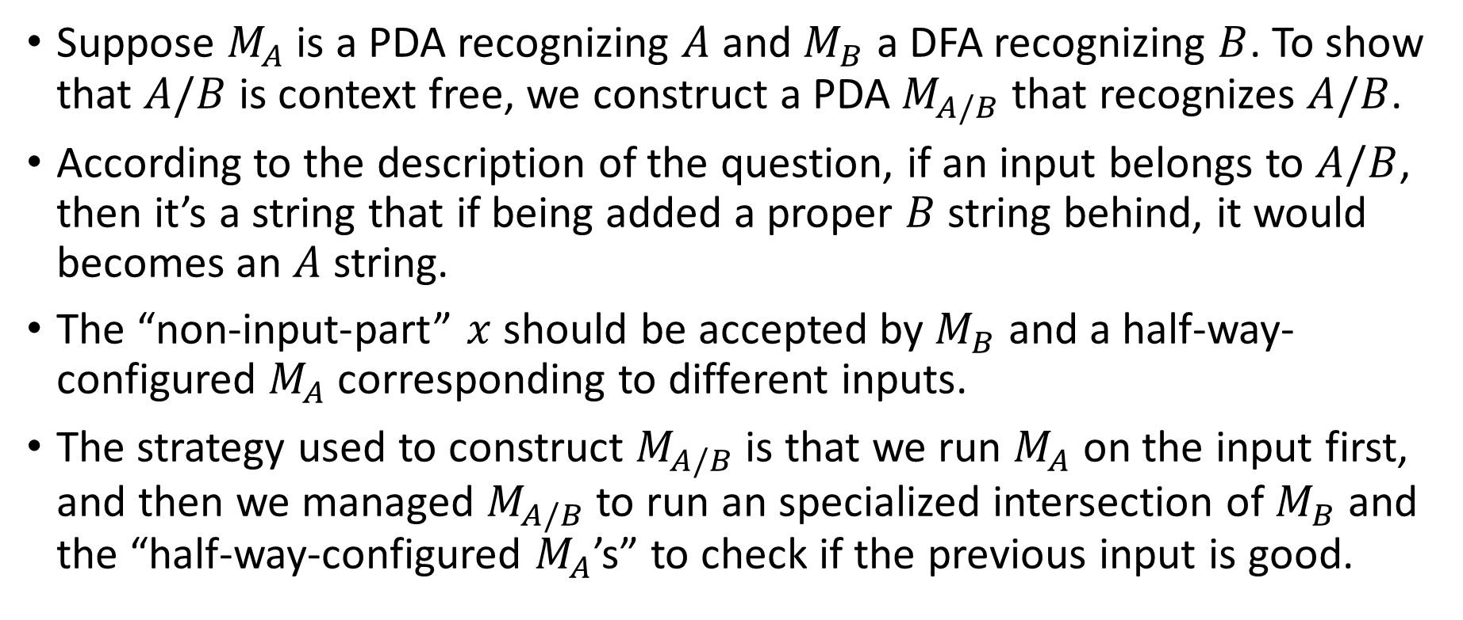
HW#6 – Q4 (1/3)
Suppose $M_{A}$ is a PDA recognizing $A$ and $M_{B}$ a DFA recognizing $B$. To show that $A/B$ is context free, we construct a PDA $M_{A/B}$ that recognizes $A/B$.
According to the description of the question, if an input belongs to $A/B$, then it’s a string that if being added a proper $B$string behind, it would becomes an $A$ string.
The “non-input-part” $x$ should be accepted by $M_{B}$ and a half-way-configured $M_{A}$ corresponding to different inputs.
The strategy used to construct $M_{A/B}$ is that we run $M_{A}$ on the input first, and then we managed $M_{A/B}$ to run an specialized intersection of $M_{B}$ and the “half-way-configured $M_{A}$’s” to check if the previous input is good.
Notes:
A/B這個語言的意思是：有一個input，當它後面再接上一個屬於B的字串、
整個就屬於A時，該input屬於A/B。
我們做一個PDA來認這件事。整個PDA前面先由A的部分檢查完現有的input，
但A還沒完成；進入第二階段，由B來提供可能接在input後面的選擇，這部分
將滿足A剩下沒走完的部分。

Slide 5
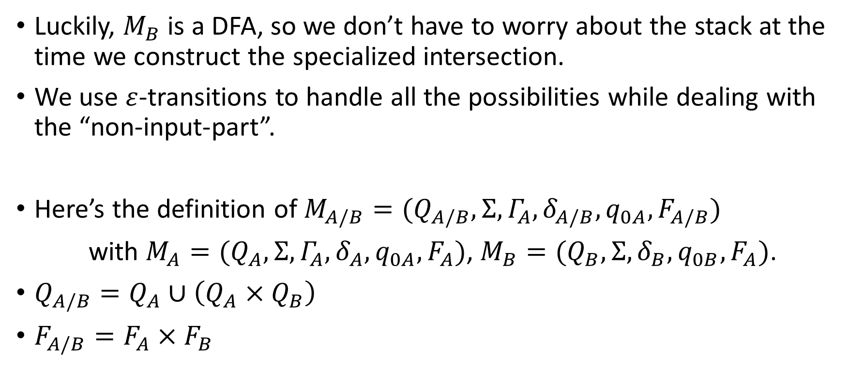
HW#6 – Q4 (2/3)
Luckily, $M_{B}$ is a DFA, so we don’t have to worry about the stack at the time we construct the specialized intersection.
We use $ε$-transitions to handle all the possibilities while dealing with the “non-input-part”.
Here’s the definition of $M_{A/B}=(Q_{A/B},Σ,Γ_{A},δ_{A/B},q_{0A}, F_{A/B})$
with $M_{A}=(Q_{A},Σ, {Γ_{A},δ}_{A},q_{0A}, F_{A})$, $M_{B}=(Q_{B},Σ, δ_{B},q_{0B}, F_{A})$.
$Q_{A/B}=Q_{A}∪\left(Q_{A}×Q_{B}\right)$
$F_{A/B}=F_{A}×F_{B}$
Notes:
因為B是FA、沒有stack，所以A的stack狀態能不受干擾地，從第一階段一路
用過來。進入第二階段後，transition必須記錄同時滿足B，也同時滿足A剩下
的部分；好像B和剩下來的A是intersection一樣，最後要兩者都接受才算計算
成功。只是在起點的設計上要再想仔細點，多點對多點，同樣是利用Cartesian
product。
另外，在這裡我們是虛擬的、non-deterministic的，我們使用$ε$-transition
提供一切可能的路徑，因為，只要有任何一個路徑能使B 和 剩餘的A 都計算
成功，新的PDA任務就達成了。

Slide 6
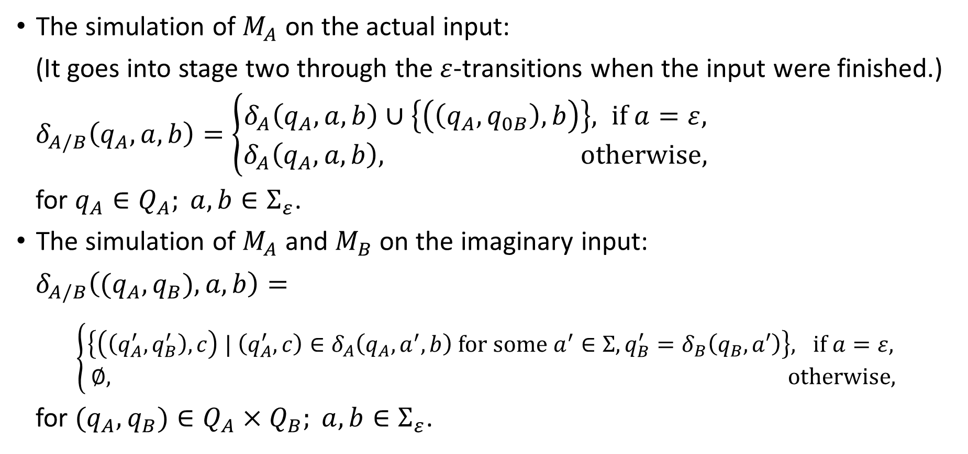
HW#6 – Q4 (3/3)
The simulation of $M_{A}$ on the actual input:
(It goes into stage two through the $ε$-transitions when the input were finished.)
$δ_{A/B}\left(q_{A},a,b\right)=\left\{\begin{aligned}δ_{A}\left(q_{A},a,b\right)∪\left\{\left(\left(q_{A},q_{0B}\right),b\right)\right\}, if a=ε, \\ δ_{A}\left(q_{A},a,b\right), otherwise,\end{aligned}\right.$
for $q_{A}∈Q_{A}; a,b∈Σ_{ε}$.
The simulation of $M_{A}$ and $M_{B}$ on the imaginary input:
$δ_{A/B}\left((q_{A},q_{B}),a,b\right)=$
$\left\{\begin{matrix}\left\{\left(\left(q_{A}^{′},q_{B}^{′}\right),c\right) | \left(q_{A}^{′},c\right)∈δ_{A}\left(q_{A},a^{′},b\right) for some a^{′}∈Σ,q_{B}^{′}=δ_{B}\left(q_{B},a′\right)\right\}, if a=ε, \\ ∅, otherwise,\end{matrix}\right.$
for $(q_{A},q_{B})∈Q_{A}×Q_{B}; a,b∈Σ_{ε}$.
Notes:
另一種作法：（此法比投影片中的更為簡潔、下次可考慮更換）
對於任意CFL A，我們都能建立一個標準化的PDA對應之；
在標準化的PDA中主要包含兩個loop state，
前者用來non-deterministically地做文法生成到stack中，
後者則讀入實際的input、與文法生成結果比對。
對於任意的RL B，我們都能找到一個DFA對應之。
同時，在前面作業的練習中，我們知道如何製作「B反轉」所對應的DFA。
利用A與B所對應的自動機，我們建構A/B如下：
我們在A之標準化PDA的兩個loop state之間插入B反轉的DFA，
並修改B反轉，使他原本針對input讀入的部分變成non-deterministically地pop stack。

Slide 7
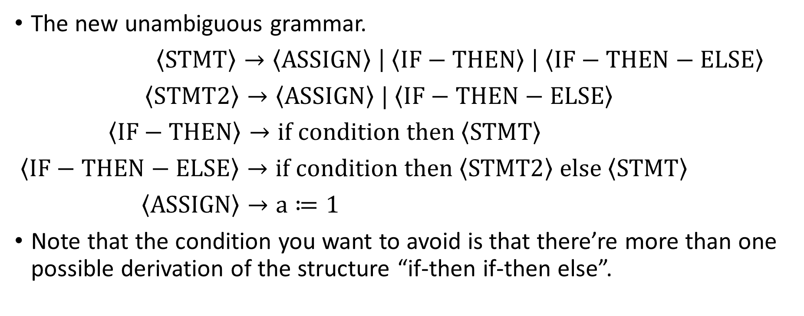
HW#6 – Q5
The new unambiguous grammar.
$\left\langle STMT\right\rangle →\left\langle ASSIGN\right\rangle \left| \left\langle IF−THEN\right\rangle \right| \left\langle IF−THEN−ELSE\right\rangle$
$\left\langle STMT2\right\rangle →\left\langle ASSIGN\right\rangle | \left\langle IF−THEN−ELSE\right\rangle$
$\left\langle IF−THEN\right\rangle →if condition then \left\langle STMT\right\rangle$
$\left\langle IF−THEN−ELSE\right\rangle →if condition then \left\langle STMT2\right\rangle else \left\langle STMT\right\rangle$
$\left\langle ASSIGN\right\rangle →a≔1$
Note that the condition you want to avoid is that there’re more than one possible derivation of the structure “if-then if-then else”.

Slide 8
HW#7 – Q2
Firstly, the instructions haven’t told about in which order a TM can try through all the possible settings.
Secondly, since the possible settings are infinitely many, a TM would never finish them; you can’t have an instruction for TM that requires it tries all the possibilities first then do something, i.e., “otherwise, reject.” in this case.

Slide 9
HW#7 – Q3
Scan the tape to find an unmarked ‘1’. If we found one, mark the first ‘1’ we found and move the head back to the front of the tape; otherwise, go to step 5.
Repeat step 1 again. But this time, the machine rejects the input if no unmarked ‘1’ were found.
Scan the tape to find an unmarked ‘0’. If we found one, mark the ‘0’ and move the head back to the front of the tape; otherwise, the machine rejects.
Go to step 1.
Scan the tape once from the beginning to the end. If there is no any unmarked ‘0’ remains, the machine accepts; otherwise, rejects.

Slide 10
HW#7 – Q6 (1/4)
IDEA – As the Turing machine with stay put instead of left has a similar operating logic with finite automata, we try to show that this type of machines recognize the same class of languages as DFAs.
The easier side first – we show that all the things a DFA can do can also be done with a Turing machine with stay put instead of left.
  Just like the way we simulate a DFA with a normal Turing machine, we can simulate a DFA with the specialized Turing machine here since the simulation of a DFA doesn’t need the head left operation.
The other side – we show that anything that can be done with a Turing machine with stay put instead of left can also be done with a DFA.
Notes:
回顧一下老師剛開始介紹TM的那堂課，
在介紹TM的時候，我們重新看了過去大家學過的幾種Machine，
並且我們說：
它們能夠做的事TM都能夠做、能simulate，TM的能力比他們都要強。
還記得TM怎麼模擬FA嗎？就是head只會moves right，只讀不寫，
所以當我們看到一個TM的head只能往右走或是停在原地時，我們自
然地想到他可能和一個FA能力是一樣的。如果我們能證明他們確實是
等價的，我們也就回答了題目。
首先，一個方向：STM至少和FA有一樣的能力，這部分能輕易得到。
接著我們要來試著證明另一個方向：FA能和STM有一樣能力。

Slide 11
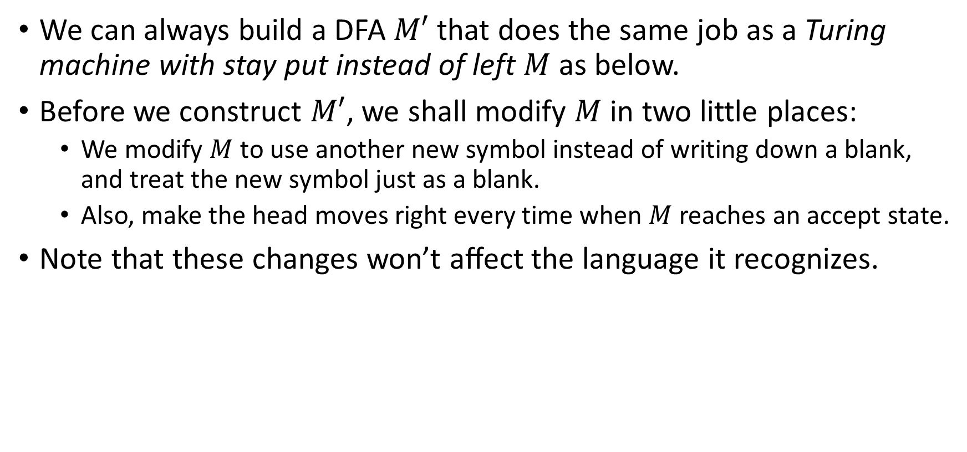
HW#7 – Q6 (2/4)
We can always build a DFA $M′$ that does the same job as a Turing machine with stay put instead of left $M$ as below.
Before we construct $M′$, we shall modify $M$ in two little places:
  We modify $M$ to use another new symbol instead of writing down a blank, and treat the new symbol just as a blank.
  Also, make the head moves right every time when $M$ reaches an accept state.
Note that these changes won’t aﬀect the language it recognizes.
Notes:
要說明FA能和STM有一樣的能力，就要說明他們看似不同之處其實
不造成能力的差異。
STM較之於FA的差異之處，就是多了讀到一個輸入之後，可以停留
與修改的能力。這會有什麼影響呢？
讓我們仔細來想一想這個多出來的功能：
先回想一下TM的運算接受是怎麼一回事：如果一個TM的執行結果
是接受的話，是指接受了原本寫在tape上的input。
所以，base on STM在一格tape上所讀到的input，STM做停留並做
一連串修改的動作、而且沒辦法回頭去看；其真正的影響就是讓STM
在讀input時，比FA多了一個可能：可能在某些情況下讀到了一個字
元，STM就會一直在原地打轉再也不讀input了。不然，STM就算在
一格打轉再久，它還是會進入下一格，並且對於input的記憶能力僅
止於state的記憶。
這個較之於FA多出來的行為，會讓STM比FA強嗎？顯然不會，在某
種情況下讀到某個input就不再往下做，其實就是沒能接受該字串的
意思、沒能接受該字串FA也有，兩者一樣。

Slide 12
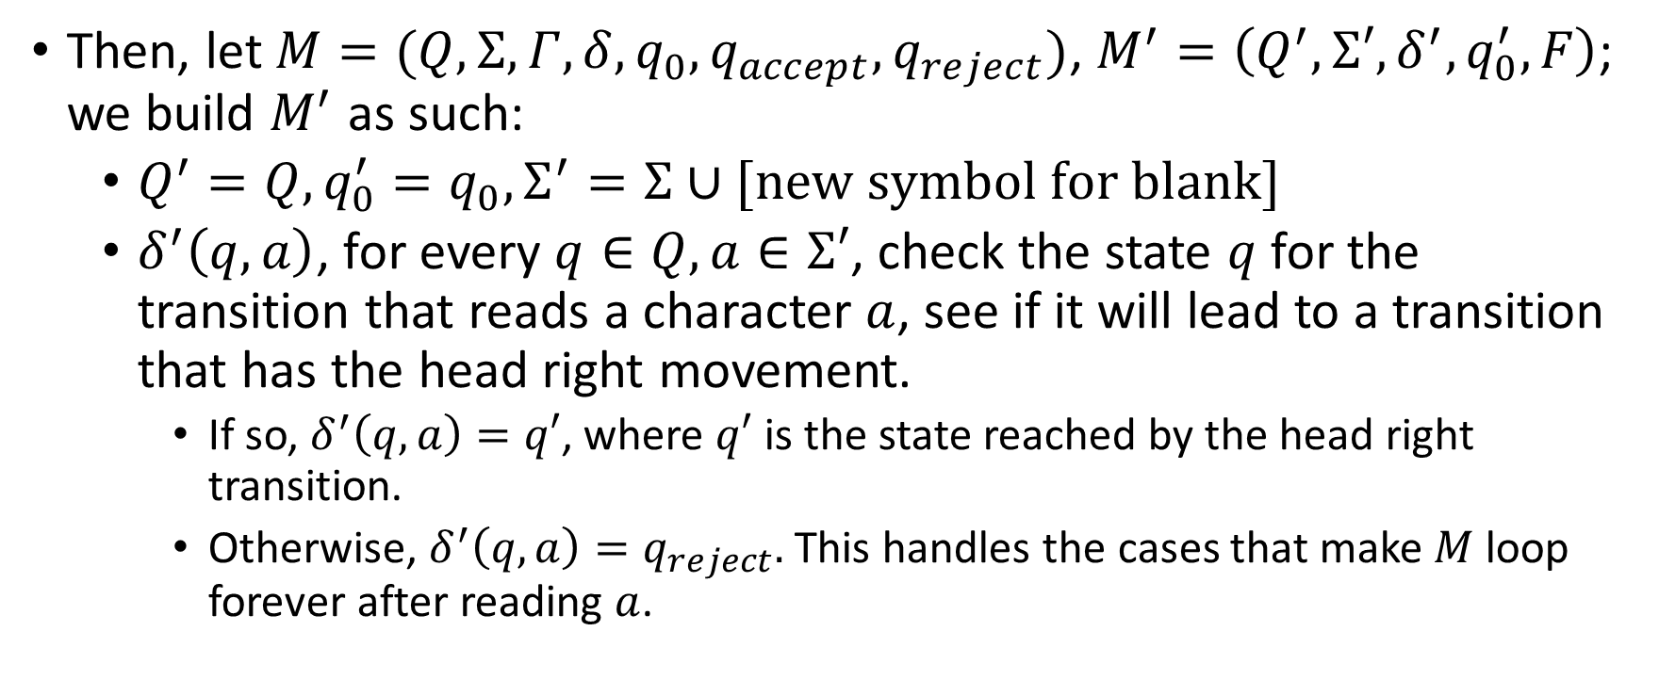
HW#7 – Q6 (3/4)
Then, let $M=(Q,Σ, Γ,δ,q_{0}, q_{accept}, q_{reject})$, $M^{′}=\left(Q^{′},Σ′,δ^{′}, q_{0}^{′},F\right)$; we build $M^{′}$ as such:
  $Q^{′}=Q,q_{0}^{′}=q_{0},Σ^{′}=Σ∪[new symbol for blank]$
  $δ^{′}\left(q,a\right)$, for every $q∈Q,a∈Σ′$, check the state $q$ for the transition that reads a character $a$, see if it will lead to a transition that has the head right movement.
    If so, $δ^{′}\left(q,a\right)=q′$, where $q′$ is the state reached by the head right transition.
    Otherwise, $δ^{′}\left(q,a\right)=q_{reject}.$ This handles the cases that make $M$loop forever after reading $a$.
Notes:
另一種FA模擬STM的方法，使用NFA：（此法比投影片中的更為簡潔、下次可考慮更換）
Q'：Q x (Sigma+空格) x Gamma
第一tuple是TM的Q、第二tuple是用來記第一次讀到紙帶格子上的字、
第三tuple是用來模擬TM對於格子中符號的修改。
這麼一來STM在紙帶上一格的各種動作，NFA都能以進入對應的state來模擬。
TM在紙帶上往右走的TM transitions，對應到NFA實際消耗input的transitions；
停留的、還有已經走到底（空格）以後的TM transitions，則對應到NFA的epsilon transitions。

Slide 13
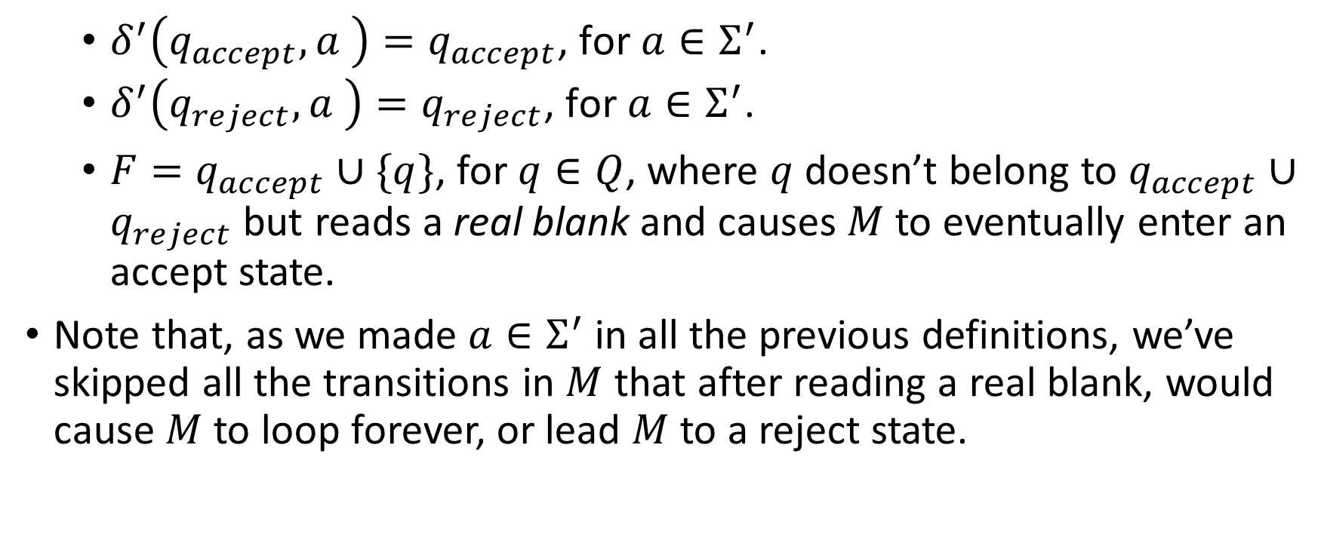
HW#7 – Q6 (4/4)
  $δ^{′}\left(q_{accept},a \right)=q_{accept}\text{, }\text{for} a∈Σ^{′}$.
  $δ^{′}\left(q_{reject},a \right)=q_{reject}\text{, }\text{for} a∈Σ^{′}$.
    $F=q_{accept}∪\{q\}$, for $q∈Q$, where $q$ doesn’t belong to $q_{accept}∪q_{reject}$ but reads a real blank and causes $M$ to eventually enter an accept state.
Note that, as we made $a∈Σ^{′}$ in all the previous definitions, we’ve skipped all the transitions in $M$ that after reading a real blank, would cause $M$ to loop forever, or lead $M$ to a reject state.

Slide 14
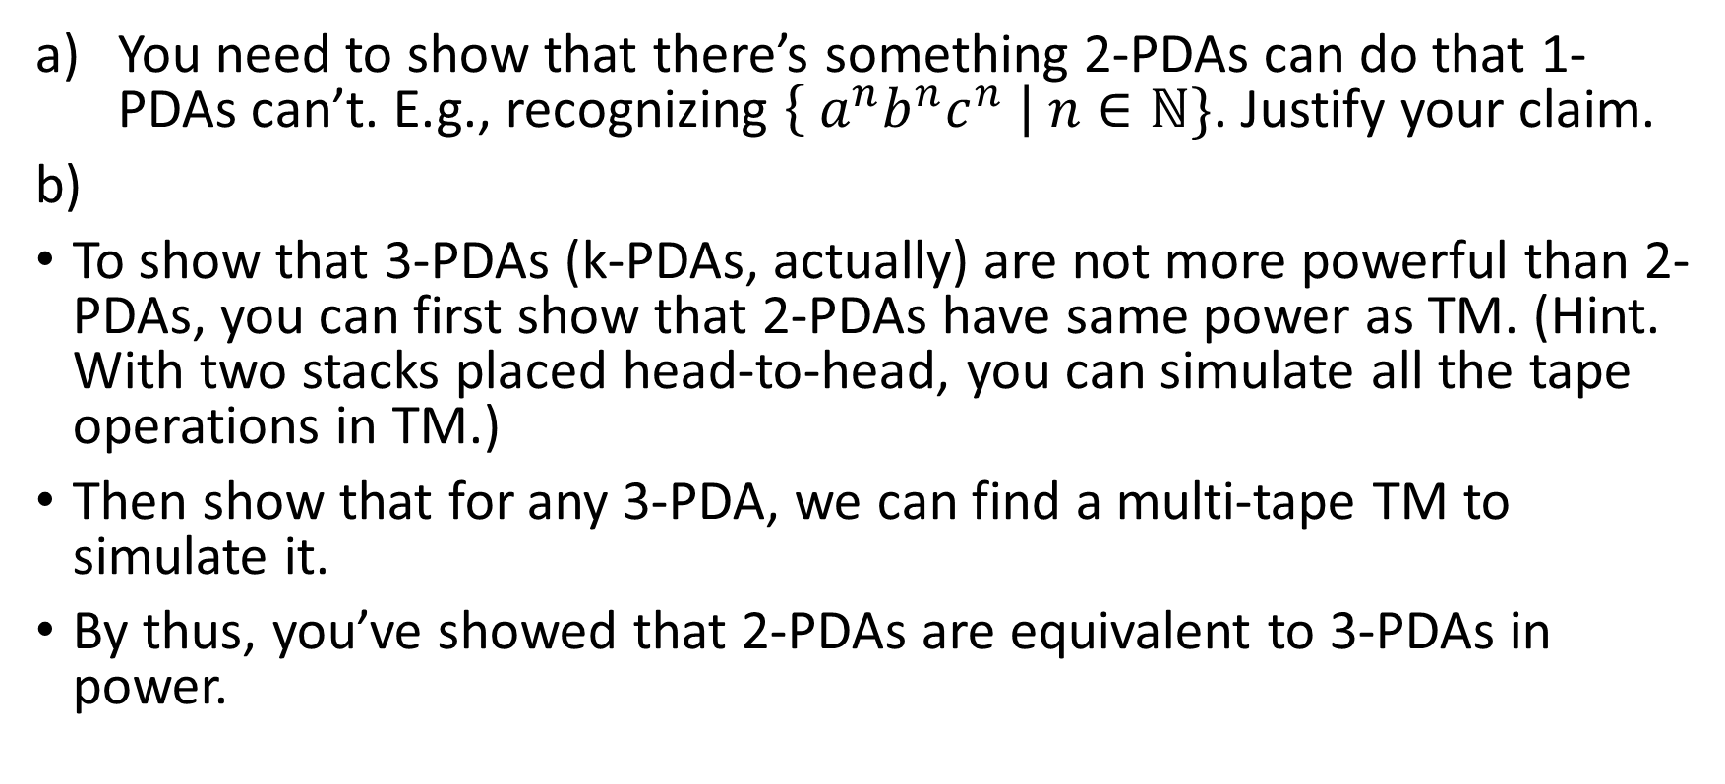
HW#7 – Q7
You need to show that there’s something 2-PDAs can do that 1-PDAs can’t. E.g., recognizing $\left\{ a^{n}b^{n}c^{n} \right| n∈ℕ\}$. Justify your claim.
To show that 3-PDAs (k-PDAs, actually) are not more powerful than 2-PDAs, you can first show that 2-PDAs have same power as TM. (Hint. With two stacks placed head-to-head, you can simulate all the tape operations in TM.)
Then show that for any 3-PDA, we can find a multi-tape TM to simulate it.
By thus, you’ve showed that 2-PDAs are equivalent to 3-PDAs in power.

