Slide 1
Theory of Computing
TA times #4
Hsu, Hung-Wei
2015/06/10

Slide 2
CAUTION
Most solutions we showed in TA’s slides are more
like the ideas rather then completed solutions.
You may take them as guides, but shouldn’t
consider them as everything you need
to get your homework done.

Slide 3
Stats.
Homework #6
  Average 88.8
  Std. Dev. 8.5
Homework #7
  Average 68.4
  Std. Dev. 16.9

Slide 4





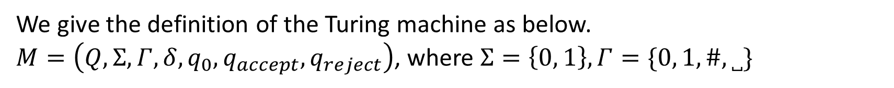








HW#8 – Q1
We give the definition of the Turing machine as below.
$M=\left(Q,Σ,Γ,δ,q_{0},q_{accept},q_{reject}\right)$, where $Σ=\left\{0, 1\right\},Γ=\{0, 1,\#,˽\}$
$$1→\#,R$$
$$1→0,R$$
$$q_{0}$$
$$0→\#,R$$
$$q_{1}$$
$$q_{2}$$
$$0→1,R$$
$$˽→\#,R$$
$$0→R$$
$$1→R$$
$$q_{accept}$$
$$˽→0,R$$
$$˽→1,R$$

Slide 5
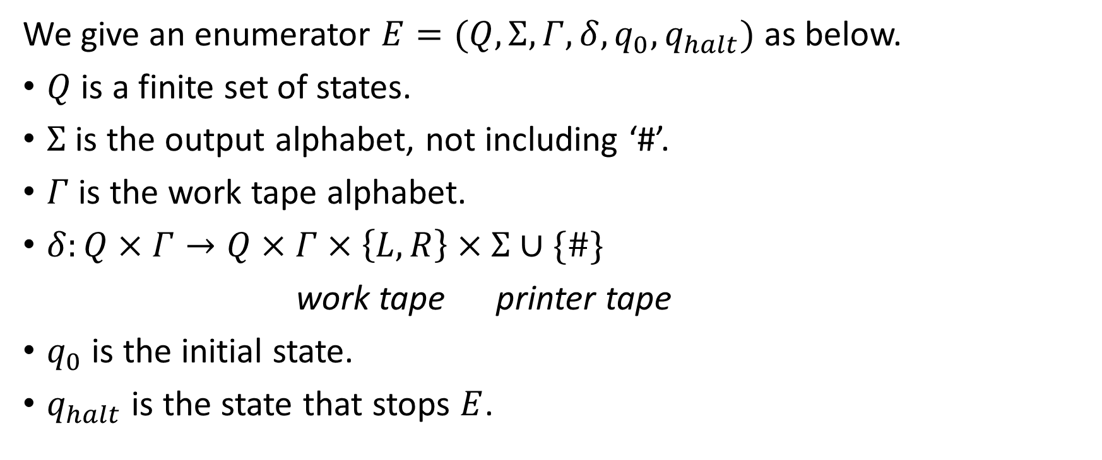
HW#8 – Q2 (1/4)
We give an enumerator $E=(Q,Σ,Γ,δ,q_{0},q_{halt})$ as below.
$Q$ is a finite set of states.
$Σ$ is the output alphabet, not including ‘#’.
$Γ$ is the work tape alphabet.
$δ:Q×Γ→Q×Γ×\left\{L,R\right\}×Σ∪\{\#\}$
work tape printer tape
$q_{0}$ is the initial state.
$q_{halt}$ is the state that stops $E$.

Slide 6
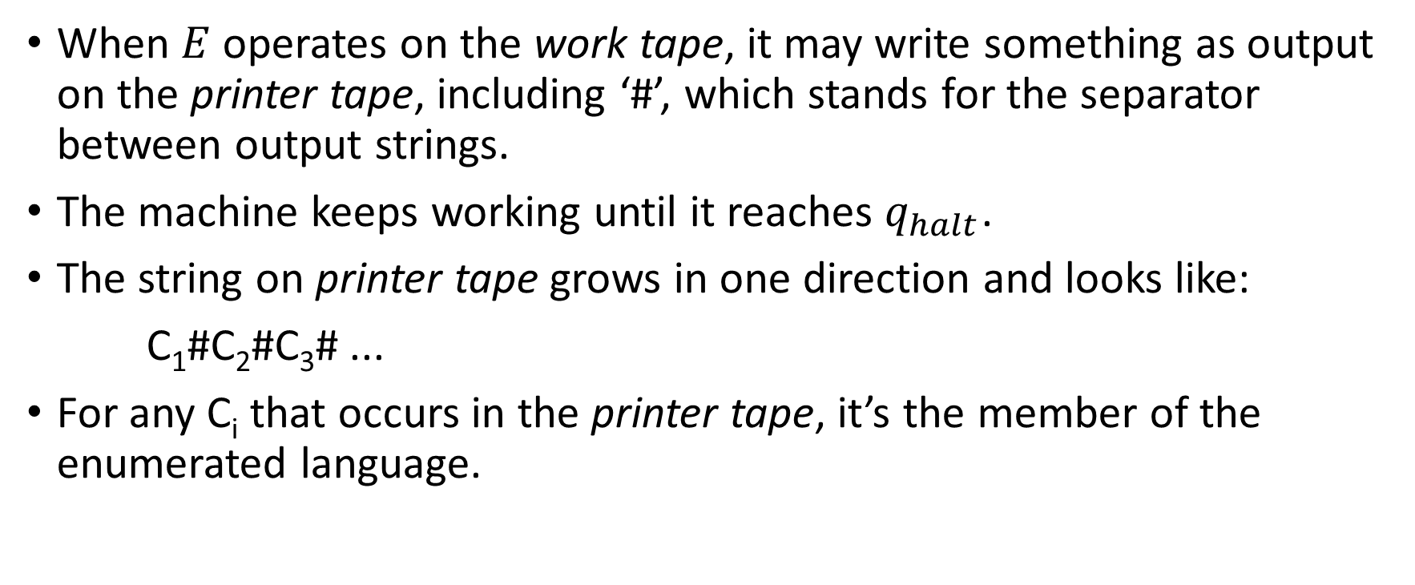
HW#8 – Q2 (2/4)
When $E$operates on the work tape, it may write something as output on the printer tape, including ‘#’, which stands for the separator between output strings.
The machine keeps working until it reaches $q_{halt}$.
The string on printer tape grows in one direction and looks like:
C₁#C₂#C₃# ...
For any C_{i} that occurs in the printer tape, it’s the member of the enumerated language.

Slide 7
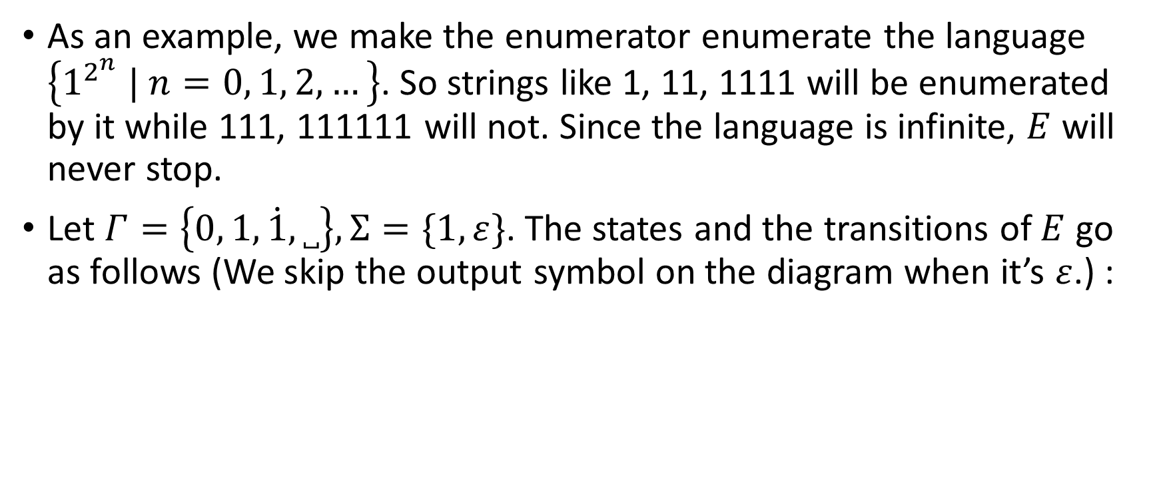
HW#8 – Q2 (3/4)
As an example, we make the enumerator enumerate the language $\left\{1^{2^{n}} | n=0, 1, 2, …\right\}$. So strings like 1, 11, 1111 will be enumerated by it while 111, 111111 will not. Since the language is infinite, $E$ will never stop.
Let $Γ=\left\{0, 1,\dot{1},˽\right\},Σ=\{1,ε\}$. The states and the transitions of $E$ go as follows (We skip the output symbol on the diagram when it’s $ε$.) :

Slide 8

























HW#8 – Q2 (4/4)
$$1,\dot{1}→1,L, 1$$
$$\dot{1}→R$$
$$1,0→R$$
$$0,1→L$$
$$q_{0}$$
$$˽→R$$
$$q_{1}$$
$$˽→1,R$$
$$q_{2}$$
$$˽→0,L$$
$$q_{3}$$
$$˽→R, \#$$
$$q_{4}$$
$$1→\dot{1},R$$
$$q_{5}$$
$$˽→1,L$$
$$q_{6}$$
$$\dot{1}→R$$
$$1→L,1$$
$$0→1,R$$
$$q_{9}$$
$$1→0,L$$
$$q_{8}$$
$$˽→L$$
$$q_{7}$$
$$1→R$$

Slide 9
HW#8* – Q4 (1/6)
Since outside the input portion, such TM can do whatever a normal TM does, the restrictions of its power will then lie in the read-only part (input portion).
We will show that given one this kind of machines, with the read-only restriction, its distinguishability on input strings has an upper bound.
  Since the possible input strings are infinite, if your distinguishability is bounded, you must treat some strings the same. And if we let those strings being treated the same form a group, “bounded” tells us that we will only have finite groups.

Slide 10
HW#8* – Q4 (2/6)
In Myhill-Nerode theorem, these groups are called equivalence classes.
And according to Myhill-Nerode theorem, if you are talking about a language with finite equivalence classes, you are talking about a regular language. (You can find more details of Myhill-Nerode theorem in the chapter 1’s PROBLEMS section in the textbook.)
So by showing the upper bound of such machine's distinguishability on strings, by showing it can only separate strings into finite groups, we have showed that such machine can only define/recognize a regular language.

Slide 11
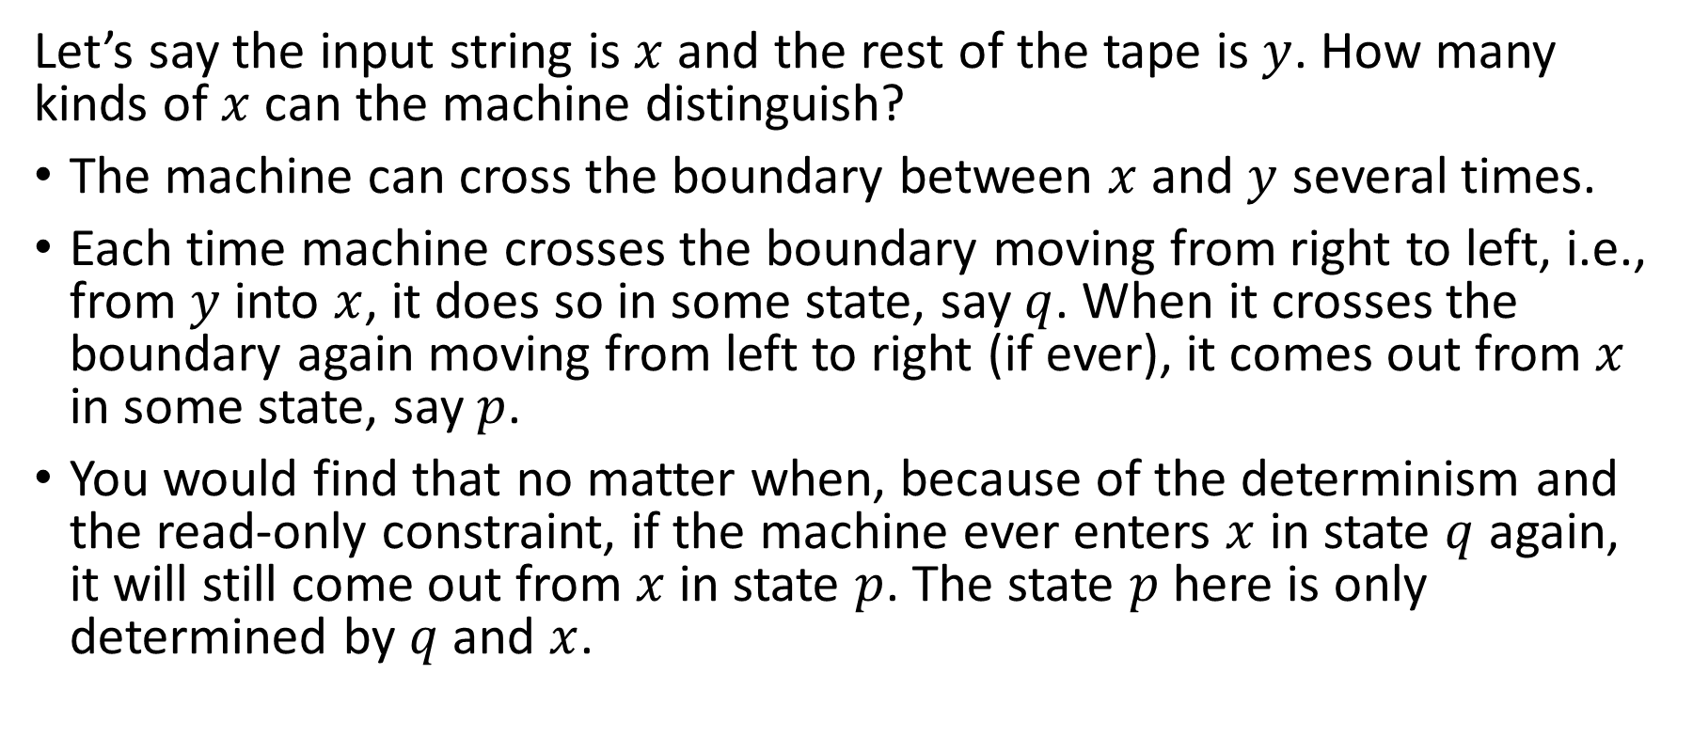


HW#8* – Q4 (3/6)
Input string
…
$$x$$
$$y$$
Let’s say the input string is $x$ and the rest of the tape is $y$. How many kinds of $x$ can the machine distinguish?
The machine can cross the boundary between $x$ and $y$ several times.
Each time machine crosses the boundary moving from right to left, i.e., from $y$ into $x$, it does so in some state, say $q$. When it crosses the boundary again moving from left to right (if ever), it comes out from $x$ in some state, say $p$.
You would find that no matter when, because of the determinism and the read-only constraint, if the machine ever enters $x$ in state $q$ again, it will still come out from $x$ in state $p$. The state $p$ here is only determined by $q$ and $x$.

Slide 12



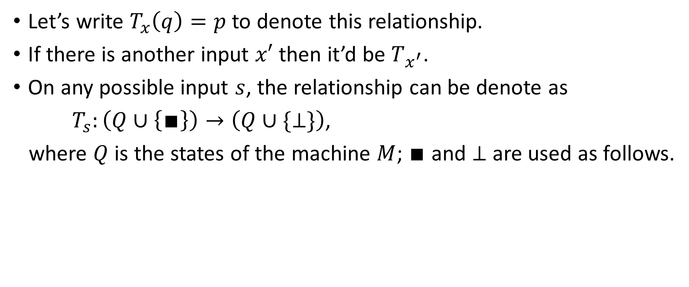



HW#8* – Q4 (4/6)
$$q$$
$$p$$
Input string
…
Input string
…
Let’s write $T_{x}\left(q\right)=p$ to denote this relationship.
If there is another input $x′$ then it’d be $T_{x^{′}}$.
On any possible input $s$, the relationship can be denote as
$T_{s}:\left(Q∪\left\{∎\right\}\right)→\left(Q∪\{⊥\}\right)$,
where $Q$ is the states of the machine $M$; $∎$ and $⊥$ are used as follows.
$$∎$$
$$p$$
$$q$$
$$⊥$$
Input string
…
Input string
…
Input string
…
Input string
…

Slide 13
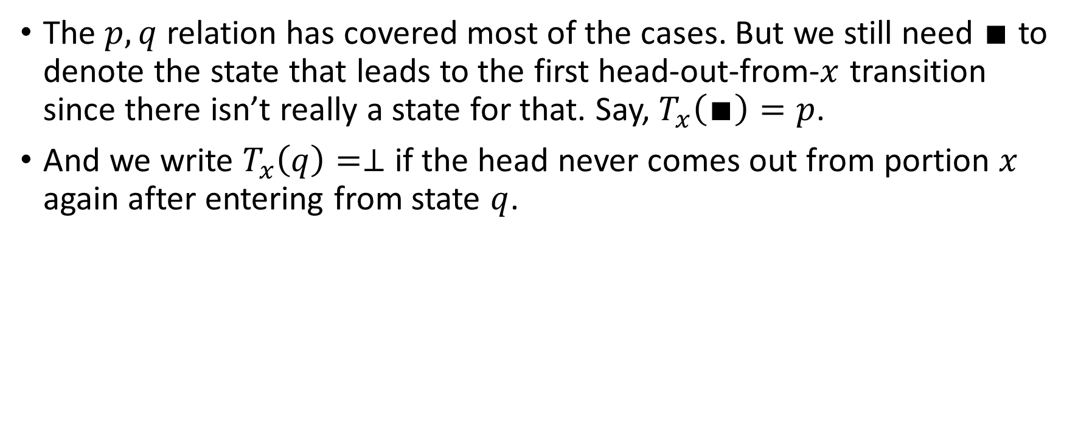
HW#8* – Q4 (5/6)
The $p,q$ relation has covered most of the cases. But we still need $∎$ to denote the state that leads to the first head-out-from-$x$ transition since there isn’t really a state for that. Say, $T_{x}\left(∎\right)=p$.
And we write $T_{x}\left(q\right)=⊥$ if the head never comes out from portion $x$ again after entering from state $q$.
$$∎$$
$$p$$
$$q$$
$$⊥$$
Input string
…
Input string
…
Input string
…
Input string
…

Slide 14
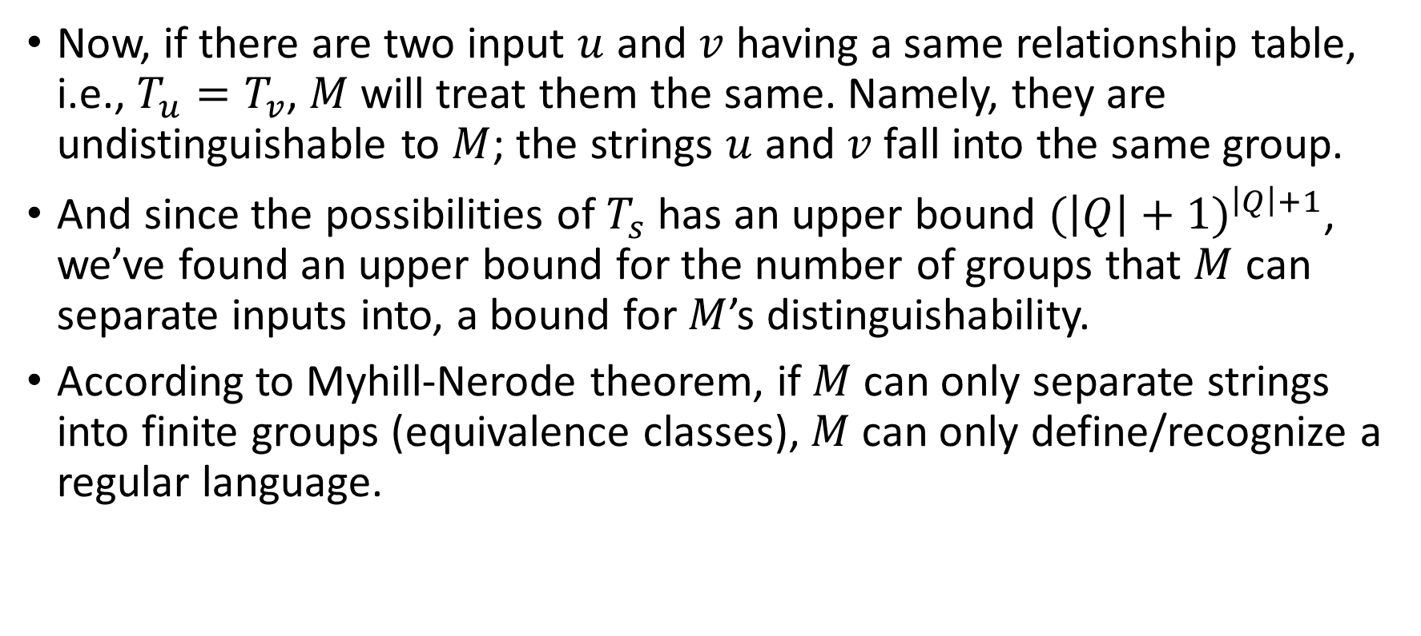
HW#8* – Q4 (6/6)
Now, if there are two input $u$ and $v$ having a same relationship table, i.e., $T_{u}=T_{v}$, $M$will treat them the same. Namely, they are undistinguishable to $M$; the strings $u$ and $v$ fall into the same group.
And since the possibilities of $T_{s}$ has an upper bound ${(\left|Q\right|+1)}^{\left|Q\right|+1}$, we’ve found an upper bound for the number of groups that $M$ can separate inputs into, a bound for $M$’s distinguishability.
According to Myhill-Nerode theorem, if $M$ can only separate strings into finite groups (equivalence classes), $M$ can only define/recognize a regular language.

Slide 15
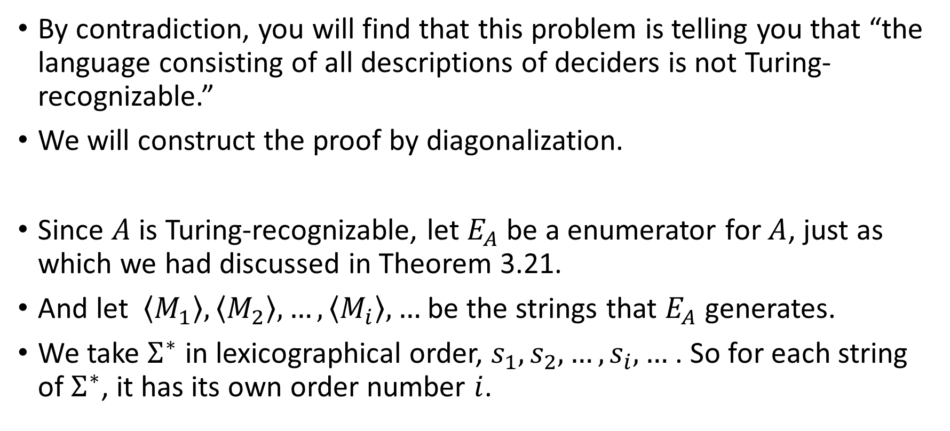
HW#9 – Q1 (1/2)
By contradiction, you will find that this problem is telling you that “the language consisting of all descriptions of deciders is not Turing-recognizable.”
We will construct the proof by diagonalization.
Since $A$ is Turing-recognizable, let $E_{A}$ be a enumerator for $A$, just as which we had discussed in Theorem 3.21.
And let $\left\langle M_{1}\right\rangle ,\left\langle M_{2}\right\rangle ,…,\left\langle M_{i}\right\rangle ,…$ be the strings that $E_{A}$ generates.
We take $Σ^{∗}$ in lexicographical order, $s_{1},s_{2},…,s_{i},…$ . So for each string of $Σ^{∗}$, it has its own order number $i$.

Slide 16
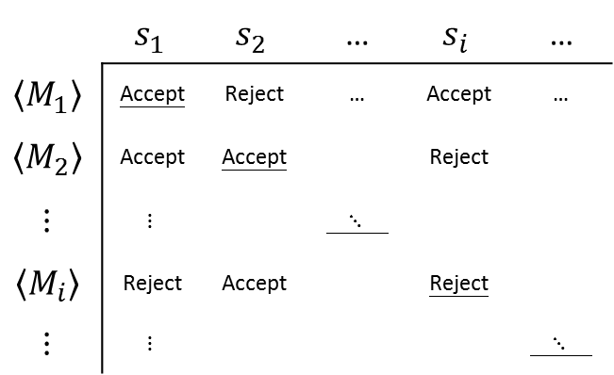
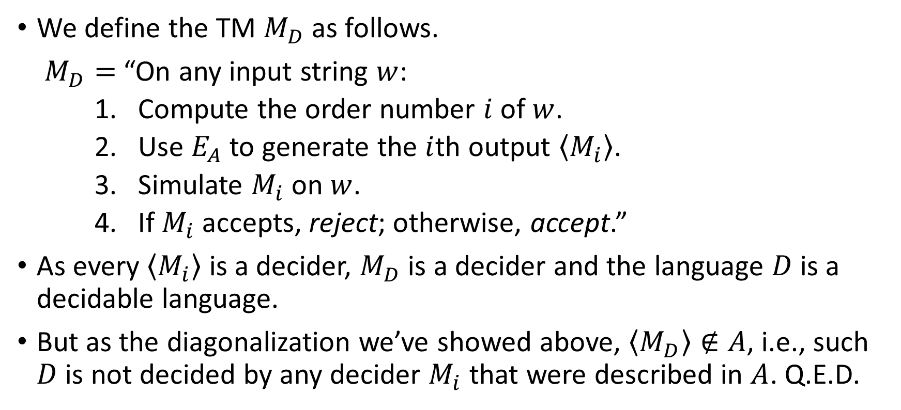
HW#9 – Q1 (2/2)
 | $$s_{1}$$ | $$s_{2}$$ | … | $$s_{i}$$ | …
$$\left\langle M_{1}\right\rangle$$ | Accept | Reject | … | Accept | …
$$\left\langle M_{2}\right\rangle$$ | Accept | Accept |  | Reject
$$⋮$$ | $$⋮$$ |  | $⋱$
$$\left\langle M_{i}\right\rangle$$ | Reject | Accept |  | Reject
$$⋮$$ | $$⋮$$ |  |  |  | $⋱$
We define the TM $M_{D}$ as follows.
$M_{D}=$ “On any input string $w$:
    Compute the order number $i$ of $w$.
    Use $E_{A}$ to generate the $i$th output $\left\langle M_{i}\right\rangle$.
    Simulate $M_{i}$ on $w$.
    If $M_{i}$ accepts, reject; otherwise, accept.”
As every $\left\langle M_{i}\right\rangle$ is a decider, $M_{D}$ is a decider and the language $D$ is a decidable language.
But as the diagonalization we’ve showed above, $\left\langle M_{D}\right\rangle ∉A$, i.e., such $D$ is not decided by any decider $M_{i}$ that were described in $A$. Q.E.D.

Slide 17



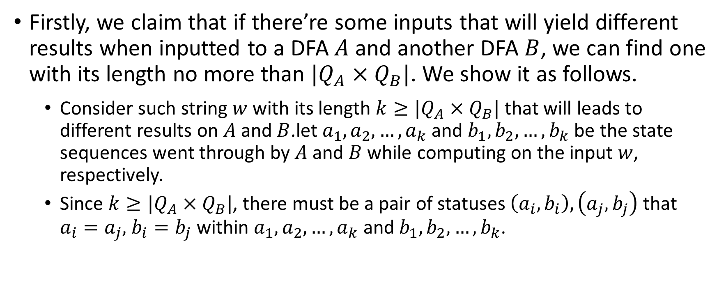












HW#9* – Q3 (1/3)
Firstly, we claim that if there’re some inputs that will yield different results when inputted to a DFA $A$ and another DFA $B$, we can find one with its length no more than $|Q_{A}×Q_{B}|$. We show it as follows.
  Consider such string $w$ with its length $k≥|Q_{A}×Q_{B}|$ that will leads to different results on $A$ and $B$.let $a_{1},a_{2},…,a_{k}$ and $b_{1},b_{2},…,b_{k}$ be the state sequences went through by $A$ and $B$ while computing on the input $w$, respectively.
  Since $k≥|Q_{A}×Q_{B}|$, there must be a pair of statuses $\left(a_{i},b_{i}\right),\left(a_{j},b_{j}\right)$ that $a_{i}=a_{j},$ $b_{i}=b_{j}$ within $a_{1},a_{2},…,a_{k}$ and $b_{1},b_{2},…,b_{k}$.
…
$$a_{i}$$
…
$$a_{j}$$
$$♡$$
…
$$a_{i}$$
$$♡$$
$$x$$
$$y$$
$$z$$
$$x$$
$$z$$
…
$$b_{i}$$
…
$$b_{j}$$
$$♠$$
…
$$b_{i}$$
$$♠$$

Slide 18
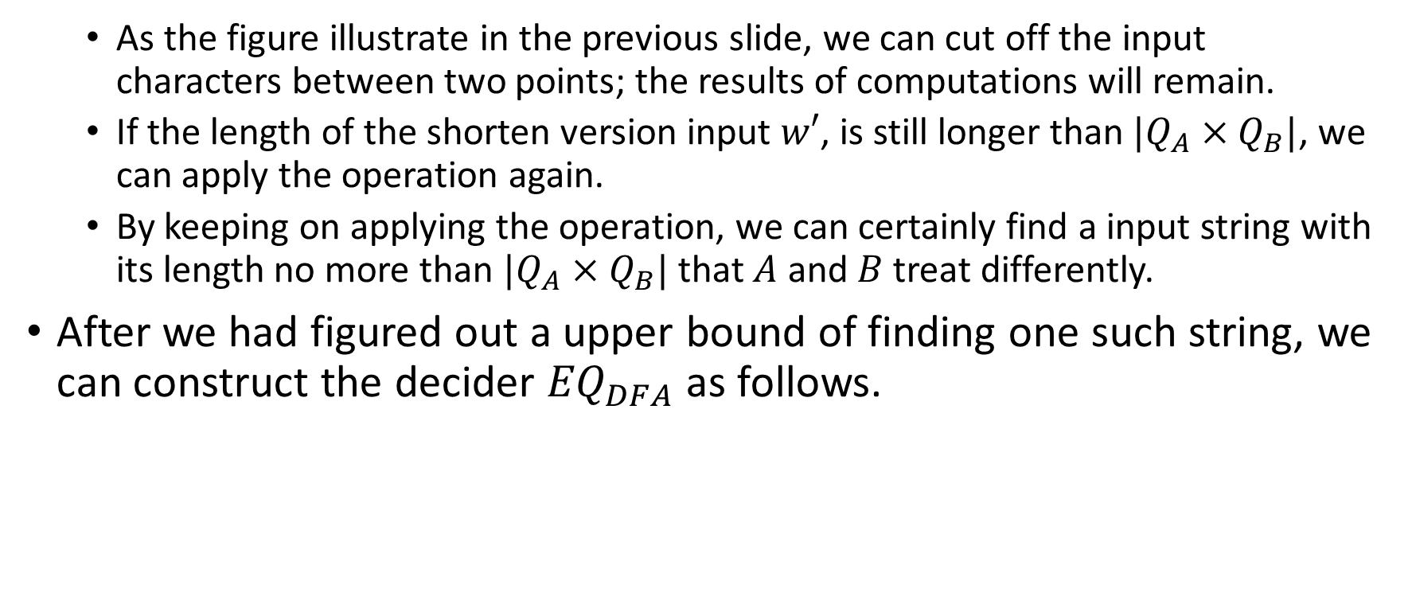
HW#9* – Q3 (2/3)
  As the figure illustrate in the previous slide, we can cut off the input characters between two points; the results of computations will remain.
  If the length of the shorten version input $w′$, is still longer than $|Q_{A}×Q_{B}|$, we can apply the operation again.
  By keeping on applying the operation, we can certainly find a input string with its length no more than $|Q_{A}×Q_{B}|$ that $A$ and $B$ treat differently.
After we had figured out a upper bound of finding one such string, we can construct the decider ${EQ}_{DFA}$ as follows.

Slide 19
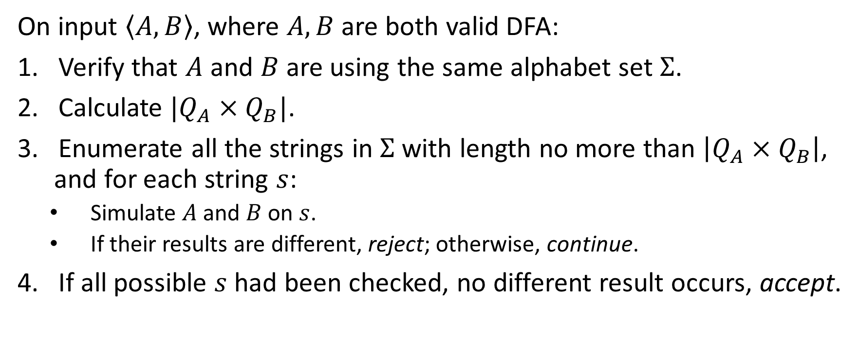
HW#9* – Q3 (3/3)
On input $\left\langle A, B\right\rangle$, where $A, B$ are both valid DFA:
Verify that $A$ and $B$ are using the same alphabet set $Σ$.
Calculate $|Q_{A}×Q_{B}|$.
Enumerate all the strings in $Σ$ with length no more than $\left|Q_{A}×Q_{B}\right|$, and for each string $s$:
  Simulate $A$ and $B$ on $s$.
  If their results are different, reject; otherwise, continue.
If all possible $s$ had been checked, no different result occurs, accept.

Slide 20
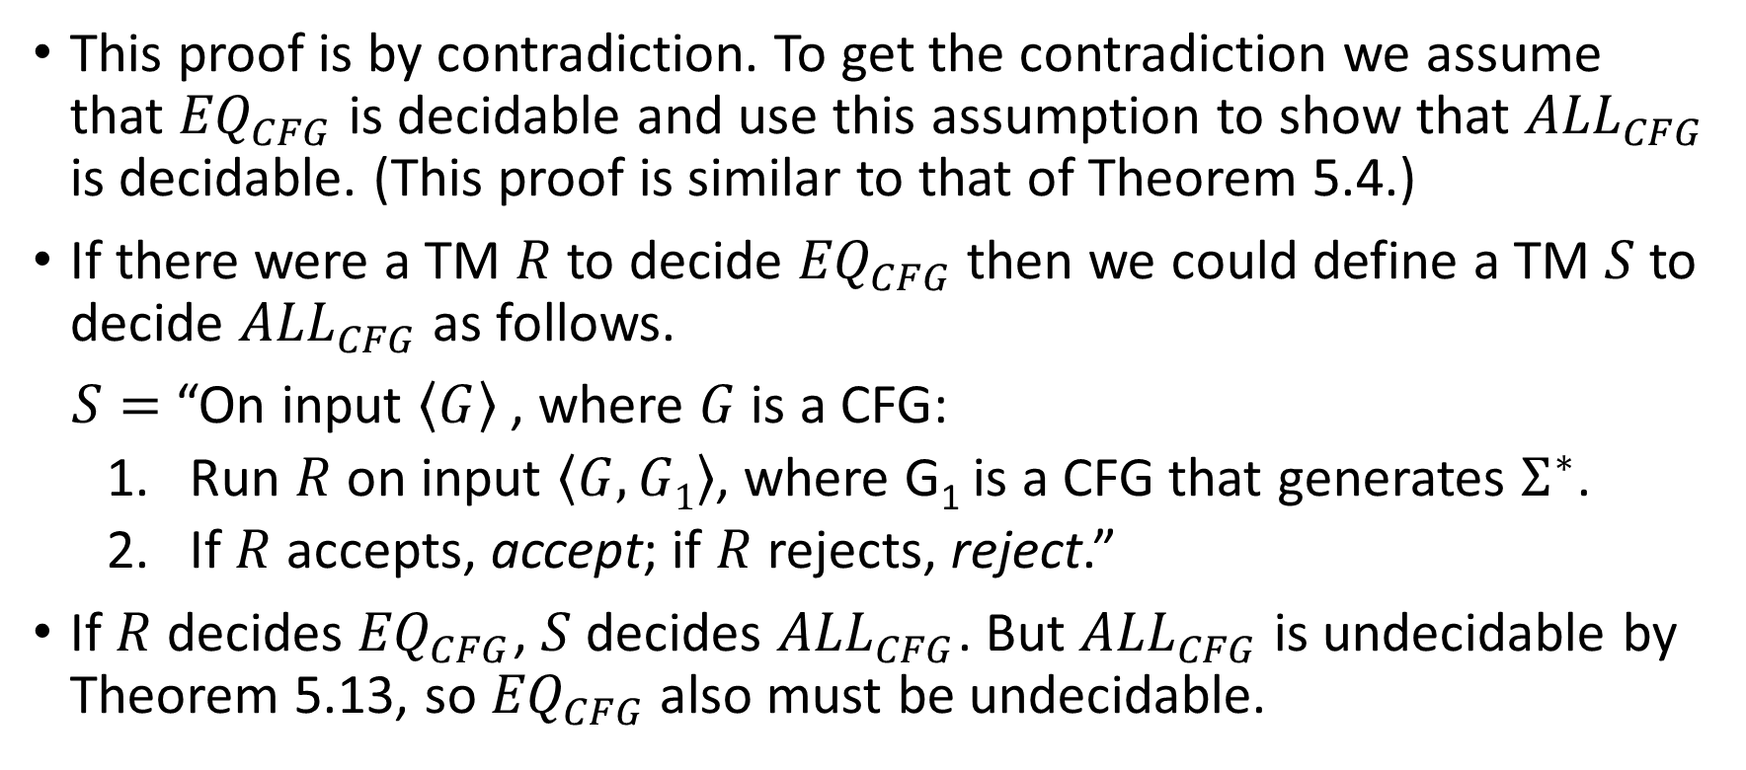
HW#9 – Q5
This proof is by contradiction. To get the contradiction we assume that ${EQ}_{CFG}$ is decidable and use this assumption to show that ${ALL}_{CFG}$ is decidable. (This proof is similar to that of Theorem 5.4.)
If there were a TM $R$ to decide ${EQ}_{CFG}$ then we could define a TM $S$ to decide ${ALL}_{CFG}$ as follows.
$S=$ “On input $\left\langle G\right\rangle$ , where $G$ is a CFG:
  Run $R$ on input $\left\langle G, G1\right\rangle$, where G₁ is a CFG that generates $Σ^{∗}$.
  If $R$ accepts, accept; if $R$ rejects, reject.”
If $R$ decides ${EQ}_{CFG}$, $S$ decides ${ALL}_{CFG}$. But ${ALL}_{CFG}$ is undecidable by Theorem 5.13, so ${EQ}_{CFG}$ also must be undecidable.

Slide 21
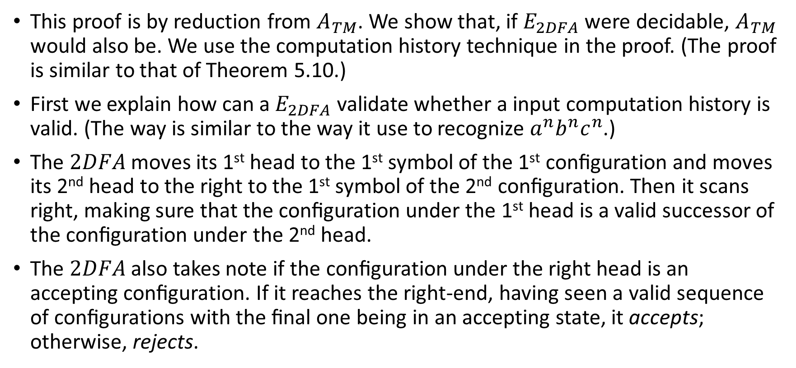
HW#10 – Q2 (1/2)
This proof is by reduction from $A_{TM}$. We show that, if $E_{2DFA}$ were decidable, $A_{TM}$ would also be. We use the computation history technique in the proof. (The proof is similar to that of Theorem 5.10.)
First we explain how can a $E_{2DFA}$ validate whether a input computation history is valid. (The way is similar to the way it use to recognize $a^{n}b^{n}c^{n}$.)
The $2DFA$ moves its 1st head to the 1st symbol of the 1st conﬁguration and moves its 2nd head to the right to the 1st symbol of the 2nd conﬁguration. Then it scans right, making sure that the conﬁguration under the 1st head is a valid successor of the conﬁguration under the 2nd head.
The $2DFA$ also takes note if the conﬁguration under the right head is an accepting conﬁguration. If it reaches the right-end, having seen a valid sequence of conﬁgurations with the ﬁnal one being in an accepting state, it accepts; otherwise, rejects.
Notes:
2DFA usually refers to “2-way deterministic finite automata”, so maybe it’s better to use 2HDFA here.

Slide 22
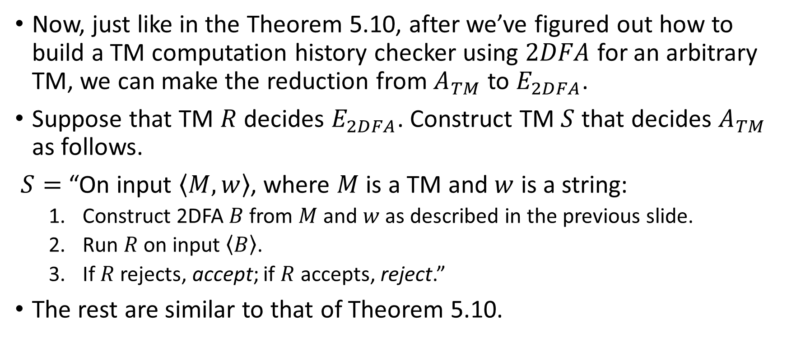
HW#10 – Q2 (2/2)
Now, just like in the Theorem 5.10, after we’ve figured out how to build a TM computation history checker using $2DFA$ for an arbitrary TM, we can make the reduction from $A_{TM}$ to $E_{2DFA}$.
Suppose that TM $R$ decides $E_{2DFA}$. Construct TM $S$ that decides $A_{TM}$ as follows.
$S=$ “On input $\left\langle M,w\right\rangle$, where $M$ is a TM and $w$ is a string:
  Construct 2DFA $B$ from $M$ and $w$ as described in the previous slide.
  Run $R$ on input $\left\langle B\right\rangle$.
  If $R$ rejects, accept; if $R$ accepts, reject.”
The rest are similar to that of Theorem 5.10.

Slide 23
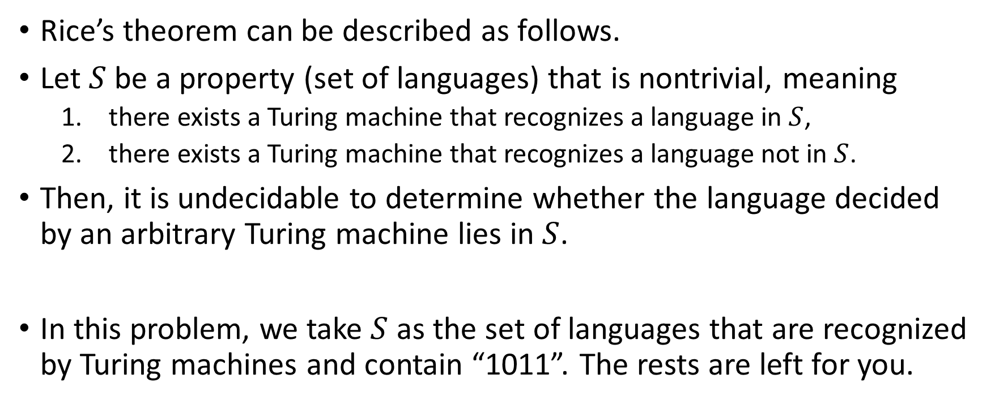
HW#10 – Q4
Rice’s theorem can be described as follows.
Let $S$ be a property (set of languages) that is nontrivial, meaning
  there exists a Turing machine that recognizes a language in $S$,
  there exists a Turing machine that recognizes a language not in $S$.
Then, it is undecidable to determine whether the language decided by an arbitrary Turing machine lies in $S$.
In this problem, we take $S$ as the set of languages that are recognized by Turing machines and contain “1011”. The rests are left for you.

Slide 24
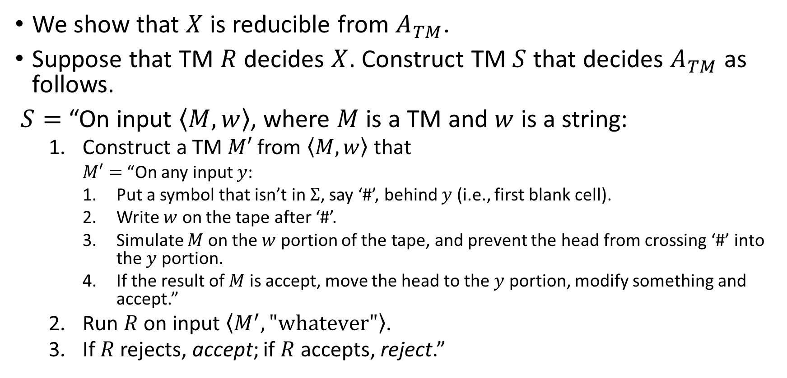
HW#10 – Q5
We show that $X$ is reducible from $A_{TM}$.
Suppose that TM $R$ decides $X$. Construct TM $S$ that decides $A_{TM}$ as follows.
$S=$ “On input $\left\langle M,w\right\rangle$, where $M$ is a TM and $w$ is a string:
  Construct a TM $M′$ from $\left\langle M,w\right\rangle$ that
    $M′=$ “On any input $y$:
    Put a symbol that isn’t in $Σ$, say ‘#’, behind $y$ (i.e., first blank cell).
    Write $w$ on the tape after ‘#’.
    Simulate $M$ on the $w$ portion of the tape, and prevent the head from crossing ‘#’ into the $y$ portion.
    If the result of $M$ is accept, move the head to the $y$ portion, modify something and accept.”
  Run $R$ on input $\left\langle M^{′},"whatever"\right\rangle$.
  If $R$ rejects, accept; if $R$ accepts, reject.”
Notes:
Where among all the operations in M’, you must not have any transition that will modify the input portion except for the one for M’ step 4.

Slide 25
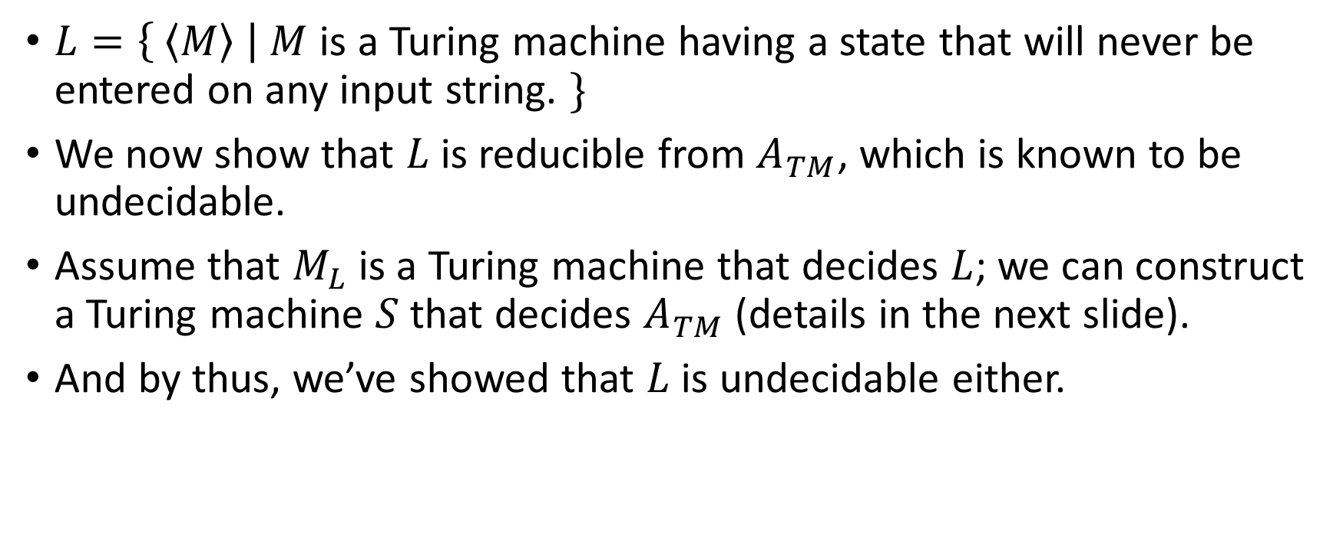
HW#10* – Q6 (1/2)
$L=\left\{ \left\langle M\right\rangle \right| M$ is a Turing machine having a state that will never be entered on any input string. $\}$
We now show that $L$ is reducible from $A_{TM}$, which is known to be undecidable.
Assume that $M_{L}$ is a Turing machine that decides $L$; we can construct a Turing machine $S$ that decides $A_{TM}$ (details in the next slide).
And by thus, we’ve showed that $L$ is undecidable either.

Slide 26
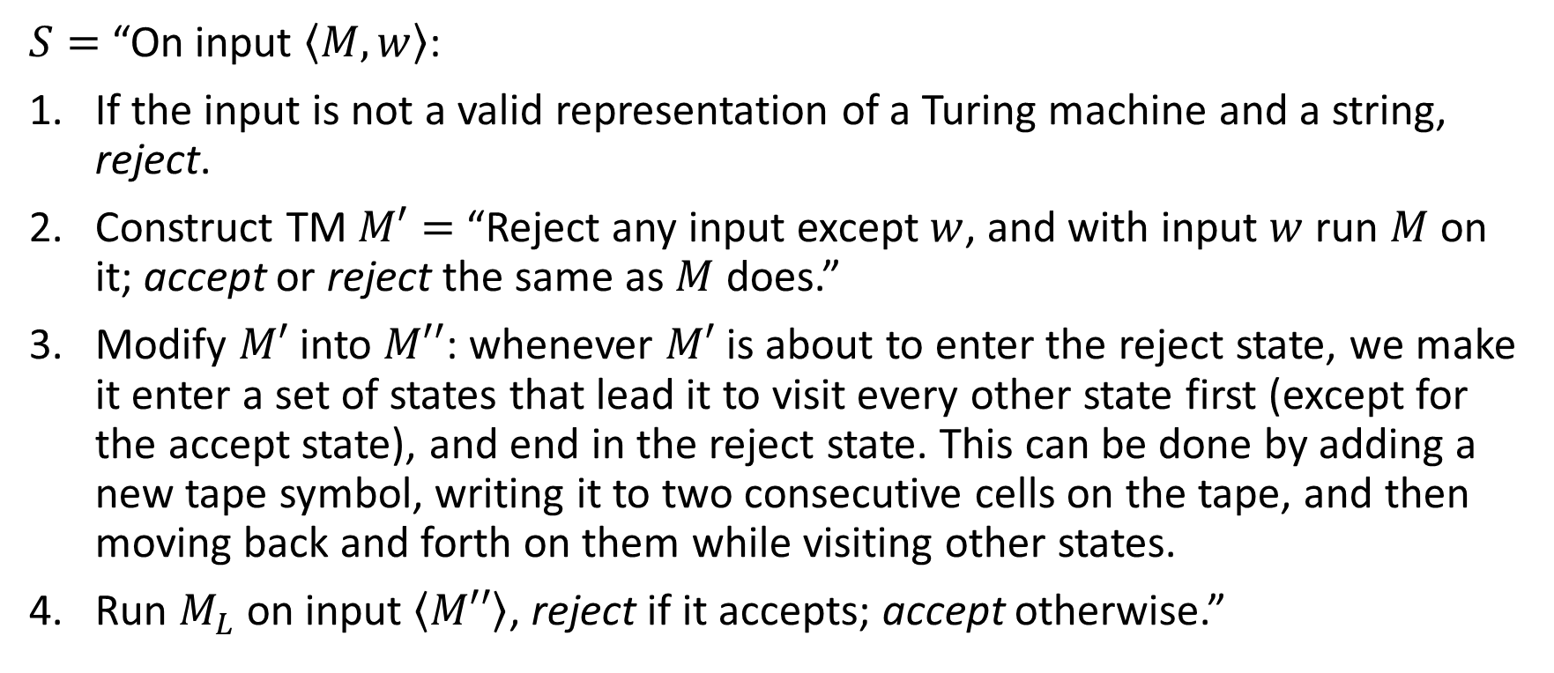
HW#10* – Q6 (2/2)
$S=$ “On input $\left\langle M, w\right\rangle$:
If the input is not a valid representation of a Turing machine and a string, reject.
Construct TM $M′=$ “Reject any input except $w$, and with input $w$ run $M$ on it; accept or reject the same as $M$ does.”
Modify $M′$ into $M′′$: whenever $M′$ is about to enter the reject state, we make it enter a set of states that lead it to visit every other state first (except for the accept state), and end in the reject state. This can be done by adding a new tape symbol, writing it to two consecutive cells on the tape, and then moving back and forth on them while visiting other states.
Run $M_{L}$ on input $\left\langle M′′\right\rangle$, reject if it accepts; accept otherwise.”

