Slide 1
Theory of Computing
TA times #2
Hsu, Hung-Wei
2016/04/06

Slide 2
CAUTION
Most solutions we showed in TA’s slides are more
like the ideas rather then completed solutions.
You may take them as guides, but shouldn’t
consider them as all the things you need
to get your homework done.

Slide 3
Stats.
Homework #3
  Average 73.5
  Std. Dev. 12.1
Homework #4
  Average 58.1
  Std. Dev. 19.9

Slide 4
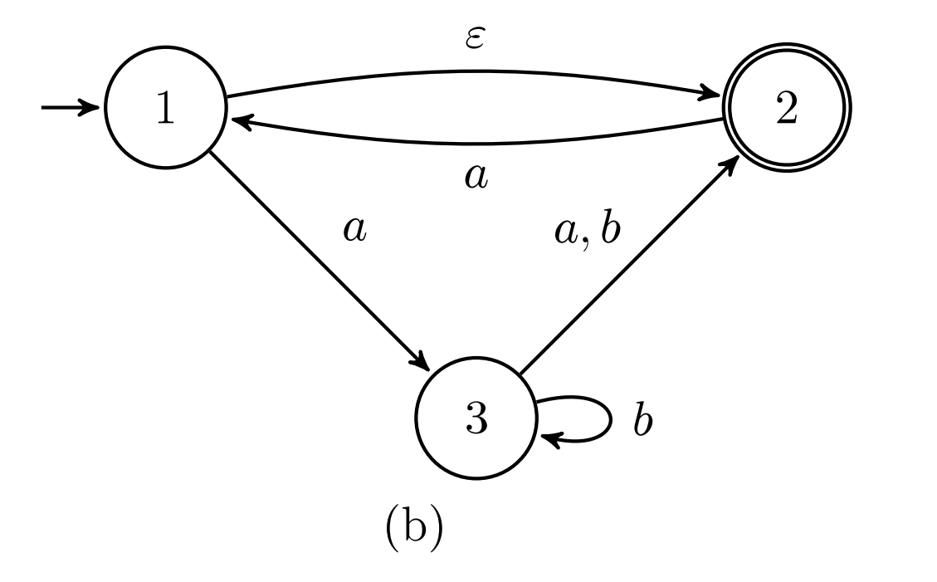
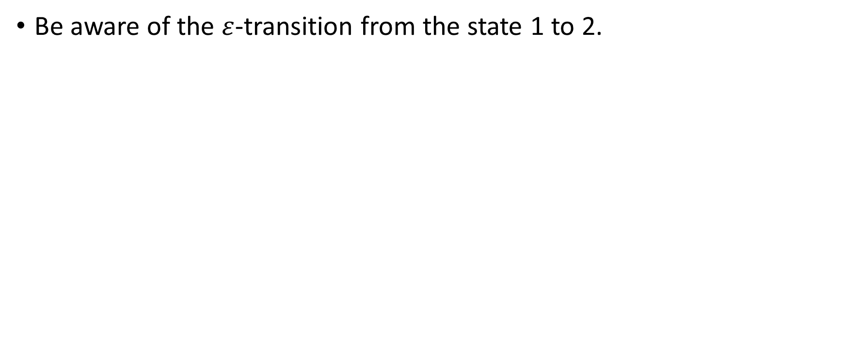
HW#3 – Q4.b
Be aware of the $ε$-transition from the state 1 to 2.

Slide 5
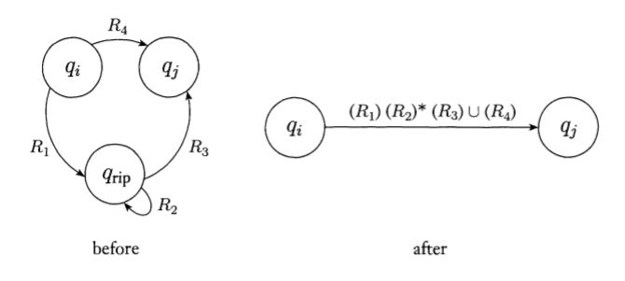
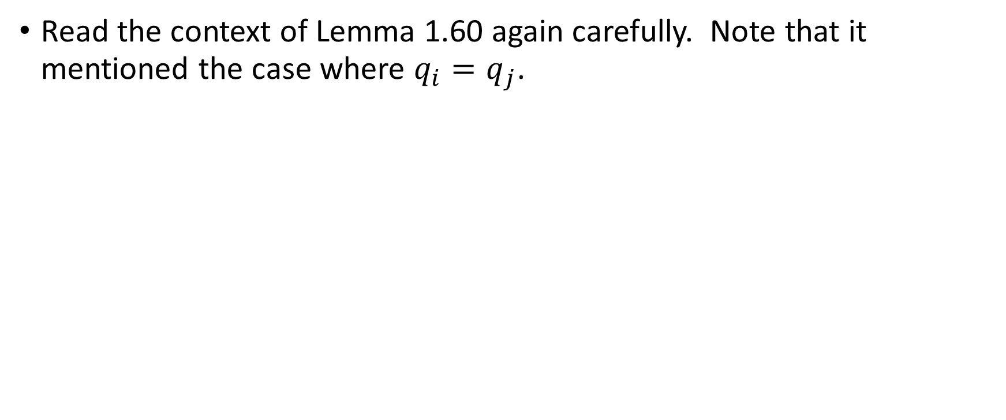
HW#3 – Q7.a
Read the context of Lemma 1.60 again carefully. Note that it mentioned the case where $q_{i}=q_{j}$.

Slide 6
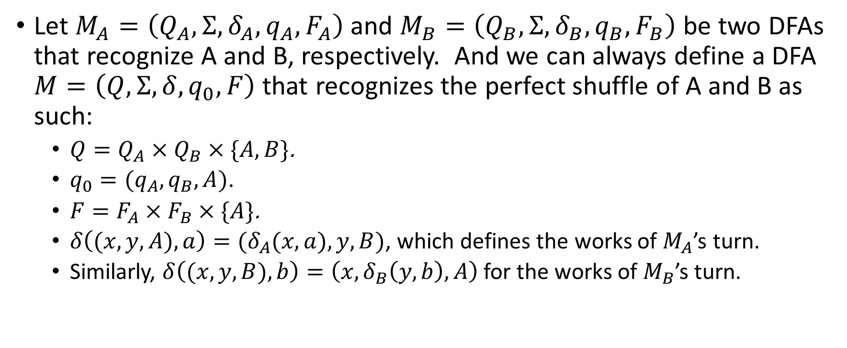
HW#4 – Q1
Let $M_{A}=\left(Q_{A},Σ, δ_{A},q_{A}, F_{A}\right)$ and $M_{B}=\left(Q_{B},Σ, δ_{B},q_{B}, F_{B}\right)$ be two DFAs that recognize A and B, respectively. And we can always define a DFA $M=\left(Q,Σ,δ,q_{0},F\right)$ that recognizes the perfect shuffle of A and B as such:
  $Q=Q_{A}×Q_{B}×\{A,B\}$.
  $q_{0}=(q_{A},q_{B},A)$.
  $F=F_{A}×F_{B}×\{A\}$.
  $δ\left((x,y,A), a\right)=(δ_{A}(x,a),y,B)$, which defines the works of $M_{A}$’s turn.
  Similarly, $δ\left((x,y,B), b\right)=\left(x,δ_{B}\left(y,b\right),A\right)$ for the works of $M_{B}$’s turn.

Slide 7
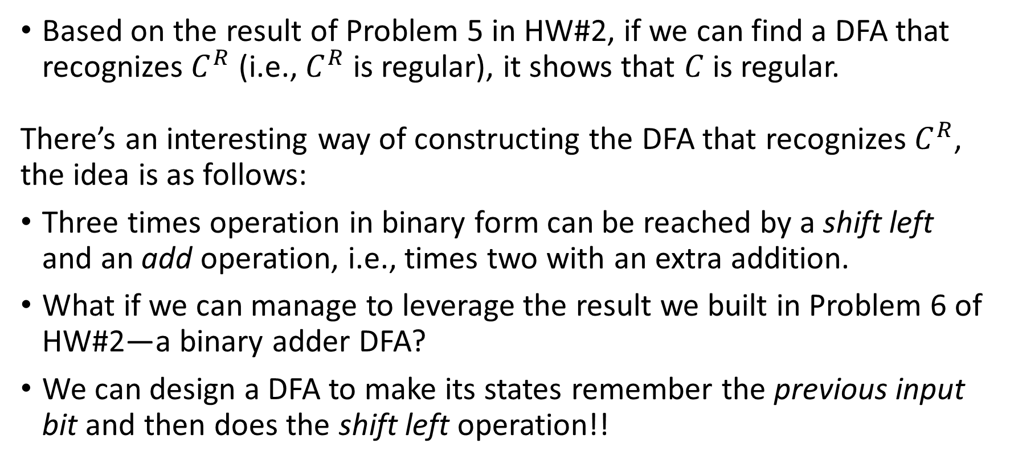
HW#4 – Q3 (1/2)
Based on the result of Problem 5 in HW#2, if we can find a DFA that recognizes $C^{R}$ (i.e., $C^{R}$ is regular), it shows that $C$ is regular.
There’s an interesting way of constructing the DFA that recognizes $C^{R}$, the idea is as follows:
Three times operation in binary form can be reached by a shift left and an add operation, i.e., times two with an extra addition.
What if we can manage to leverage the result we built in Problem 6 of HW#2—a binary adder DFA?
We can design a DFA to make its states remember the previous input bit and then does the shift left operation!!

Slide 8
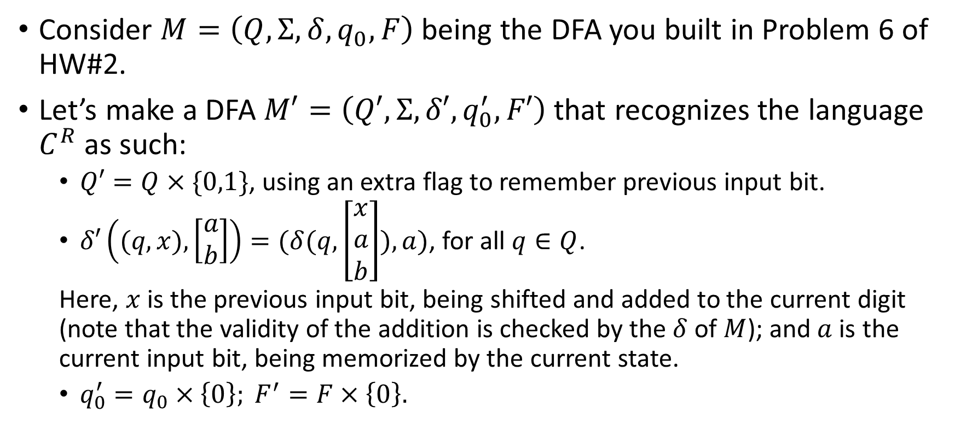
HW#4 – Q3 (2/2)
Consider $M=\left(Q,Σ,δ,q_{0},F\right)$ being the DFA you built in Problem 6 of HW#2.
Let’s make a DFA $M′=\left(Q′,Σ,δ′,q_{0}^{′},F′\right)$ that recognizes the language $C^{R}$ as such:
  $Q′=Q×\{0,1\}$, using an extra flag to remember previous input bit.
  $δ′\left((q,x), \left[\begin{matrix}a \\ b\end{matrix}\right]\right)=(δ(q,\left[\begin{matrix}x \\ a \\ b\end{matrix}\right]),a)$, for all $q∈Q$.
  Here, $x$ is the previous input bit, being shifted and added to the current digit (note that the validity of the addition is checked by the $δ$ of $M$); and $a$ is the current input bit, being memorized by the current state.
  $q_{0}^{′}=q_{0}×\left\{0\right\}; F^{′}=F×\left\{0\right\}.$

Slide 9
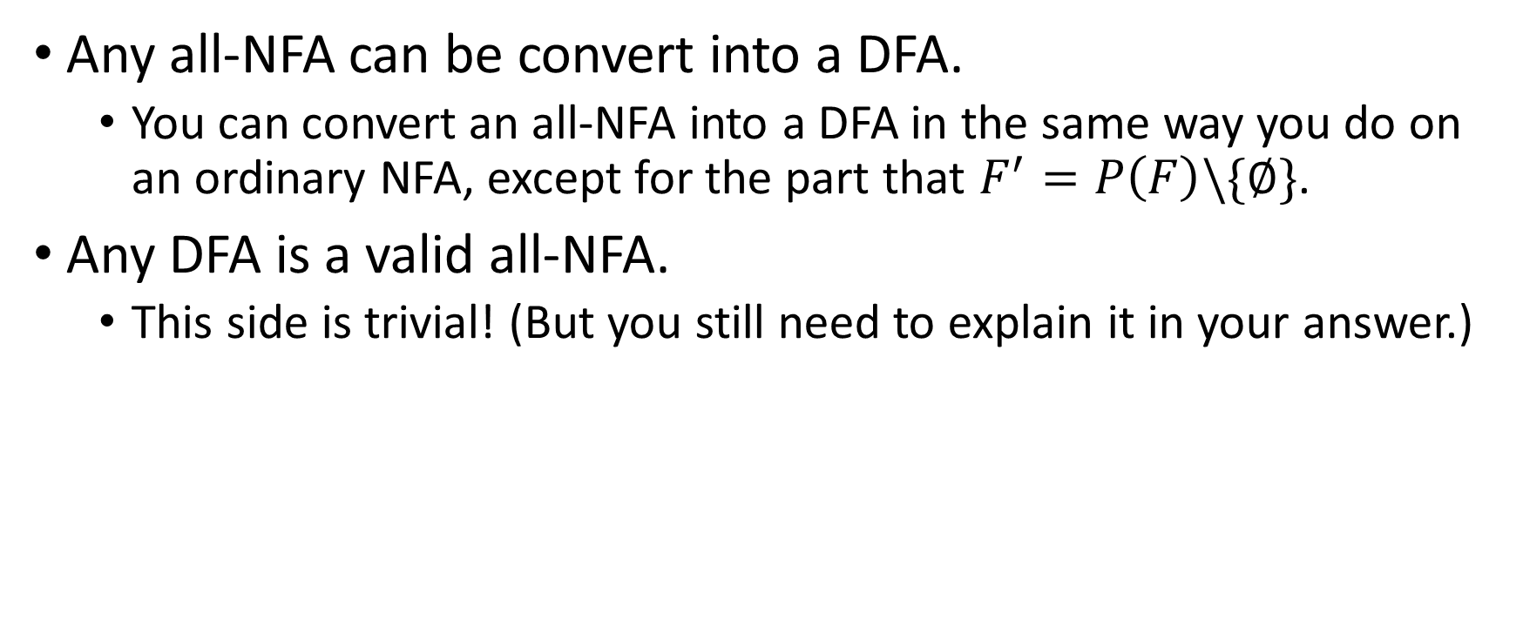
HW#4 – Q5
Any all-NFA can be convert into a DFA.
  You can convert an all-NFA into a DFA in the same way you do on an ordinary NFA, except for the part that $F^{′}=P\left(F\right)\backslash \{∅\}$.
Any DFA is a valid all-NFA.
  This side is trivial! (But you still need to explain it in your answer.)

Slide 10
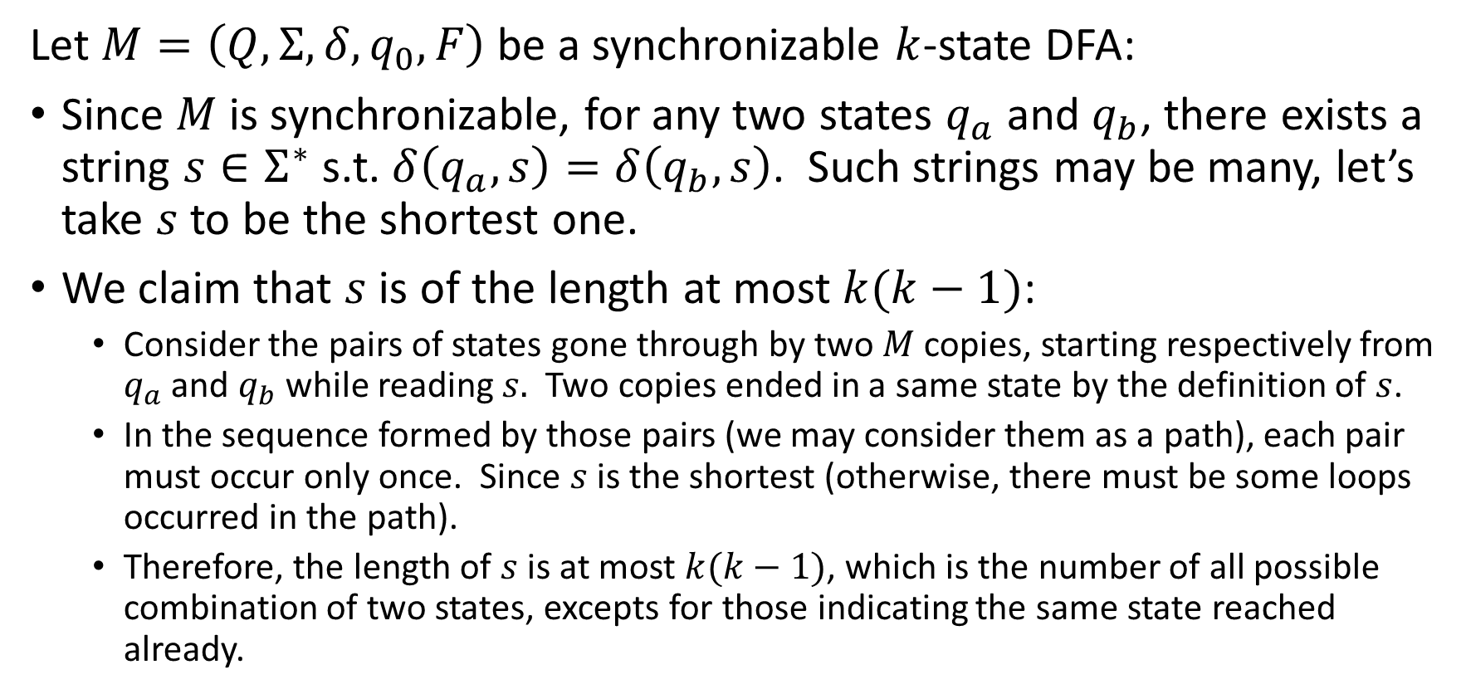
HW#4 – Q7 (1/3)
Let $M=\left(Q, Σ, δ, q_{0}, F\right)$ be a synchronizable $k$-state DFA:
Since $M$is synchronizable, for any two states $q_{a}$ and $q_{b}$, there exists a string $s∈Σ^{∗}$ s.t. $δ\left(q_{a}, s\right)=δ\left(q_{b}, s\right)$. Such strings may be many, let’s take $s$ to be the shortest one.
We claim that $s$is of the length at most $k(k−1)$:
  Consider the pairs of states gone through by two $M$ copies, starting respectively from $q_{a}$ and $q_{b}$ while reading $s.$ Two copies ended in a same state by the definition of $s$.
  In the sequence formed by those pairs (we may consider them as a path), each pair must occur only once. Since $s$ is the shortest (otherwise, there must be some loops occurred in the path).
  Therefore, the length of $s$ is at most $k(k−1)$, which is the number of all possible combination of two states, excepts for those indicating the same state reached already.

Slide 11
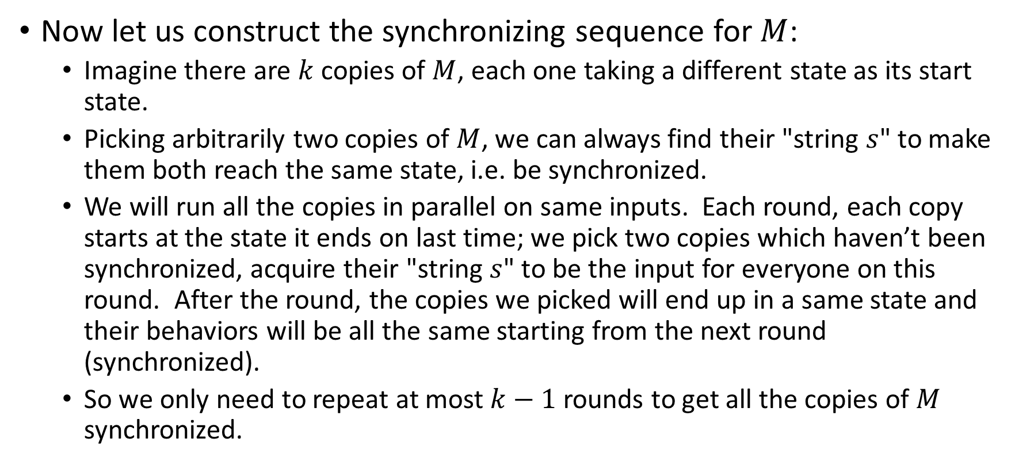
HW#4 – Q7 (2/3)
Now let us construct the synchronizing sequence for $M$:
  Imagine there are $k$ copies of $M$, each one taking a different state as its start state.
  Picking arbitrarily two copies of $M$, we can always find their "string $s$" to make them both reach the same state, i.e. be synchronized.
  We will run all the copies in parallel on same inputs. Each round, each copy starts at the state it ends on last time; we pick two copies which haven’t been synchronized, acquire their "string $s$" to be the input for everyone on this round. After the round, the copies we picked will end up in a same state and their behaviors will be all the same starting from the next round (synchronized).
  So we only need to repeat at most $k−1$ rounds to get all the copies of $M$ synchronized.

Slide 12
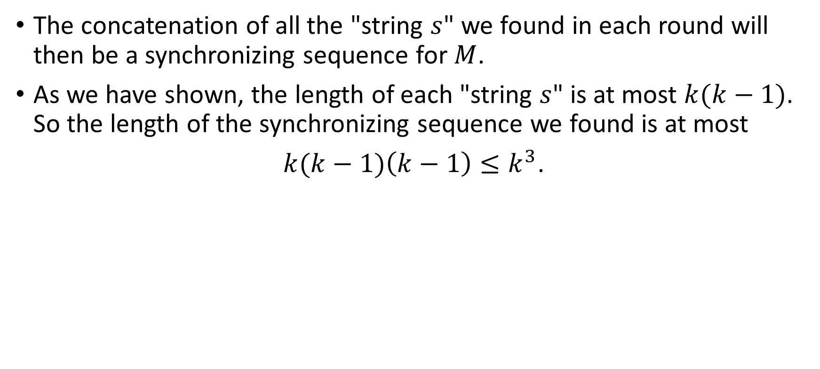
HW#4 – Q7 (3/3)
The concatenation of all the "string $s$" we found in each round will then be a synchronizing sequence for $M$.
As we have shown, the length of each "string $s$" is at most $k(k−1)$. So the length of the synchronizing sequence we found is at most
$k(k−1)\left(k−1\right)≤k^{3}$.

Slide 13
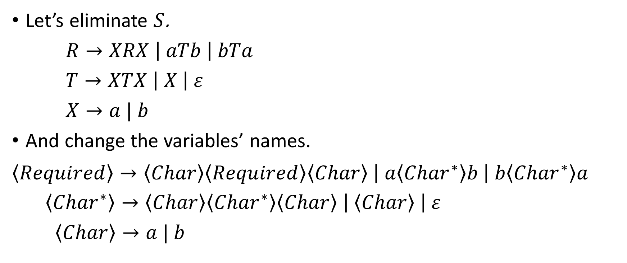
HW#5 – Q2 (1/2)
Let’s eliminate $S$.
$R→XRX \left| aTb \right| bTa$
$T→XTX \left| X \right| ε$
$X→a | b$
And change the variables’ names.
$$\left\langle Required\right\rangle →\left\langle Char\right\rangle \left\langle Required\right\rangle \left\langle Char\right\rangle \left| a\left\langle {Char}^{∗}\right\rangle b \right| b\left\langle {Char}^{∗}\right\rangle a$$
$\left\langle {Char}^{∗}\right\rangle →\left\langle Char\right\rangle \left\langle {Char}^{∗}\right\rangle \left\langle Char\right\rangle \left| \left\langle Char\right\rangle \right| ε$
$\left\langle Char\right\rangle →a | b$

Slide 14
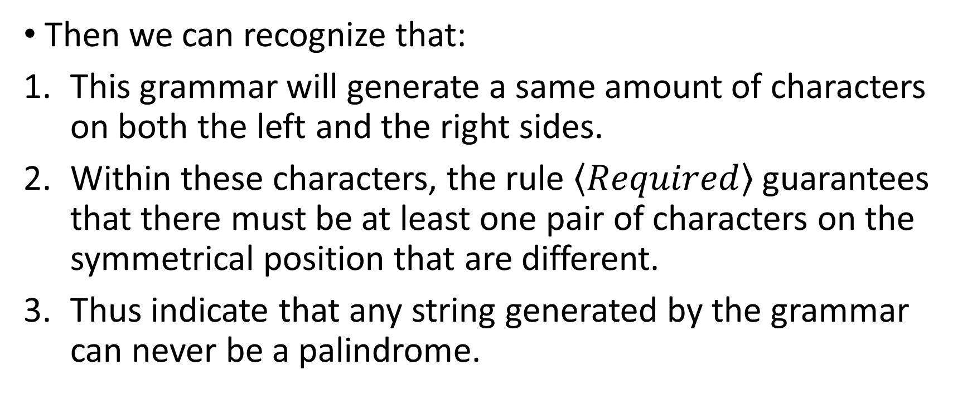
HW#5 – Q2 (2/2)
Then we can recognize that:
This grammar will generate a same amount of characters on both the left and the right sides.
Within these characters, the rule $\left\langle Required\right\rangle$ guarantees that there must be at least one pair of characters on the symmetrical position that are different.
Thus indicate that any string generated by the grammar can never be a palindrome.

Slide 15
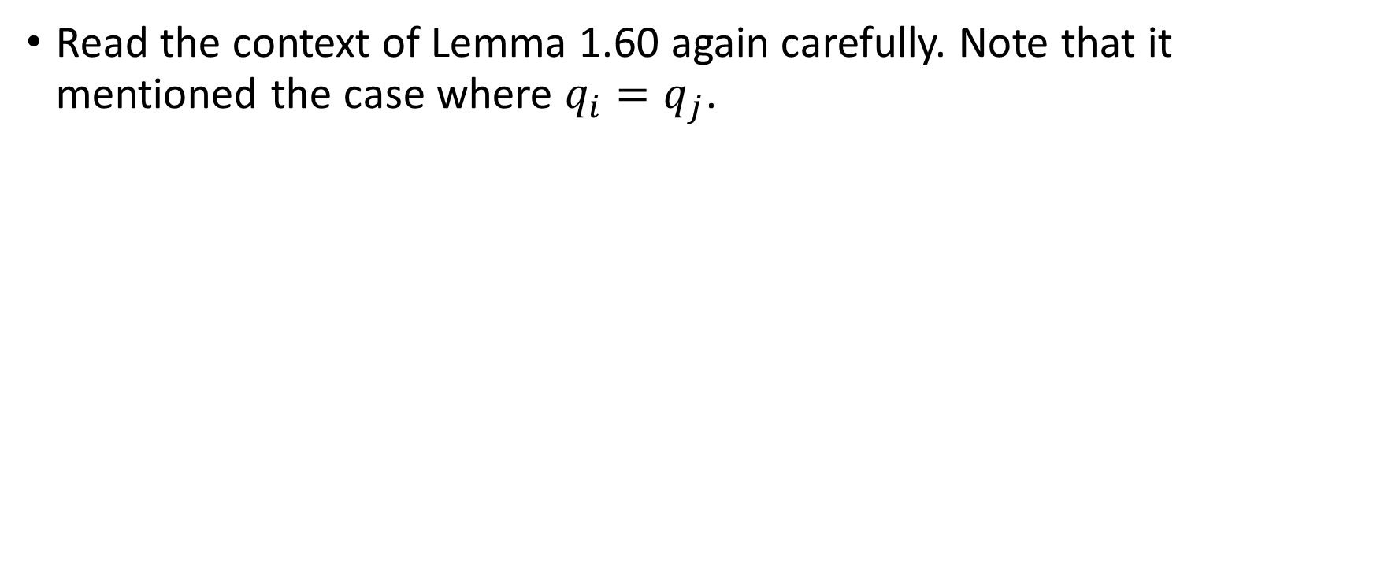
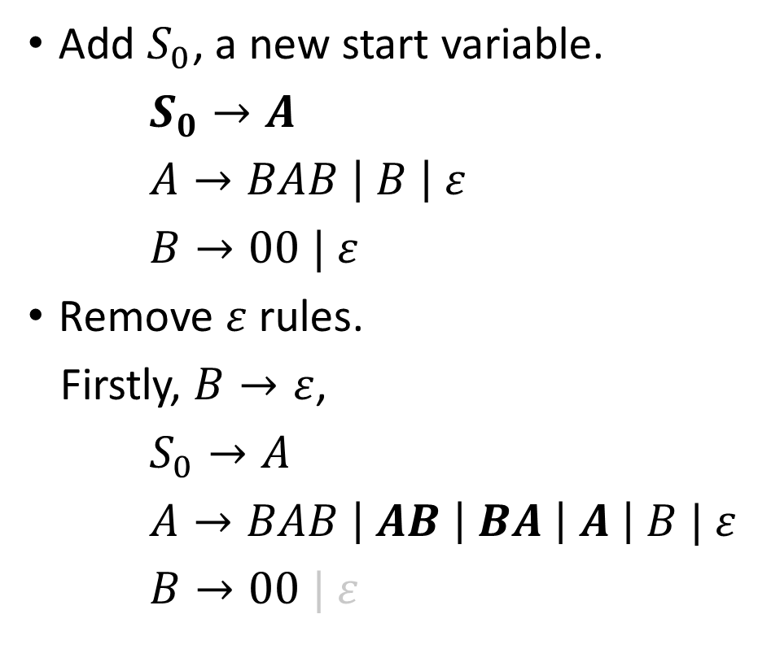
HW#5 – Q6 (1/3)
Add $S_{0}$, a new start variable.
$S_{0}→A$
$A→BAB \left| B \right| ε$
$B→00 | ε$
Remove $ε$ rules.
Firstly, $B→ε$,
$S_{0}→A$
$A→BAB \left| AB \right| BA \left| A \right| B | ε$
$B→00 | ε$
Then, $A→ε$,
$S_{0}→A | ε$
$A→BAB \left| AB \right| BA | BB \left| A \right| B | ε$
$B→00$

Slide 16
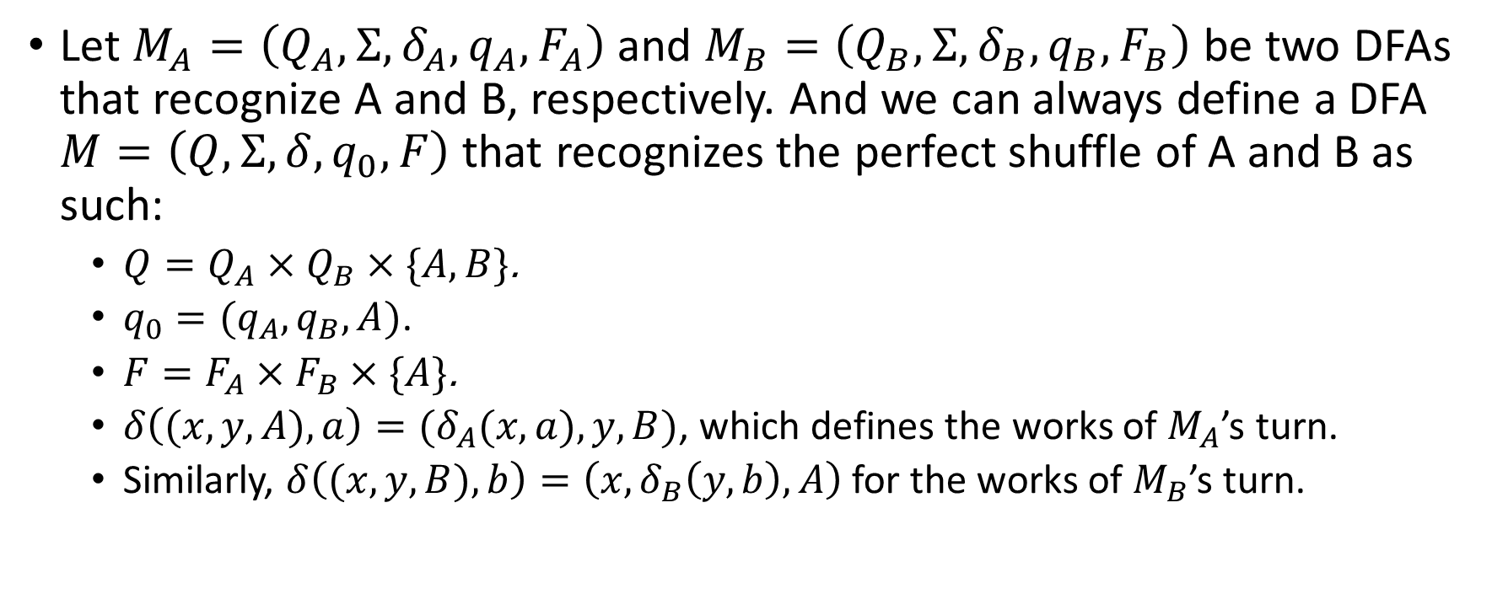
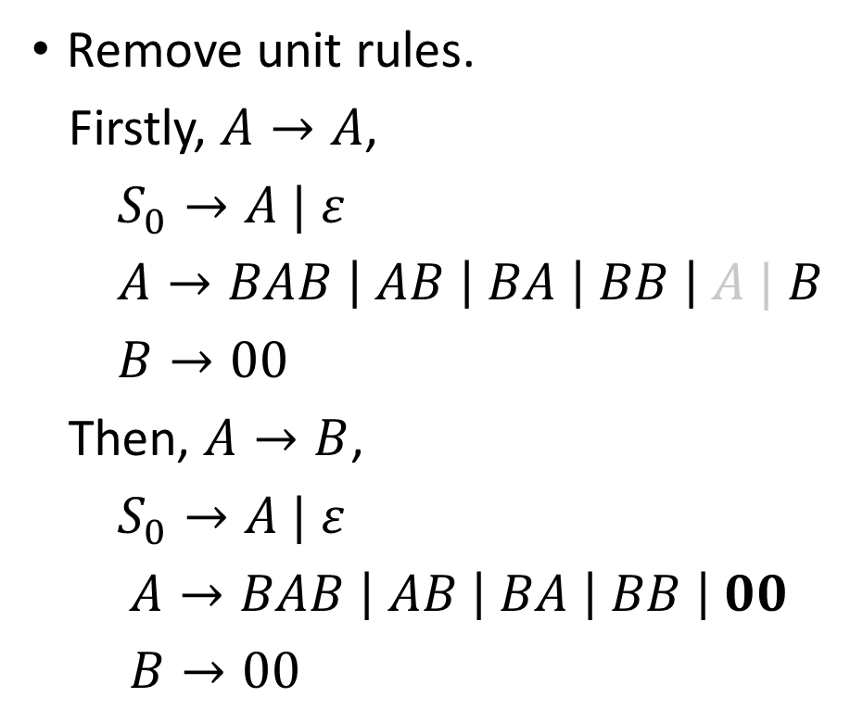
HW#5 – Q6 (2/3)
Remove unit rules.
Firstly, $A→A$,
$S_{0}→A | ε$
$A→BAB \left| AB \right| BA \left| BB \right| A | B$
$B→00$
Then, $A→B$,
$S_{0}→A | ε$
$A→BAB \left| AB \right| BA \left| BB \right| 00$
$B→00$
Then, $S_{0}→A$,
$S_{0}→BAB \left| AB \right| BA \left| BB \right| 00 | ε$
$A→BAB \left| AB \right| BA \left| BB \right| 00$
$B→00$

Slide 17
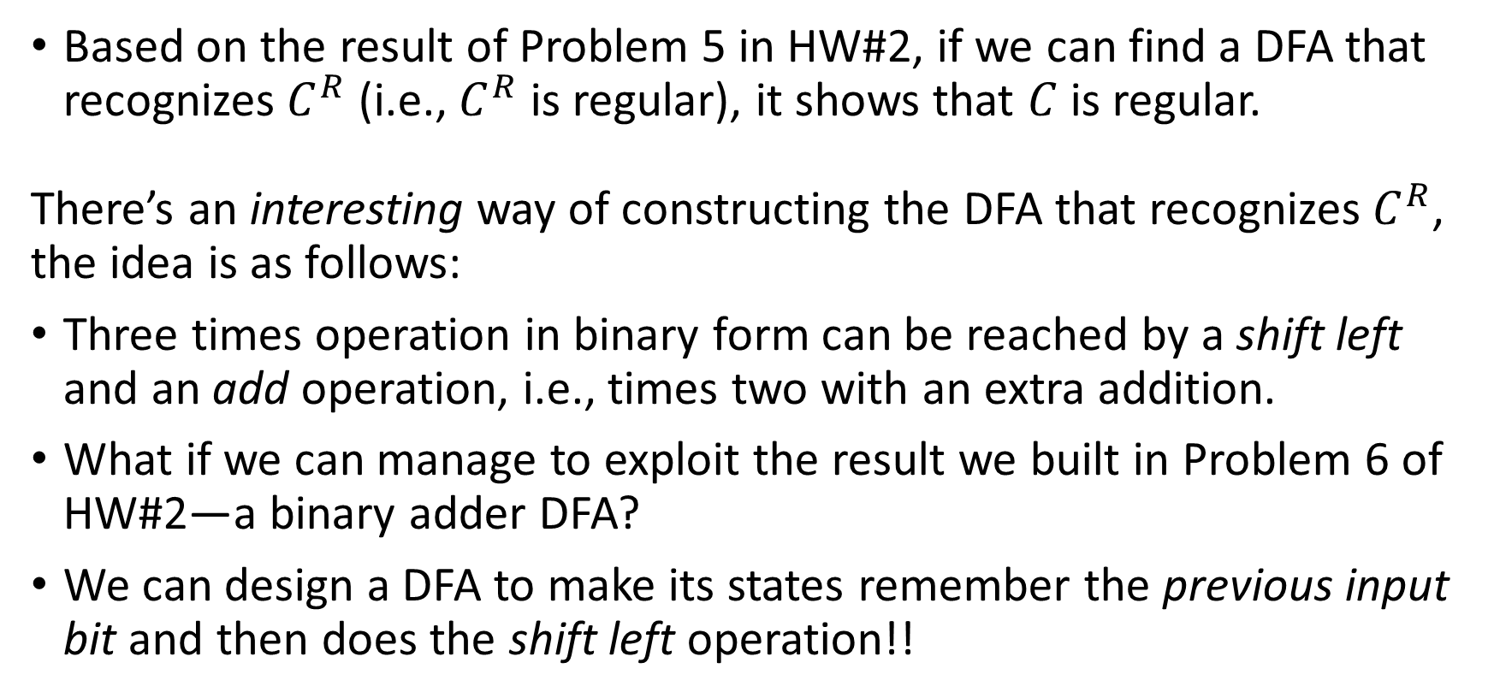
HW#5 – Q6 (3/3)
Variables replacement.
$S_{0}→BA_{1} \left| AB \right| BA \left| BB \right| U_{1}U_{1} | ε$
$A →BA_{1} \left| AB \right| BA \left| BB \right| U_{1}U_{1}$
$B →U_{1}U_{1}$
$A_{1}→AB$
$U_{1}→0$

