Slide 1
Theory of Computing
TA times #4
Hsu, Hung-Wei
2016/06/08

Slide 2
CAUTION
Most solutions we showed in TA’s slides are more
like the ideas rather then completed solutions.
You may take them as guides, but shouldn’t
consider them as all the things you need
to get your homework done.

Slide 3
Stats.
Homework #7*
  Average 53.6
  Std. Dev. 17.4
Homework #8*
  Average 48.9
  Std. Dev. 14.7
Homework #9
  Average 71.3
  Std. Dev. 11.3

Slide 4
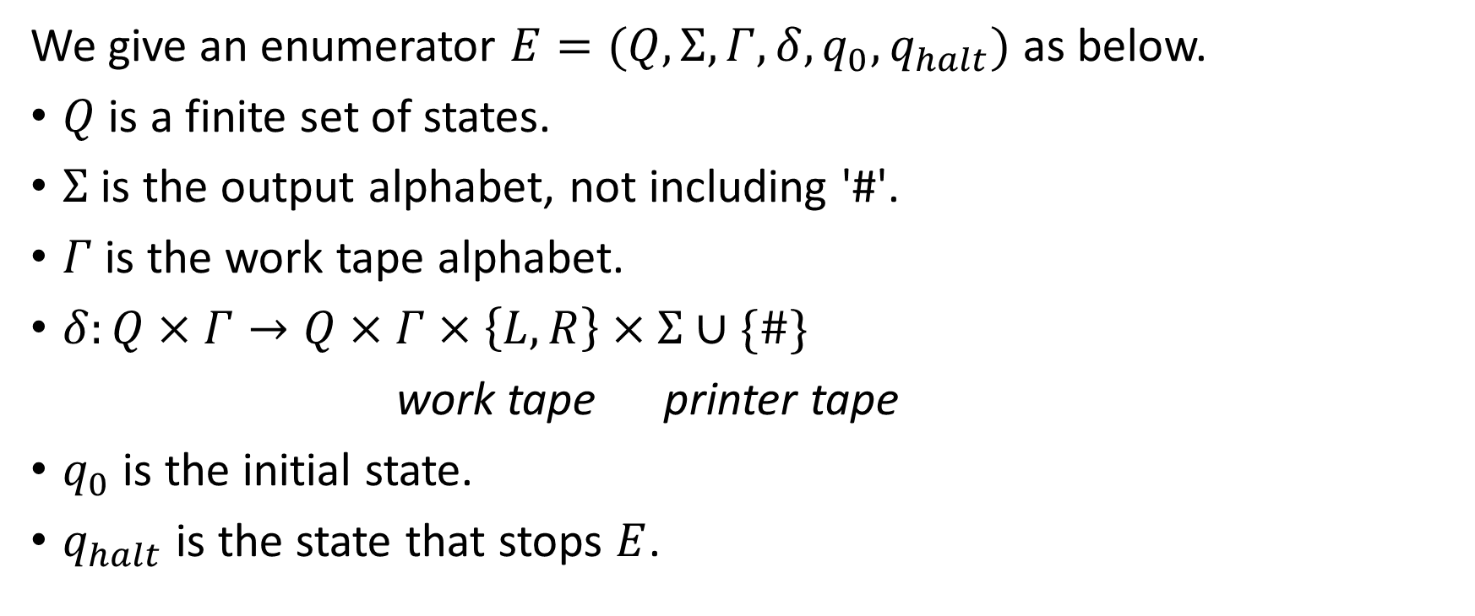
HW#8 – Q2 (1/4)
We give an enumerator $E=(Q,Σ,Γ,δ,q_{0},q_{halt})$ as below.
$Q$ is a finite set of states.
$Σ$ is the output alphabet, not including '#'.
$Γ$ is the work tape alphabet.
$δ:Q×Γ→Q×Γ×\left\{L,R\right\}×Σ∪\{\#\}$
work tape printer tape
$q_{0}$ is the initial state.
$q_{halt}$ is the state that stops $E$.

Slide 5
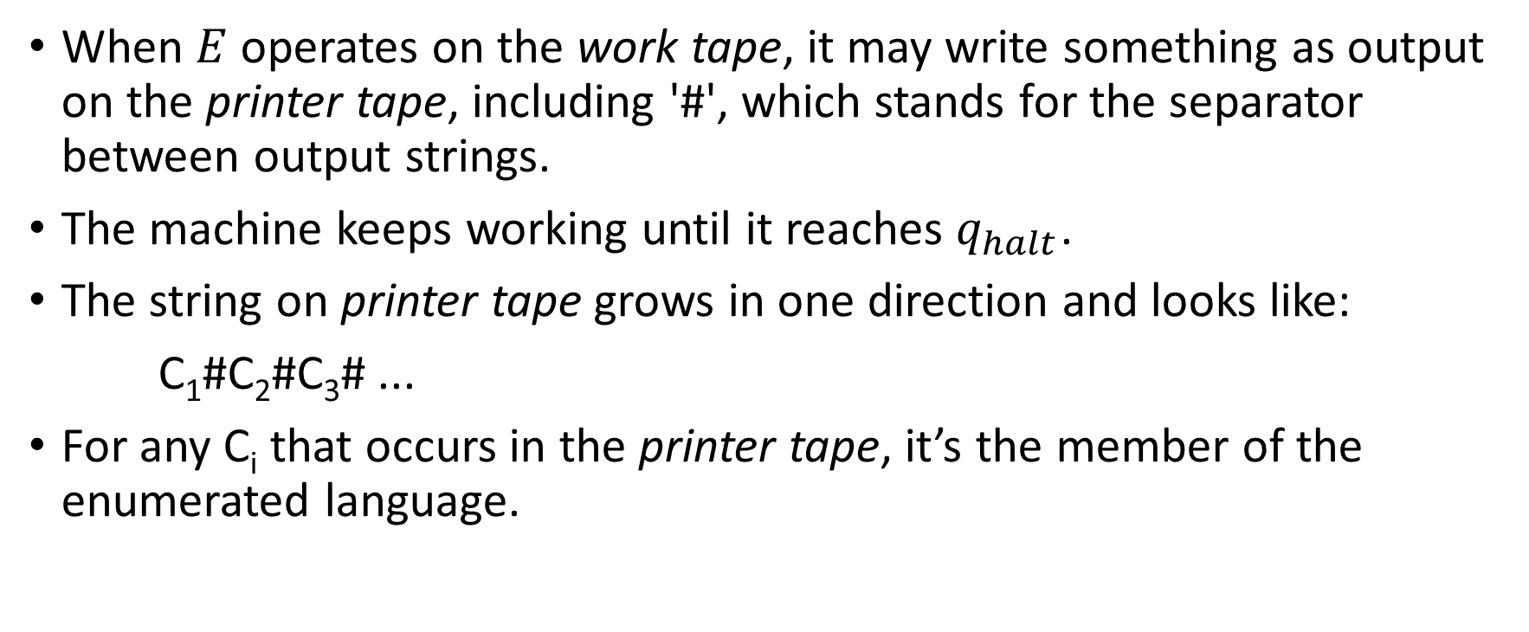
HW#8 – Q2 (2/4)
When $E$operates on the work tape, it may write something as output on the printer tape, including '#', which stands for the separator between output strings.
The machine keeps working until it reaches $q_{halt}$.
The string on printer tape grows in one direction and looks like:
C₁#C₂#C₃# ...
For any C_{i} that occurs in the printer tape, it’s the member of the enumerated language.

Slide 6
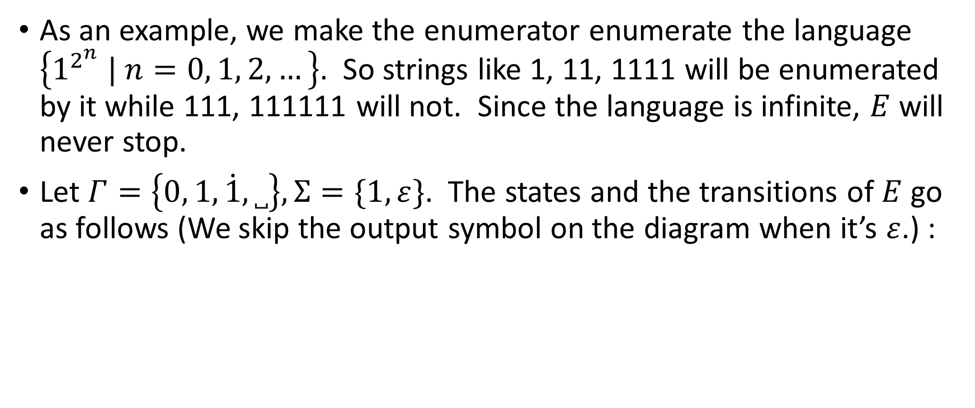
HW#8 – Q2 (3/4)
As an example, we make the enumerator enumerate the language $\left\{1^{2^{n}} | n=0, 1, 2, …\right\}$. So strings like 1, 11, 1111 will be enumerated by it while 111, 111111 will not. Since the language is infinite, $E$ will never stop.
Let $Γ=\left\{0, 1,\dot{1},˽\right\},Σ=\{1,ε\}$. The states and the transitions of $E$ go as follows (We skip the output symbol on the diagram when it’s $ε$.) :

Slide 7


























HW#8 – Q2 (4/4)
$$1,\dot{1}→1,L, 1$$
$$\dot{1}→R$$
$$1,0→R$$
$$0,1→L$$
$$q_{0}$$
$$˽→R$$
$$q_{1}$$
$$˽→1,R$$
$$q_{2}$$
$$˽→0,L$$
$$q_{3}$$
$$˽→R, \#$$
$$q_{4}$$
$$1→\dot{1},R$$
$$q_{5}$$
$$˽→1,L$$
$$q_{6}$$
$$\dot{1}→R$$
$$1→L,1$$
$$0→1,R$$
$$q_{9}$$
$$1→0,L$$
$$q_{8}$$
$$˽→L$$
$$q_{7}$$
$$1→R$$

Slide 8
HW#8* – Q4 (1/6)
Since outside the input portion such TM can do whatever a normal TM does, the restriction on its power will then lie in the read-only part (on input portion).
We will show that given one this kind of input read-only machines, its distinguishability on input strings has an upper bound.
  Since the possible input strings are infinite, if your distinguishability is bounded, you will treat some strings the same. And if we let those strings being treated the same form a group, “bounded” tells us that we will only have finite groups.

Slide 9
HW#8* – Q4 (2/6)
In Myhill-Nerode theorem, these groups are called equivalence classes.
And according to Myhill-Nerode theorem, if you are talking about a language with finite equivalence classes, you are talking about a regular language. (You can find more details of Myhill-Nerode theorem in the chapter 1’s PROBLEMS section in the textbook.)
So by showing the upper bound of the machine's distinguishability on strings, showing it can only separate strings into finite groups, we have showed that such kind of machines can only define/recognize regular languages.

Slide 10
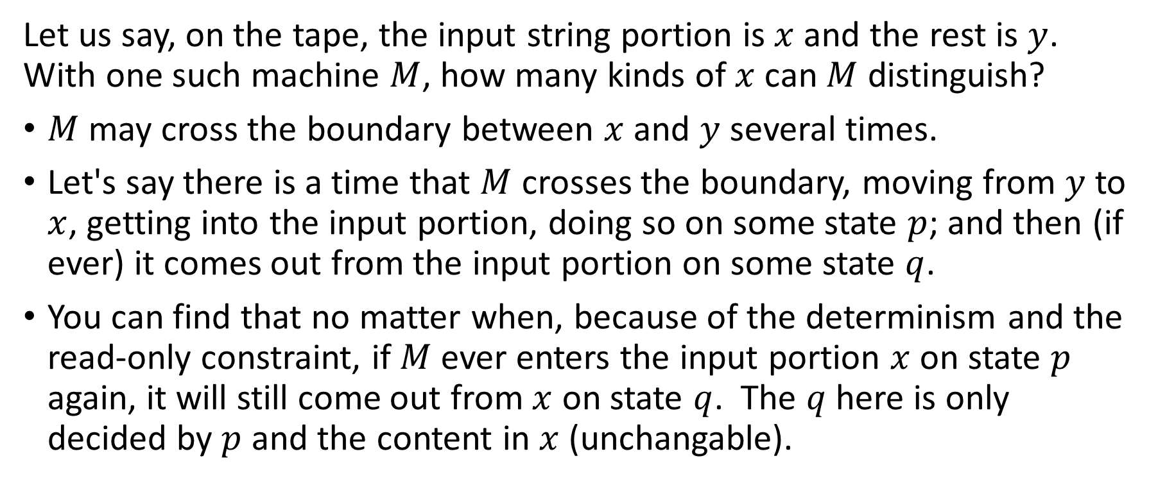


HW#8* – Q4 (3/6)
Input string
…
$$x$$
$$y$$
Let us say, on the tape, the input string portion is $x$ and the rest is $y$. With one such machine $M$, how many kinds of $x$ can $M$ distinguish?
$M$ may cross the boundary between $x$ and $y$ several times.
Let's say there is a time that $M$ crosses the boundary, moving from $y$ to $x$, getting into the input portion, doing so on some state $p$; and then (if ever) it comes out from the input portion on some state $q$.
You can find that no matter when, because of the determinism and the read-only constraint, if $M$ ever enters the input portion $x$ on state $p$ again, it will still come out from $x$ on state $q$. The $q$ here is only decided by $p$ and the content in $x$ (unchangable).

Slide 11



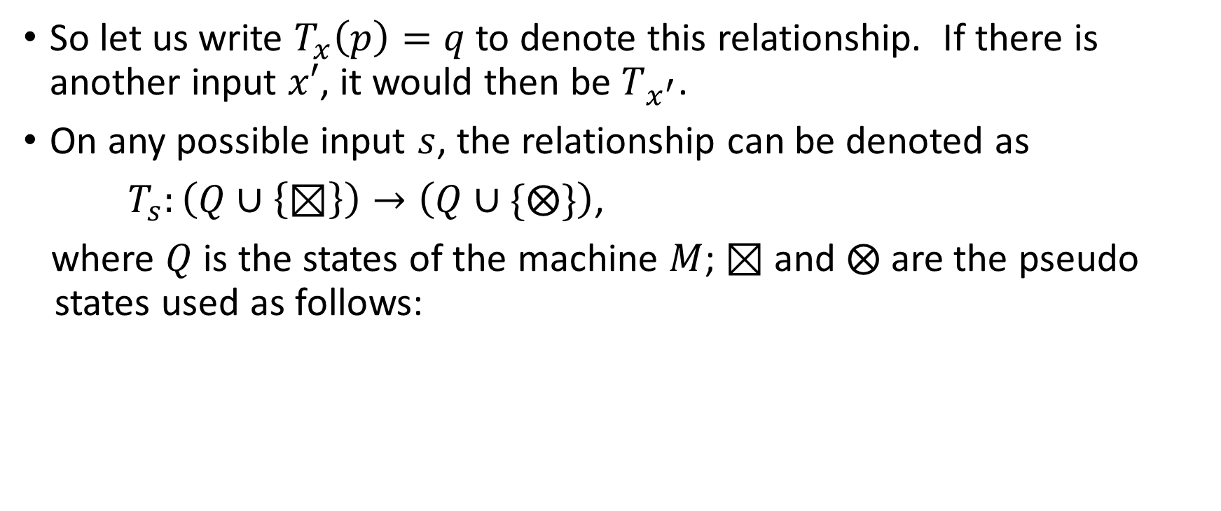



HW#8* – Q4 (4/6)
$$p$$
$$q$$
Input string
…
Input string
…
So let us write $T_{x}\left(p\right)=q$ to denote this relationship. If there is another input $x′$, it would then be $T_{x^{′}}$.
On any possible input $s$, the relationship can be denoted as
$T_{s}:\left(Q∪\left\{⊠\right\}\right)→\left(Q∪\{⨂\}\right)$,
where $Q$ is the states of the machine $M$; $⊠$ and $⨂$ are the pseudo states used as follows:
$$⊠$$
$$q$$
$$p$$
$$⨂$$
Input string
…
Input string
…
Input string
…
Input string
…

Slide 12
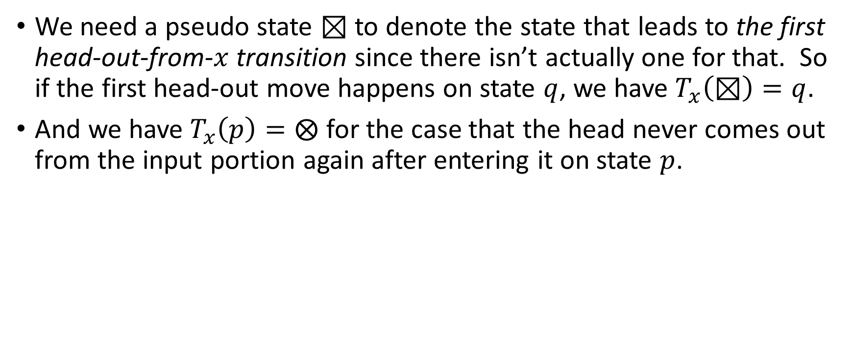
HW#8* – Q4 (5/6)
We need a pseudo state $⊠$ to denote the state that leads to the first head-out-from-$x$ transition since there isn’t actually one for that. So if the first head-out move happens on state $q$, we have $T_{x}\left(⊠\right)=q$.
And we have $T_{x}\left(p\right)=⨂$ for the case that the head never comes out from the input portion again after entering it on state $p$.
$$⊠$$
$$q$$
$$p$$
$$⨂$$
Input string
…
Input string
…
Input string
…
Input string
…

Slide 13
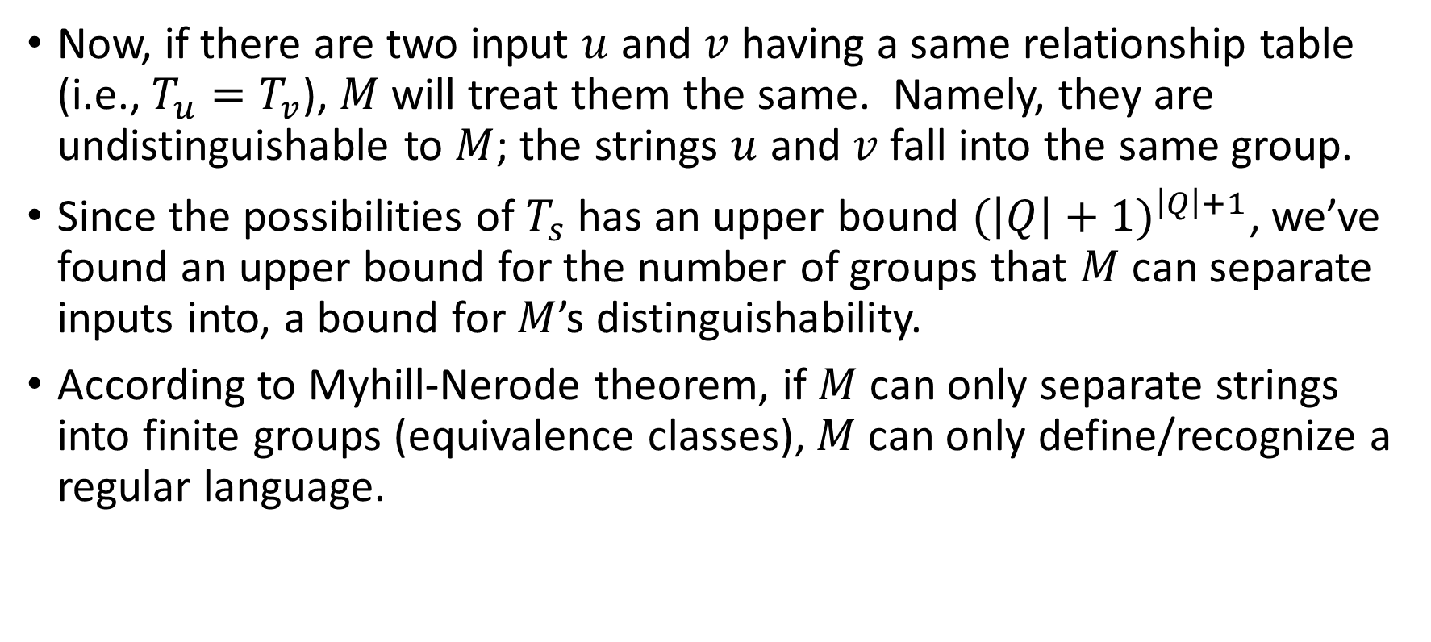
HW#8* – Q4 (6/6)
Now, if there are two input $u$ and $v$ having a same relationship table (i.e., $T_{u}=T_{v}$), $M$will treat them the same. Namely, they are undistinguishable to $M$; the strings $u$ and $v$ fall into the same group.
Since the possibilities of $T_{s}$ has an upper bound ${(\left|Q\right|+1)}^{\left|Q\right|+1}$, we’ve found an upper bound for the number of groups that $M$ can separate inputs into, a bound for $M$’s distinguishability.
According to Myhill-Nerode theorem, if $M$ can only separate strings into finite groups (equivalence classes), $M$ can only define/recognize a regular language.

Slide 14
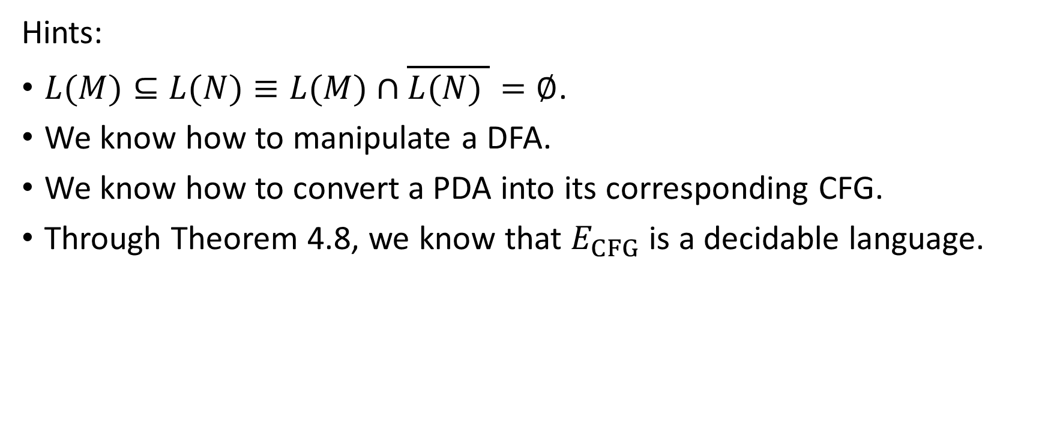
HW8 – Q6
Hints:
$L(M)⊆L(N)≡L(M)∩\overline{L(N) }=∅$.
We know how to manipulate a DFA.
We know how to convert a PDA into its corresponding CFG.
Through Theorem 4.8, we know that $E_{CFG}$ is a decidable language.

Slide 15
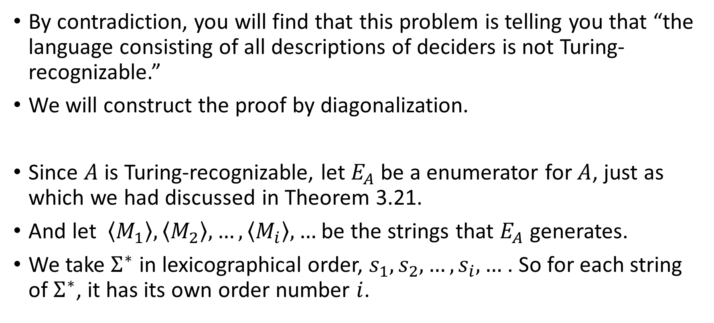
HW#9 – Q1 (1/2)
By contradiction, you will find that this problem is telling you that “the language consisting of all descriptions of deciders is not Turing-recognizable.”
We will construct the proof by diagonalization.
Since $A$ is Turing-recognizable, let $E_{A}$ be a enumerator for $A$, just as which we had discussed in Theorem 3.21.
And let $\left\langle M_{1}\right\rangle ,\left\langle M_{2}\right\rangle ,…,\left\langle M_{i}\right\rangle ,…$ be the strings that $E_{A}$ generates.
We take $Σ^{∗}$ in lexicographical order, $s_{1},s_{2},…,s_{i},…$ . So for each string of $Σ^{∗}$, it has its own order number $i$.

Slide 16
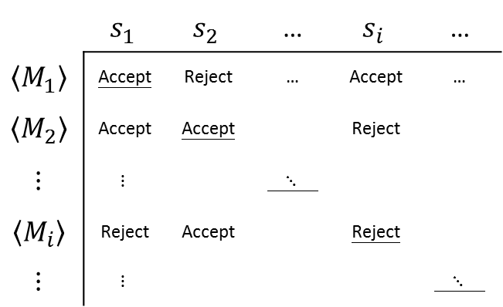
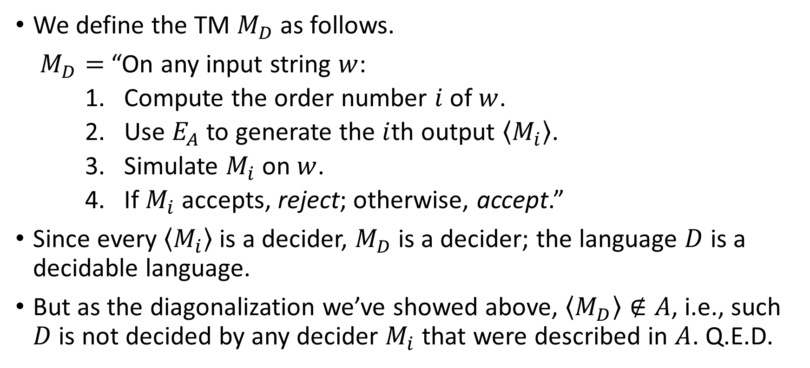
HW#9 – Q1 (2/2)
 | $$s_{1}$$ | $$s_{2}$$ | … | $$s_{i}$$ | …
$$\left\langle M_{1}\right\rangle$$ | Accept | Reject | … | Accept | …
$$\left\langle M_{2}\right\rangle$$ | Accept | Accept |  | Reject
$$⋮$$ | $$⋮$$ |  | $⋱$
$$\left\langle M_{i}\right\rangle$$ | Reject | Accept |  | Reject
$$⋮$$ | $$⋮$$ |  |  |  | $⋱$
We define the TM $M_{D}$ as follows.
$M_{D}=$ “On any input string $w$:
    Compute the order number $i$ of $w$.
    Use $E_{A}$ to generate the $i$th output $\left\langle M_{i}\right\rangle$.
    Simulate $M_{i}$ on $w$.
    If $M_{i}$ accepts, reject; otherwise, accept.”
Since every $\left\langle M_{i}\right\rangle$ is a decider, $M_{D}$ is a decider; the language $D$ is a decidable language.
But as the diagonalization we’ve showed above, $\left\langle M_{D}\right\rangle ∉A$, i.e., such $D$ is not decided by any decider $M_{i}$ that were described in $A$. Q.E.D.

Slide 17
HW#9 – Q2
Hints:
The idea is like the one we applied in HW8 – Q6.
Substring relationships can be described in a regular expression.

Slide 18
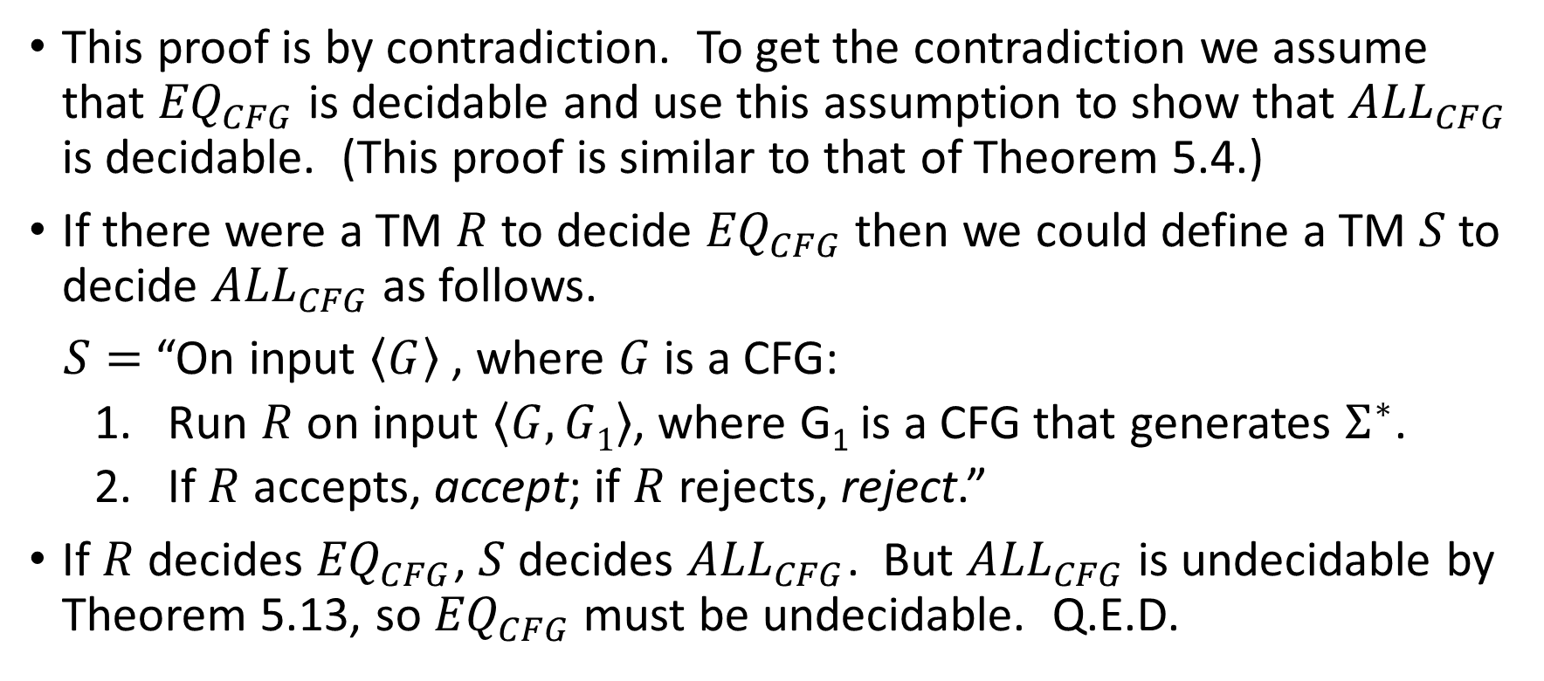
HW#9 – Q5
This proof is by contradiction. To get the contradiction we assume that ${EQ}_{CFG}$ is decidable and use this assumption to show that ${ALL}_{CFG}$ is decidable. (This proof is similar to that of Theorem 5.4.)
If there were a TM $R$ to decide ${EQ}_{CFG}$ then we could define a TM $S$ to decide ${ALL}_{CFG}$ as follows.
$S=$ “On input $\left\langle G\right\rangle$ , where $G$ is a CFG:
  Run $R$ on input $\left\langle G, G1\right\rangle$, where G₁ is a CFG that generates $Σ^{∗}$.
  If $R$ accepts, accept; if $R$ rejects, reject.”
If $R$ decides ${EQ}_{CFG}$, $S$ decides ${ALL}_{CFG}$. But ${ALL}_{CFG}$ is undecidable by Theorem 5.13, so ${EQ}_{CFG}$ must be undecidable. Q.E.D.

Slide 19
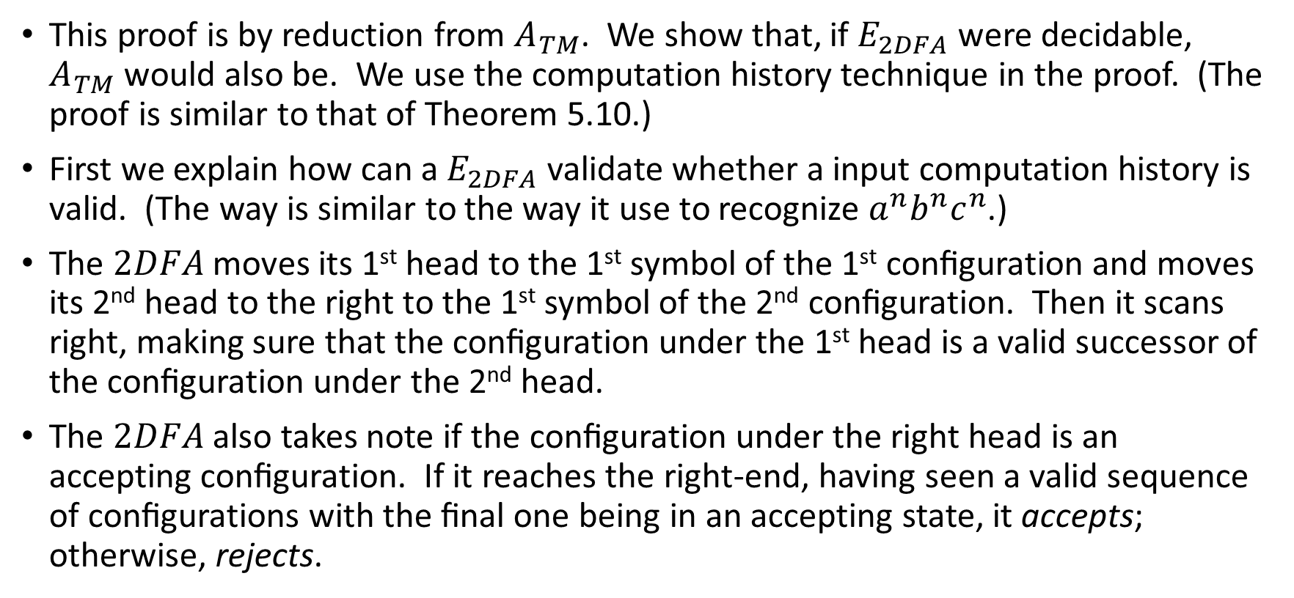
HW#10 – Q2 (1/2)
This proof is by reduction from $A_{TM}$. We show that, if $E_{2DFA}$ were decidable, $A_{TM}$ would also be. We use the computation history technique in the proof. (The proof is similar to that of Theorem 5.10.)
First we explain how can a $E_{2DFA}$ validate whether a input computation history is valid. (The way is similar to the way it use to recognize $a^{n}b^{n}c^{n}$.)
The $2DFA$ moves its 1st head to the 1st symbol of the 1st conﬁguration and moves its 2nd head to the right to the 1st symbol of the 2nd conﬁguration. Then it scans right, making sure that the conﬁguration under the 1st head is a valid successor of the conﬁguration under the 2nd head.
The $2DFA$ also takes note if the conﬁguration under the right head is an accepting conﬁguration. If it reaches the right-end, having seen a valid sequence of conﬁgurations with the ﬁnal one being in an accepting state, it accepts; otherwise, rejects.
Notes:
2DFA usually refers to “2-way deterministic finite automata”, so maybe it’s better to use 2HDFA here.

Slide 20
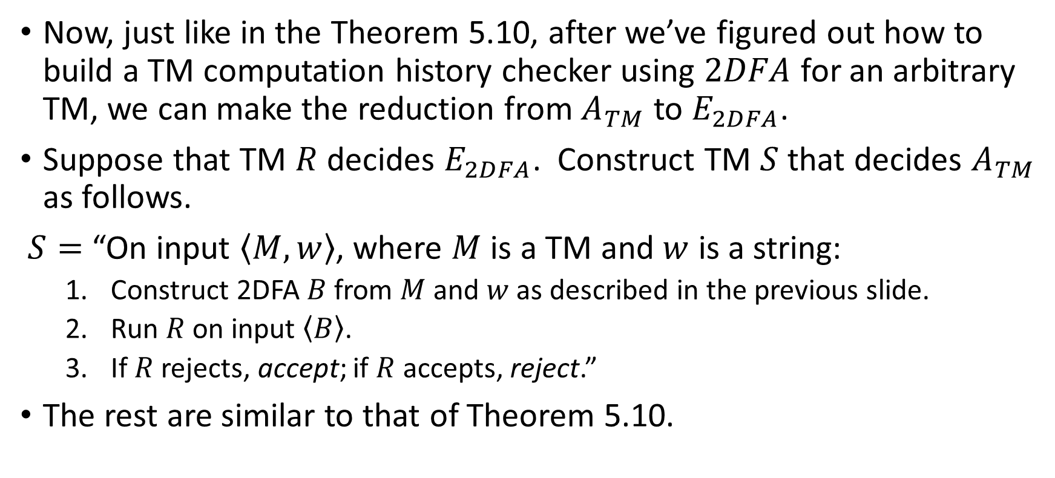
HW#10 – Q2 (2/2)
Now, just like in the Theorem 5.10, after we’ve figured out how to build a TM computation history checker using $2DFA$ for an arbitrary TM, we can make the reduction from $A_{TM}$ to $E_{2DFA}$.
Suppose that TM $R$ decides $E_{2DFA}$. Construct TM $S$ that decides $A_{TM}$ as follows.
$S=$ “On input $\left\langle M,w\right\rangle$, where $M$ is a TM and $w$ is a string:
  Construct 2DFA $B$ from $M$ and $w$ as described in the previous slide.
  Run $R$ on input $\left\langle B\right\rangle$.
  If $R$ rejects, accept; if $R$ accepts, reject.”
The rest are similar to that of Theorem 5.10.

Slide 21
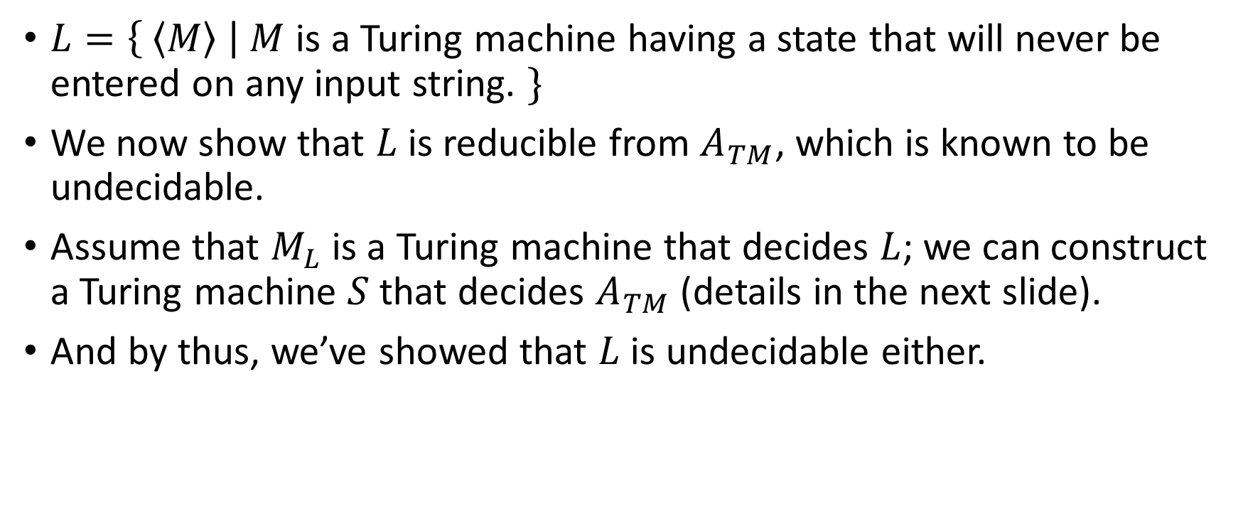
HW#10* – Q6 (1/2)
$L=\left\{ \left\langle M\right\rangle \right| M$ is a Turing machine having a state that will never be entered on any input string. $\}$
We now show that $L$ is reducible from $A_{TM}$, which is known to be undecidable.
Assume that $M_{L}$ is a Turing machine that decides $L$; we can construct a Turing machine $S$ that decides $A_{TM}$ (details in the next slide).
And by thus, we’ve showed that $L$ is undecidable either.

Slide 22
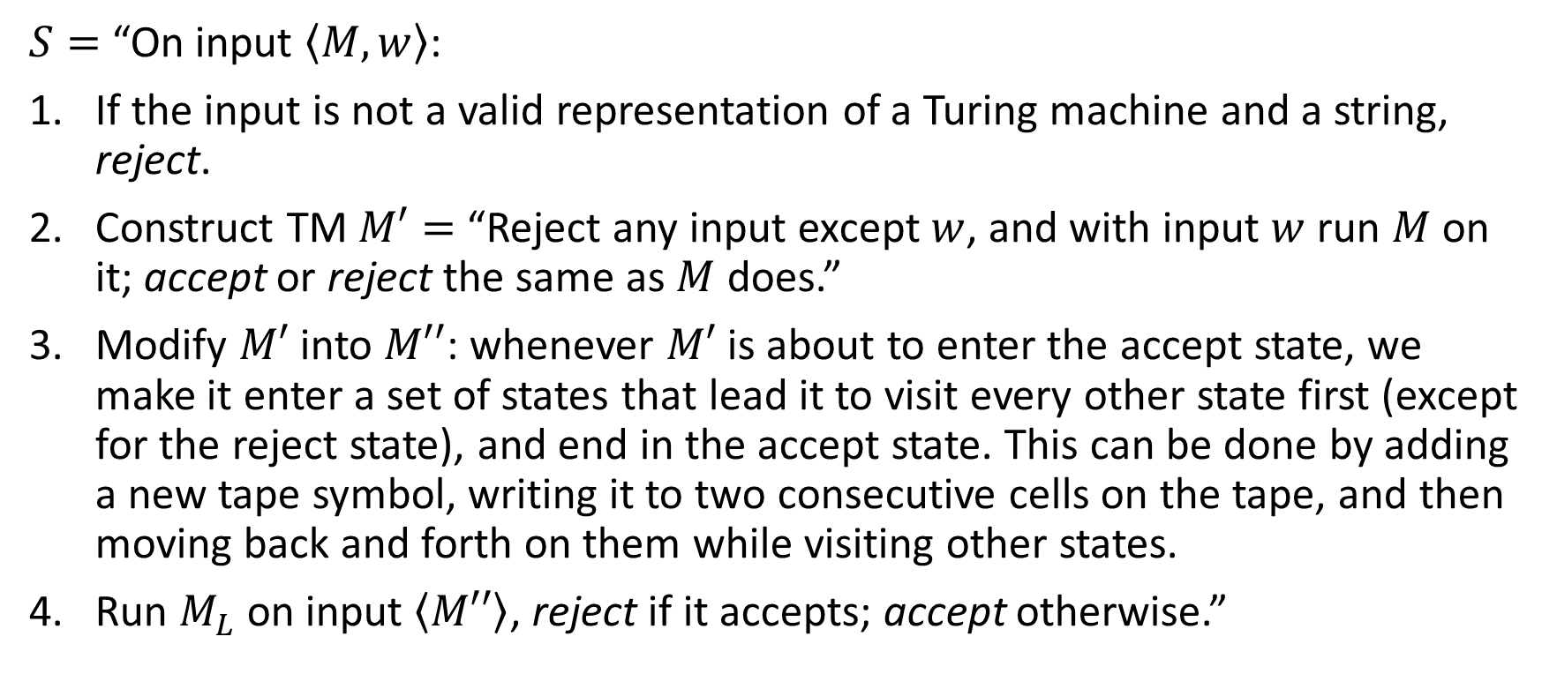
HW#10* – Q6 (2/2)
$S=$ “On input $\left\langle M, w\right\rangle$:
If the input is not a valid representation of a Turing machine and a string, reject.
Construct TM $M′=$ “Reject any input except $w$, and with input $w$ run $M$ on it; accept or reject the same as $M$ does.”
Modify $M′$ into $M′′$: whenever $M′$ is about to enter the accept state, we make it enter a set of states that lead it to visit every other state first (except for the reject state), and end in the accept state. This can be done by adding a new tape symbol, writing it to two consecutive cells on the tape, and then moving back and forth on them while visiting other states.
Run $M_{L}$ on input $\left\langle M′′\right\rangle$, reject if it accepts; accept otherwise.”
Notes:
更正：$M′$ 到 $M′′$ 的調整是針對「即將進入accept state的transition」而非reject state。
目標：當$w$會被$M$接受時，$M′′$沒有useless state；不會時，$M′′$有useless state（至少，於調整時加入的那些用於準備遍訪各state用的那些states即為useless state）。

