Slide 1
Theory of Computing
TA times #1
Willy Chang
2017.03.22

Slide 2
To find a proof (Ch0.3) (1/3)
Be patient – Be patient to what you want to explain, tell a whole story.
Come back to it – Make sure what you wrote is consistent.
Be neat – Organize a good structure of your logic and intentions. Screen out the redundant statements.
Be concise – Use brief expressions that generally have clear and precise meaning. (Formal systems are your good friends.)

Slide 3
To find a proof (Ch0.3) (2/3)
Be patient – Be patient to what you want to explain, tell a whole story.
Come back to it – Make sure what you wrote is consistent.
Be neat – Organize a good structure of your logic and intentions. Screen out the redundant statements.
Be concise – Use brief expressions that generally have clear and precise meaning. (Formal systems are your good friends.)

Slide 4
To find a proof (Ch0.3) (3/3)
Proof Idea
  You should talk about any idea, strategy of your proof here. Better not to let any high level, informal expression goes into your proof parts (below). These expressions usually are not precise enough, and may cause confusion.
Proof
  In this part, please follow the four guidelines mentioned in the previous slide to construct your proof nicely. You should tell a whole story – each part should have clear logic connections with others, and most importantly, the proof should have both a proper beginning, and a conclusive ending.

Slide 5
CAUTION
Most solutions we showed in TA’s slides are more
like the ideas rather than completed solutions.
You may take them as guides, but shouldn’t
consider them as all the things you need
to get your homework done.

Slide 6
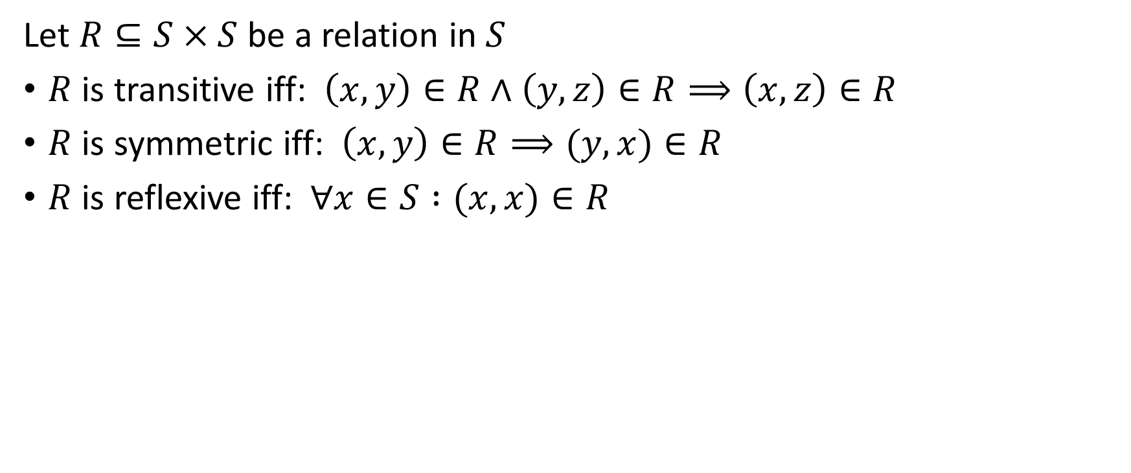
HW#1 – Q1 (1/3)
Let $R⊆S×S$ be a relation in $S$
$R$ is transitive iff: $\left(x,y\right)∈R∧\left(y,z\right)∈R⟹\left(x,z\right)∈R$
$R$ is symmetric iff: $\left(x,y\right)∈R⟹(y,x)∈R$
$R$ is reflexive iff: $∀x∈S :(x,x)∈R$

Slide 7
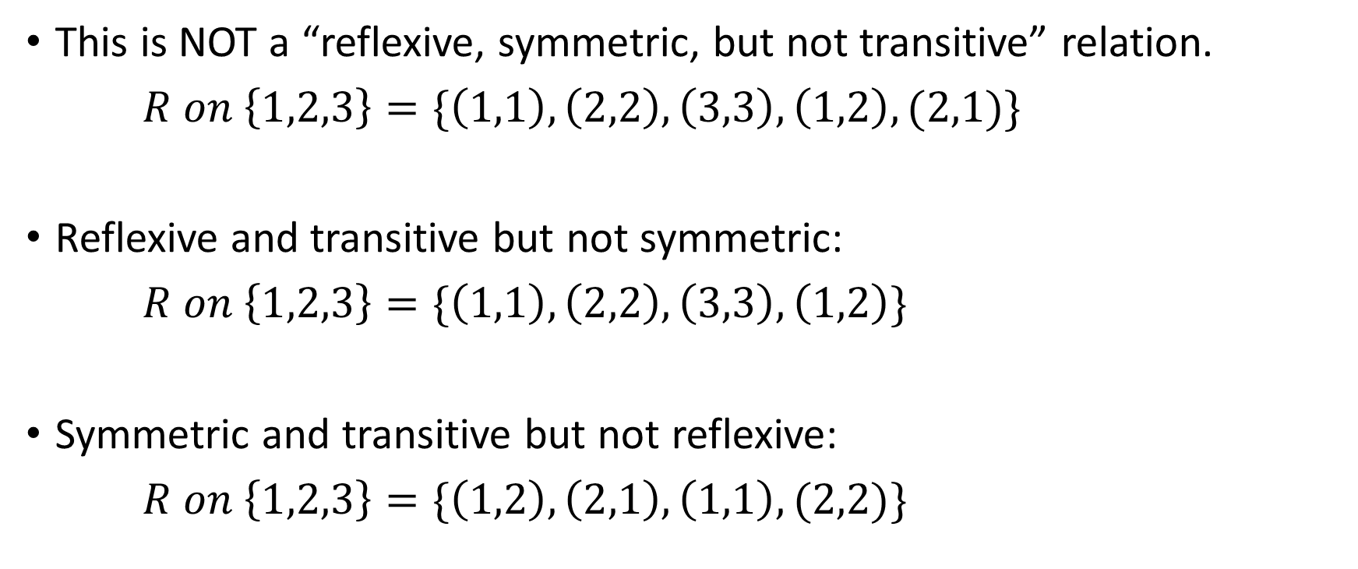
HW#1 – Q1 (2/3)
This is NOT a “reflexive, symmetric, but not transitive” relation.
$R on \left\{1,2,3\right\}=\{\left(1,1\right),\left(2,2\right),\left(3,3\right),\left(1,2\right),(2,1)\}$
Reflexive and transitive but not symmetric:
$R on \left\{1,2,3\right\}=\{\left(1,1\right),\left(2,2\right),\left(3,3\right),\left(1,2\right)\}$
Symmetric and transitive but not reflexive:
$R on \left\{1,2,3\right\}=\{\left(1,2\right),\left(2,1\right),\left(1,1\right),(2,2)\}$
1
2
3
1
2
3
1
2
3

Slide 8
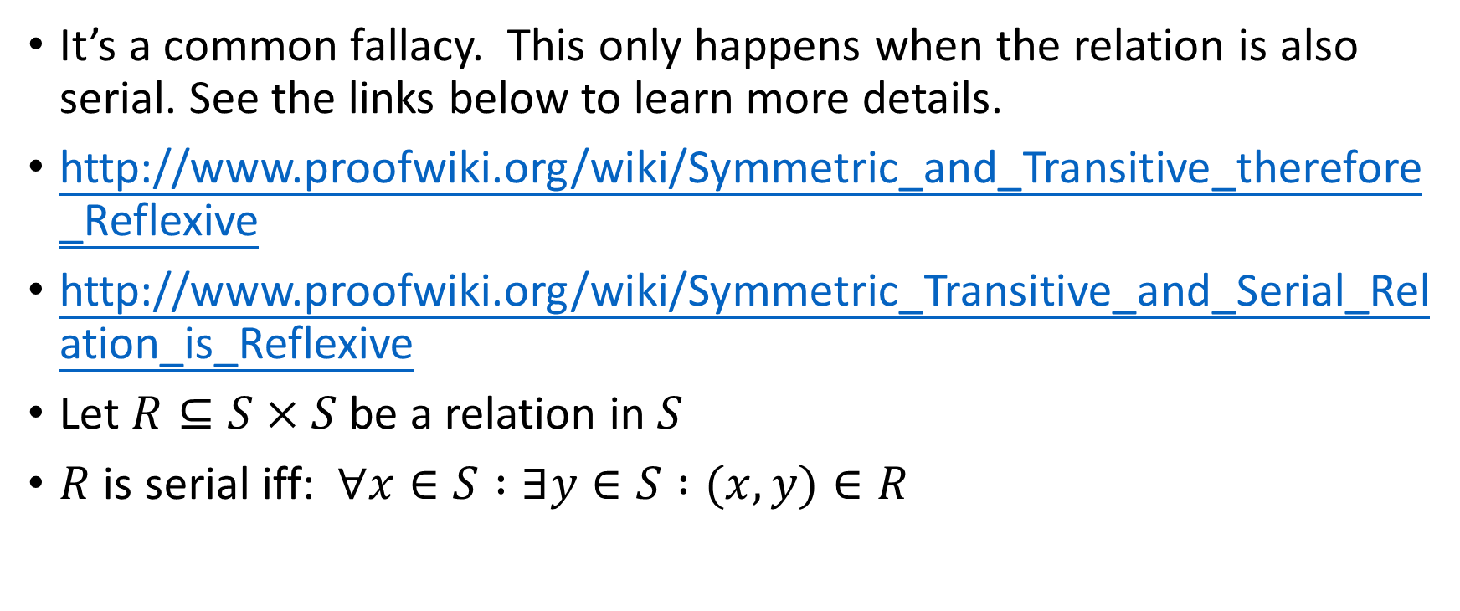
Symmetric, Transitive therefore Reflexive? (3/3)
It’s a common fallacy. This only happens when the relation is also serial. See the links below to learn more details.
http://www.proofwiki.org/wiki/Symmetric_and_Transitive_therefore_Reflexive
http://www.proofwiki.org/wiki/Symmetric_Transitive_and_Serial_Relation_is_Reflexive
Let $R⊆S×S$ be a relation in $S$
$R$ is serial iff: $∀x∈S :∃y∈S :(x,y)∈R$

Slide 9
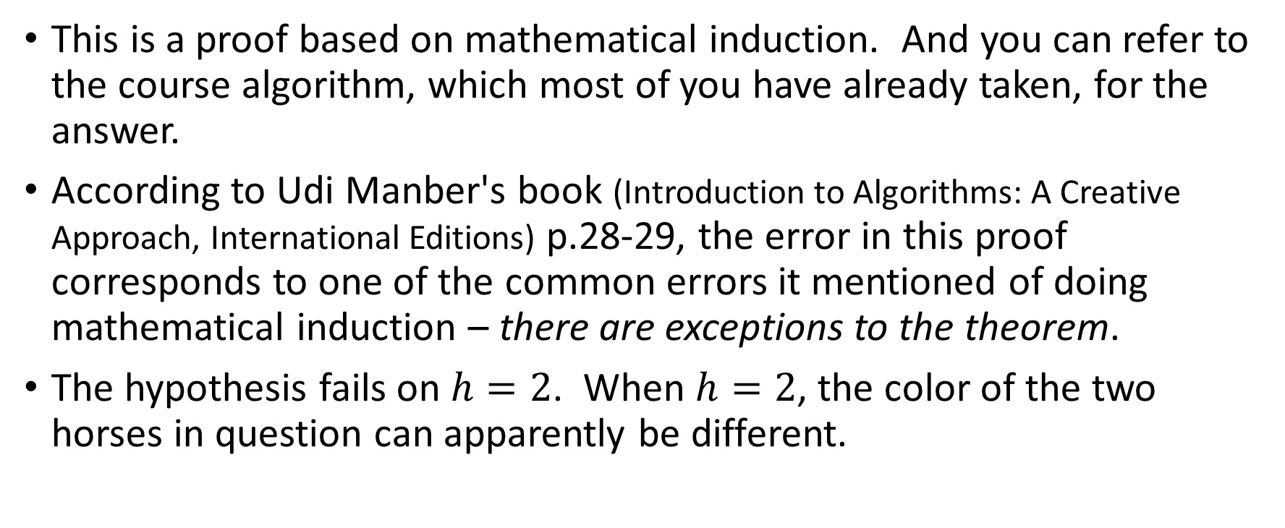
HW#1 – Q4
This is a proof based on mathematical induction. And you can refer to the course algorithm, which most of you have already taken, for the answer.
According to Udi Manber's book (Introduction to Algorithms: A Creative Approach, International Editions) p.28-29, the error in this proof corresponds to one of the common errors it mentioned of doing mathematical induction – there are exceptions to the theorem.
The hypothesis fails on $h=2$. When $h=2$, the color of the two horses in question can apparently be different.

Slide 10
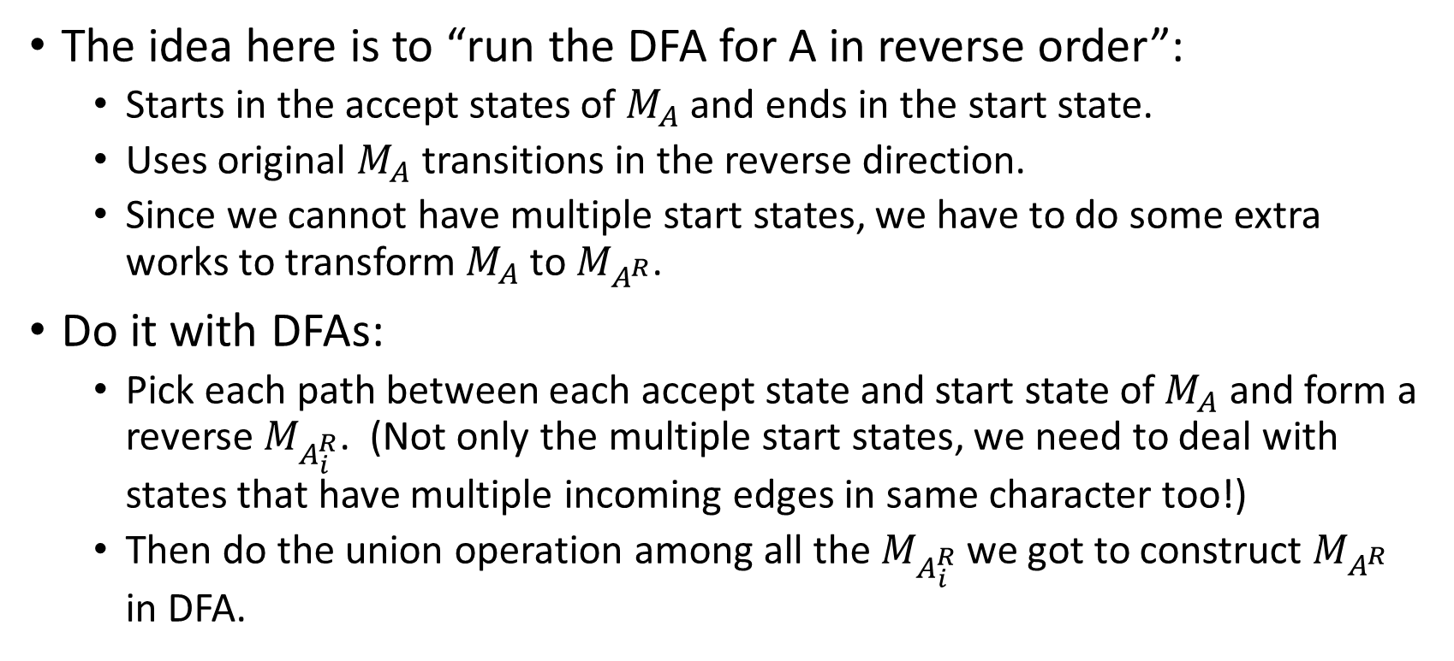
HW#2 – Q5 (1/3)
The idea here is to “run the DFA for A in reverse order”:
  Starts in the accept states of $M_{A}$ and ends in the start state.
  Uses original $M_{A}$ transitions in the reverse direction.
  Since we cannot have multiple start states, we have to do some extra works to transform $M_{A}$ to $M_{A^{R}}$.
Do it with DFAs:
  Pick each path between each accept state and start state of $M_{A}$ and form a reverse $M_{A_{i}^{R}}$. (Not only the multiple start states, we need to deal with states that have multiple incoming edges in same character too!)
  Then do the union operation among all the $M_{A_{i}^{R}}$ we got to construct $M_{A^{R}}$ in DFA.

Slide 11
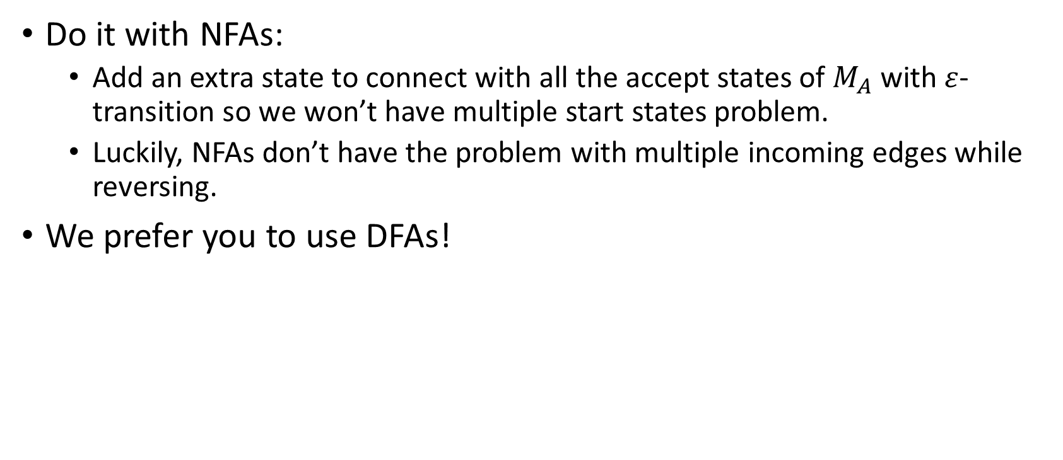
HW#2 – Q5 (2/3)
Do it with NFAs:
  Add an extra state to connect with all the accept states of $M_{A}$ with $ε$-transition so we won’t have multiple start states problem.
  Luckily, NFAs don’t have the problem with multiple incoming edges while reversing.
We prefer you to use DFAs!

Slide 12
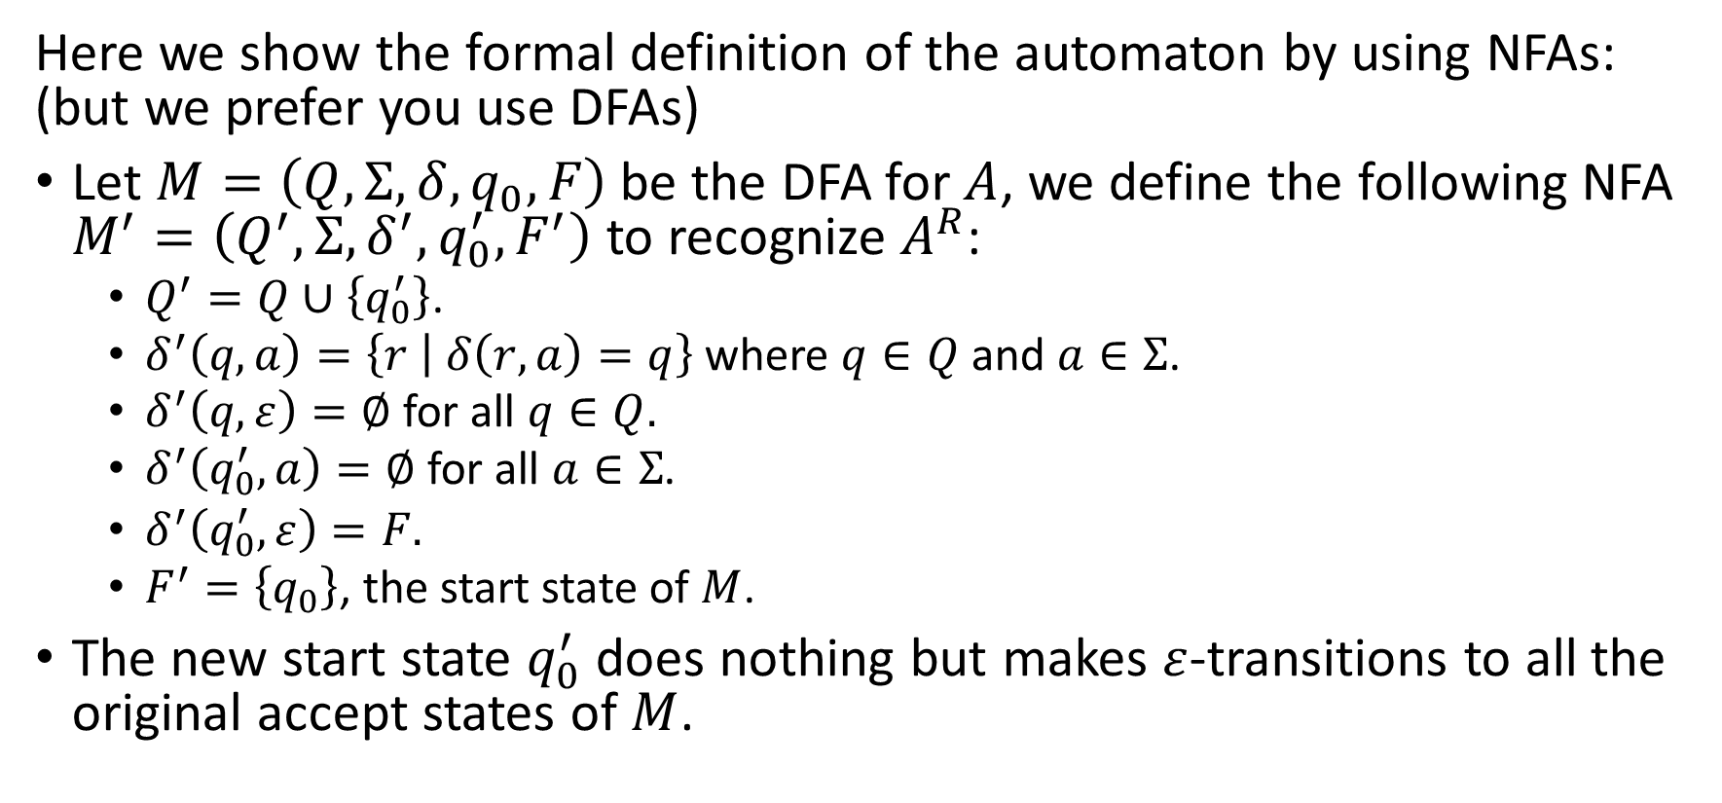
HW#2 – Q5 (3/3)
Here we show the formal definition of the automaton by using NFAs: (but we prefer you use DFAs)
Let $M=\left(Q,Σ,δ,q_{0},F\right)$ be the DFA for $A$, we define the following NFA $M^{′}=\left(Q^{′},Σ,δ^{′},q_{0}^{′},F^{′}\right)$ to recognize $A^{R}$:
  $Q^{′}=Q∪\left\{q_{0}^{′}\right\}$.
  $δ^{′}\left(q, a\right)=\left\{r | δ\left(r, a\right)=q\right\}$ where $q∈Q$ and $a∈Σ$.
  $δ^{′}\left(q,ε\right)=∅$ for all $q∈Q.$
  $δ^{′}\left(q_{0}^{′}, a\right)=∅$ for all $a∈Σ$.
  $δ^{′}\left(q_{0}^{′},ε\right)=F.$
  $F^{′}=\left\{q_{0}\right\}$, the start state of $M$.
The new start state $q_{0}^{′}$ does nothing but makes $ε$-transitions to all the original accept states of $M$.

Slide 13
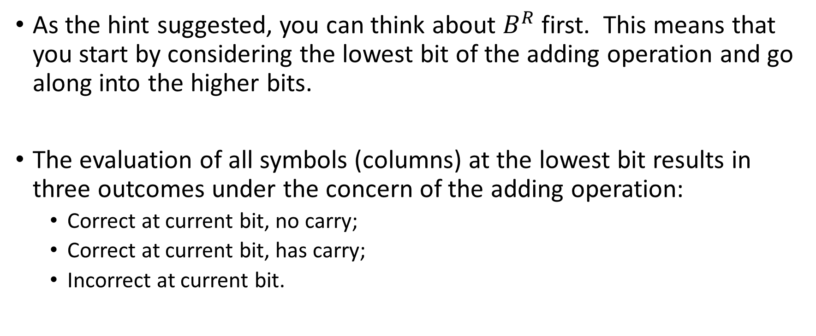
HW#2 – Q6 (1/3)
As the hint suggested, you can think about $B^{R}$ first. This means that you start by considering the lowest bit of the adding operation and go along into the higher bits.
The evaluation of all symbols (columns) at the lowest bit results in three outcomes under the concern of the adding operation:
  Correct at current bit, no carry;
  Correct at current bit, has carry;
  Incorrect at current bit.

Slide 14
HW#2 – Q6 (2/3)
As you continue to move on to the higher bits, you would feel the need of maintaining the states of your evaluation:
  Do I got a carry-in from the previous bit ? (one state for yes, another for no)
  Has the calculation failed already because of some bad columns ahead ?
So all the states you need to represent the adding operation are the 3 states below:
  So far the calculation is good, no carry-in for the next column;
  So far the calculation is good, with a carry-in for the next column;
  The calculation had failed. And of course, no any follow-on columns can fix it.

Slide 15
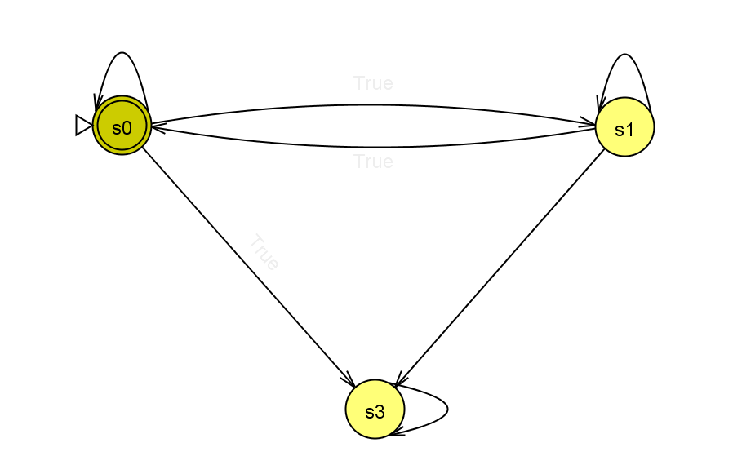
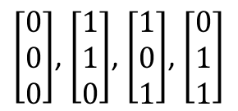
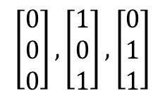
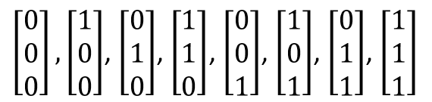


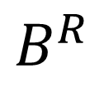
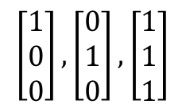
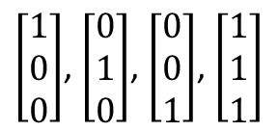
HW#2 – Q6 (3/3)
$$B^{R}$$
$$\left[\begin{matrix}0 \\ 0 \\ 0\end{matrix}\right],\left[\begin{matrix}1 \\ 0 \\ 1\end{matrix}\right],\left[\begin{matrix}0 \\ 1 \\ 1\end{matrix}\right]$$
$$\left[\begin{matrix}1 \\ 0 \\ 0\end{matrix}\right],\left[\begin{matrix}0 \\ 1 \\ 0\end{matrix}\right],\left[\begin{matrix}1 \\ 1 \\ 1\end{matrix}\right]$$
$$\left[\begin{matrix}1 \\ 1 \\ 0\end{matrix}\right]$$
$$\left[\begin{matrix}0 \\ 0 \\ 1\end{matrix}\right]$$
$\left[\begin{matrix}1 \\ 0 \\ 0\end{matrix}\right]$, $\left[\begin{matrix}0 \\ 1 \\ 0\end{matrix}\right]$, $\left[\begin{matrix}0 \\ 0 \\ 1\end{matrix}\right]$, $\left[\begin{matrix}1 \\ 1 \\ 1\end{matrix}\right]$
$\left[\begin{matrix}0 \\ 0 \\ 0\end{matrix}\right]$, $\left[\begin{matrix}1 \\ 1 \\ 0\end{matrix}\right]$, $\left[\begin{matrix}1 \\ 0 \\ 1\end{matrix}\right]$, $\left[\begin{matrix}0 \\ 1 \\ 1\end{matrix}\right]$
$\left[\begin{matrix}0 \\ 0 \\ 0\end{matrix}\right],\left[\begin{matrix}1 \\ 0 \\ 0\end{matrix}\right]$, $\left[\begin{matrix}0 \\ 1 \\ 0\end{matrix}\right]$, $\left[\begin{matrix}1 \\ 1 \\ 0\end{matrix}\right]$, $\left[\begin{matrix}0 \\ 0 \\ 1\end{matrix}\right]$, $\left[\begin{matrix}1 \\ 0 \\ 1\end{matrix}\right]$, $\left[\begin{matrix}0 \\ 1 \\ 1\end{matrix}\right]$, $\left[\begin{matrix}1 \\ 1 \\ 1\end{matrix}\right]$

