Slide 1
Theory of Computing
TA times #2
Willy Chang
2017.04.12

Slide 2

CEIBA site
We have enabled a CEIBA site for this course:
https://ceiba.ntu.edu.tw/1052theory2017
  This link will redirect to our course website
  (http://im.ntu.edu.tw/~tsay/dokuwiki/doku.php?id=courses:theory2017:main)
Course announcement may be sent via group mail from CEIBA.
  Enrolled students only; for auditors please contact me if needed.
All detailed grades (HW, Terms) will be announced on CEIBA too!
  Shorten URL https://goo.gl/FkOt0K
  LOG IN to CEIBA first

Slide 3
CAUTION
Most solutions we showed in TA’s slides are more
like the ideas rather than completed solutions.
You may take them as guides, but shouldn’t
consider them as everything you need
to get your homework done.

Slide 4
SUGGESTION
For any questions, if possible, write down the whole proof / operation detail, not just the answer.
This not only helps you understand the whole mechanism but gets you more points on exams.
Ex. When converting an NFA to DFA, write down the detailed transition function construction steps.

Slide 5
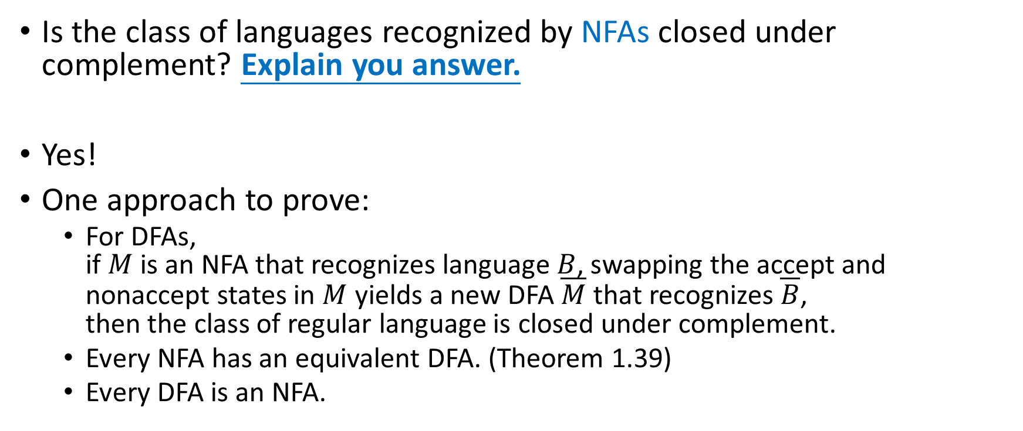
HW#3 – Q3.b (1/2)
Is the class of languages recognized by NFAs closed under complement? Explain you answer.
Yes!
One approach to prove:
  For DFAs,
  if $M$ is an NFA that recognizes language $B$, swapping the accept and nonaccept states in $M$ yields a new DFA $\overline{M}$ that recognizes $\overline{B}$,
  then the class of regular language is closed under complement.
  Every NFA has an equivalent DFA. (Theorem 1.39)
  Every DFA is an NFA.

Slide 6
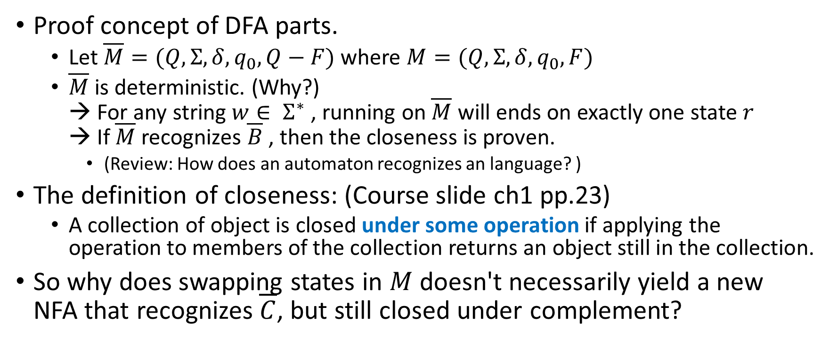
HW#3 – Q3.b (2/2)
Proof concept of DFA parts.
  Let $\overline{M}=(Q,Σ,δ,q_{0},Q−F)$ where $M=(Q,Σ,δ,q_{0},F)$
  $\overline{M}$ is deterministic. (Why?)
  → For any string $w∈ Σ^{∗}$ , running on $\overline{M}$ will ends on exactly one state $r$
  → If $\overline{M}$ recognizes $\overline{B}$ , then the closeness is proven.
    (Review: How does an automaton recognizes an language? )
The definition of closeness: (Course slide ch1 pp.23)
  A collection of object is closed under some operation if applying the operation to members of the collection returns an object still in the collection.
So why does swapping states in $M$ doesn't necessarily yield a new NFA that recognizes $\overline{C}$, but still closed under complement?

Slide 7
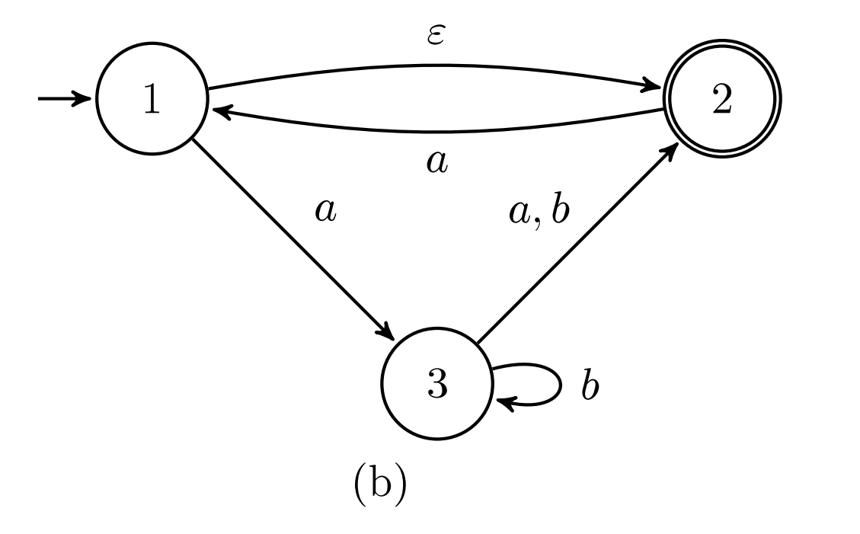
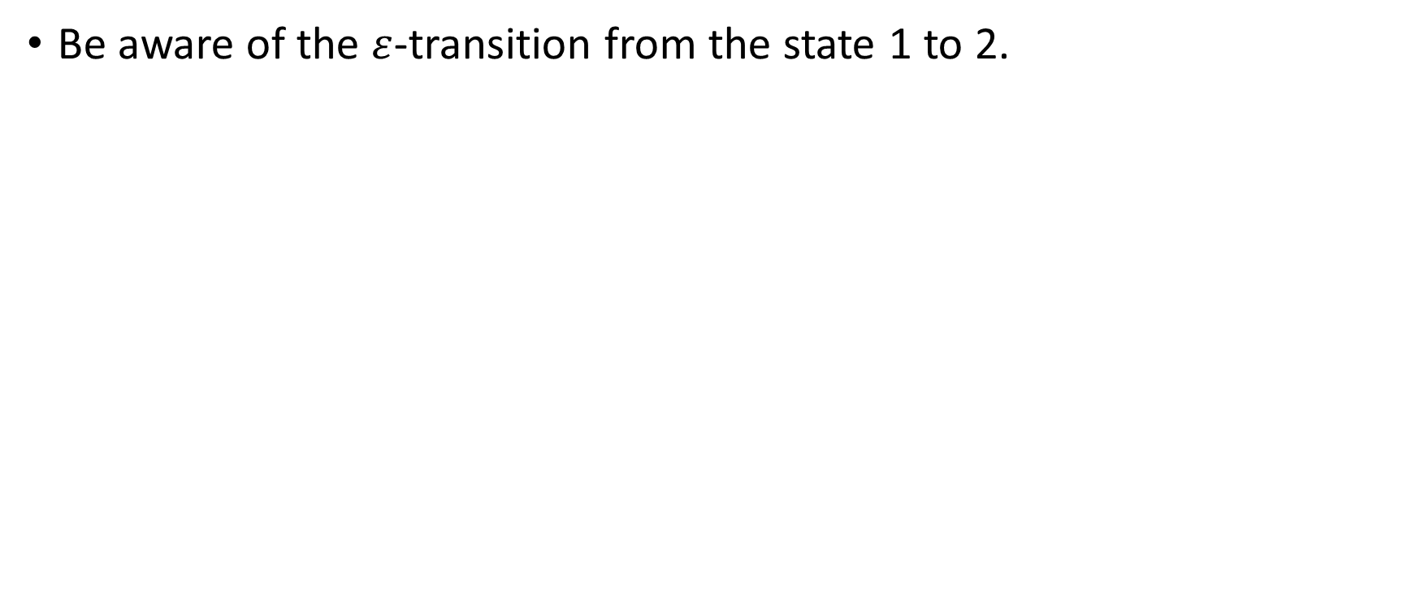
HW#3 – Q4.b
Be aware of the $ε$-transition from the state 1 to 2.

Slide 8
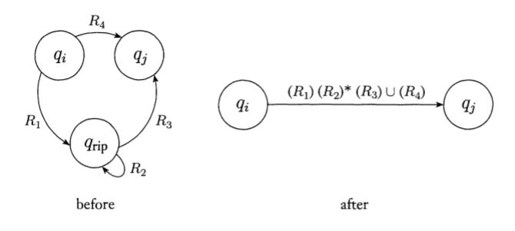
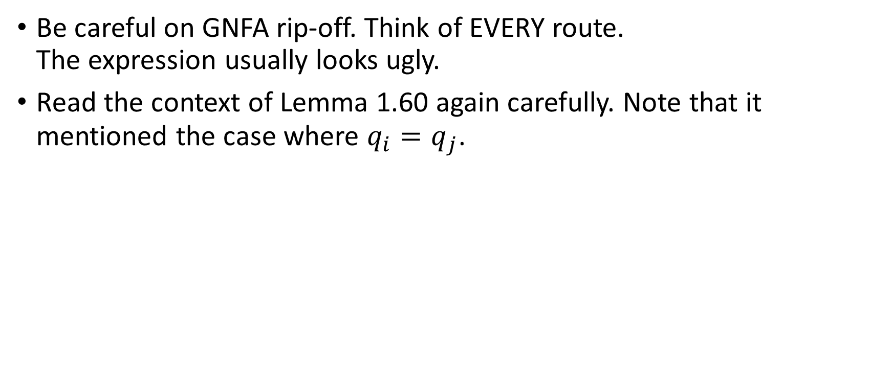
HW#3 – Q7.a
Be careful on GNFA rip-off. Think of EVERY route.
The expression usually looks ugly.
Read the context of Lemma 1.60 again carefully. Note that it mentioned the case where $q_{i}=q_{j}$.

Slide 9
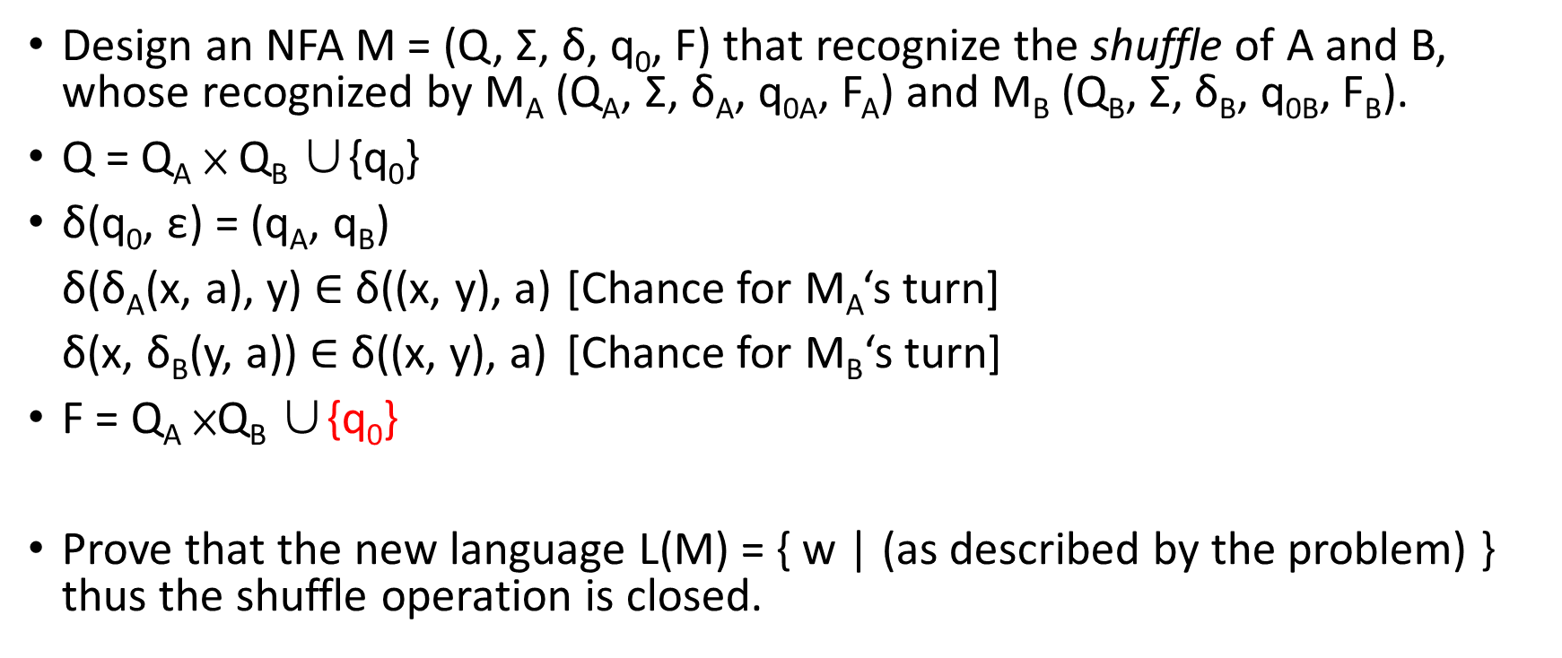
HW#4 – Q1
Design an NFA M = (Q, Σ, δ, q₀, F) that recognize the shuffle of A and B, whose recognized by M_{A} (Q_{A}, Σ, δ_{A}, q_{0A}, F_{A}) and M_{B} (Q_{B}, Σ, δ_{B}, q_{0B}, F_{B}).
Q = Q_{A} × Q_{B} ∪{q₀}
δ(q₀, ε) = (q_{A}, q_{B})
δ(δ_{A}(x, a), y) $∈$ δ((x, y), a) [Chance for M_{A}‘s turn]
δ(x, δ_{B}(y, a)) $∈$ δ((x, y), a) [Chance for M_{B}‘s turn]
F = Q_{A} ×Q_{B} ∪{q₀}
Prove that the new language L(M) = { w | (as described by the problem) }
thus the shuffle operation is closed.
Notes:
目前的Q=(x, y)讀到a的時候，可能是讓x跑δ_{A}，也可能讓y跑δ_{B}。

Slide 10
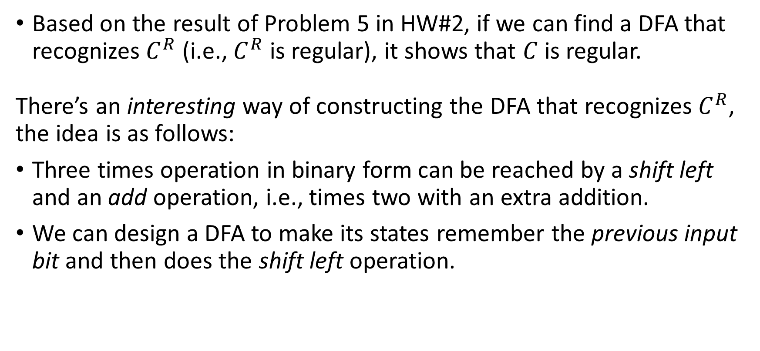
HW#4 – Q2 (1/2)
Based on the result of Problem 5 in HW#2, if we can find a DFA that recognizes $C^{R}$ (i.e., $C^{R}$ is regular), it shows that $C$ is regular.
There’s an interesting way of constructing the DFA that recognizes $C^{R}$, the idea is as follows:
Three times operation in binary form can be reached by a shift left and an add operation, i.e., times two with an extra addition.
We can design a DFA to make its states remember the previous input bit and then does the shift left operation.

Slide 11
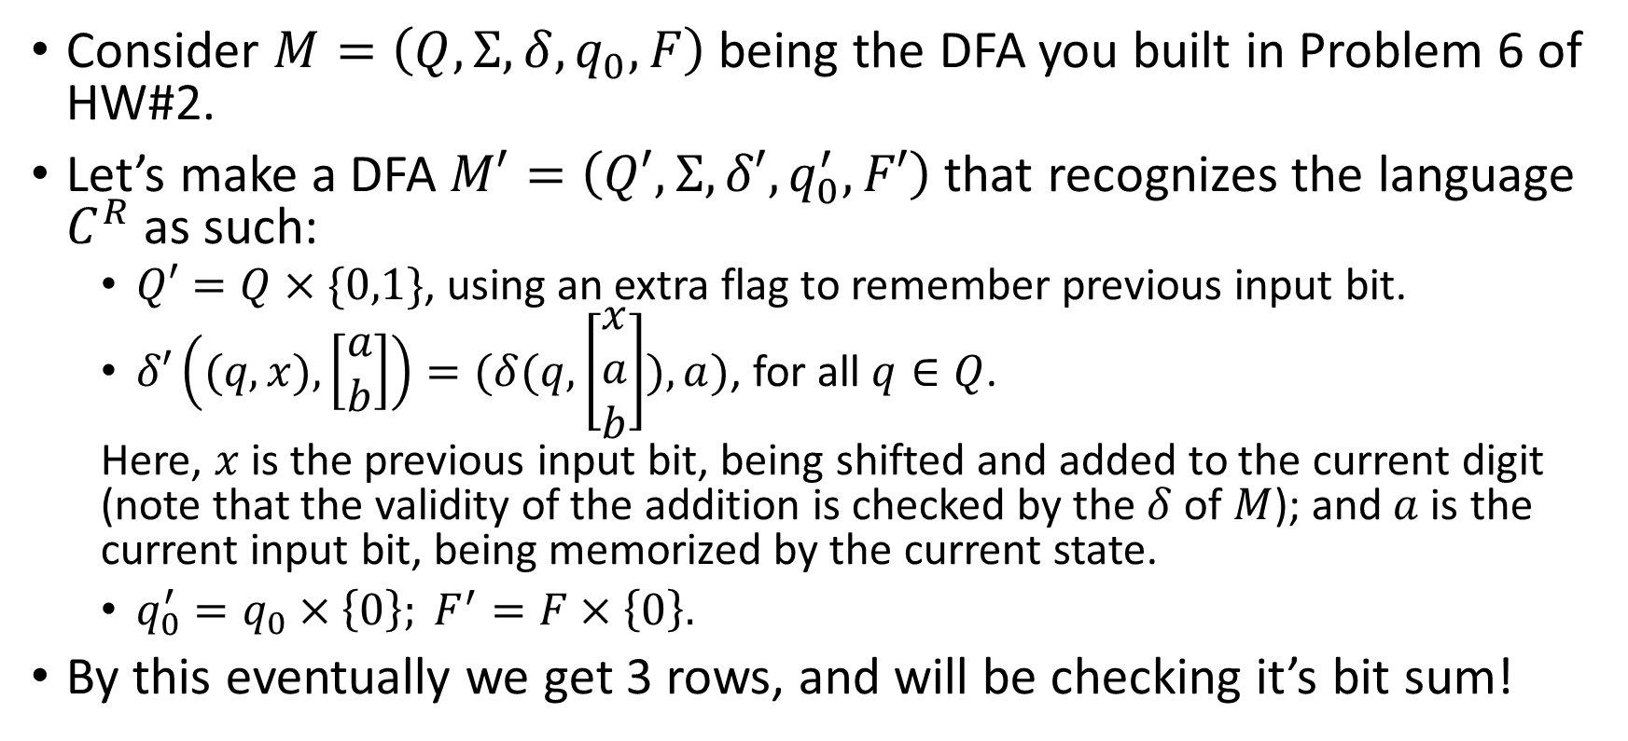
HW#4 – Q2 (2/2)
Consider $M=\left(Q,Σ,δ,q_{0},F\right)$ being the DFA you built in Problem 6 of HW#2.
Let’s make a DFA $M′=\left(Q′,Σ,δ′,q_{0}^{′},F′\right)$ that recognizes the language $C^{R}$ as such:
  $Q′=Q×\{0,1\}$, using an extra flag to remember previous input bit.
  $δ′\left((q,x), \left[\begin{matrix}a \\ b\end{matrix}\right]\right)=(δ(q,\left[\begin{matrix}x \\ a \\ b\end{matrix}\right]),a)$, for all $q∈Q$.
  Here, $x$ is the previous input bit, being shifted and added to the current digit (note that the validity of the addition is checked by the $δ$ of $M$); and $a$ is the current input bit, being memorized by the current state.
  $q_{0}^{′}=q_{0}×\left\{0\right\}; F^{′}=F×\left\{0\right\}.$
By this eventually we get 3 rows, and will be checking it’s bit sum!

Slide 12
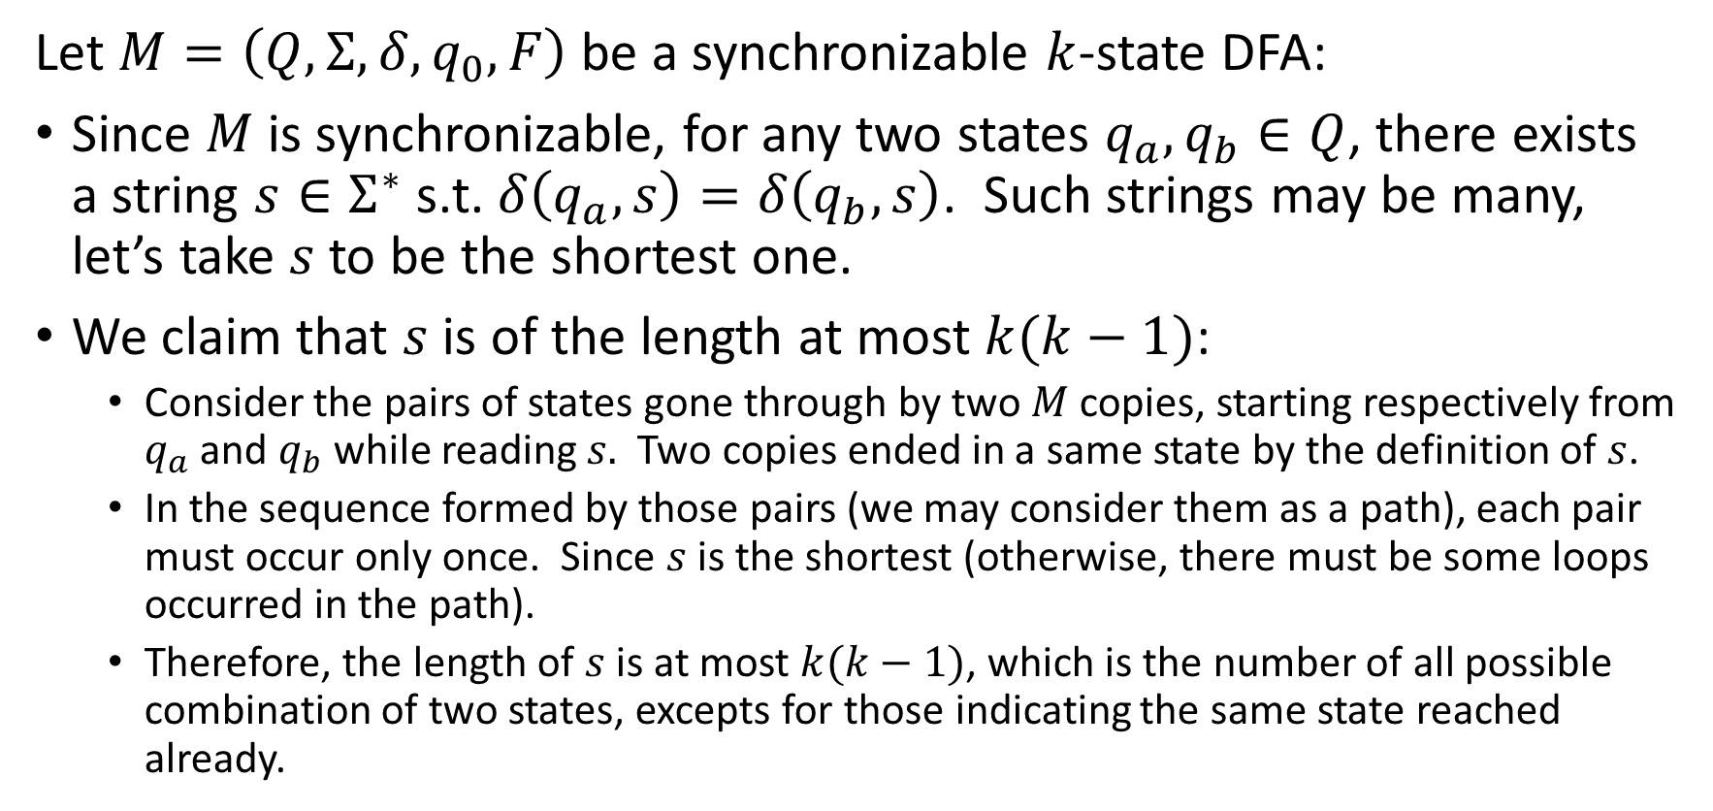
HW#4 – Q6 (1/3)
Let $M=\left(Q, Σ, δ, q_{0}, F\right)$ be a synchronizable $k$-state DFA:
Since $M$is synchronizable, for any two states $q_{a}, q_{b}∈Q$, there exists a string $s∈Σ^{∗}$ s.t. $δ\left(q_{a}, s\right)=δ\left(q_{b}, s\right)$. Such strings may be many, let’s take $s$ to be the shortest one.
We claim that $s$is of the length at most $k(k−1)$:
  Consider the pairs of states gone through by two $M$ copies, starting respectively from $q_{a}$ and $q_{b}$ while reading $s.$ Two copies ended in a same state by the definition of $s$.
  In the sequence formed by those pairs (we may consider them as a path), each pair must occur only once. Since $s$ is the shortest (otherwise, there must be some loops occurred in the path).
  Therefore, the length of $s$ is at most $k(k−1)$, which is the number of all possible combination of two states, excepts for those indicating the same state reached already.

Slide 13
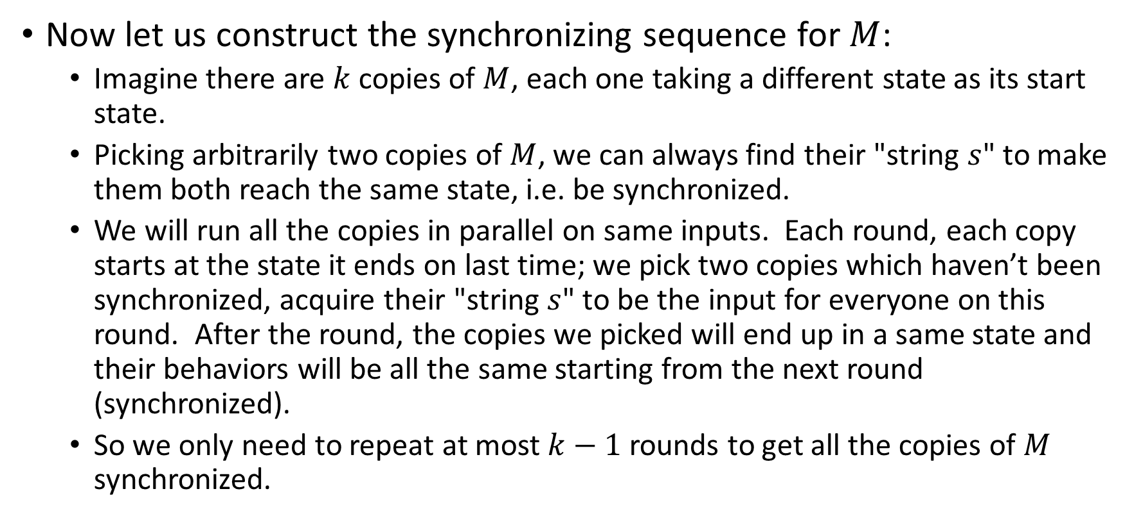
HW#4 – Q6 (2/3)
Now let us construct the synchronizing sequence for $M$:
  Imagine there are $k$ copies of $M$, each one taking a different state as its start state.
  Picking arbitrarily two copies of $M$, we can always find their "string $s$" to make them both reach the same state, i.e. be synchronized.
  We will run all the copies in parallel on same inputs. Each round, each copy starts at the state it ends on last time; we pick two copies which haven’t been synchronized, acquire their "string $s$" to be the input for everyone on this round. After the round, the copies we picked will end up in a same state and their behaviors will be all the same starting from the next round (synchronized).
  So we only need to repeat at most $k−1$ rounds to get all the copies of $M$ synchronized.

Slide 14
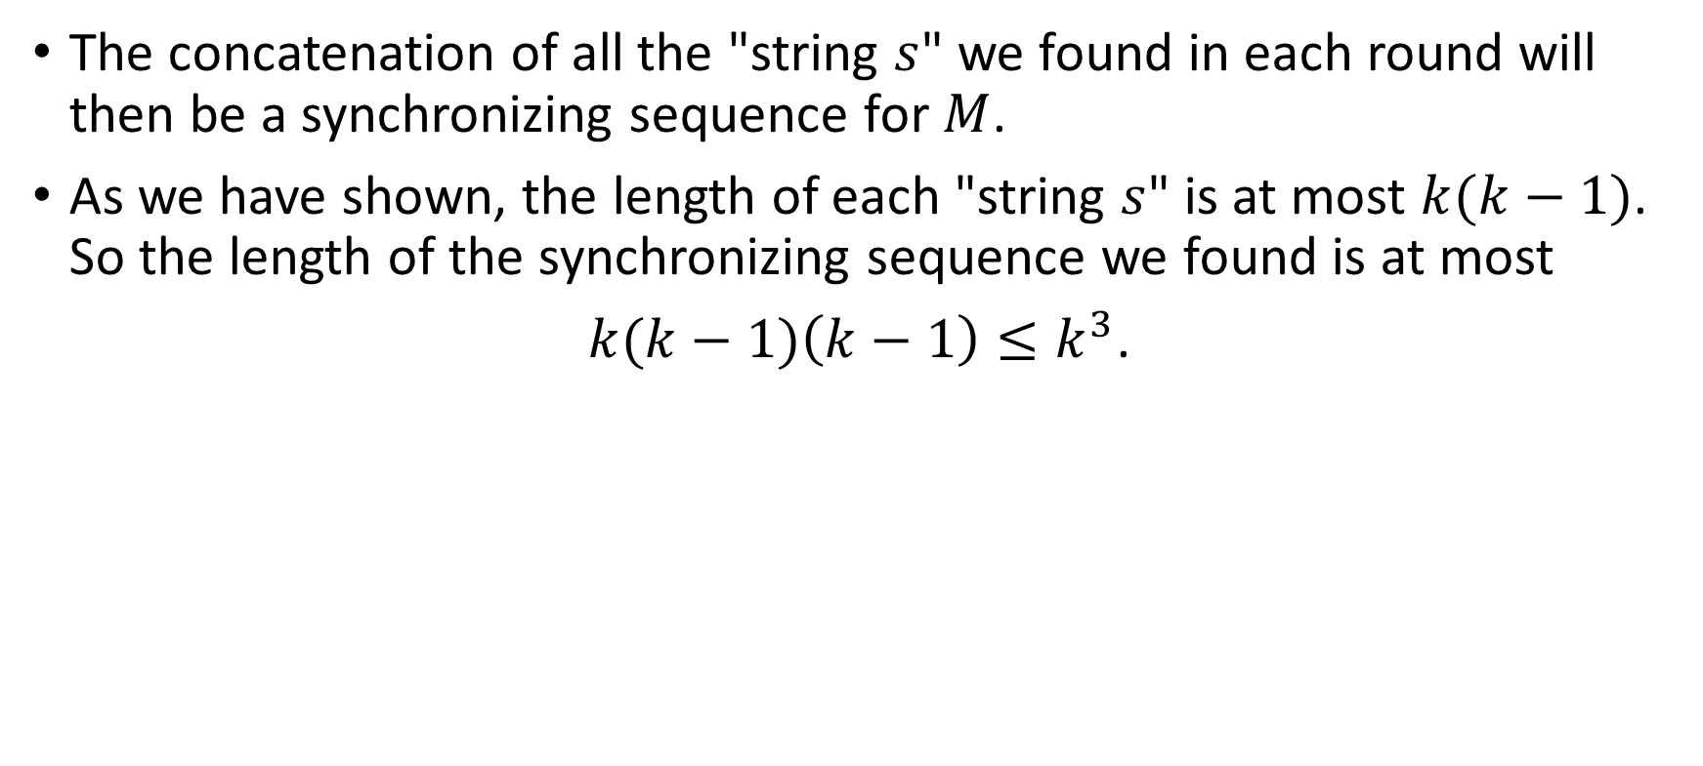
HW#4 – Q6 (3/3)
The concatenation of all the "string $s$" we found in each round will then be a synchronizing sequence for $M$.
As we have shown, the length of each "string $s$" is at most $k(k−1)$. So the length of the synchronizing sequence we found is at most
$k(k−1)\left(k−1\right)≤k^{3}$.
Notes:
因為每個string s run完都會回到h 所以所有s 串起來，就是跑過k-1次h state 所能找到的最長序列

Slide 15
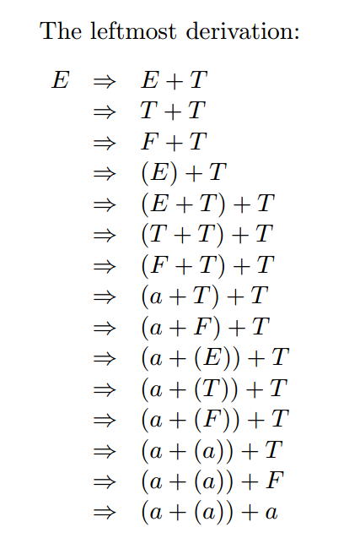
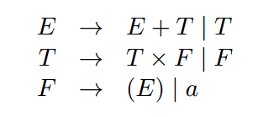
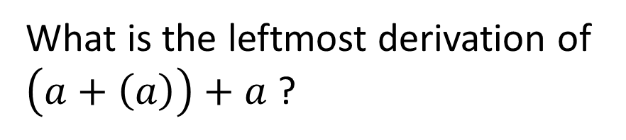
HW#5 – Q1.a
  Leftmost derivation
e.g.,
What is the leftmost derivation of $\left(a+\left(a\right)\right)+a$ ?

Slide 16
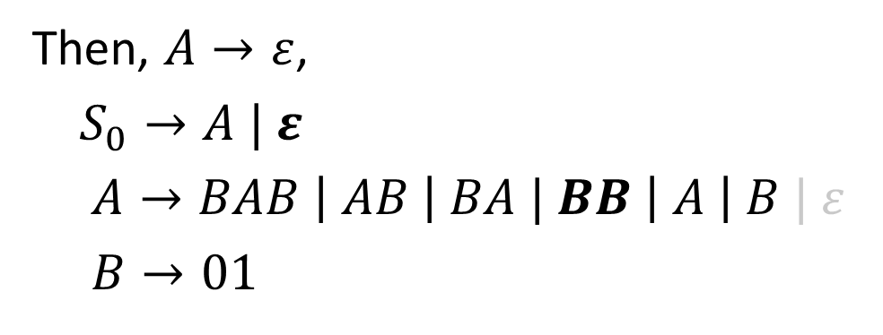
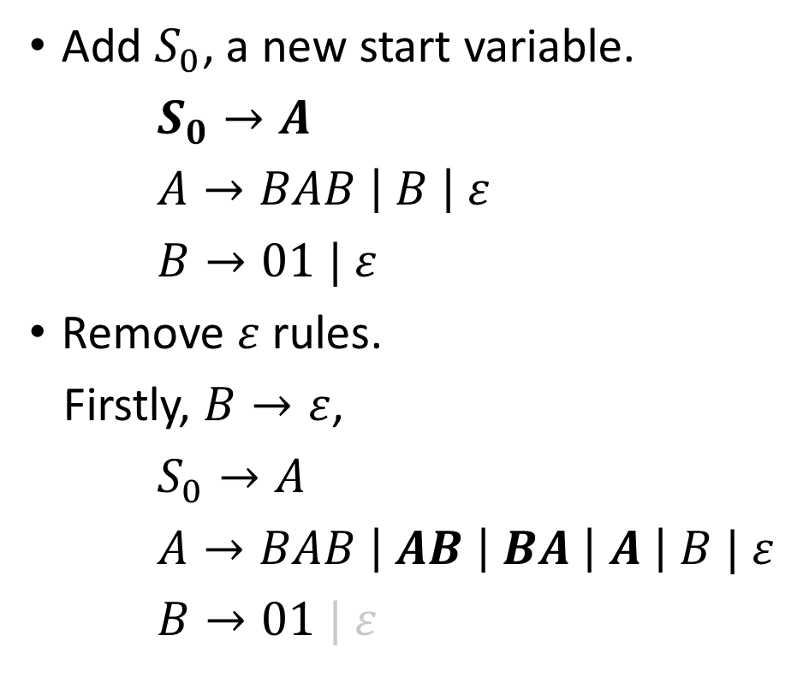
HW#5 – Q6 (1/3)
Add $S_{0}$, a new start variable.
$S_{0}→A$
$A→BAB \left| B \right| ε$
$B→01 | ε$
Remove $ε$ rules.
Firstly, $B→ε$,
$S_{0}→A$
$A→BAB \left| AB \right| BA \left| A \right| B | ε$
$B→01 | ε$
Then, $A→ε$,
$S_{0}→A | ε$
$A→BAB \left| AB \right| BA | BB \left| A \right| B | ε$
$B→01$

Slide 17
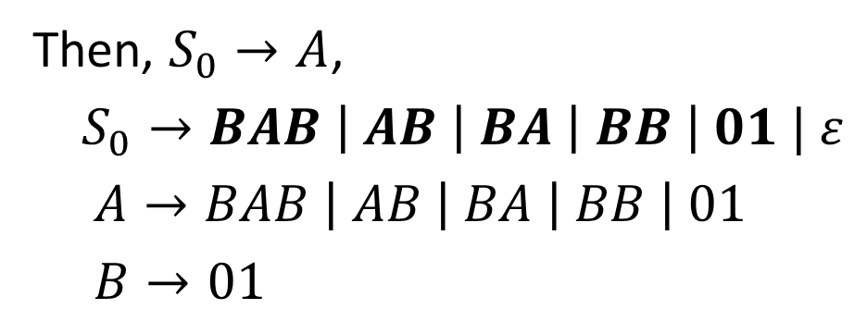
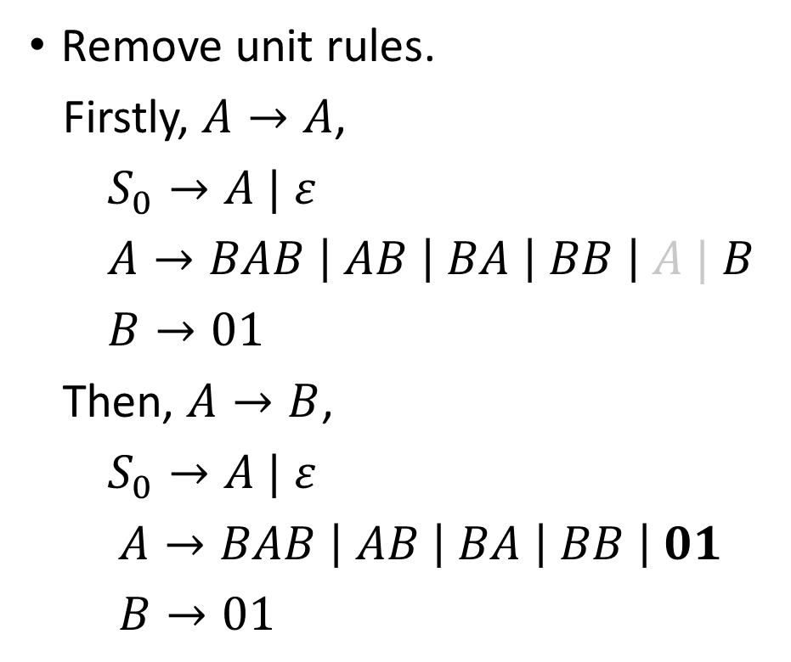
HW#5 – Q6 (2/3)
Remove unit rules.
Firstly, $A→A$,
$S_{0}→A | ε$
$A→BAB \left| AB \right| BA \left| BB \right| A | B$
$B→01$
Then, $A→B$,
$S_{0}→A | ε$
$A→BAB \left| AB \right| BA \left| BB \right| 01$
$B→01$
Then, $S_{0}→A$,
$S_{0}→BAB \left| AB \right| BA \left| BB \right| 01 | ε$
$A→BAB \left| AB \right| BA \left| BB \right| 01$
$B→01$

Slide 18
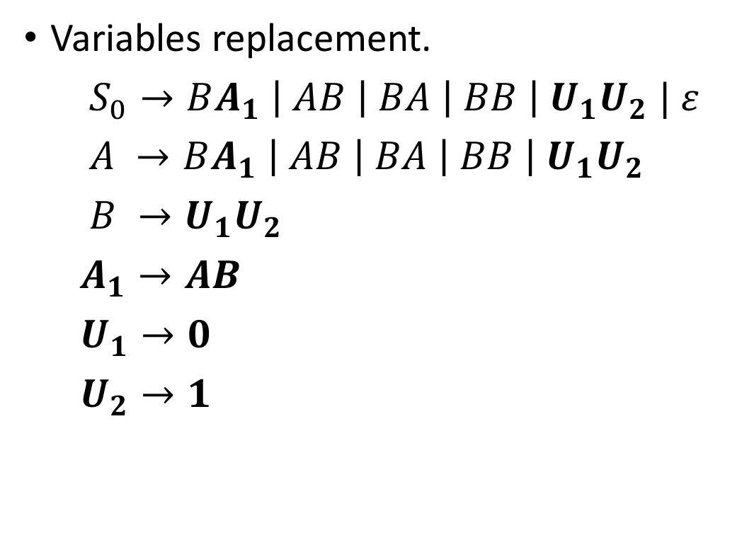
HW#5 – Q6 (3/3)
Variables replacement.
$S_{0}→BA_{1} \left| AB \right| BA \left| BB \right| U_{1}U_{2} | ε$
$A →BA_{1} \left| AB \right| BA \left| BB \right| U_{1}U_{2}$
$B →U_{1}U_{2}$
$A_{1}→AB$
$U_{1}→0$
$U_{2}→1$
Notes:
靠右 三個以上variable時 把右邊兩個換成新的 兩個一組串下去

