Slide 1
Theory of Computing
TA times #3
Willy Chang
2017.05.17

Slide 2
CAUTION
Most solutions we showed in TA’s slides are more
like the ideas rather than completed solutions.
You may take them as guides, but shouldn’t
consider them as all the things you need
to get your homework done.

Slide 3
Head first: Proof by construction
Proof of construction is a good way to give an steady example (or counterexample) that recognizes (or rejects) proof statements.
The important part is WHY it is such defined, and then HOW it is.
So do write down the proof about WHY your design (assignment) is exactly the case that original proof statements require (or reject).

Slide 4
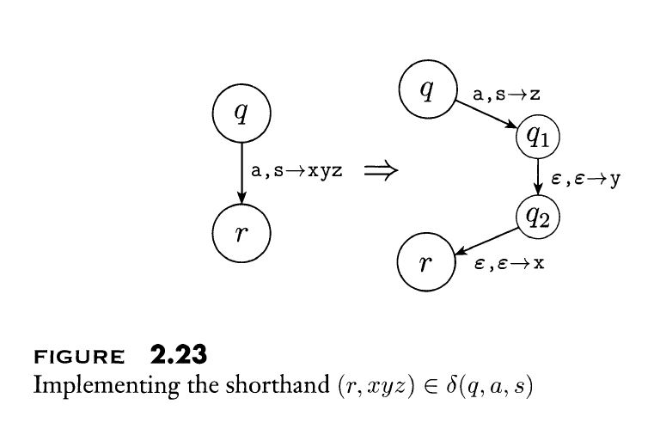
HW#6 – Q3
Take a look at the shorthand expression mentioned in our textbook one more time if you have used it in your homework.
This PDA could handle the following part:
  GRAMMAR Variables
  TERMINALS

Slide 5
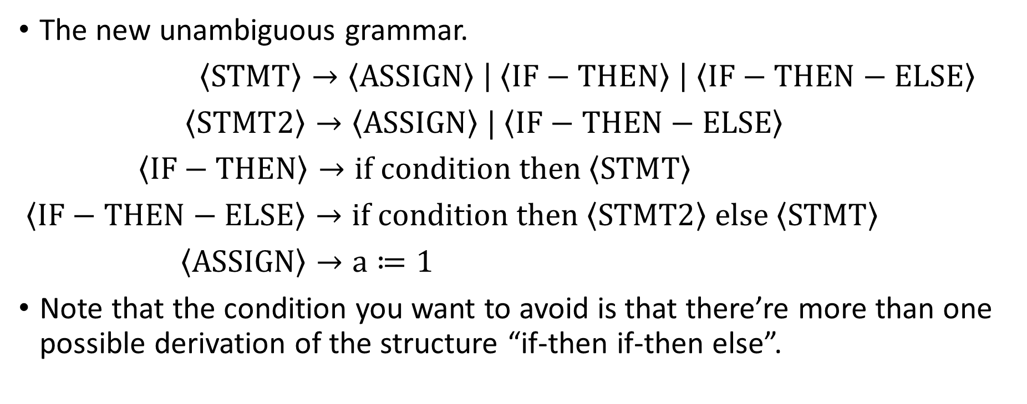
HW#6 – Q4
The new unambiguous grammar.
$\left\langle STMT\right\rangle →\left\langle ASSIGN\right\rangle \left| \left\langle IF−THEN\right\rangle \right| \left\langle IF−THEN−ELSE\right\rangle$
$\left\langle STMT2\right\rangle →\left\langle ASSIGN\right\rangle | \left\langle IF−THEN−ELSE\right\rangle$
$\left\langle IF−THEN\right\rangle →if condition then \left\langle STMT\right\rangle$
$\left\langle IF−THEN−ELSE\right\rangle →if condition then \left\langle STMT2\right\rangle else \left\langle STMT\right\rangle$
$\left\langle ASSIGN\right\rangle →a≔1$
Note that the condition you want to avoid is that there’re more than one possible derivation of the structure “if-then if-then else”.

Slide 6
HW#7 – Q3
Firstly, the instructions haven’t told about in which order a TM can try through all the possible settings.
Secondly, since the possible settings are infinitely many, a TM would never finish them; you can’t have an instruction for TM that requires it tries all the possibilities first then do something, i.e., “otherwise, reject.” in this case.

Slide 7
HW#7 – Q5
Intuitively, two machines recognize the same class of language
(“the same”) if their behaviors are equivalent.
A Turing Machine with left reset could simulate the original version of Turing machine. How?
What if the machine is with RIGHT reset? Is it still equivalent with original Turing Machines?

Slide 8
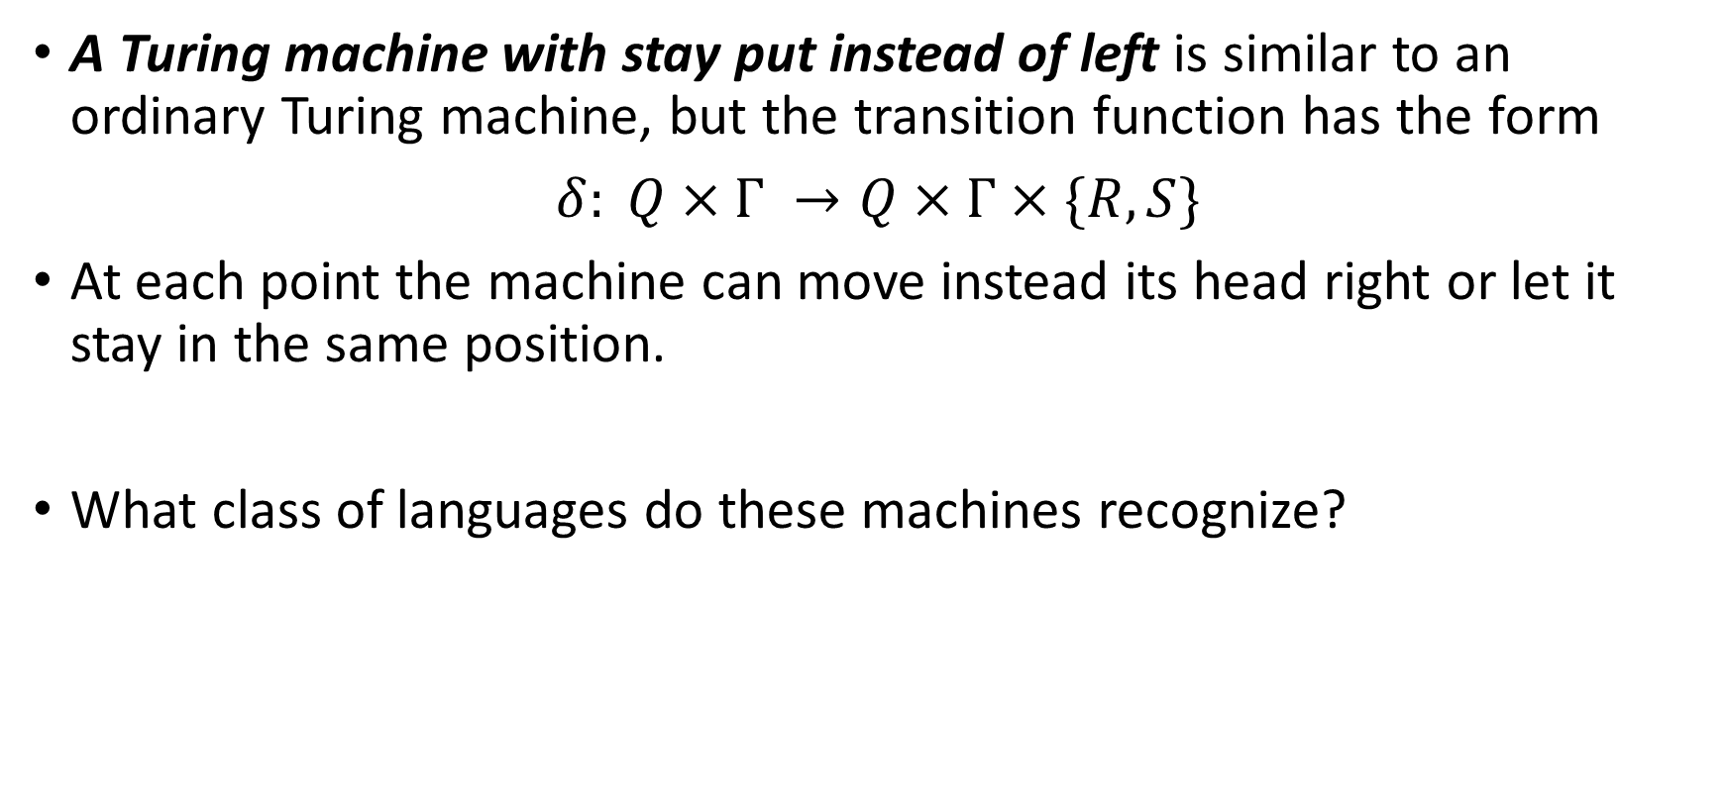
Extra: 2016 HW#7 – Q6 (1/5)
A Turing machine with stay put instead of left is similar to an ordinary Turing machine, but the transition function has the form
$δ: Q×Γ →Q×Γ×\{R,S\}$
At each point the machine can move instead its head right or let it stay in the same position.
What class of languages do these machines recognize?

Slide 9
Extra: 2016 HW#7 – Q6 (2/5)
IDEA – As the Turing machine with stay put instead of left has a similar operating logic with finite automata, we try to show that this type of machines recognize the same class of languages as DFAs.
The easier side first – we show that all the things a DFA can do can also be done with a Turing machine with stay put instead of left.
  Just like the way we simulate a DFA with a normal Turing machine, we can simulate a DFA with the specialized Turing machine here since the simulation of a DFA doesn’t need the head left operation.
The other side – we show that anything that can be done with a Turing machine with stay put instead of left can also be done with a DFA.
Notes:
回顧一下老師剛開始介紹TM的那堂課，
在介紹TM的時候，我們重新看了過去大家學過的幾種Machine，
並且我們說：
它們能夠做的事TM都能夠做、能simulate，TM的能力比他們都要強。
還記得TM怎麼模擬FA嗎？就是head只會moves right，只讀不寫，
所以當我們看到一個TM的head只能往右走或是停在原地時，我們自
然地想到他可能和一個FA能力是一樣的。如果我們能證明他們確實是
等價的，我們也就回答了題目。
首先，一個方向：STM至少和FA有一樣的能力，這部分能輕易得到。
接著我們要來試著證明另一個方向：FA能和STM有一樣能力。

Slide 10
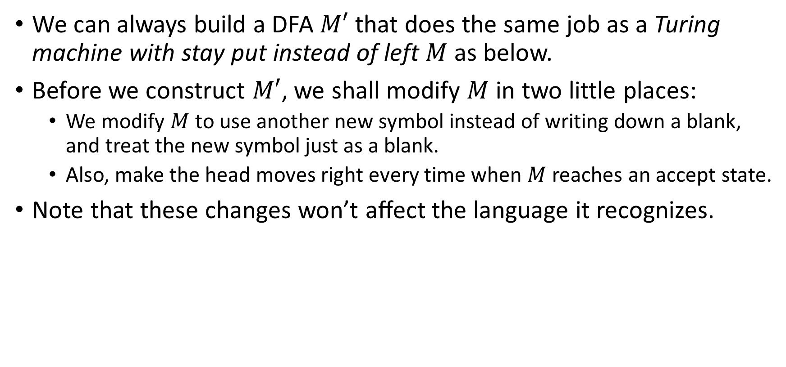
Extra: 2016 HW#7 – Q6 (3/5)
We can always build a DFA $M′$ that does the same job as a Turing machine with stay put instead of left $M$ as below.
Before we construct $M′$, we shall modify $M$ in two little places:
  We modify $M$ to use another new symbol instead of writing down a blank, and treat the new symbol just as a blank.
  Also, make the head moves right every time when $M$ reaches an accept state.
Note that these changes won’t aﬀect the language it recognizes.
Notes:
要說明FA能和STM有一樣的能力，就要說明他們看似不同之處其實
不造成能力的差異。
STM較之於FA的差異之處，就是多了讀到一個輸入之後，可以停留
與修改的能力。這會有什麼影響呢？
讓我們仔細來想一想這個多出來的功能：
先回想一下TM的運算接受是怎麼一回事：如果一個TM的執行結果
是接受的話，是指接受了原本寫在tape上的input。
所以，base on STM在一格tape上所讀到的input，STM做停留並做
一連串修改的動作、而且沒辦法回頭去看；其真正的影響就是讓STM
在讀input時，比FA多了一個可能：可能在某些情況下讀到了一個字
元，STM就會一直在原地打轉再也不讀input了。不然，STM就算在
一格打轉再久，它還是會進入下一格，並且對於input的記憶能力僅
止於state的記憶。
這個較之於FA多出來的行為，會讓STM比FA強嗎？顯然不會，在某
種情況下讀到某個input就不再往下做，其實就是沒能接受該字串的
意思、沒能接受該字串FA也有，兩者一樣。

Slide 11
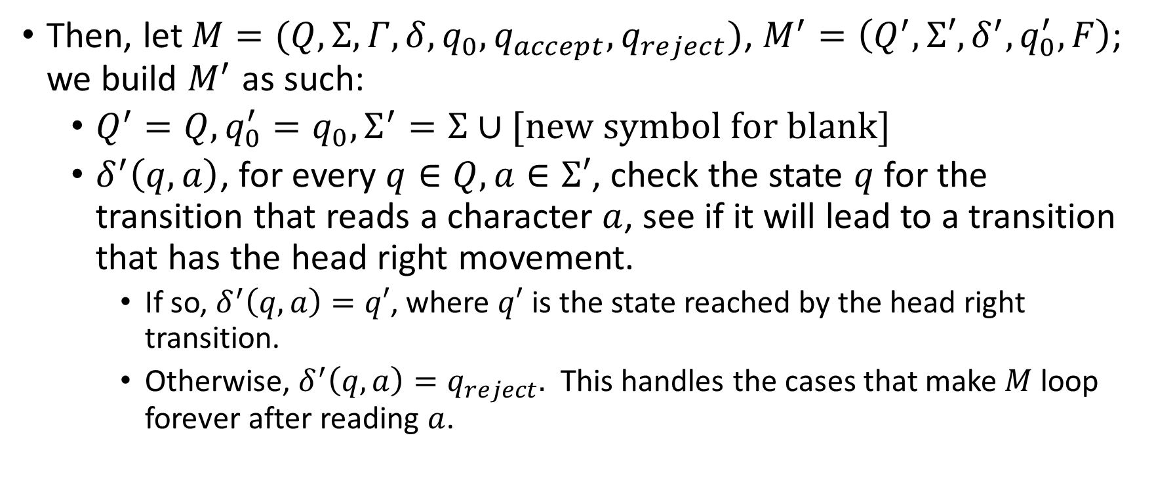
Extra: 2016 HW#7 – Q6 (4/5)
Then, let $M=(Q,Σ, Γ,δ,q_{0}, q_{accept}, q_{reject})$, $M^{′}=\left(Q^{′},Σ′,δ^{′}, q_{0}^{′},F\right)$; we build $M^{′}$ as such:
  $Q^{′}=Q,q_{0}^{′}=q_{0},Σ^{′}=Σ∪[new symbol for blank]$
  $δ^{′}\left(q,a\right)$, for every $q∈Q,a∈Σ′$, check the state $q$ for the transition that reads a character $a$, see if it will lead to a transition that has the head right movement.
    If so, $δ^{′}\left(q,a\right)=q′$, where $q′$ is the state reached by the head right transition.
    Otherwise, $δ^{′}\left(q,a\right)=q_{reject}.$ This handles the cases that make $M$loop forever after reading $a$.
Notes:
另一種FA模擬STM的方法，使用NFA：（此法比投影片中的更為簡潔、下次可考慮更換）
Q'：Q x (Sigma+空格) x Gamma
第一tuple是TM的Q、第二tuple是用來記第一次讀到紙帶格子上的字、
第三tuple是用來模擬TM對於格子中符號的修改。
這麼一來STM在紙帶上一格的各種動作，NFA都能以進入對應的state來模擬。
TM在紙帶上往右走的TM transitions，對應到NFA實際消耗input的transitions；
停留的、還有已經走到底（空格）以後的TM transitions，則對應到NFA的epsilon transitions。

Slide 12
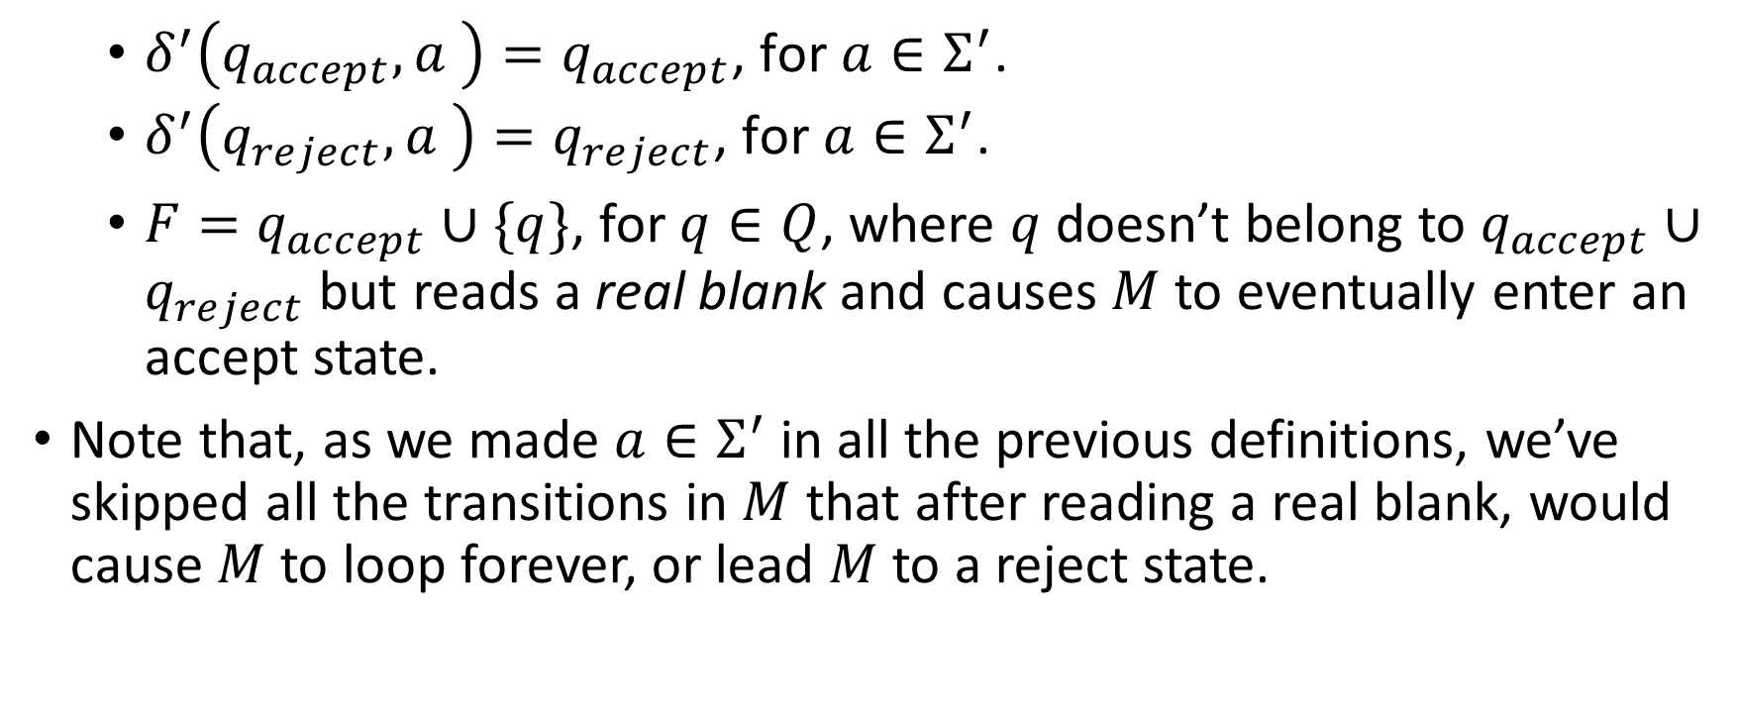
Extra: 2016 HW#7 – Q6 (5/5)
  $δ^{′}\left(q_{accept},a \right)=q_{accept}\text{, }\text{for} a∈Σ^{′}$.
  $δ^{′}\left(q_{reject},a \right)=q_{reject}\text{, }\text{for} a∈Σ^{′}$.
    $F=q_{accept}∪\{q\}$, for $q∈Q$, where $q$ doesn’t belong to $q_{accept}∪q_{reject}$ but reads a real blank and causes $M$ to eventually enter an accept state.
Note that, as we made $a∈Σ^{′}$ in all the previous definitions, we’ve skipped all the transitions in $M$ that after reading a real blank, would cause $M$ to loop forever, or lead $M$ to a reject state.

Slide 13
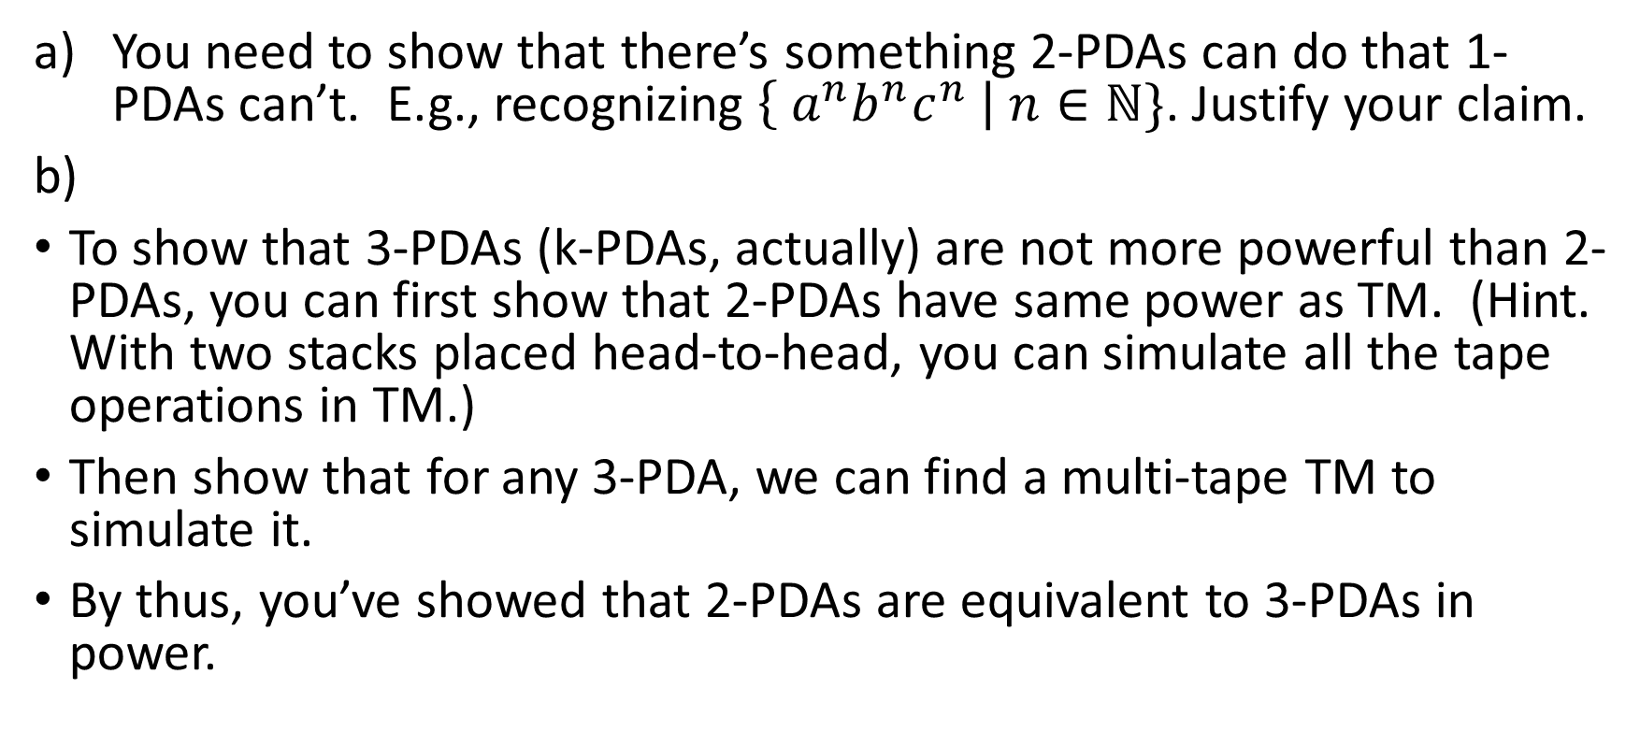
HW#7 – Q6
You need to show that there’s something 2-PDAs can do that 1-PDAs can’t. E.g., recognizing $\left\{ a^{n}b^{n}c^{n} \right| n∈ℕ\}$. Justify your claim.
To show that 3-PDAs (k-PDAs, actually) are not more powerful than 2-PDAs, you can first show that 2-PDAs have same power as TM. (Hint. With two stacks placed head-to-head, you can simulate all the tape operations in TM.)
Then show that for any 3-PDA, we can find a multi-tape TM to simulate it.
By thus, you’ve showed that 2-PDAs are equivalent to 3-PDAs in power.

