Slide 1
Theory of Computing
TA times #4
Willy Chang
2017/06/14

Slide 2
CAUTION
Most solutions we showed in TA’s slides are more
like the ideas rather than completed solutions.
You may take them as guides, but shouldn’t
consider them as all the things you need
to get your homework done.

Slide 3





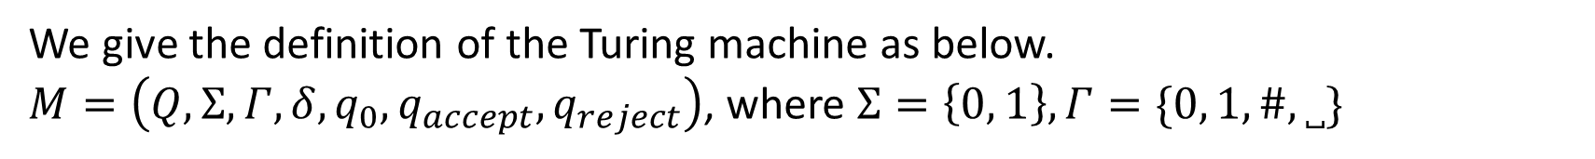








HW#8 – Q1
We give the definition of the Turing machine as below.
$M=\left(Q,Σ,Γ,δ,q_{0},q_{accept},q_{reject}\right)$, where $Σ=\left\{0, 1\right\},Γ=\{0, 1,\#,˽\}$
$$1→\#,R$$
$$1→0,R$$
$$q_{0}$$
$$0→\#,R$$
$$q_{1}$$
$$q_{2}$$
$$0→1,R$$
$$˽→\#,R$$
$$0→R$$
$$1→R$$
$$q_{accept}$$
$$˽→0,R$$
$$˽→1,R$$

Slide 4
HW#8 – Q2 (1/4)
We give an enumerator $E=(Q,Σ,Γ,δ,q_{0},q_{halt})$ as below.
$Q$ is a finite set of states.
$Σ$ is the output alphabet, not including '#'.
$Γ$ is the work tape alphabet.
$δ:Q×Γ→Q×Γ×\left\{L,R\right\}×Σ∪\{\#\}$
work tape printer tape
$q_{0}$ is the initial state.
$q_{halt}$ is the state that stops $E$.

Slide 5
HW#8 – Q2 (2/4)
When $E$operates on the work tape, it may write something as output on the printer tape, including '#', which stands for the separator between output strings.
The machine keeps working until it reaches $q_{halt}$.
The string on printer tape grows in one direction and looks like:
C₁#C₂#C₃# ...
For any C_{i} that occurs in the printer tape, it’s the member of the enumerated language.

Slide 6
HW#8 – Q2 (3/4)
As an example, we make the enumerator enumerate the language $\left\{1^{2^{n}} | n=0, 1, 2, …\right\}$. So strings like 1, 11, 1111 will be enumerated by it while 111, 111111 will not. Since the language is infinite, $E$ will never stop.
Let $Γ=\left\{0, 1,\dot{1},˽\right\},Σ=\{1,ε\}$. The states and the transitions of $E$ go as follows (We skip the output symbol on the diagram when it’s $ε$.) :

Slide 7

























HW#8 – Q2 (4/4)
$$1,\dot{1}→1,L, 1$$
$$\dot{1}→R$$
$$1,0→R$$
$$0,1→L$$
$$q_{0}$$
$$˽→R$$
$$q_{1}$$
$$˽→1,R$$
$$q_{2}$$
$$˽→0,L$$
$$q_{3}$$
$$˽→R, \#$$
$$q_{4}$$
$$1→\dot{1},R$$
$$q_{5}$$
$$˽→1,L$$
$$q_{6}$$
$$\dot{1}→R$$
$$1→L,1$$
$$0→1,R$$
$$q_{9}$$
$$1→0,L$$
$$q_{8}$$
$$˽→L$$
$$q_{7}$$
$$1→R$$
Notes:
Try simulate the dot yourself!

Slide 8
HW#8* – Q3 (1/6)
Since outside the input portion such TM can do whatever a normal TM does, the restriction on its power will then lie in the read-only part (on input portion).
We will show that given one this kind of input read-only machines, its distinguishability on input strings has an upper bound.
  Since the possible input strings are infinite, if your distinguishability is bounded, you will treat some strings the same. And if we let those strings being treated the same form a group, “bounded” tells us that we will only have finite groups.

Slide 9
HW#8* – Q3 (2/6)
In Myhill-Nerode theorem, these groups are called equivalence classes.
And according to Myhill-Nerode theorem, if you are talking about a language with finite equivalence classes, you are talking about a regular language. (You can find more details of Myhill-Nerode theorem in the chapter 1’s PROBLEMS section in the textbook.)
So by showing the upper bound of the machine's distinguishability on strings, showing it can only separate strings into finite groups, we have showed that such kind of machines can only define/recognize regular languages.
Notes:
Problem 1.52 (in U.S. ed.)

Slide 10


HW#8* – Q3 (3/6)
Input string
…
$$x$$
$$y$$
Let us say, on the tape, the input string portion is $x$ and the rest is $y$. With one such machine $M$, how many kinds of $x$ can $M$ distinguish?
$M$ may cross the boundary between $x$ and $y$ several times.
Let's say there is a time that $M$ crosses the boundary, moving from $y$ to $x$, getting into the input portion, doing so on some state $p$; and then (if ever) it comes out from the input portion on some state $q$.
You can find that no matter when, because of the determinism and the read-only constraint, if $M$ ever enters the input portion $x$ on state $p$ again, it will still come out from $x$ on state $q$. The $q$ here is only decided by $p$ and the content in $x$ (unchangable).

Slide 11
HW#8* – Q3 (4/6)
$$p$$
$$q$$
Input string
…
Input string
…
So let us write $T_{x}\left(p\right)=q$ to denote this relationship. If there is another input $x′$, it would then be $T_{x^{′}}$.
On any possible input $s$, the relationship can be denoted as
$T_{s}:\left(Q∪\left\{⊠\right\}\right)→\left(Q∪\{⨂\}\right)$,
where $Q$ is the states of the machine $M$; $⊠$ and $⨂$ are the pseudo states used as follows:
$$⊠$$
$$q$$
$$p$$
$$⨂$$
Input string
…
Input string
…
Input string
…
Input string
…

Slide 12
HW#8* – Q3 (5/6)
We need a pseudo state $⊠$ to denote the state that leads to the first head-out-from-$x$ transition since there isn’t actually one for that. So if the first head-out move happens on state $q$, we have $T_{x}\left(⊠\right)=q$.
And we have $T_{x}\left(p\right)=⨂$ for the case that the head never comes out from the input portion again after entering it on state $p$.
$$⊠$$
$$q$$
$$p$$
$$⨂$$
Input string
…
Input string
…
Input string
…
Input string
…

Slide 13
HW#8* – Q3 (6/6)
Now, if there are two input $u$ and $v$ having a same relationship table (i.e., $T_{u}=T_{v}$), $M$will treat them the same. Namely, they are undistinguishable to $M$; the strings $u$ and $v$ fall into the same group.
Since the possibilities of $T_{s}$ has an upper bound ${(\left|Q\right|+1)}^{\left|Q\right|+1}$, we’ve found an upper bound for the number of groups that $M$ can separate inputs into, a bound for $M$’s distinguishability.
According to Myhill-Nerode theorem, if $M$ can only separate strings into finite groups (equivalence classes), $M$ can only define/recognize a regular language.

Slide 14
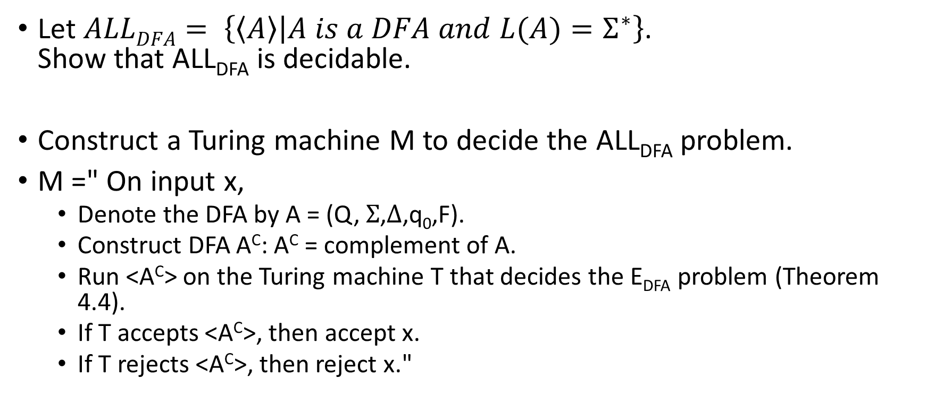
HW#8 – Q5
Let $ALLDFA= \left\{\left\langle A\right\rangle | A is a DFA and L(A)=Σ^{∗}\right\}$.
Show that ALL_{DFA} is decidable.
Construct a Turing machine M to decide the ALL_{DFA} problem.
M =" On input x,
  Denote the DFA by A = (Q, $Σ$,$Δ$,q₀,F).
  Construct DFA A^{C}: A^{C} = complement of A.
  Run <A^{C}> on the Turing machine T that decides the E_{DFA} problem (Theorem 4.4).
  If T accepts <A^{C}>, then accept x.
  If T rejects <A^{C}>, then reject x."
Notes:
It is easy to see that L(A) and L(A^{C}) are the complement of each other with respect to $Σ$*. That is, L(A) = $Σ$* - L(A^{C}).
Hence, L(A) = $Σ$* iff L(A^{C}) = empty. Determining if L(A^{C}) is empty is decidable due to Theorem 4.5, and so determining if L(A) = $Σ$* is decidable as well.

Slide 15
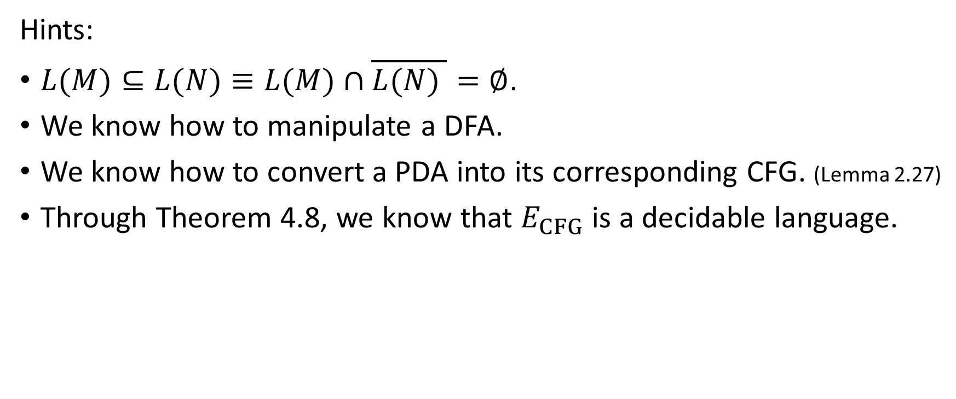
HW#8 – Q6
Hints:
$L(M)⊆L(N)≡L(M)∩\overline{L(N) }=∅$.
We know how to manipulate a DFA.
We know how to convert a PDA into its corresponding CFG. (Lemma 2.27)
Through Theorem 4.8, we know that $E_{CFG}$ is a decidable language.
Notes:
L(M) ⊆ L(N) ≡ L(M)∩ L(N)的補集 = ∅
DFA is closed under complementation
Regular Language ⊆ CFG
所以如果CFG(M) 跟 L(N) 的 bar 作交集，應該可以得到 Theorem 4.8 需要的條件。

Slide 16
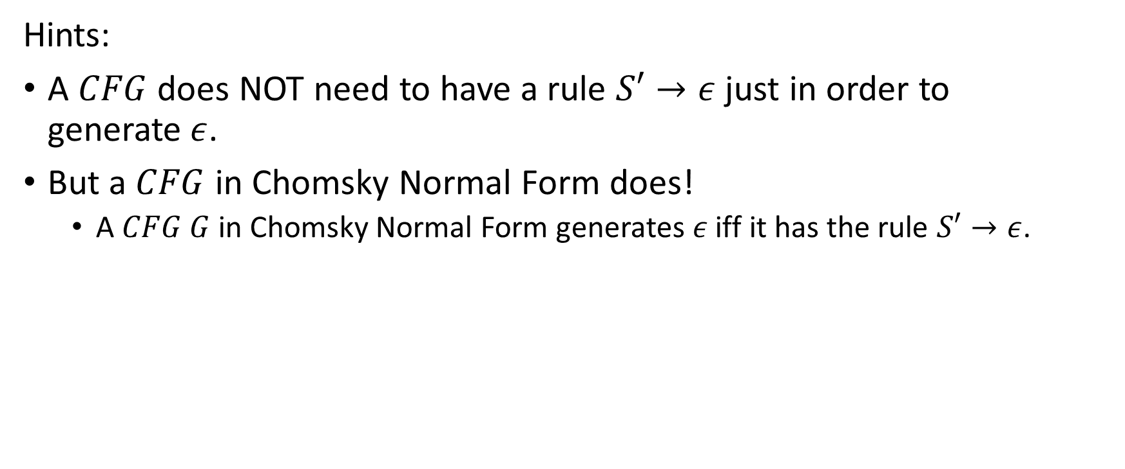
HW#8 – Q7
Hints:
A $CFG$does NOT need to have a rule $S′→ε$ just in order to generate$ε$.
But a $CFG$ in Chomsky Normal Form does!
  A $CFG G$ in Chomsky Normal Form generates$ε$ iff it has the rule $S′→ε$.

Slide 17
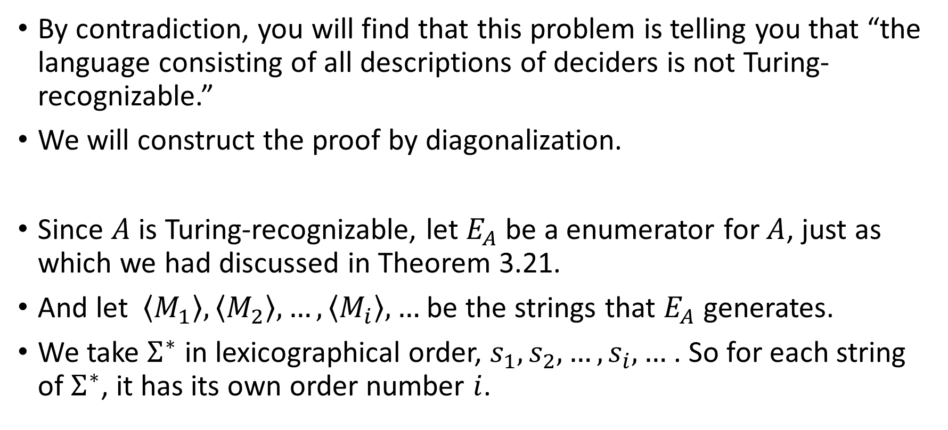
HW#9 – Q2 (1/2)
By contradiction, you will find that this problem is telling you that “the language consisting of all descriptions of deciders is not Turing-recognizable.”
We will construct the proof by diagonalization.
Since $A$ is Turing-recognizable, let $E_{A}$ be a enumerator for $A$, just as which we had discussed in Theorem 3.21.
And let $\left\langle M_{1}\right\rangle ,\left\langle M_{2}\right\rangle ,…,\left\langle M_{i}\right\rangle ,…$ be the strings that $E_{A}$ generates.
We take $Σ^{∗}$ in lexicographical order, $s_{1},s_{2},…,s_{i},…$ . So for each string of $Σ^{∗}$, it has its own order number $i$.

Slide 18
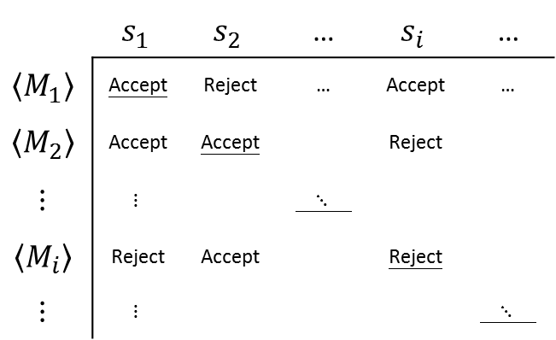
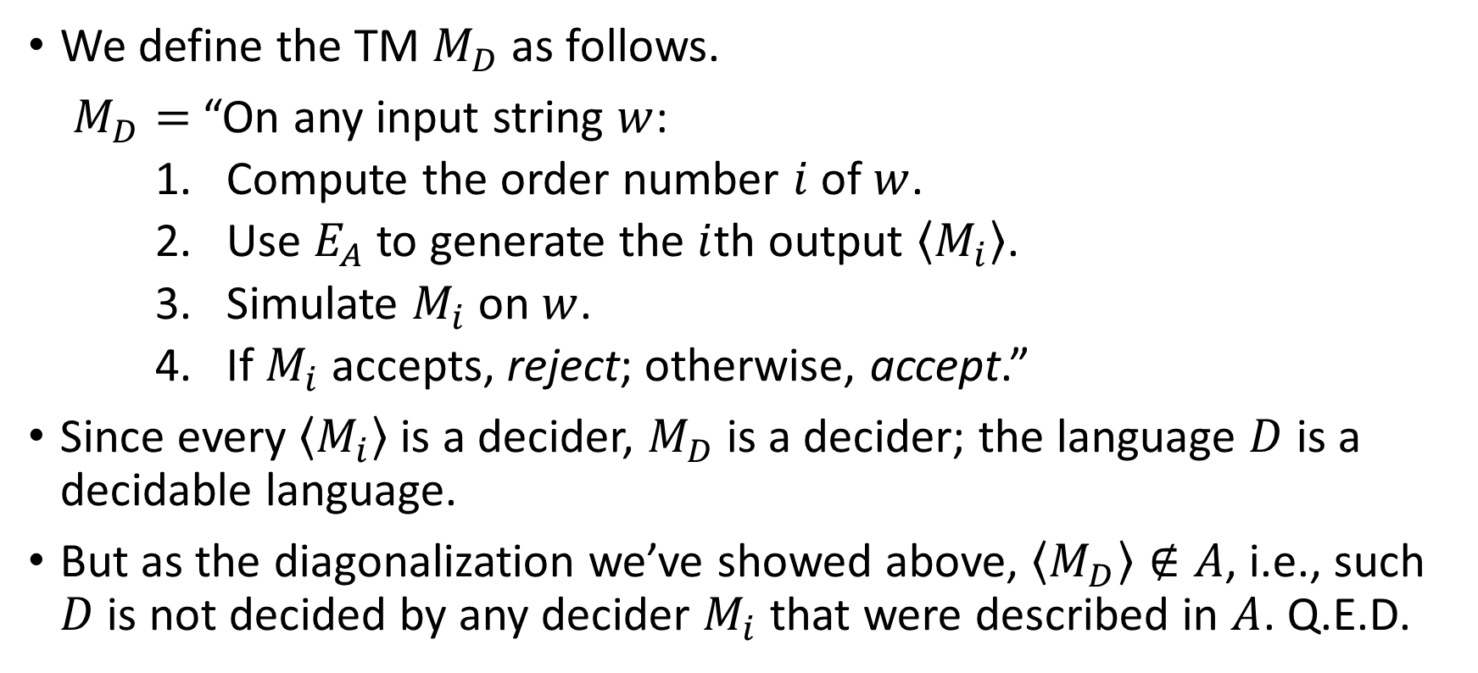
HW#9 – Q2 (2/2)
 | $$s_{1}$$ | $$s_{2}$$ | … | $$s_{i}$$ | …
$$\left\langle M_{1}\right\rangle$$ | Accept | Reject | … | Accept | …
$$\left\langle M_{2}\right\rangle$$ | Accept | Accept |  | Reject
$$⋮$$ | $$⋮$$ |  | $⋱$
$$\left\langle M_{i}\right\rangle$$ | Reject | Accept |  | Reject
$$⋮$$ | $$⋮$$ |  |  |  | $⋱$
We define the TM $M_{D}$ as follows.
$M_{D}=$ “On any input string $w$:
    Compute the order number $i$ of $w$.
    Use $E_{A}$ to generate the $i$th output $\left\langle M_{i}\right\rangle$.
    Simulate $M_{i}$ on $w$.
    If $M_{i}$ accepts, reject; otherwise, accept.”
Since every $\left\langle M_{i}\right\rangle$ is a decider, $M_{D}$ is a decider; the language $D$ is a decidable language.
But as the diagonalization we’ve showed above, $\left\langle M_{D}\right\rangle ∉A$, i.e., such $D$ is not decided by any decider $M_{i}$ that were described in $A$. Q.E.D.

Slide 19
HW#9 – Q3
Hints:
The idea is like the one we applied in HW8 – Q6.
Substring relationships can be described in a regular expression.
Run another machine to make use of Theorem 4.8.
Notes:
L (G) \cap (\Sigma* x \Sigma*) = L (G’<G,x>)
Build TM T=“On input <G,x> where G is a CFG and x is a string
1. Let G’<G,x> be the CFG of …
2. Run a decider R:=R(Ecfg) on <G’<G,x>>
3. If R accepts which means x is not accepted on G’ , so T rejects; otherwise, accepts. R always halts
If x is a substring of some w \in L(G) then L(G) \cap (RE) \neq \emptyset

Slide 20
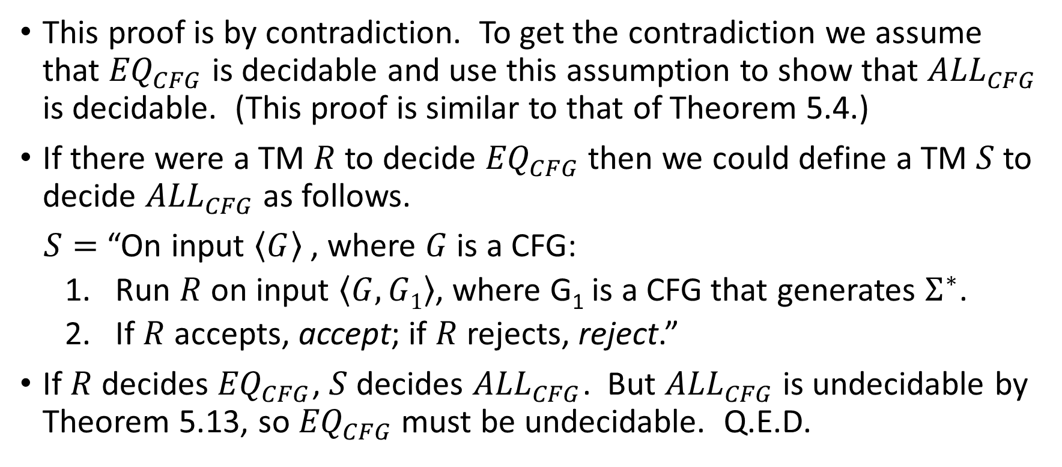
HW#9 – Q5
This proof is by contradiction. To get the contradiction we assume that ${EQ}_{CFG}$ is decidable and use this assumption to show that ${ALL}_{CFG}$ is decidable. (This proof is similar to that of Theorem 5.4.)
If there were a TM $R$ to decide ${EQ}_{CFG}$ then we could define a TM $S$ to decide ${ALL}_{CFG}$ as follows.
$S=$ “On input $\left\langle G\right\rangle$ , where $G$ is a CFG:
  Run $R$ on input $\left\langle G, G1\right\rangle$, where G₁ is a CFG that generates $Σ^{∗}$.
  If $R$ accepts, accept; if $R$ rejects, reject.”
If $R$ decides ${EQ}_{CFG}$, $S$ decides ${ALL}_{CFG}$. But ${ALL}_{CFG}$ is undecidable by Theorem 5.13, so ${EQ}_{CFG}$ must be undecidable. Q.E.D.

Slide 21
HW#10 – Q2 (1/2)
Given a TM M and input w, we can construct a 2DFA M’ to test if M accepts w.
Given a TM D can decide E_{2DFA}, we can decide E_{TM} based on D. (Reduction: E_{TM} → E_{2DFA})
That is,
M = “On input <M>,
  Construct a 2DFA M’ which recognizes the accepting computation history of M.
  Run D on M’. If D accepts, accept. Otherwise, reject.”
→ Since E_{TM} is undecidable, we meet a contradiction.
→ E_{2DFA} is undecidable.

Slide 22
HW#10 – Q2 (2/2)
To construct M’:
For a TM M and an input w, M’ accepts an accepting computation history for M on w.
  We assume a computation history should look like:
  C₁#C₂#C₃#...#C_{k}
  And M’ will decide the computation history by checking following 2 conditions:
  C₁ and C_{k} are valid start and accepting configurations.
    Check if C₁ contains q₀ and C_{k} contains q_{accept}.
  For each C_{i}, C_{i+1} will legally follow from C_{i}.
    Using two heads, we check if the symbol of C_{i} applying to the transition function leads to the corresponding position of C_{i+1 ,}
    L(M)=L(‘M)=emptyset.
  If both conditions holds, M’ accepts. Otherwise, reject.
Notes:
Valid : contains legal alphabet from M

Slide 23
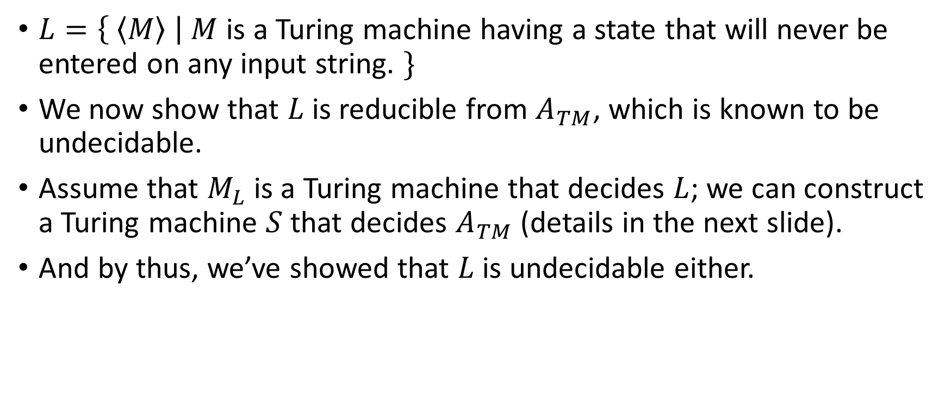
HW#10* – Q4 (1/2)
$L=\left\{ \left\langle M\right\rangle \right| M$ is a Turing machine having a state that will never be entered on any input string. $\}$
We now show that $L$ is reducible from $A_{TM}$, which is known to be undecidable.
Assume that $M_{L}$ is a Turing machine that decides $L$; we can construct a Turing machine $S$ that decides $A_{TM}$ (details in the next slide).
And by thus, we’ve showed that $L$ is undecidable either.

Slide 24
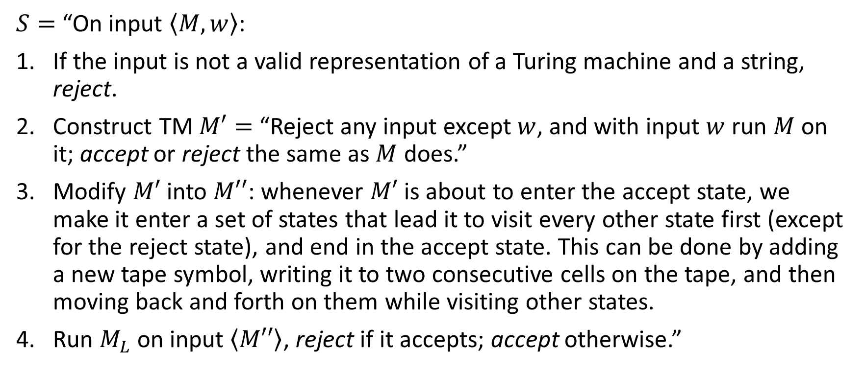
HW#10* – Q4 (2/2)
$S=$ “On input $\left\langle M, w\right\rangle$:
If the input is not a valid representation of a Turing machine and a string, reject.
Construct TM $M′=$ “Reject any input except $w$, and with input $w$ run $M$ on it; accept or reject the same as $M$ does.”
Modify $M′$ into $M′′$: whenever $M′$ is about to enter the accept state, we make it enter a set of states that lead it to visit every other state first (except for the reject state), and end in the accept state. This can be done by adding a new tape symbol, writing it to two consecutive cells on the tape, and then moving back and forth on them while visiting other states.
Run $M_{L}$ on input $\left\langle M′′\right\rangle$, reject if it accepts; accept otherwise.”
Notes:
更正：$M′$ 到 $M′′$ 的調整是針對「即將進入accept state的transition」而非reject state。
目標：當$w$會被$M$接受時，$M′′$沒有useless state；不會時，$M′′$有useless state（至少，於調整時加入的那些用於準備遍訪各state用的那些states即為useless state）。

