Slide 1
Theory of Computing
TA times #3
Ching Chieh Lin
2018/5/16

Slide 2
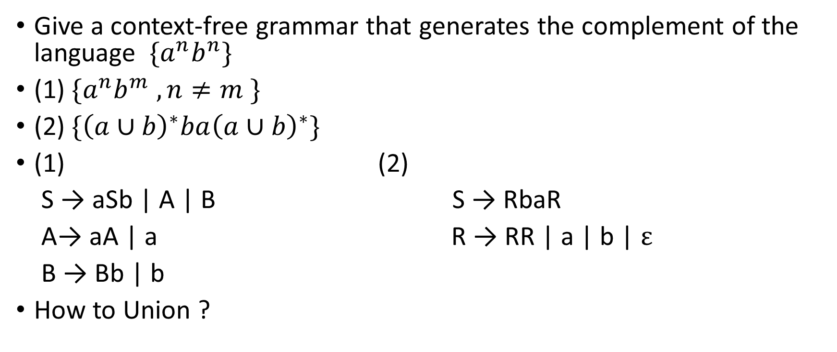
Hw5. Q3 Generate CFG
Give a context-free grammar that generates the complement of the language $\{a^{n}b^{n}\}$
(1) $\{a^{n}b^{m} , n≠m \}$
(2) $\{{\left(a∪b\right)}^{∗}ba{\left(a∪b\right)}^{∗}\}$
(1) (2)
S → aSb | A | B S → RbaR
A→ aA | a R → RR | a | b | $ε$
B → Bb | b
How to Union ?

Slide 3
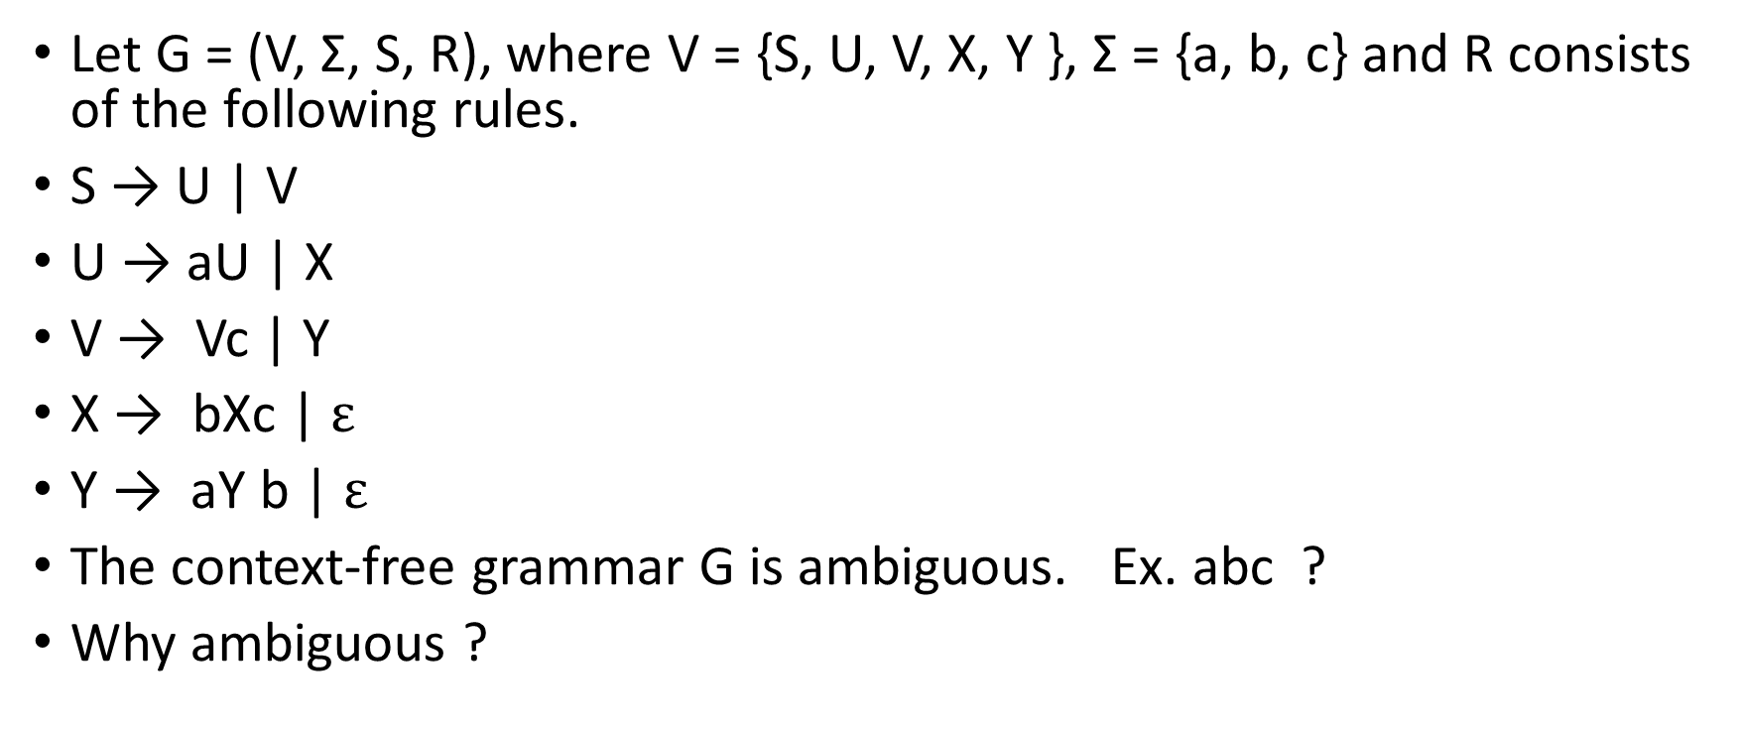
Hw5.Q5 CFG & ambiguity
Let G = (V, Σ, S, R), where V = {S, U, V, X, Y }, Σ = {a, b, c} and R consists of the following rules.
S → U | V
U → aU | X
V → Vc | Y
X → bXc | $ε$
Y → aY b | $ε$
The context-free grammar G is ambiguous. Ex. abc ?
Why ambiguous ?

Slide 4
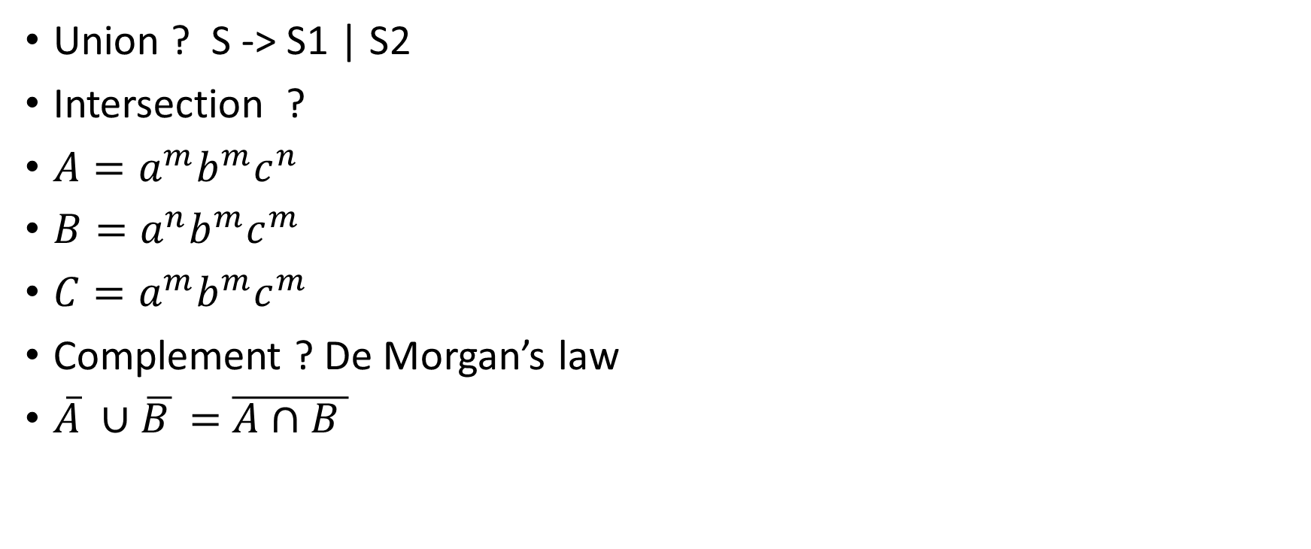
Hw6.Q1 CFL closedness
Union ? S -> S1 | S2
Intersection ?
$A=a^{m}b^{m}c^{n}$
$B=a^{n}b^{m}c^{m}$
$C=a^{m}b^{m}c^{m}$
Complement ? De Morgan’s law
$\overline{A} ∪\overline{B }$ $=$ $\overline{A∩B }$

Slide 5
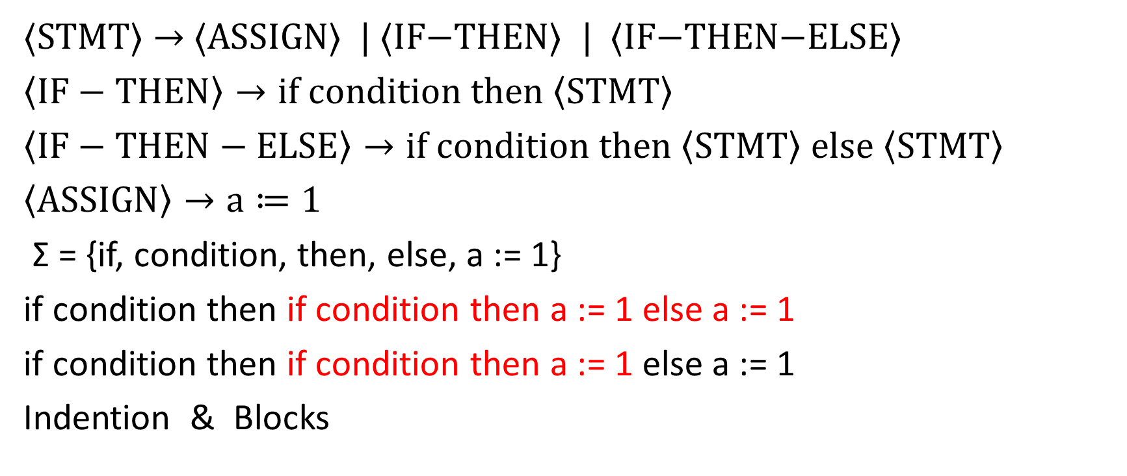
Hw6.Q4 Ambiguity of grammar
⟨STMT⟩ → ⟨ASSIGN⟩ | ⟨IF−THEN⟩ | ⟨IF−THEN−ELSE⟩
$\left\langle IF−THEN\right\rangle →if condition then \left\langle STMT\right\rangle$
$\left\langle IF−THEN−ELSE\right\rangle →if condition then \left\langle STMT\right\rangle else \left\langle STMT\right\rangle$
$\left\langle ASSIGN\right\rangle →a≔1$
Σ = {if, condition, then, else, a := 1}
if condition then if condition then a := 1 else a := 1
if condition then if condition then a := 1 else a := 1
Indention & Blocks

Slide 6
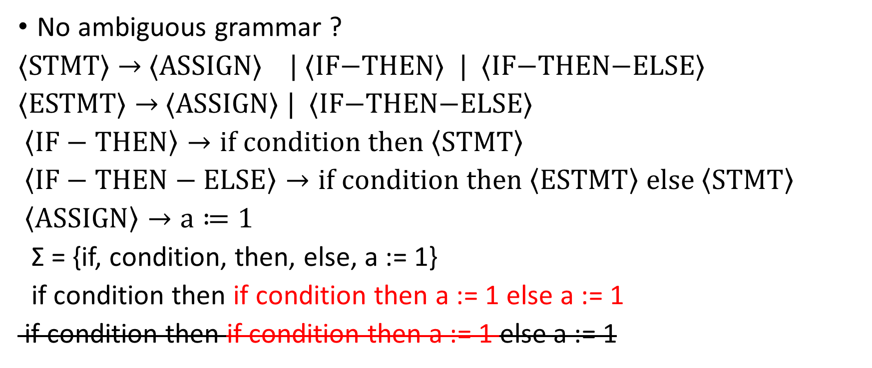
Hw6.Q4 Ambiguity of grammar (Cont.)
No ambiguous grammar ?
⟨STMT⟩ → ⟨ASSIGN⟩ | ⟨IF−THEN⟩ | ⟨IF−THEN−ELSE⟩
⟨ESTMT⟩ → ⟨ASSIGN⟩ | ⟨IF−THEN−ELSE⟩
$\left\langle IF−THEN\right\rangle →if condition then \left\langle STMT\right\rangle$
$\left\langle IF−THEN−ELSE\right\rangle →if condition then \left\langle ESTMT\right\rangle else \left\langle STMT\right\rangle$
$\left\langle ASSIGN\right\rangle →a≔1$
Σ = {if, condition, then, else, a := 1}
if condition then if condition then a := 1 else a := 1
if condition then if condition then a := 1 else a := 1

Slide 7
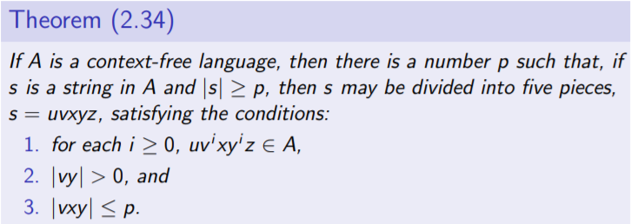
Hw6.Q5 Pumping Lemma for CFL
Pumping lemma in regular language
Pumping lemma in context free language
Finite ! (1) State (2) Variable
Let A be the language of all palindromes over {0, 1} with equal numbers of 0s and 1s

Slide 8
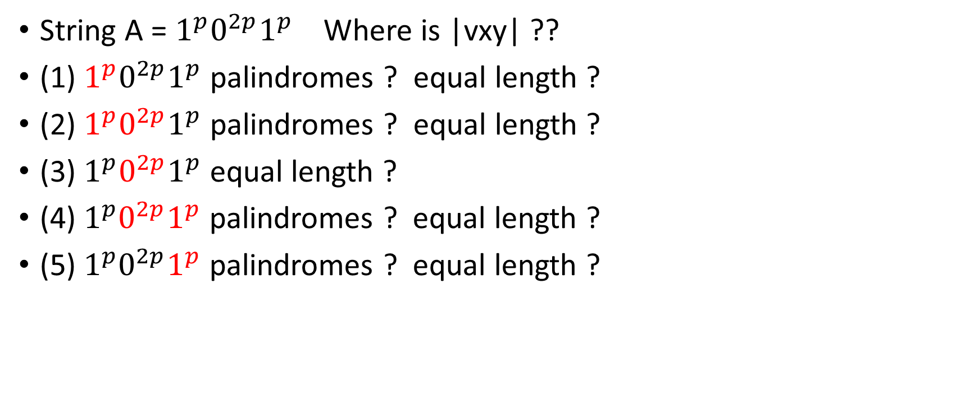
Hw6.Q5 Pumping Lemma for CFL (Cont.)
String A = $1^{p}0^{2p}1^{p}$ Where is |vxy| ??
(1) $1^{p}0^{2p}1^{p}$ palindromes ? equal length ?
(2) $1^{p}0^{2p}1^{p}$ palindromes ? equal length ?
(3) $1^{p}0^{2p}1^{p}$ equal length ?
(4)${ 1}^{p}0^{2p}1^{p}$ palindromes ? equal length ?
(5)${ 1}^{p}0^{2p}1^{p}$ palindromes ? equal length ?

Slide 9
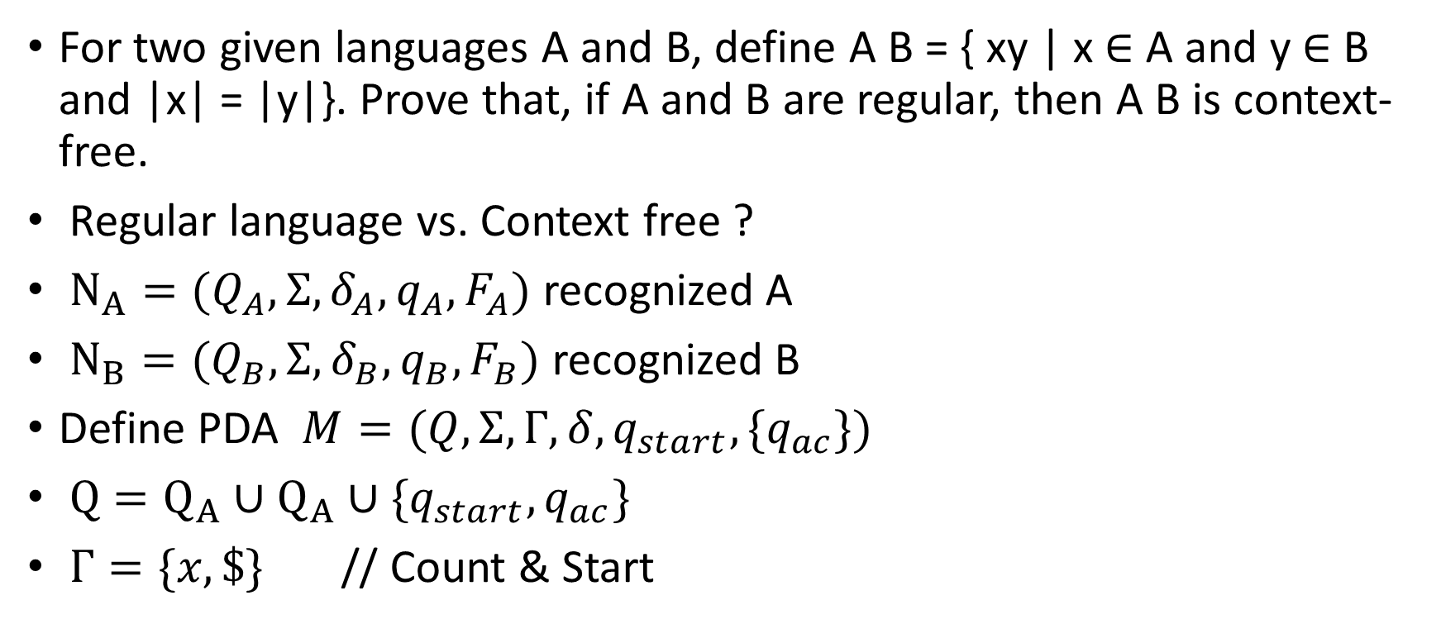
Hw6.Q6 Equal length Combination
For two given languages A and B, define A B = { xy | x ∈ A and y ∈ B and |x| = |y|}. Prove that, if A and B are regular, then A B is context-free.
Regular language vs. Context free ?
$N_{A}=(Q_{A},Σ,δ_{A},q_{A},F_{A})$ recognized A
$N_{B}=(Q_{B},Σ,δ_{B},q_{B},F_{B})$ recognized B
Define PDA $M=(Q,Σ,Γ,δ,q_{start},\{q_{ac}\})$
$Q=Q_{A}∪Q_{A}∪\{q_{start},q_{ac}\}$
$Γ=\{x,\$\}$ // Count & Start

Slide 10
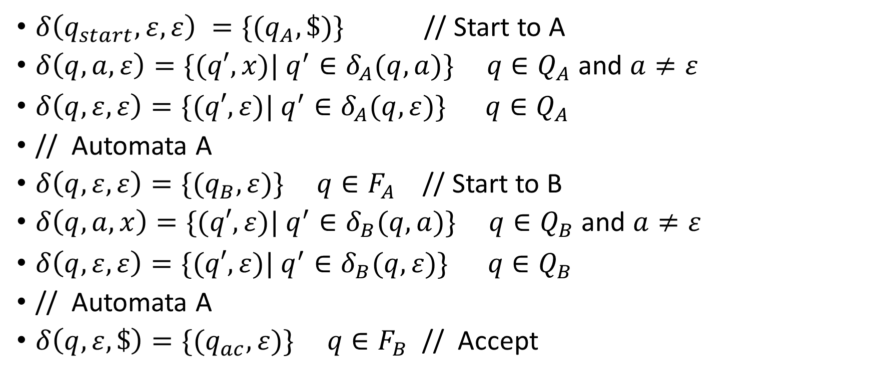
Hw6.Q6 Equal length Combination (Cont.)
$δ\left(q_{start},ε,ε\right) =\{(q_{A},\$)\}$ // Start to A
$δ\left(q,a,ε\right)=\{(q′,x)| q^{′}∈δ_{A}(q,a)\} q∈Q_{A}$and $a≠ε$
$δ\left(q,ε,ε\right)=\{(q′,ε)| q^{′}∈δ_{A}(q,ε)\} q∈Q_{A}$
// Automata A
$δ\left(q,ε,ε\right)=\{(q_{B},ε)\} q∈F_{A}$ // Start to B
$δ\left(q,a,x\right)=\{(q′,ε)| q^{′}∈δ_{B}(q,a)\} q∈Q_{B}$and $a≠ε$
$δ\left(q,ε,ε\right)=\{(q′,ε)| q^{′}∈δ_{B}(q,ε)\} q∈Q_{B}$
// Automata A
$δ\left(q,ε,\$\right)=\{(q_{ac},ε)\} q∈F_{B}$ // Accept

Slide 11
Hw7. Q4 Left-reset TM recognizability
Origin TM recognizability >= Left - reset TM recognizability
Left - rest TM simulate origin TM
right operation = > Stay the same
left operation ?
Move head?
Move Tape !
1 | 2 | 3 | 4 | …
1 | 2 | 3 | 4 | …
 | 1 | 2 | 3 | …

Slide 12
Hw7. Q4 Left-reset TM recognizability(Cont.)
How to shift the tape ?
State can memorize previous symbol until blank
Mark position ?
1
X | 2 | 3 | 4 | …
2
X | 1 | 3 | 4 | …

Slide 13
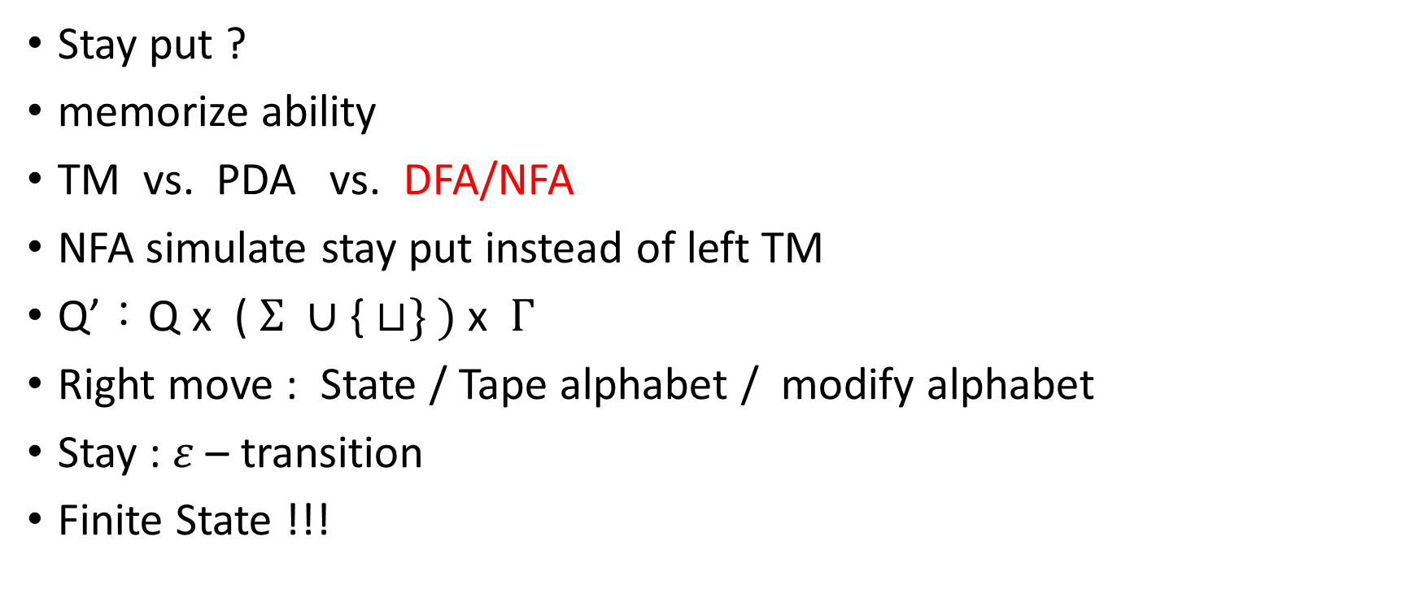
Hw7.Q5 Stay put instead of left TM
Stay put ?
memorize ability
TM vs. PDA vs. DFA/NFA
NFA simulate stay put instead of left TM
Q’：Q x ( $Σ ∪\text{\{}⊔\} )$ x $Γ$
Right move : State / Tape alphabet / modify alphabet
Stay : $ε$ – transition
Finite State !!!

Slide 14
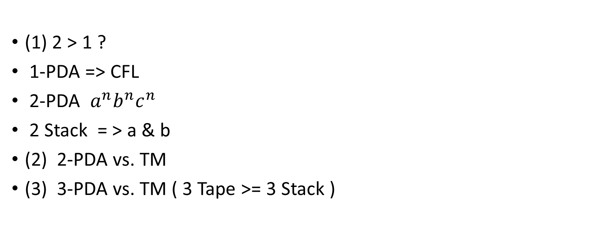
Hw7.Q6 k-PDA recognizability
(1) 2 > 1 ?
1-PDA => CFL
2-PDA $a^{n}b^{n}c^{n}$
2 Stack = > a & b
(2) 2-PDA vs. TM
(3) 3-PDA vs. TM ( 3 Tape >= 3 Stack )
Tape
Stack1
Stack2

Slide 15
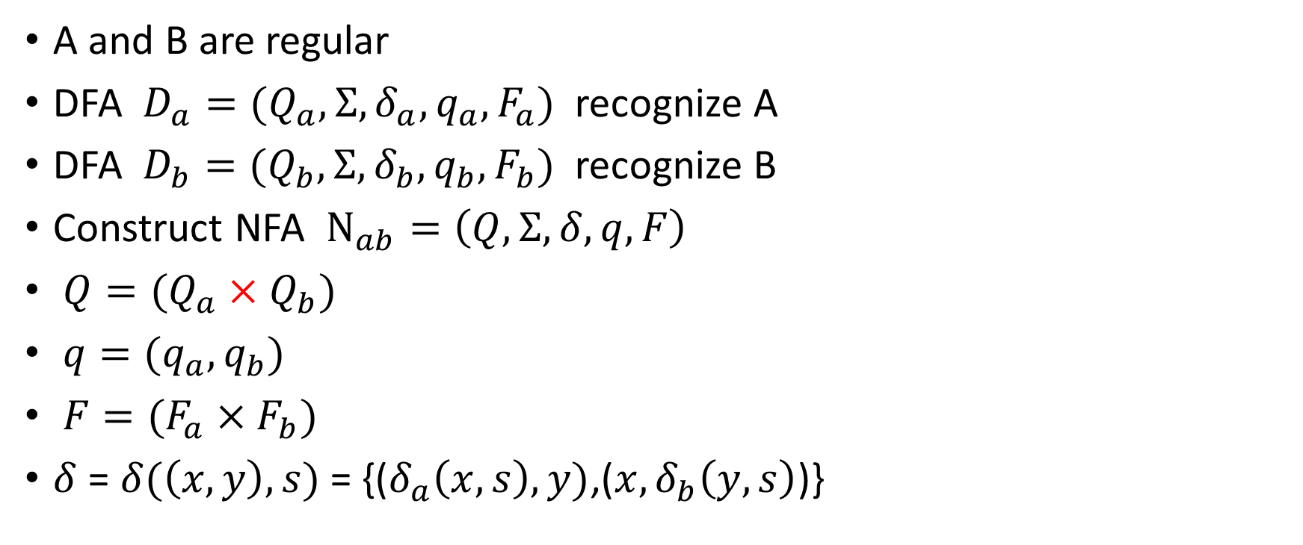
Midterm. Q4
Regular languages is closed under shuffle
A and B are regular
DFA $D_{a}=(Q_{a},Σ,δ_{a},q_{a}, F_{a})$ recognize A
DFA $D_{b}=(Q_{b},Σ,δ_{b},q_{b}, F_{b})$ recognize B
Construct NFA $N_{ab}=\left(Q,Σ,δ,q,F\right)$
$Q=(Q_{a}×Q_{b})$
$q=(q_{a},q_{b})$
$F=(F_{a}×F_{b})$
$δ$ = $δ(\left(x,y\right),s)$ = {($δ_{a}\left(x,s\right),y)$,(${x,δ}_{b}\left(y,s\right)$)}

Slide 16
Midterm Q8.
Same as Hw6.Q6

