Slide 1
Theory of Computing
TA times #4
Ching Chieh Lin
2018/6/13

Slide 2
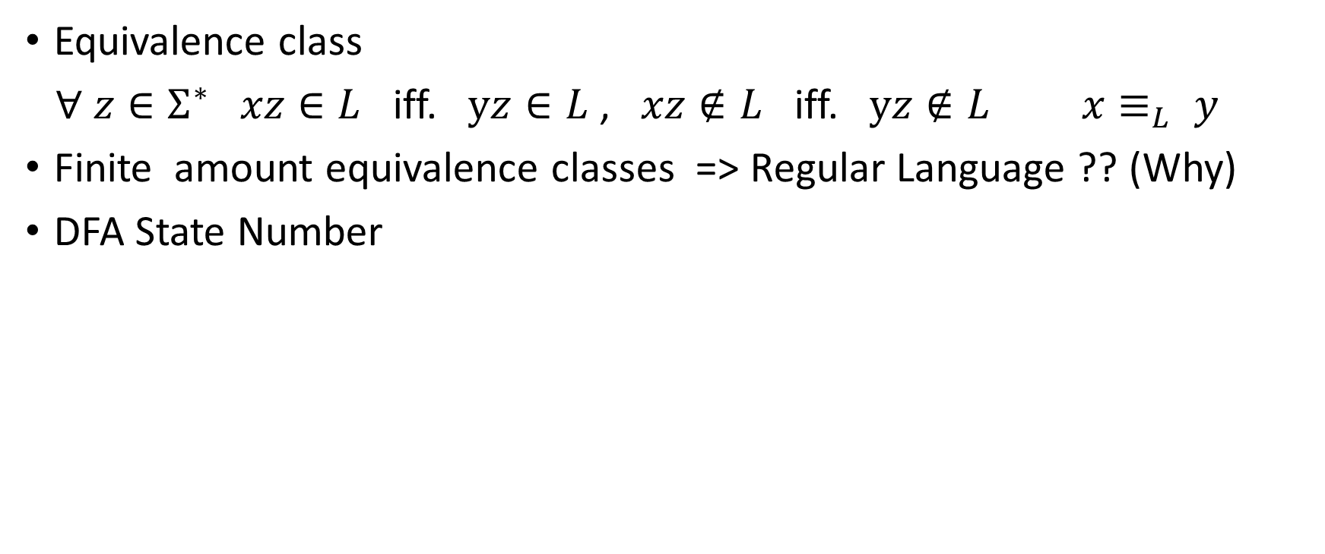
Hw8.Q3 Myhill-Nerode Theorem
Equivalence class
$∀ z∈Σ^{∗} xz∈L$ iff. $yz∈L$ , $xz∉L$ iff. $yz∉L$ $x≡_{L} y$
Finite amount equivalence classes => Regular Language ?? (Why)
DFA State Number

Slide 3

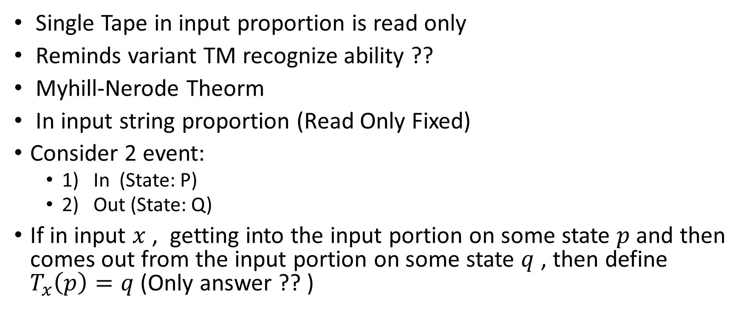



Hw8.Q3 Partial read-only TM
Single Tape in input proportion is read only
Reminds variant TM recognize ability ??
Myhill-Nerode Theorm
In input string proportion (Read Only Fixed)
Consider 2 event:
  1) In (State: P)
  2) Out (State: Q)
If in input $x$ , getting into the input portion on some state $p$ and then comes out from the input portion on some state $q$ , then define $T_{x}\left(p\right)=q$ (Only answer ?? )
Input string
…
$$x$$
$$y$$
$$P$$
$$Q$$
Input string
…
Input string
…

Slide 4
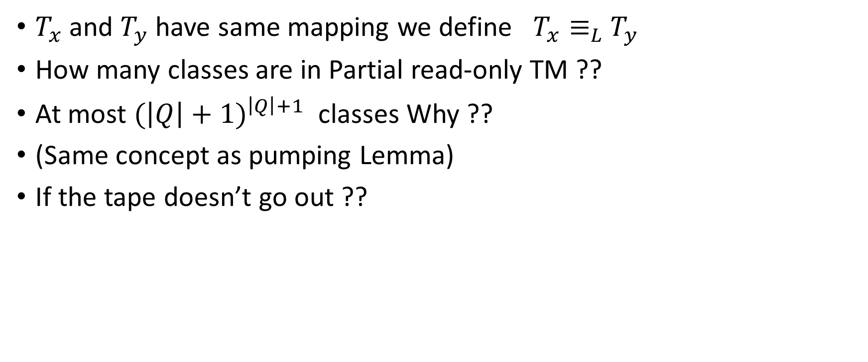
Hw8.Q3 Partial read-only TM (Cont.)
$T_{x}$ and $T_{y}$ have same mapping we define $T_{x}≡_{L}$ $T_{y}$
How many classes are in Partial read-only TM ??
At most ${(\left|Q\right|+1)}^{\left|Q\right|+1}$ classes Why ??
(Same concept as pumping Lemma)
If the tape doesn’t go out ??

Slide 5
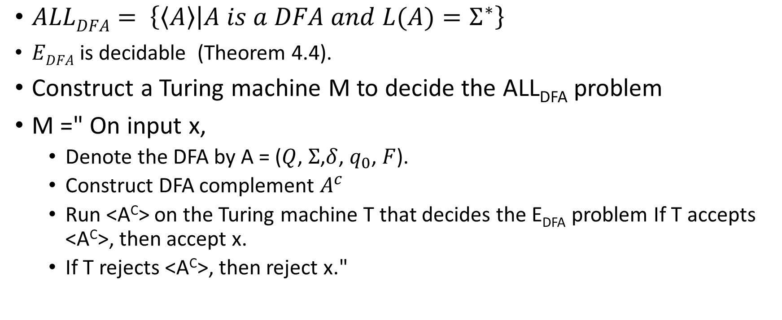
Hw8. Q5 All- DFA Decidability
$ALLDFA= \left\{\left\langle A\right\rangle | A is a DFA and L(A)=Σ^{∗}\right\}$
  $EDFA$ is decidable (Theorem 4.4).
Construct a Turing machine M to decide the ALL_{DFA} problem
M =" On input x,
  Denote the DFA by A = ($Q$, $Σ$,$δ$, $q_{0}$, $F$).
  Construct DFA complement $A^{c}$
  Run <A^{C}> on the Turing machine T that decides the E_{DFA} problem If T accepts <A^{C}>, then accept x.
  If T rejects <A^{C}>, then reject x."

Slide 6
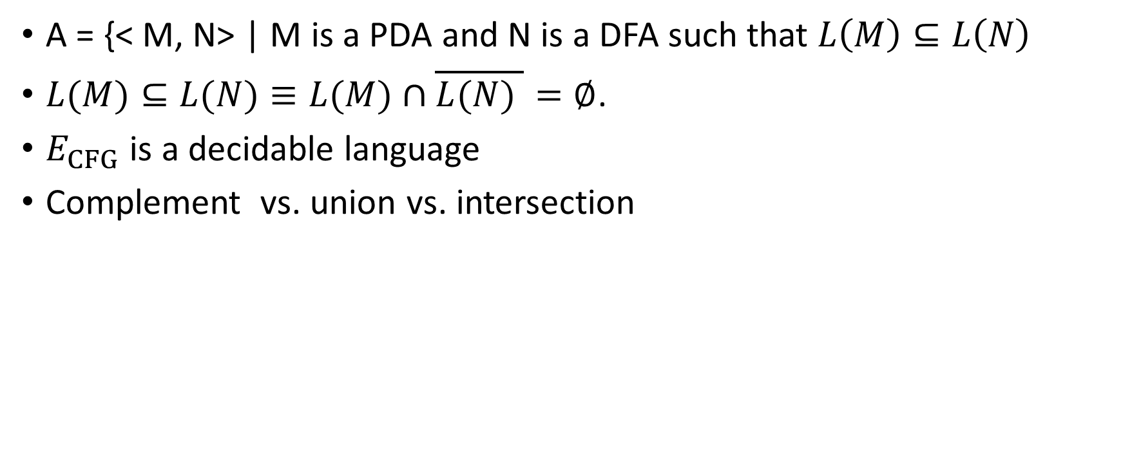
Hw8. Q6 PDA – DFA decidability
A = {< M, N> | M is a PDA and N is a DFA such that $L\left(M\right)⊆L\left(N\right)$
$L(M)⊆L(N)≡L(M)∩\overline{L(N) }=∅$.
$E_{CFG}$ is a decidable language
Complement vs. union vs. intersection

Slide 7
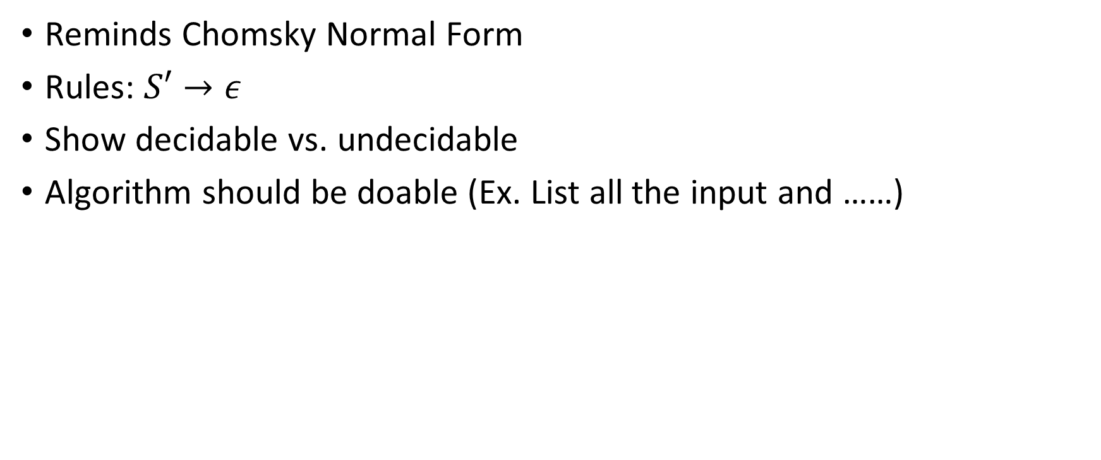
Hw8. Q7 AεCFG decidability
Reminds Chomsky Normal Form
Rules: $S′→ε$
Show decidable vs. undecidable
Algorithm should be doable (Ex. List all the input and ……)

Slide 8
Hw9. Q1 Same size & Equivalence relation
Equivalence relation :
  Symmetric
  Reflexive
  Transitive
Same size : Correspondence
You need to show the property satisfy !!

Slide 9
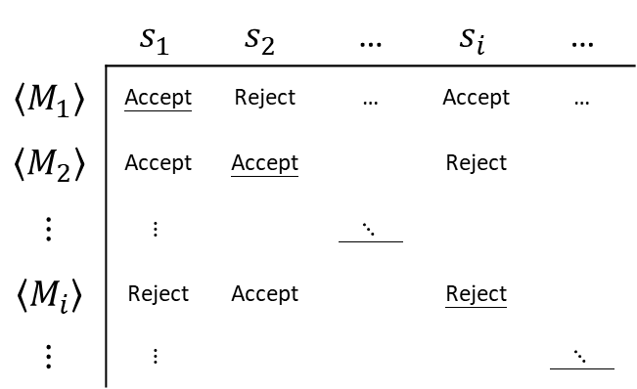
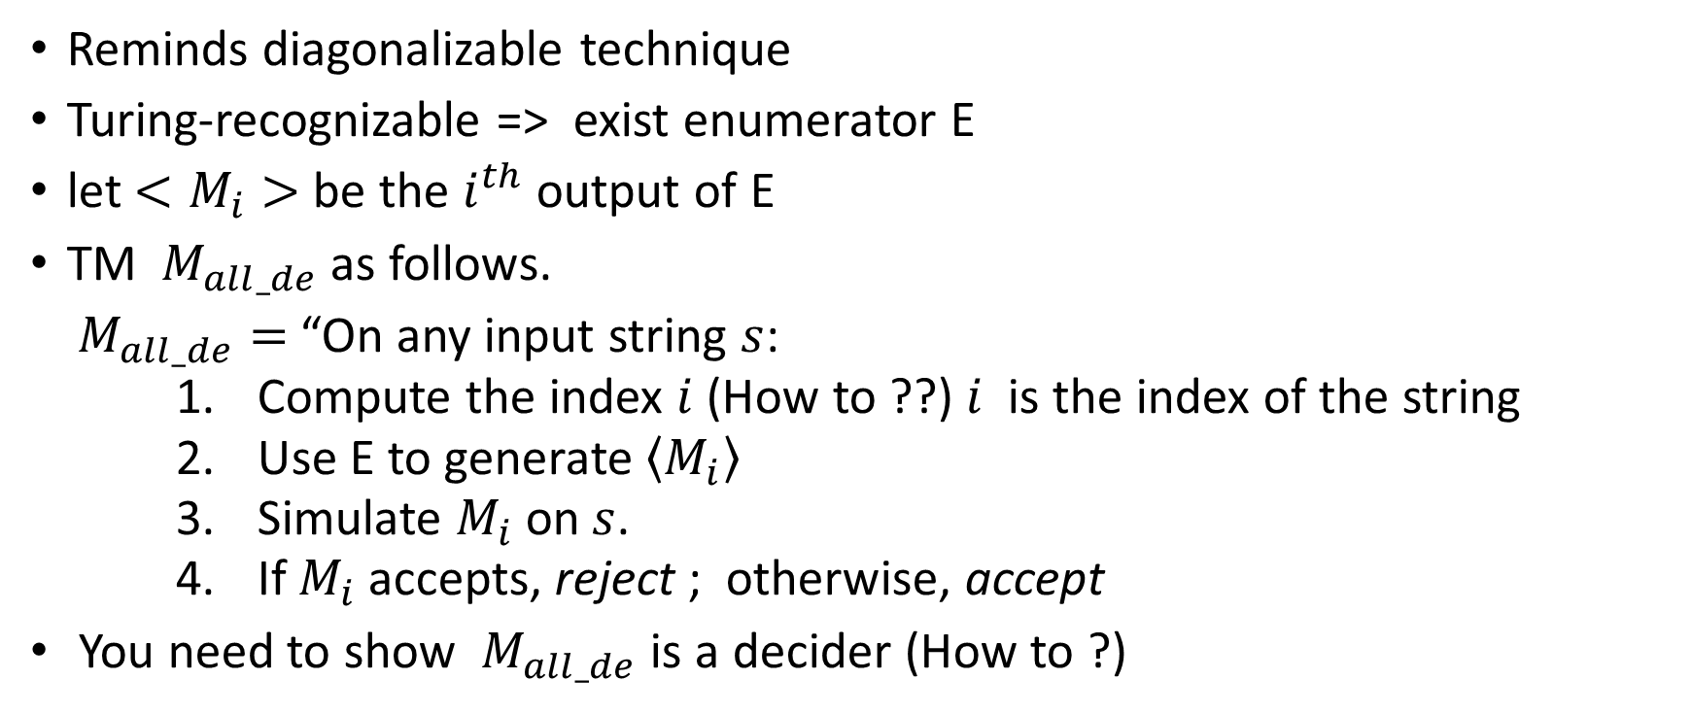
Hw9. Q2 All-TM description undecidable
 | $$s_{1}$$ | $$s_{2}$$ | … | $$s_{i}$$ | …
$$\left\langle M_{1}\right\rangle$$ | Accept | Reject | … | Accept | …
$$\left\langle M_{2}\right\rangle$$ | Accept | Accept |  | Reject
$$⋮$$ | $$⋮$$ |  | $⋱$
$$\left\langle M_{i}\right\rangle$$ | Reject | Accept |  | Reject
$$⋮$$ | $$⋮$$ |  |  |  | $⋱$
Reminds diagonalizable technique
Turing-recognizable => exist enumerator E
let $<M_{i}>$be the $i^{th}$ output of E
TM $M_{all_de}$ as follows.
$M_{all_de}=$ “On any input string $s$:
    Compute the index $i$ (How to ??) $i$ is the index of the string
    Use E to generate $\left\langle M_{i}\right\rangle$
    Simulate $M_{i}$ on$s$.
    If $M_{i}$ accepts, reject ; otherwise, accept
You need to show $M_{all_de}$ is a decider (How to ?)

Slide 10
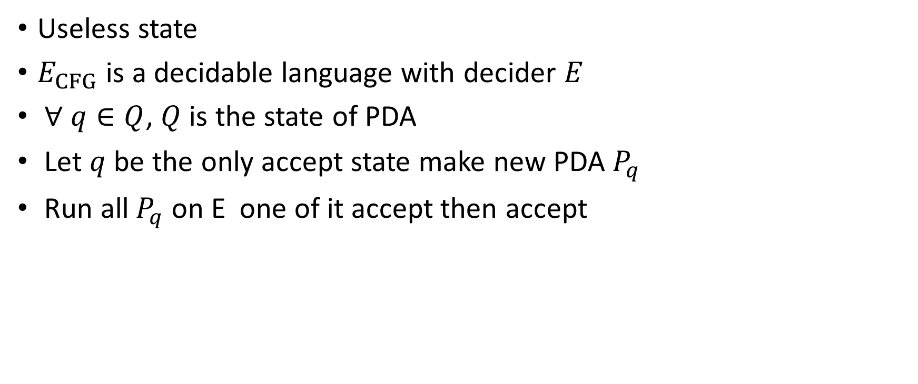
Hw9. Q3 Useless State decidable
Useless state
$E_{CFG}$ is a decidable language with decider $E$
$∀ q∈Q$, $Q$ is the state of PDA
Let $q$ be the only accept state make new PDA $P_{q}$
Run all $P_{q}$ on E one of it accept then accept

Slide 11
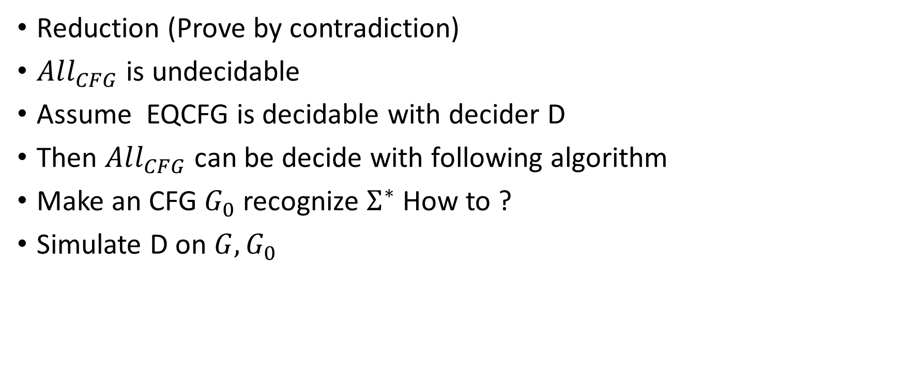
Hw9. Q5 EQCFG decidability
Reduction (Prove by contradiction)
$All_{CFG}$ is undecidable
Assume EQCFG is decidable with decider D
Then $All_{CFG}$ can be decide with following algorithm
Make an CFG $G_{0}$ recognize $Σ^{∗}$ How to ?
Simulate D on $G,G_{0}$

Slide 12
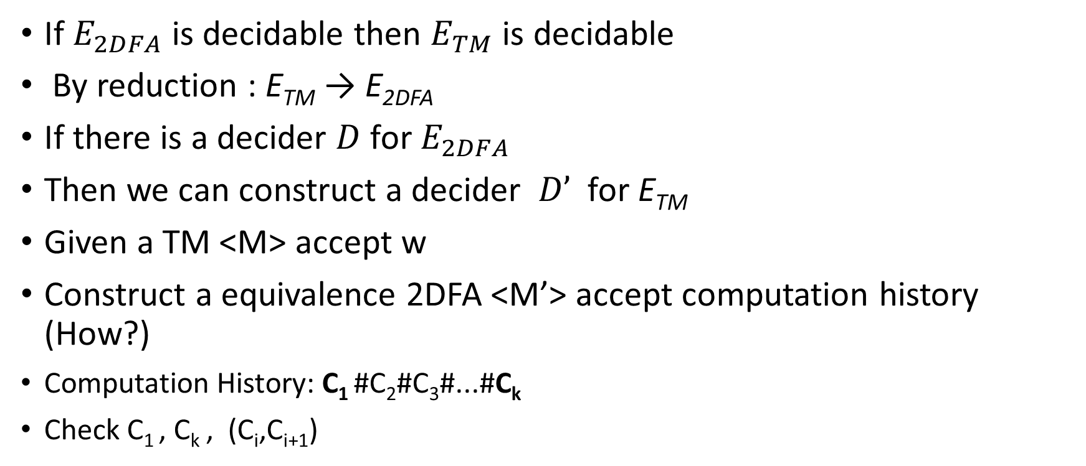

Hw10. Q2 $E_{2DFA}$ undecidablility
If $E_{2DFA}$ is decidable then $E_{TM}$ is decidable
By reduction : E_{TM} → E_{2DFA}
If there is a decider $D$ for $E_{2DFA}$
Then we can construct a decider $D’$ for E_{TM}
Given a TM <M> accept w
Construct a equivalence 2DFA <M’> accept computation history (How?)
  Computation History: C₁ #C₂#C₃#...#C_{k}
  Check C₁ , C_{k} , (C_{i},C_{i+1})

Slide 13
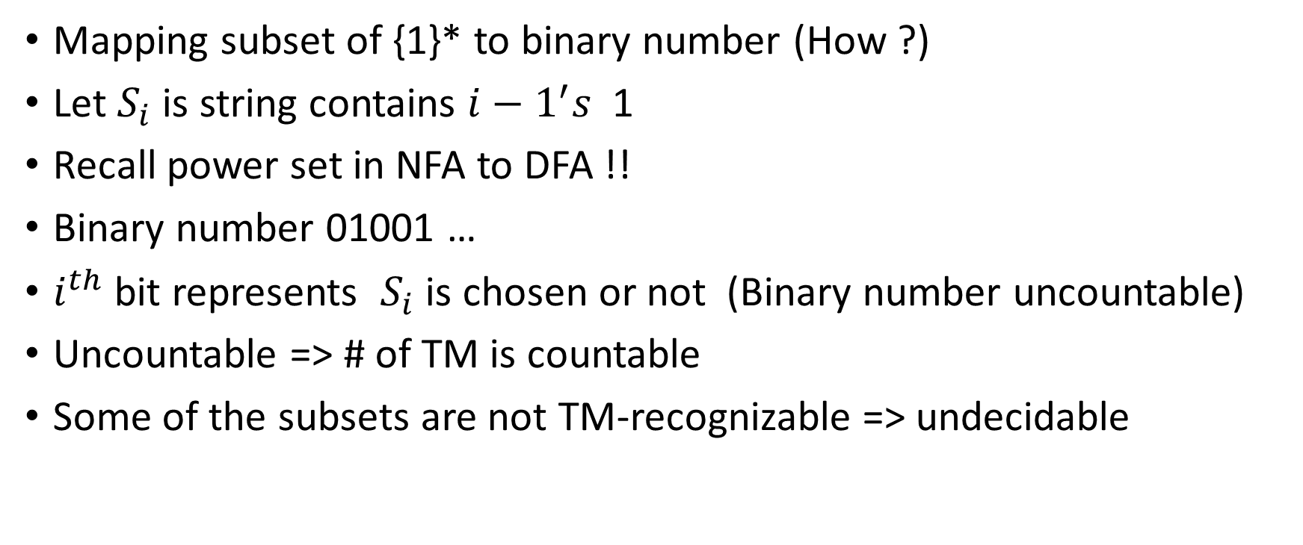
Hw10. Q6 Uncountable # of Subset of {1}*
Mapping subset of {1}* to binary number (How ?)
Let $S_{i}$ is string contains $i−1^{′}s$ 1
Recall power set in NFA to DFA !!
Binary number 01001 …
$i^{th}$ bit represents $S_{i}$ is chosen or not (Binary number uncountable)
Uncountable => # of TM is countable
Some of the subsets are not TM-recognizable => undecidable

