Slide 1
Design Document Introduction
Clement Su
cwsu@tw.ibm.com

Slide 2
Development Cycle (WaterFall)
Requirement
Design
Implement
Testing

Slide 3
Why Design Document?
Communicate with
  Architect
  Peer developers
  Tester
  Document team
  Successors/ Backup
  Yourself
Help developer/architect to think more
Reduce possibility of rework

Slide 4
Different Design Document
High level Design Document
  For architect (or written by architect)
  Focus on system level design
Implement level Design Document
  For peer developer (or whoever want to know detail)
  Focus on component level implementation detail
Both are important and valuable

Slide 5
Keys of a Good Design Document
Showing that the requirement is fulfilled
Describe the design clearly (with Diagram, UML, etc)
Reveal the reason (benefit) of choosing this design
List assumptions, risks, issues and future extension

Slide 6
Components of a Design Document
The goal of this implementation
High level entities
For each entity, a detail description
  How to use
  How to configure
  UML Model
  How does it interact with others
Benefits, assumptions, risks, and other issues

Slide 7
Tips
Prepare a skeleton, then fill it up.
Pretend you are the readers, what do you want to see?
Let others to read and ask questions and improve the content.

Slide 8
What to avoid
Do not assume readers’ background knowledge
Do not use too many abbreviation or create terminology

Slide 9
Design Document Example – Requirement form Customer
Our hospital registration system needs to be ported to the application running on mobile devices
The system should be High Availability

Slide 10
Design Document Example – Requirement after SA
Server Side
  Move the infrastructure to cloud
  Need to be convert into RESTful web service and be available on hospital registration server
Client Side
  Develop an Android based hospital registration application (ObjectC is the next target)
  User can register/login/logout
  User are Aministrator, Doctor, Patient
  etc…

Slide 11
Documentation in the code
Copyright claim
Javadoc
ESLint
The pluggable linting utility for JavaScript and JSX
Code comments

Slide 12
Javadoc example
/**
* Returns an Image object that can then be painted on the screen.
* The url argument must specify an absolute {@link URL}. The name
* argument is a specifier that is relative to the url argument.
* <p>
* This method always returns immediately, whether or not the
* image exists. When this applet attempts to draw the image on
* the screen, the data will be loaded. The graphics primitives
* that draw the image will incrementally paint on the screen.
*
* @param url an absolute URL giving the base location of the image
* @param name the location of the image, relative to the url argument
* @return the image at the specified URL
* @see Image
*/
public Image getImage(URL url, String name) {
try {
return getImage(new URL(url, name));
} catch (MalformedURLException e) {
return null;
}
}

Slide 13
Agile Development
lightweight development method
Incremental development
Iterative development

Slide 14
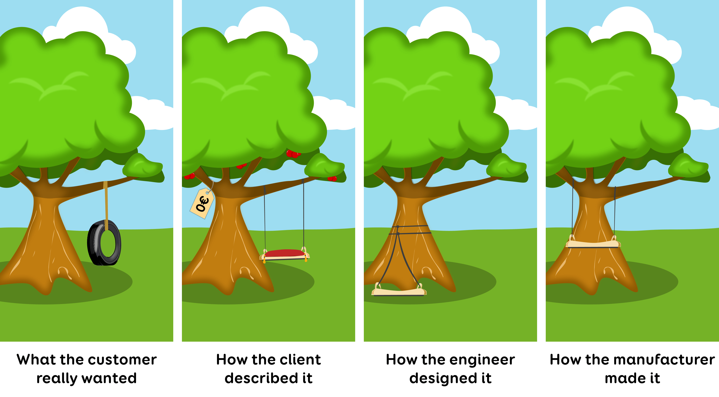
Why Agile?

Slide 15
Development Cycle (Agile)
Requirement
Testing
Design
Implement

Slide 16
Key of Agile Development
Individuals and interactions over processes and tools
Working software over comprehensive documentation
Customer collaboration over contract negotiation
Responding to change over following a plan

Slide 17
Design Document in Agile
Documentation should take on a collaborative nature.
Focus on just barely good enough documentation and avoid big upfront details.
Documentation can take many forms.

Slide 18
AI Generated Content vs Design Document
The purpose is to help developers to save time
Developers still need to review the generated content
Able to generate design document from code or user actions, etc

